Slide 1
HTML DOM in Practice
Solving a System of Linear Equations
Name:Nguyễn Vũ Duy Hiển
Class:DA24TTC

Slide 2
What is HTML DOM?
DOM stands for Document Object Model.
Represents HTML as a tree structure.
Each element is an object (node).
JavaScript can access and modify it.
Example: <input> becomes an object in DOM

Slide 3
DOM Tree Structure
Document
<HTML>
<HEAR>
<TITLE>
<BODY>
<H1>
<SCRIPT>

Slide 4
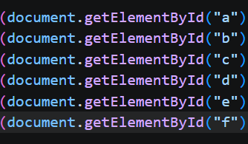
Accessing Elements
Use document.getElementById() to return a DOM object
Used in your code to retrieve user input data

Slide 5
Reading Input Values
.value gets data from <input>
convert to number using Number()
Converting data into numbers is crucial for calculations.

Slide 6
Event Handling
HTML DOM allows interaction via events.
Example:button click
The onclick event will trigger a JavaScript function.

Slide 7

DOM + Logic (Math Processing)
DOM collects input data
JavaScript processes the data
Formulas used:
D = ae − bd
Dx = ce − bf
Dy = af − cd
In the code, it is written as follows:

Slide 8

Engaging the audience
Use .innerHTML to change content.
Used to display the result on the webpage.

Slide 9
Output Display
DOM Help:
Results shown dynamically.
No page reload needed.
Improves user experience.

Slide 10
Conclusion
HTML DOM connects HTML & JavaScript.
Key functions used:
-getElementById()
-.value
-.innerHTML
Enables interactive web applications.

Slide 11
Thank you

