Slide 1


Disjoint Sets
Group 1- 19CLC9

Slide 2

Disjoint-set operations
Disjoint-set forests
01
03
linked-list implementation
02
describes the operations supported by a disjoint-set data structure and presents a simple application
presents a more efficient representation using rooted trees.
Analysis
a simple linked-list implementation for disjoint sets
04
Defines and discusses

Slide 3
Disjoint-set operations
01
describes the operations supported by a disjoint-set data structure and presents a simple application

Slide 4

WHAT is disjoint-set data structure?
A disjoint-set data structure maintains a collection S = {S₁, S₂, S₃, ..., S_{k}} of disjoint dynamic sets.
Each set is identified by a representative, which is some member of the set.
In some applications, it may not matter which member is used
In some applications, the smallest member
In some applications, a user selected member
Each element of a set is represented by an object x.

Slide 5
Disjoint set operations
MAKE-SET(x) - creates a new set whose only member (and thus representative)
is x. Since the sets are disjoint, we require that x not already be in some other
set. UNION(x, y) - unites the dynamic sets that contain x and y, say S_{x} and S_{y}, into a
new set that is the union of these two sets. What will be the new representative? x or y? Where do we implement it?
FIND-SET(x) - returns a pointer to the representative of the (unique) set containing x. Running times of disjoint-set data structures - depends on two parameters: (a) n - the number of MAKE-SET operations (b) m - the total number of MAKE-SET, UNION, and FIND-SET operations.
Always, m ≥ n. Why?
Notes:
UNION.x; y/ unites the dynamic sets that contain x and y, say Sx and Sy, into a new set that is the union of these two sets. We assume that the two sets are disjoint prior to the operation. The representative of the resulting set is any member of Sx [ Sy, although many implementations of UNION specifically choose the representative of either Sx or Sy as the new representative. Since we require the sets in the collection to be disjoint, conceptually we destroy sets Sx and Sy, removing them from the collection S. In practice, we often absorb the elements of one of the sets into the other set. FIND-SET.x/ returns a pointer to the representative of the (unique) set containing x

Slide 6
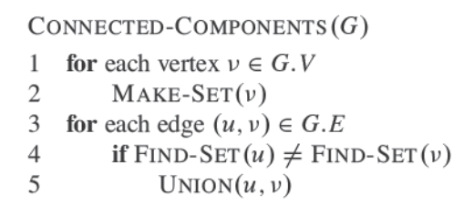
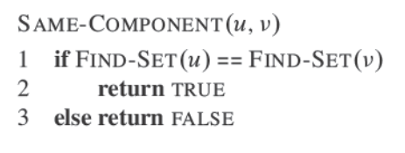
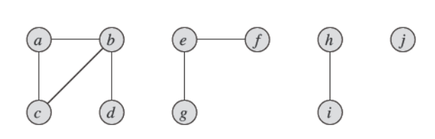
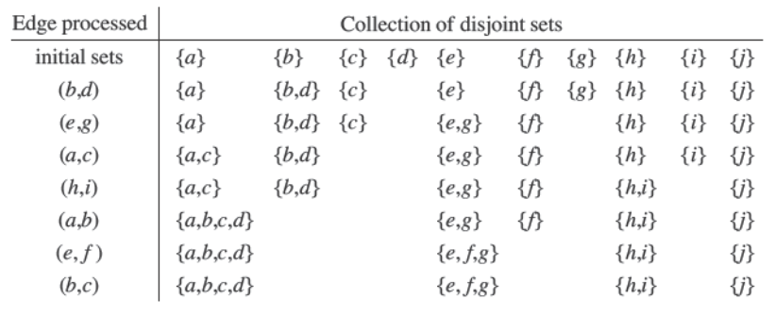
linked-list implementation
02
shows a simple way to implement a disjoint-set data structure: each set is represented by its own linked list.

Slide 7
linked-list implementation
02
shows a simple way to implement a disjoint-set data structure: each set is represented by its own linked list.

Slide 8
linked-list implementation
Say, S1 contains members f, g, and d with f as the representative member.
Each object in the list contains a set member, a pointer to the next object in the list, and a pointer back to the set object. Each object has pointers head and tail to the first and last objects.

Slide 9
MAKE-SET(x) - we create a new linked list whose only object is x.
FIND-SET(x) - we follow the pointer from x back to its set object and then return the member of the object that the head points to. Example, FIND-SET(g) would return f
f
g
d
Head
Tail

Slide 10
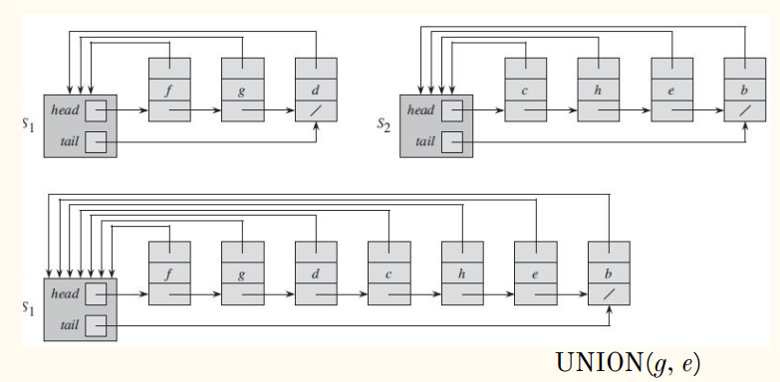
linked-list implementation
We can perform UNION(x,y) by appending y’s list into the end of x’s list.
x’s representative becomes the resulting set’s representative.
Use the tail pointer of x’s list to quickly find where to append y’s list.
We must update the pointer to the set object for each object originally in y’s list -> takes linear time proportional to the length of y.
Example: UNION(g, e) causes pointer updates
for c, h, e, b.

Slide 11
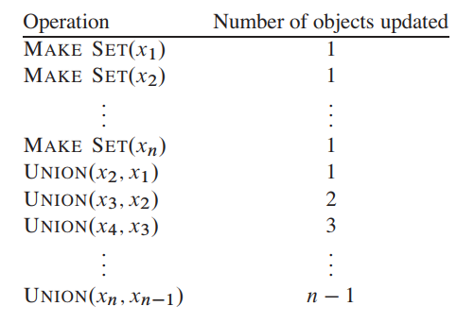
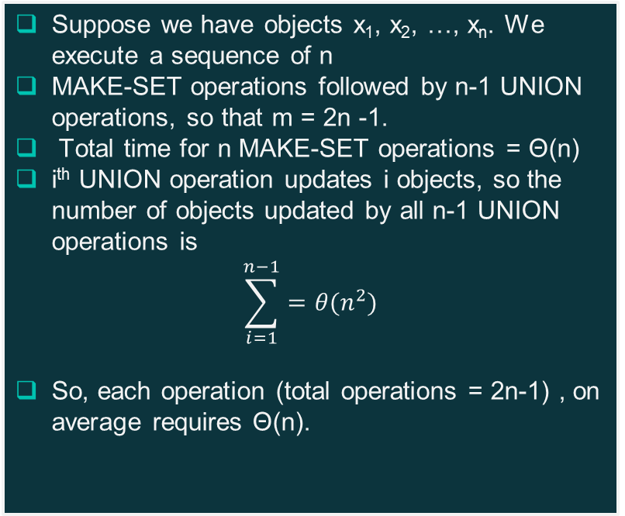
Running time of the linked list implementation
Suppose we have objects x₁, x₂, …, x_{n}. We execute a sequence of n
MAKE-SET operations followed by n-1 UNION operations, so that m = 2n -1.
Total time for n MAKE-SET operations = Θ(n)
i^{th} UNION operation updates i objects, so the number of objects updated by all n-1 UNION operations is
$$\sum_{i=1}^{n−1}{=θ(n^{2})}$$
So, each operation (total operations = 2n-1) , on average requires Θ(n).
A sequence of 2n-1 operations on n objects that takes Θ(n2) time, or Θ(n) time per operation

Slide 12
A weighted-union heuristic
In the worst case, our implementation of the UNION procedure requires an average of Θ(n) time per call.
Why? May be we are always appending a longer list onto a shorter list.
Solution: We maintain the length of the list along with each list
This way, we will always append a shorter list onto the longer.
With this simple weighted-union heuristic, a single UNION operation can still take Ω(n) time if both sets have Ω(n) members.
Overall, the total time spent in updating object pointers over all UNION operations is O(n lg (n)). i.e. each UNION operation on average takes O(lg(n)) time.
Each MAKE-SET and FIND-SET take O(1) time and there are total O(m) of them. Thus the total time for entire sequence is O(m+n lg(n)).

Slide 13
03
Disjoint-set forests
presents a more efficient representation using rooted trees. .

Slide 14
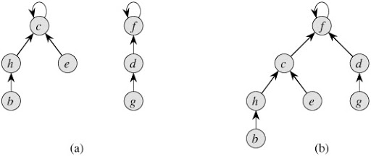
We represent sets by rooted trees, with each node containing one member and each tree representing a set.
Each member points only to its parent.
The root of each tree contains the representative and is its own parent

Slide 15
Disjoint-set forests
MAKE-SET operation creates a tree with just one node.
FIND-SET operation is following the parents pointer until we find the root of the tree. The nodes visited on this simple path towards the root constitute the find path.
UNION operation causes the root of one tree to point to the root of the other.
Algorithms that use this representation are no faster than the ones that use the linked-list representation.

Slide 16
Heuristics to improve running time - Union by Rank
Scenario: A sequence of n-1 UNION operations may create a tree that is just a linear chain of n nodes.
Similar to the weighted-union heuristic, we can make the root of the tree with fewer nodes point to the root of the tree with more nodes.
For each node, we maintain a rank, which is an upper bound on the height of the node.
We make the root with smaller rank point to the root with larger rank during a UNION operation.
This will improve the time required for each FIND-SET from O(n) to O(lg n).
The total running time is O(m lg n) because for each MAKE-SET and UNION, we may have to run FIND-SET.

Slide 17
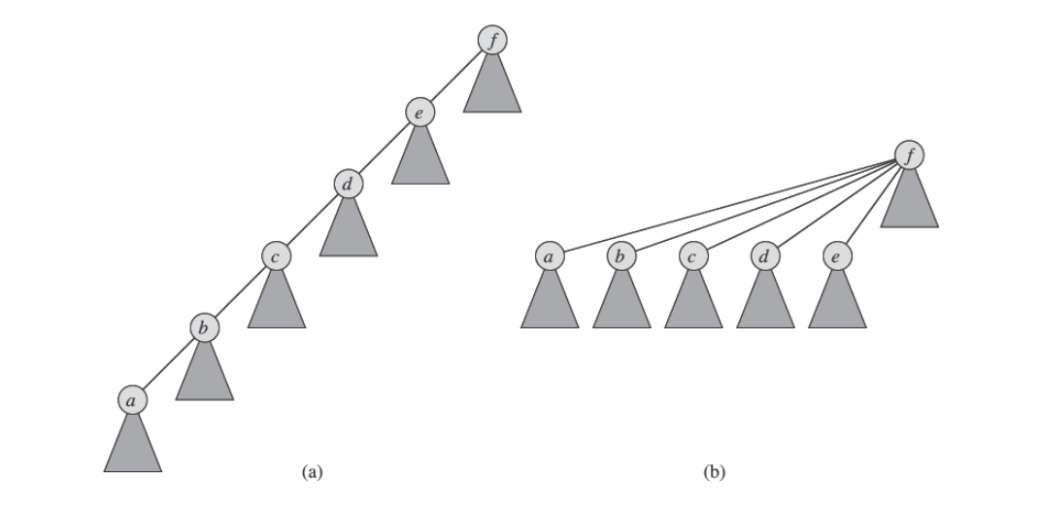
Heuristics to improve running time - Path compression
Path compression is simple and yet highly effective.
During the FIND-SET operations, make each node on the find path point directly to the root.
Path compression does not change any ranks.
What is the consequence?
Future FIND-SET operations take constant time.
Now, the total running time is O(m) and each operation, on average, takes almost constant time
Path compression during the FIND-SET operation. Triangles are subtrees whose root nodes are shown.

Slide 18
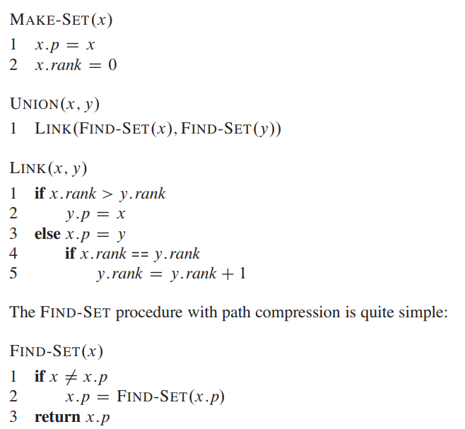
Notes:
With each node x, we maintain the integer value x.rank, which is an upper bound on the height of x. The parent of x is x.p. MAKE-SET creates a singleton set, the single node in the corresponding tree has an initial rank 0. Each FIND-SET operation leaves the ranks unchanged. The FIND-SET procedure is a two-pass method: as it recurses, it makes one pass up the find path to find the root, and as the recursion unwinds, it makes a second pass back down the find path to update each node to point directly to the root
The UNION operation has two cases, depending on whether the roots of the trees have equal ranks. If the roots have unequal ranks, we make the root with higher rank the parent root of the root with lower rank, but the rank themselves remain unchanged. If the roots have equal ranks, we arbitrarily choose one of the roots as the parent and increment the rank.

Slide 19
Analysis
04
Defines and discusses a very quickly growing function and its very slowly growing inverse, which appears in the running time of operations on the tree-based implementation, and then, by a complex amortized analysis, proves an upper bound on the running time that is just barely superlinear.

Slide 20
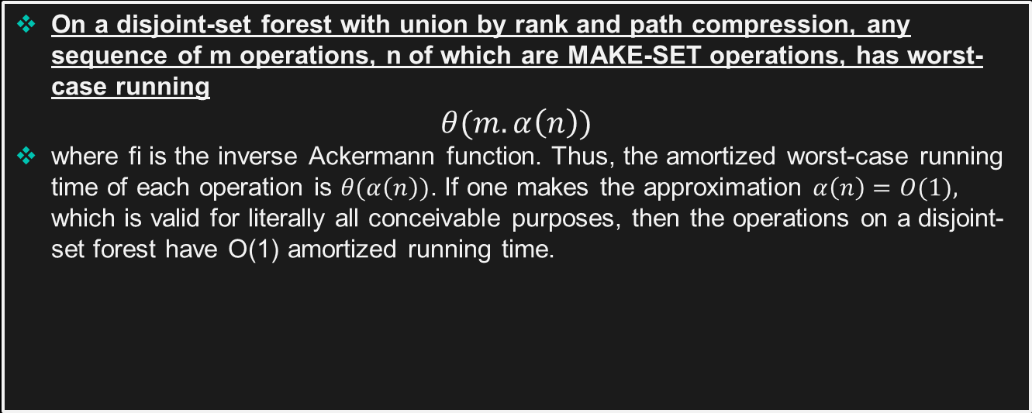
Analysis
On a disjoint-set forest with union by rank and path compression, any sequence of m operations, n of which are MAKE-SET operations, has worst-case running
$$θ(m.α\left(n\right))$$
where fi is the inverse Ackermann function. Thus, the amortized worst-case running time of each operation is $θ(α\left(n\right))$. If one makes the approximation $α\left(n\right)=O(1),$ which is valid for literally all conceivable purposes, then the operations on a disjoint-set forest have O(1) amortized running time.

Slide 21
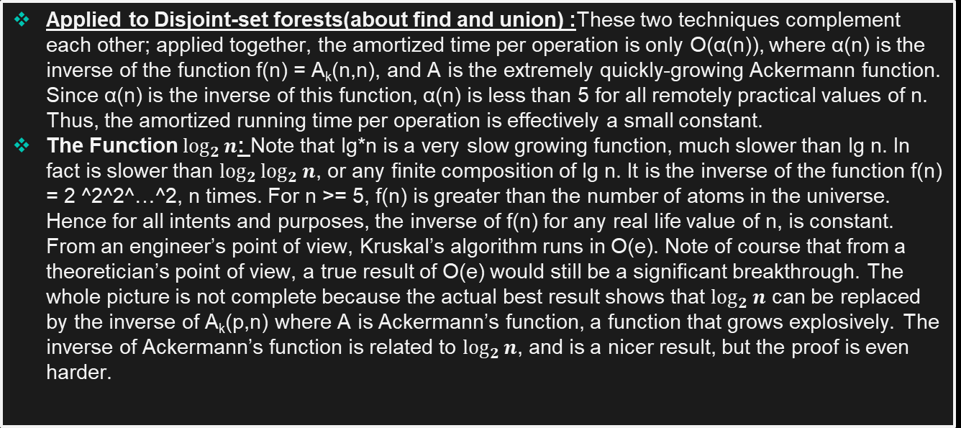
Analysis
Applied to Disjoint-set forests(about find and union) :These two techniques complement each other; applied together, the amortized time per operation is only O(α(n)), where α(n) is the inverse of the function f(n) = A_{k}(n,n), and A is the extremely quickly-growing Ackermann function. Since α(n) is the inverse of this function, α(n) is less than 5 for all remotely practical values of n. Thus, the amortized running time per operation is effectively a small constant.
The Function $\log_{2}{n}$: Note that lg*n is a very slow growing function, much slower than lg n. In fact is slower than $\log_{2}{\log_{2}{n}}$, or any finite composition of lg n. It is the inverse of the function f(n) = 2 ^2^2^…^2, n times. For n >= 5, f(n) is greater than the number of atoms in the universe. Hence for all intents and purposes, the inverse of f(n) for any real life value of n, is constant. From an engineer’s point of view, Kruskal’s algorithm runs in O(e). Note of course that from a theoretician’s point of view, a true result of O(e) would still be a significant breakthrough. The whole picture is not complete because the actual best result shows that $\log_{2}{n}$ can be replaced by the inverse of A_{k}(p,n) where A is Ackermann’s function, a function that grows explosively. The inverse of Ackermann’s function is related to $\log_{2}{n}$, and is a nicer result, but the proof is even harder.

Slide 22

THANKS FOR YOUR ATTENTION!

