Slide 1
Mobile App Presentation
“NoteTaker” mobile app
Student Name : Nguyen Ngoc Nguyen
Student ID : 24104131
Teacher : Nguyen Dinh Anh Dung
Class : Mobile and Wearable App Design & Develope

Slide 2
Project Outline
Introduction
Use Case
Class Diagram
Data Design
UI screenshot

Slide 3
1. Introduction

Slide 4
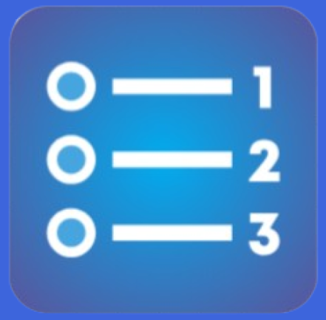
1. Introduction
The mobile app for user especially for student in noting their to-do task, with the “priority”
This app was created by “Kotlin language” on “Android Studio ide”
With “DOM Database” for storing process
NoteTaker app
The positive of this app:
User can easily track their tasks daily in day, and sorting with the priority what should be done first.
Helping them in concentrating and managing time more effectively

Slide 5
1. Use Cases

Slide 6
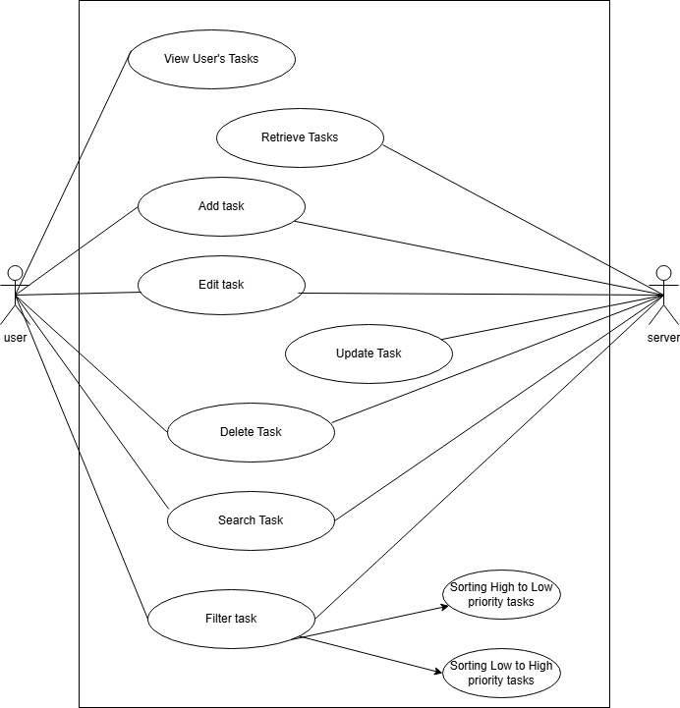
1. Use Cases
The use cases for the Notetaker
In our app, there are 5 main functions for user to interact with it. The server will return data for user’s demand
5 function included:
Get all tasks for users,
Add a new tasks,
Edit task’s description or task’s title,
Delete task which is done,
Searching for task for user,
Sorting tasks with from Hight to Low priority tasks and Low to High priority tasks
Figure 1 All Use-case design diagram

Slide 7
3. Class Diagram

Slide 8
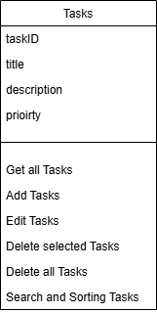
Class Diagram
Class contains attributes that store specific information attribute related to “Task model”
The class diagram include the task class with it’s attrite data and the method function of it
Figure 2 Class design diagram

Slide 9
3. Data Design

Slide 10
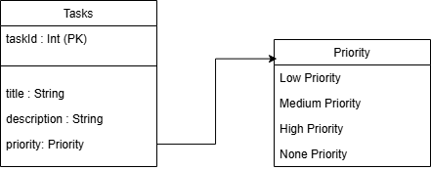
Data Design
The model for Task table, includes
“taskId” : Int data type and Primary Key
“title” : String data type, present the title of task
“Description : String data type, present the description of task
“Priority” : Priority data type (which is enum class), present the priority of task
Figure 6 Database design diagram

Slide 11
4. UI Design

Slide 12
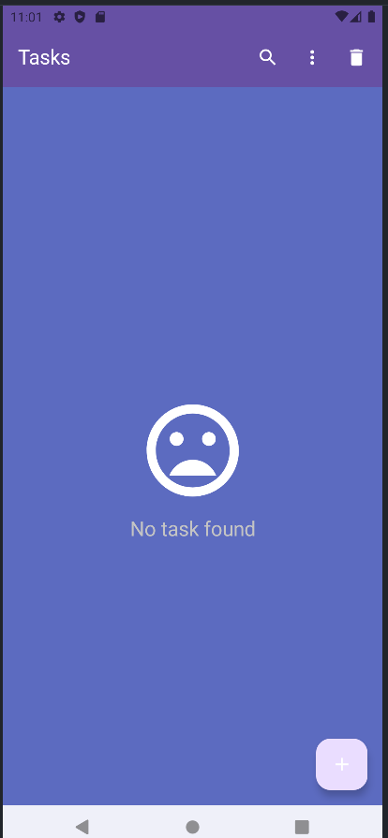
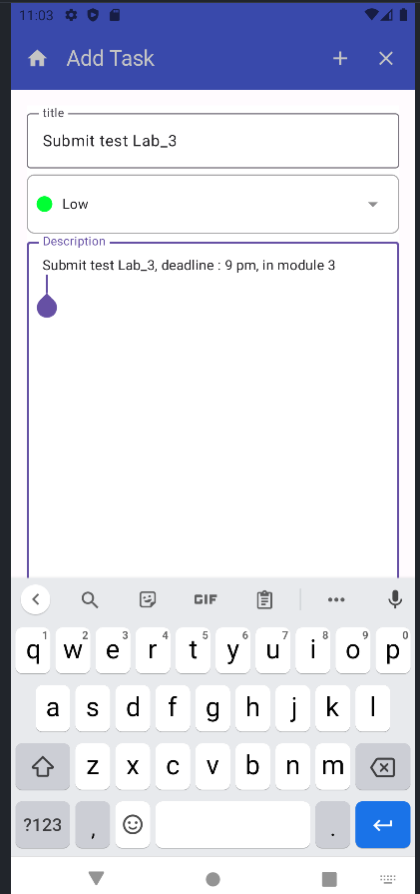
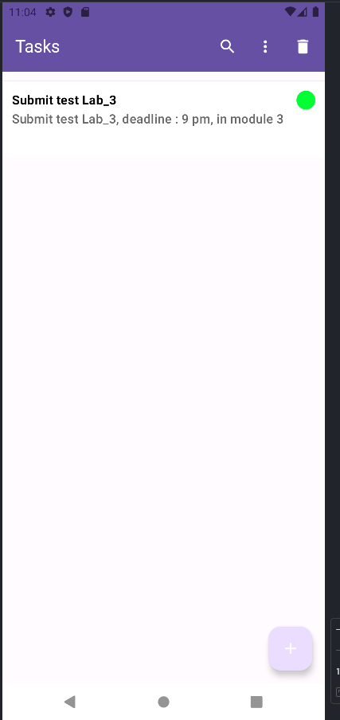
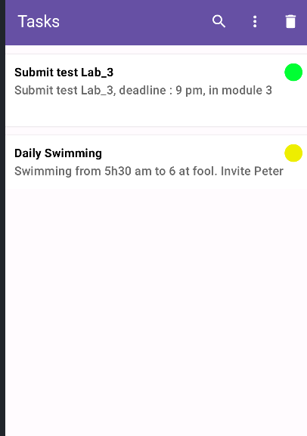
UI Design
Figure 7 Login_Page, Inser_Data_Page, Home_Page UI Design

Slide 13
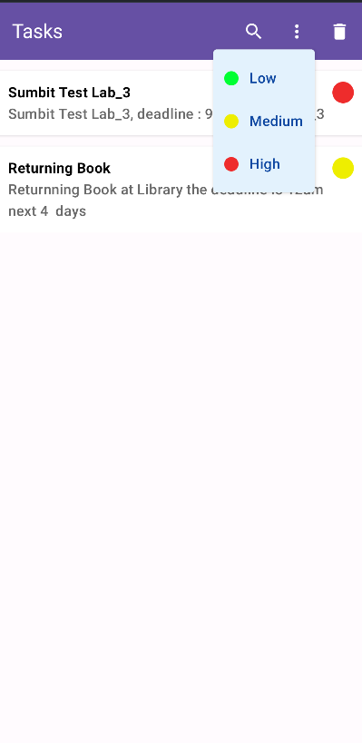
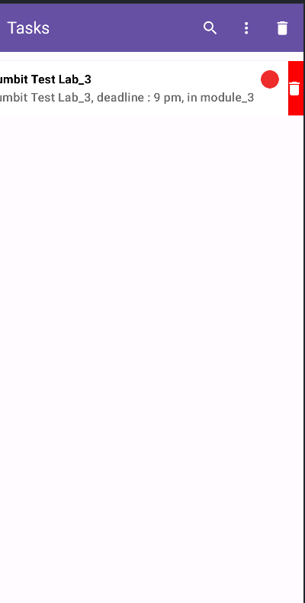
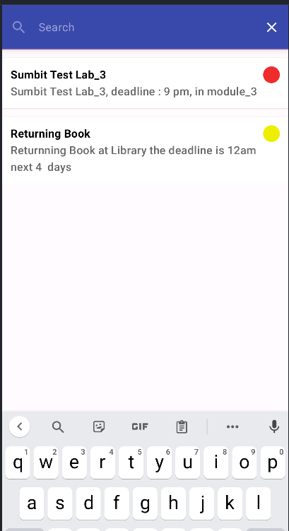
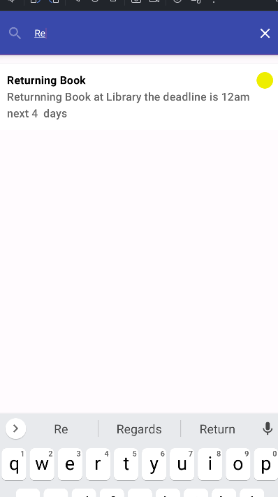
UI Design
Figure 8 Booking_Page and booking features UI Design

Slide 14
Thank you
For your Listening

