Slide 1
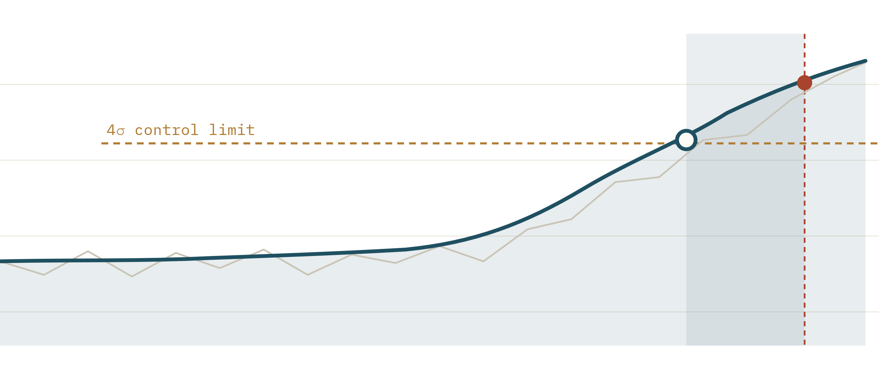
XBRAIN CAPSTONE · TASK FORCE 4 · AIO-03
PITCH · W12 FINAL BUILD
TIME-SERIES ANOMALY DETECTION
Foresight Lens
PAYMENT-GW · MEMORY %
EWMA CONTROL CHART
A capacity-exhaustion prediction engine for tier-1 cloud services.
● alert · t₀
◀ 110 min lead ▶
● SLO breach
Fig. 1 — EWMA control chart raises an alert ~110 min before the de-seasonalised signal breaches the SLO.
LEAD TIME
INFERENCE
MODEL
≥ 15 min
~$0 cost
ewma-stl-v1
AI GROUP · STATISTICAL ANOMALY ENGINE
2026
Notes:
Foresight Lens: a capacity-exhaustion prediction engine. We predict OOM / CPU starvation at least 15 minutes before an SLO breach, advise the SRE team, and never act on our own — at essentially zero inference cost. XBrain Capstone, Task Force 4, AI group AIO-03.

Slide 2
FORESIGHT LENS · PREDICTION ENGINE
02 / 16
Client Context
02
HARD CONSTRAINTS
≤ $200
total monthly spend for the whole AI solution
“
When the monitor turns red, the system is already down . We need to predict the incident early enough for SRE to intervene — but we don't want the AI to act on its own, and the monthly bill must stay under $200.
Advise
no auto-remediation — humans keep the decision
— CLIENT INTERVIEW · W11
3 svc
Payment Gateway · Fraud Detection · Ledger
Notes:
The client's words: by the time the monitor goes red, the system is already down. They want early prediction, but they do NOT want the AI to act on its own, and the entire monthly bill must stay under $200. Three tier-1 services are in scope: Payment Gateway, Fraud Detection, Ledger.

Slide 3
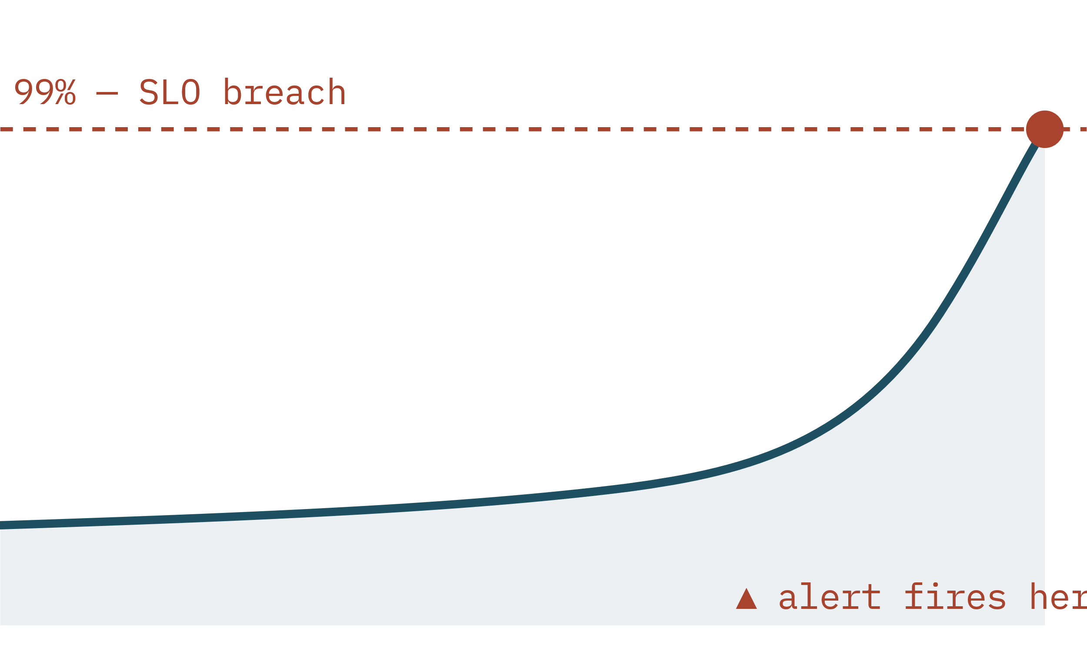
FORESIGHT LENS · PREDICTION ENGINE
03 / 16
Reactive monitoring alerts too late
03
CPU % · TODAY'S THRESHOLD ALERT
01
Slow exhaustion, sudden collapse
Memory leak → OOM, CPU starvation, connection-pool & queue backlog.
02
Reactive, not predictive
Thresholds fire at 99% — no lead time to scale up or restart.
03
AIOps tools are heavy & costly
Market platforms blow past the $200 budget at this scale.
04
Auto-remediation is distrusted
Fear of an AI shutting down healthy servers by mistake.
Fig. 2 — The signal is visible for 90+ minutes, yet the threshold only triggers at the cliff edge.
Notes:
Today's monitoring is reactive: it fires at 99% CPU, when the outage has already started. The failure modes are slow — memory leaks to OOM, CPU starvation, connection-pool and queue exhaustion — they build over tens of minutes but the alert only arrives at the cliff edge. Off-the-shelf AIOps is too heavy and too expensive, and the team distrusts anything that auto-restarts healthy servers.

Slide 4
FORESIGHT LENS · PREDICTION ENGINE
04 / 16
Predict early, advise clearly — never act alone
04
OUTCOME 01
OUTCOME 02
OUTCOME 03
OUTCOME 04
Early prediction
Tenant isolation
FinOps first
Actionable advice
Flag capacity exhaustion ≥ 15 min before an SLO breach.
Per-service baselines, zero cross-tenant data bleed.
In-house statistical model — no LLM tokens.
Action, target, confidence & evidence per alert.
110min
3tenants
$0tokens
5verbs
Predict + Recommend — an advisor, not an actor. The CDO platform owns every action.
Notes:
Foresight Lens predicts capacity exhaustion early and advises — it never touches infrastructure. Four outcomes: early prediction with 15+ minutes of lead, strict multi-tenant isolation across the three services, FinOps discipline through an in-house statistical model with zero token cost, and actionable advice — every alert carries a recommended action, target, confidence, and an evidence link. The CDO platform keeps the kill switch.

Slide 5
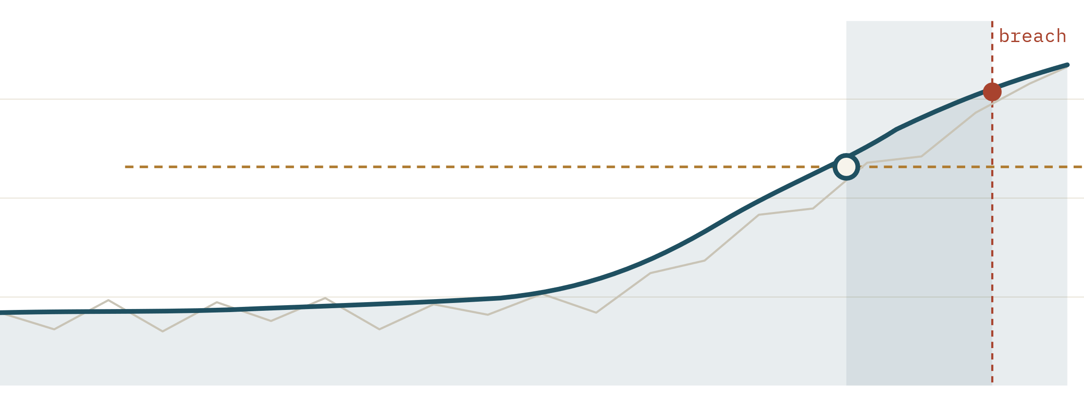
FORESIGHT LENS · PREDICTION ENGINE
05 / 16
How it works — STL + EWMA
05
DE-SEASONALISED RESIDUAL
K = 4Σ LIMIT
STEP 1
STL · offline
Learn each service's daily load curve from clean days; store seasonal profile + residual σ. Removes the season that fools naïve detectors.
STEP 2
EWMA · inference
Run a control chart on the residual. Sustained drift breaches the K=4σ limit → anomaly.
< 10 ms
100%
— raw
— EWMA (α=0.3)
● alert
● breach
Fig. 3 — Sustained drift breaches the 4σ limit; one-off spikes are smoothed.
compute / call
deterministic & explainable
Notes:
Two stages. Offline, STL decomposition learns each service's daily load curve from clean days and stores a seasonal profile plus residual sigma. At inference, we subtract the season and run an EWMA control chart over the residual — alpha 0.3 smooths one-off spikes, and a breach of the K=4-sigma limit raises an anomaly. De-seasonalising first is the key: it stops normal daytime peaks from looking like incidents. It's deterministic, fully explainable, runs in under 10 ms, and costs about zero.

Slide 6
FORESIGHT LENS · PREDICTION ENGINE
06 / 16
Why not an LLM?
TABLE 1 — IDENTICAL HOLDOUT
06
APPROACH
COST / MO
LATENCY
FP RATE
VERDICT
STL + EWMA
~$36
<10 ms
7.1%
✓ chosen
control chart
Isolation Forest
~$150
~20 ms
21.4%
FP gate fail
contamination 0.02
LLM (Bedrock)
~$10k
~2 s
—
cost + hallucination
per-window prompt
For infrastructure time-series, exact math beats generated text — a 4σ breach is a sentence any engineer can defend. ADR-001 · ADR-004
Notes:
We considered three approaches on the same held-out data. An LLM would cost on the order of ten thousand dollars a month, answer in seconds, and can hallucinate arithmetic — disqualified on cost and latency. Isolation Forest failed the false-positive gate at 21.4% because it has no concept of season. STL plus EWMA passes both gates, runs in milliseconds, costs about $36 a month, and is mathematically exact. For infrastructure time-series, statistics beat generation.

Slide 7
FORESIGHT LENS · PREDICTION ENGINE
07 / 16
System architecture
Fig. 4 — Stateless, one-directional request path
07
CDO PLATFORM
AWS · STATELESS ECS FARGATE · min 2 / max 4 · internal ALB
Prometheus push
API & Routing
→
Anomaly engine
→
Decision router
120-min signal window, per service
FastAPI · Pydantic validation · X-Tenant-Id
STL baseline + EWMA control chart
confidence gate ≥ 0.7 → verb
POST /v1/predict
→
7 gauges · 1-min
S3
per-service baselines (KMS) — read each request
AUDIT
SHA-256 input hash → CloudWatch / S3
← RECOMMENDATION
JSON: action_verb · target · confidence · evidence_link · audit_id
SRE = manual approval gate
Notes:
One-directional data flow. CDO platforms push a 120-minute signal window over POST /v1/predict to an internal ALB. FastAPI plus Pydantic validates schema and tenant, the STL+EWMA engine scores it, and the decision router turns the score into a confidence-gated recommendation. Before responding, we hash the input with SHA-256 and write a six-field audit record. The engine is a stateless ECS Fargate service — it reads per-service baselines from S3 and never calls back into CDO infrastructure. SRE stays in the loop as the manual approval gate.

Slide 8
FORESIGHT LENS · PREDICTION ENGINE
08 / 16
Three signed contracts
08
Telemetry
01
AI API
02
Deployment
03
Signals CDO emits → AI consumes.
The endpoint AI exposes, CDO calls.
How CDO hosts the engine.
—
7 gauges · CPU, memory, latency, pool…
—
POST /v1/predict · request + response
—
ECS Fargate · 0.5 vCPU / 1 GB · min2/max4
—
1-min granularity, RFC3339 UTC
—
SLA: p99 < 500 ms · 100 RPS · 99.5%
—
canary 10→50→100 · auto-rollback
—
mandatory tenant_id · no PII
—
errors 400 / 401 / 422 / 429 / 503
—
$200 cost circuit breaker
Frozen W11 T5 — schema unchanged W11 → W12, so CDO never rewrites code.
Notes:
Three contracts, signed and frozen on W11 T5. The Telemetry contract defines the signals CDO emits — seven gauges at one-minute granularity. The API contract defines POST /v1/predict, its request and response schema, the SLA, and the error codes. The Deployment contract defines compute, scaling, canary rollout and rollback. The schema is identical between the W11 mock and the W12 final build, so CDO never has to rewrite their integration.

Slide 9
FORESIGHT LENS · PREDICTION ENGINE
09 / 16
Evaluation results
measured, not hard-coded
09
A/B · SAME HOLDOUT
STL + EWMA
.971 · FP 7.1%
Recall
FP rate
Lead time
Isolation Forest
.638 · FP 21.4%
0.971
7.1%
110m
CONFUSION MATRIX · 3 SVC
gate ≥ 0.80 ✓
gate ≤ 12% ✓
gate ≥ 15m ✓
169
5
TP
FN
Brier
Precision
Pytest
0.049
0.793
9/9
< 0.10 ✓ calibrated
stretch ≥ 0.75 ✓
scenarios pass
44
574
FP
TN
Table 2 — Measured on ~790 sliding windows, 3 tier-1 services. Re-run: tf4_evidence.py
Notes:
Every number here is measured on a held-out labelled day across the three services, with about 790 scored windows — nothing is hard-coded; re-run tf4_evidence.py to reproduce it. Recall 0.971 against a 0.80 gate, false-positive rate 7.1% against a 12% gate, median lead time 110 minutes against 15, Brier score 0.049 — well calibrated. Precision 0.793 hits the stretch target; the slightly-below-0.80 comes from boundary windows just after a fault clears. Nine of nine pytest scenarios pass.

Slide 10
FORESIGHT LENS · PREDICTION ENGINE
10 / 16
Cost model
10
Inference token cost
$0
no LLM in the loop
~$36
/ month
Marginal / tenant
<$1
Fargate 2-task HA, flat. Measured — not a forecast.
scales to thousands
SPEND VS $200 BUDGET
18% USED
alert $160
$0
$200 — circuit breaker → scale to zero
Training
~$0
offline weekly batch
Budget priority is explicit: the $200 cap outranks the 99.5% SLA — fail-open, then CDO falls back to rules.
Notes:
The whole engine runs at about $36 a month — two Fargate tasks for high availability, flat. That's 18% of the $200 budget. There is zero inference token cost because there's no LLM, and the marginal cost of adding a tenant is under a dollar a month. As a hard backstop, a cost circuit breaker scales the service to zero if spend ever reaches $200; in practice it never fires.

Slide 11
FORESIGHT LENS · PREDICTION ENGINE
11 / 16
Safety guardrails
11
01 · GATE
02 · ASSIST-ONLY
03 · AUDIT
Confidence gating
Never executes
6-field audit log
Below 0.7 → downgrade SCALE_UP to INVESTIGATE.
Recommends only; no closed-loop auto-remediation.
SHA-256 input hash, KMS-encrypted, no raw PII.
04 · FAIL-OPEN
05 · ISOLATION
06 · RATE LIMIT
Graceful degrade
Per-request scoping
Noisy-neighbour guard
5xx → CDO falls back to rule-based alerts.
X-Tenant-Id enforced; stateless — zero data bleed.
600 req/min/tenant → 429 with backoff.
Notes:
Six guardrails make this safe to put in an operations loop. A confidence below 0.7 is downgraded from SCALE_UP to INVESTIGATE. The engine is assist-only — it never executes. Every decision writes a six-field audit record with a SHA-256 input hash and no raw PII. If the engine returns a 5xx, CDO fails open to rule-based alerting. Tenants are isolated by header and stateless per-request scoping. And a 600-request-per-minute rate limit stops a noisy neighbour.

Slide 12
FORESIGHT LENS · PREDICTION ENGINE
12 / 16
Multi-tenant isolation
12
X-Tenant-Id
routes to the right baseline
POST /v1/predict
200 OK
X-Tenant-Id: tnt-payment-core
{ "signal_window": [120 pts], … }
payment-gw
baseline · σ profile
{
"anomaly": true ,
"severity": 0.78 ,
"recommendation" : {
"action_verb": "SCALE_UP" ,
"target": "payment-gw ECS" ,
"confidence": 0.82 ,
"evidence_link": "…/cpu" },
"audit_id": "audit-xyz789" }
fraud-detector
baseline · σ profile
ledger
baseline · σ profile
Stateless per-request scoping → zero cross-tenant bleed . Missing header → 401 · mismatch → 400.
audit written · 6 fields · SHA-256 input hash
Notes:
One endpoint serves all three services. The X-Tenant-Id header routes each request to that service's own baseline, and the engine state is created and destroyed within a single request — there is no global memory that could carry one tenant's data into another's analysis. Here's a live request and response for the payment gateway: a SCALE_UP recommendation at 0.82 confidence, with an evidence link and an audit id. A missing header is a 401; a mismatched tenant_id is a 400.

Slide 13
FORESIGHT LENS · PREDICTION ENGINE
13 / 16
Decision records
13
ADR-001
Statistical model over LLM
ADR-002
Confidence threshold 0.7
Exactness & $0 tokens vs. natural-language RCA.
Between 0.5 (too loose) and 0.8 (too strict).
ADR-003
Manual silence for flash sales
ADR-004
STL+EWMA over Isolation Forest
Reliable 99% of the year; no blunted sensitivity.
Proven by measured A/B: better recall & FP.
ADR-005
Weekly + drift-triggered retrain
ADR-006
EWMA α = 0.3, K = 4.0
Manual cadence; no auto-pipeline in scope.
From a 16-point sweep — K=3 fails FP, K=4.5 costs recall.
Notes:
Six architecture decision records capture the trade-offs. Statistics over LLM. A 0.7 confidence gate, chosen between a too-loose 0.5 and a too-strict 0.8. Manual silence for flash sales rather than blunting sensitivity year-round. STL+EWMA over Isolation Forest, proven by A/B. Weekly plus drift-triggered retraining. And the EWMA parameters alpha 0.3 and K=4, picked from a 16-point sweep where K=3 failed the FP gate and K=4.5 cost recall.

Slide 14
FORESIGHT LENS · PREDICTION ENGINE
14 / 16
Curveball response
14
SMALL
✓ pass
MEDIUM
✓ pass
CHAOS
✓ pass
Noisy baseline, no shift
Sudden spike + slow leak
Engine outage
A false-positive trap: high variance, zero mean shift. EWMA smoothing averages the noise away.
Injected latency spike and a 180-min memory leak. EWMA catches the sustained drift early.
The AI engine returns 5xx or is scaled to zero by the cost breaker.
FP 7.1% (17.5% at K=3)
caught · 110 min lead
fail-open → CDO rules
Scenarios from documented eval traps & failure modes — replace with the actual graded W12 curveballs once confirmed.
Notes:
Three resilience scenarios, ordered by severity — these are drawn from the documented eval traps and failure modes; swap in the actual graded W12 curveballs if they differ. Small: a noisy baseline with no mean shift — EWMA smoothing holds false positives at 7.1% where K=3 would have given 17.5%. Medium: an injected sudden spike plus a slow leak — both caught with 110-minute median lead. Chaos: the engine itself goes down — CDO fails open to rule-based alerting and the cost breaker can scale to zero, with no cascade.

Slide 15
FORESIGHT LENS · PREDICTION ENGINE
15 / 16
What we shipped
15
All
~$36
3
9/9
client gates met, with margin
/ month — 18% of budget
contracts signed & frozen
tests · real artifact, not slideware
A working FastAPI engine on stateless Fargate, with reproducible evidence — ready for W12 final build : IAM SigV4 enforced, schema unchanged.
FORESIGHT LENS · AIO-03 · TASK FORCE 4
THANK YOU
Notes:
To close: every client gate is met with margin, the bill is about $36 a month — under a fifth of the budget — three contracts are signed and frozen, and we have a real artifact, not a slide-ware demo: a FastAPI engine on Fargate with nine passing tests and reproducible evidence. We're ready for the W12 final build, where IAM SigV4 is enforced and the schema stays exactly the same.

Slide 16
FORESIGHT LENS · PREDICTION ENGINE
16 / 16
Appendix · backup
16
TABLE 3 — EWMA PARAMETER SWEEP
TELEMETRY · 7 SIGNALS
API ERROR CODES
α
K
FP%
recall
cpu_usage_percent
400 tenant/data mismatch · no retry
0.3
3.0
17.5
.977
401 missing X-Tenant-Id / auth
memory_usage_percent
422 schema · <120 points
api_latency_ms
429 rate limit · backoff
0.3
4.0
7.1
.971
503 unavailable → CDO fallback
queue_depth
DEPLOYMENT
us-east-1 · multi-AZ · private subnet
0.3
4.5
6.5
.966
active_connections
internal ALB · no public IP
db_connection_pool_pct
0.15
4.0
11.8
.977
canary 10→50→100 · RTO < 60s
cache_hit_rate_pct
Chosen α=0.3, K=4.0 — best FP margin while holding recall.
4 baselined · 3 z-score fallback. 1-min, 90-day retention.
baseline in S3 (KMS) · audit 365d
Notes:
Backup material for questions: the full EWMA parameter sweep, the seven-signal telemetry catalogue, the API error-code table, and the deployment specifics — region, networking, rollout and rollback.

