Slide 1
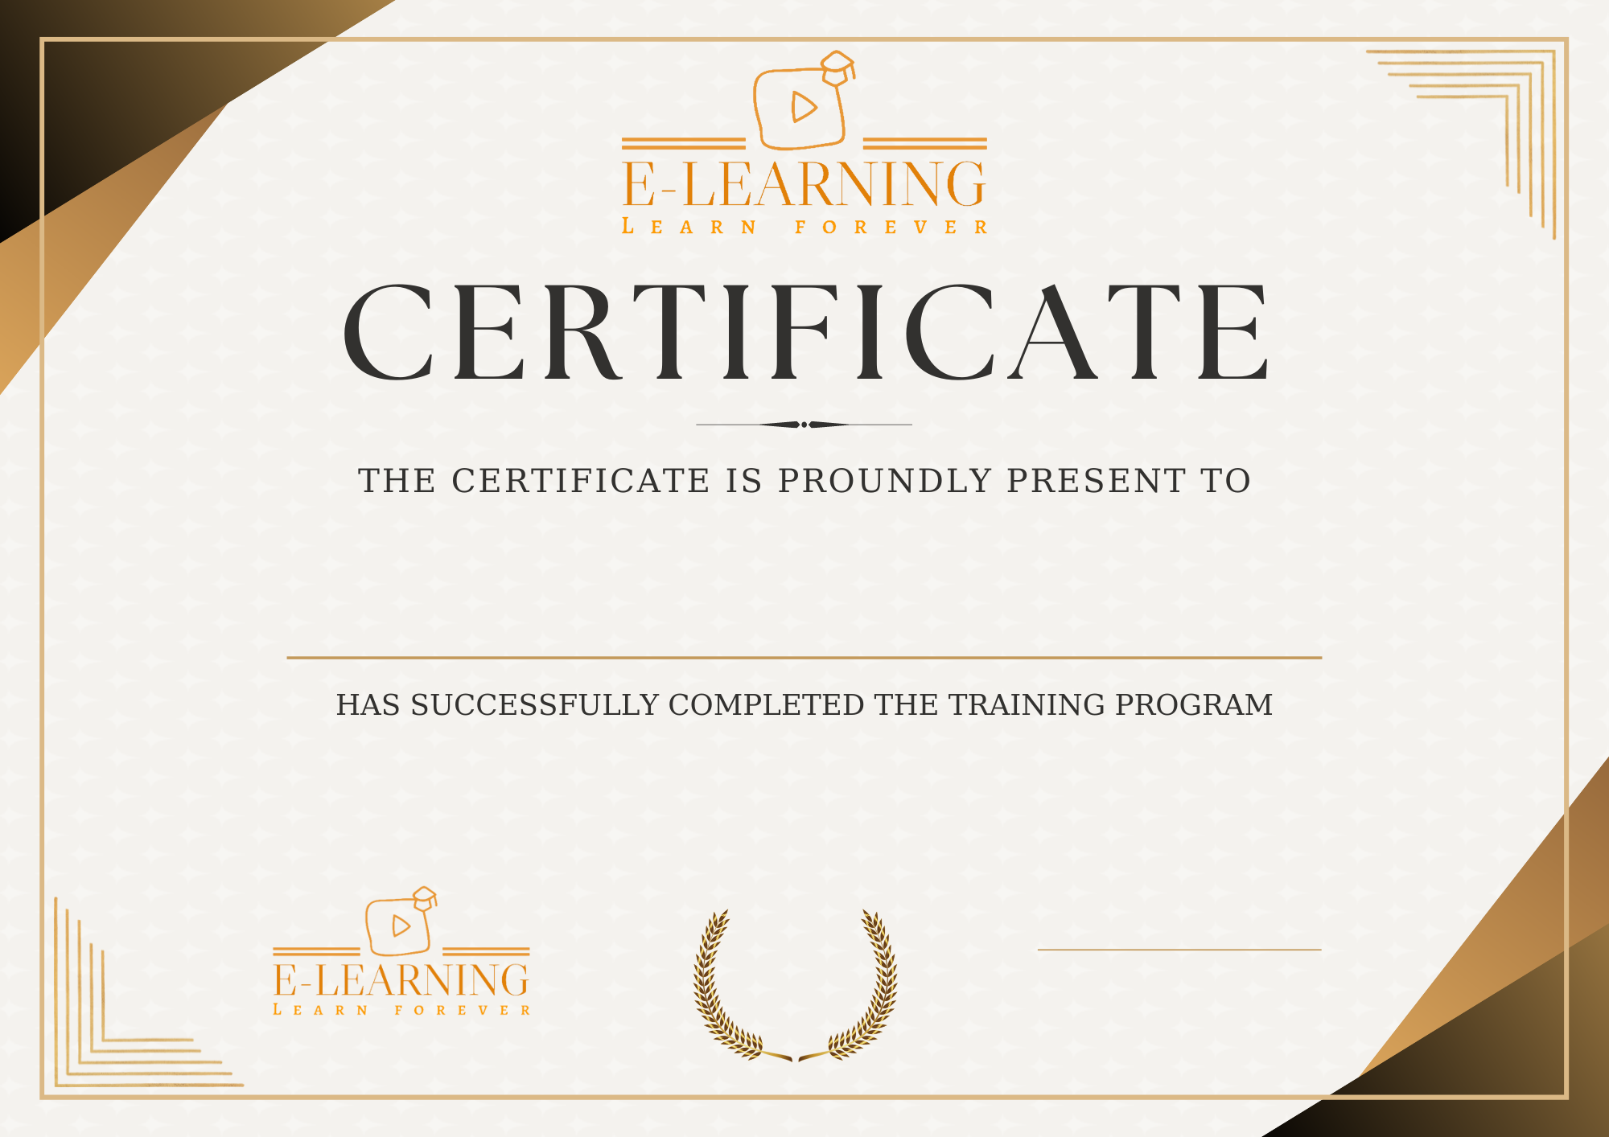
HAS SUCCESSFULLY COMPLETED THE TRAINING PROGRAM
#managerName#
#position#

