Slide 1
WEBSITE BUILDING PROCESS

Slide 2
Analysing Website
Source Folder Architect
Libraries and Framework to build a website
Built Bootstrap Framework?

Slide 3
1. Analysing Website
Layout of Website
Site Map
Analysing Layout
Analysing Element

Slide 4


Slide 5
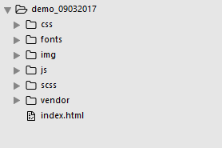
2. Source Folder Architect

Slide 6
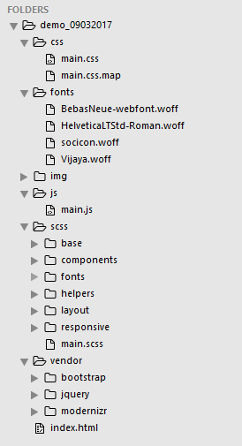

Slide 7
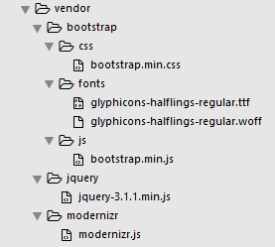
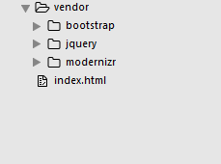

Slide 8
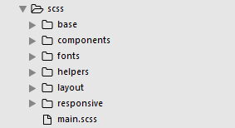


Slide 9
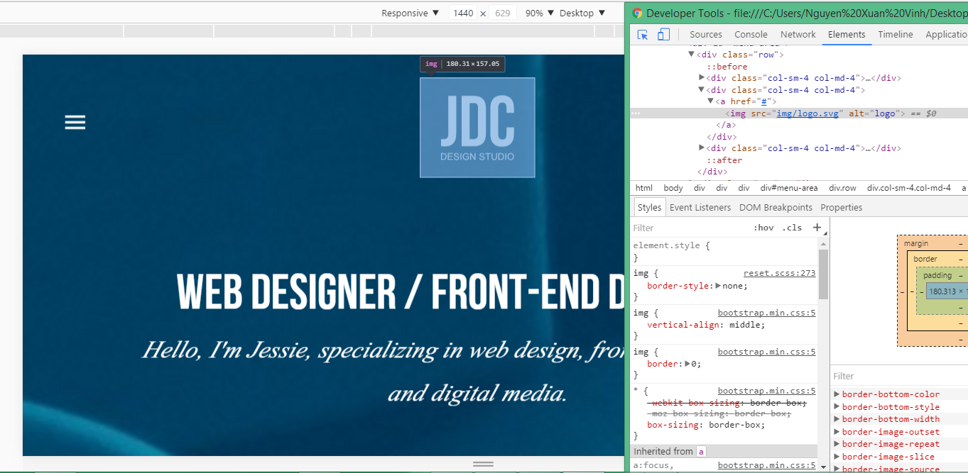

Slide 10
3. Libraries and Framework to build a website
Normalize(normalize.css)
Modernizr(modernizr.js)
Bootstrap
SASS

Slide 11
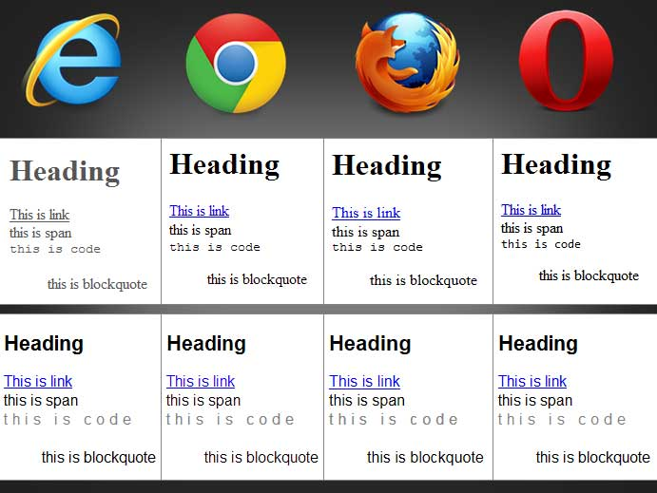
3.1. RESET CSS AND NORMALIZE
(http://www.cssterm.com/css-reset/css-reset-test)

Slide 12
Reset value of elements

Slide 13
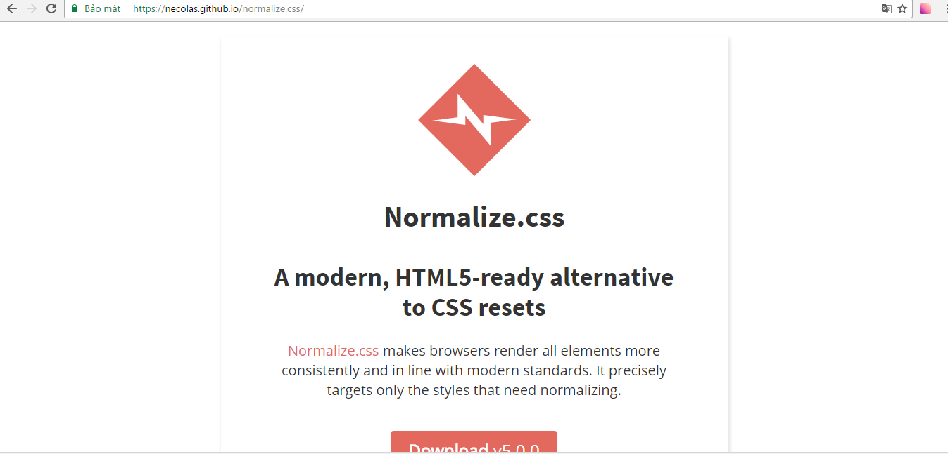

Slide 14
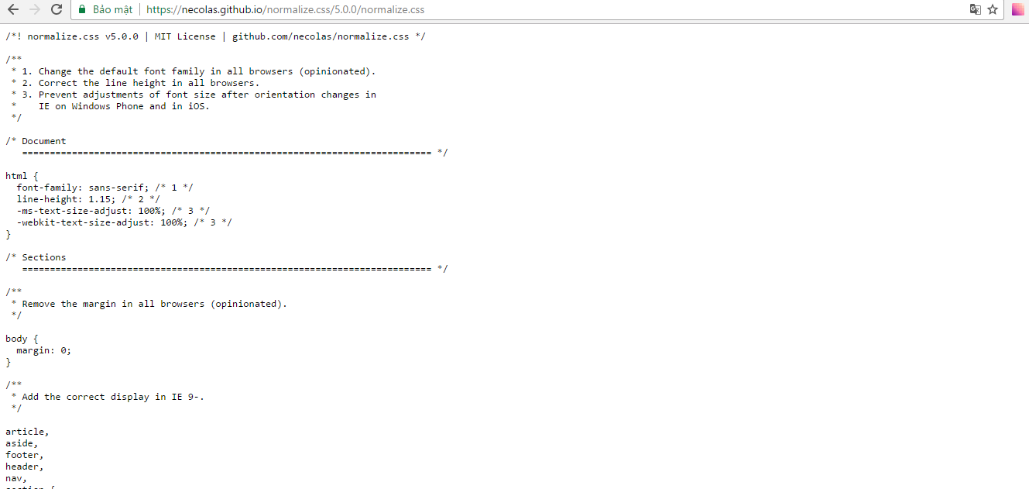

Slide 15

3.2. Modernizr?

Slide 16
Don’t support HTML5 & CSS
ERROR

Slide 17
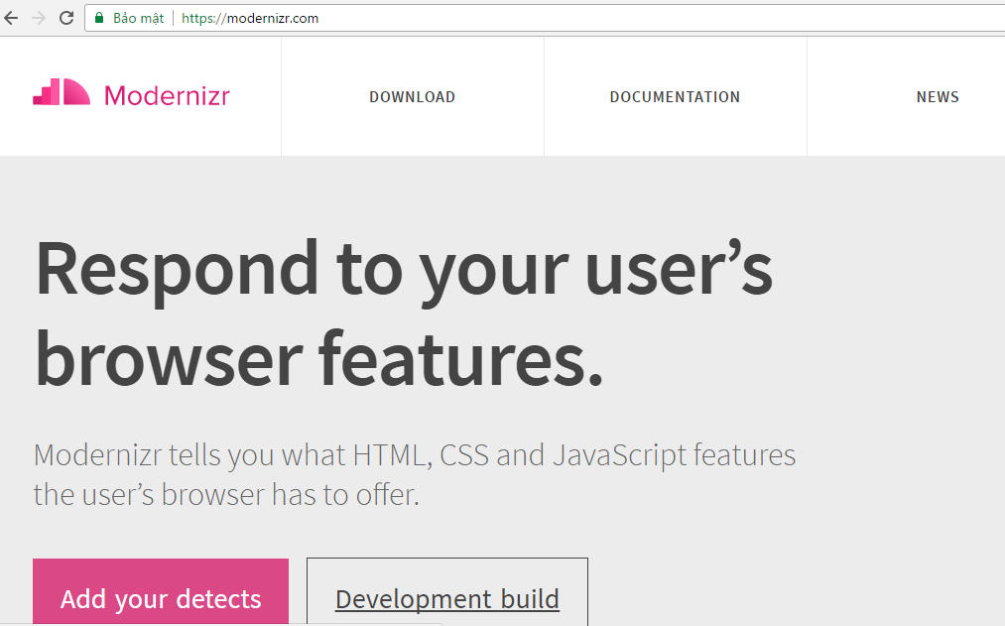
How to use?
Step 1: Go to (https://modernizr.com/)

Slide 18
Step 2: Add file moderizr.js to source folder
Step 3: Add class “no-js” in html

Slide 19
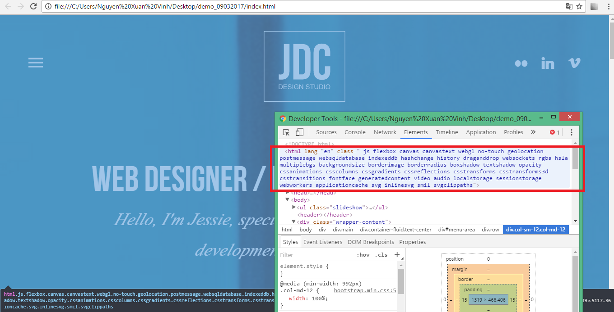
Step 4: Finish

Slide 20

3.2. SASS

Slide 21
CSS Processor
Clearly

Slide 22
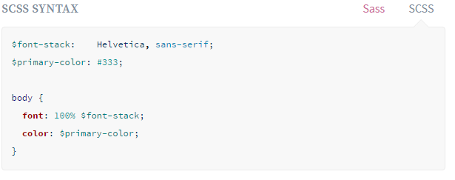
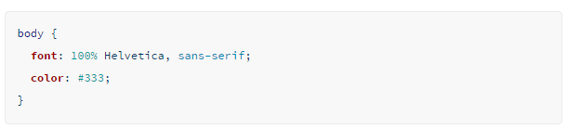
(http://sass-lang.com/guide)

Slide 23

4. Built Bootstrap Framework?

Slide 24


Slide 25

4.1. Grid System
.col-xs-
.col-sm-
.col-md-
.col-lg-
(http://getbootstrap.com/)

Slide 26
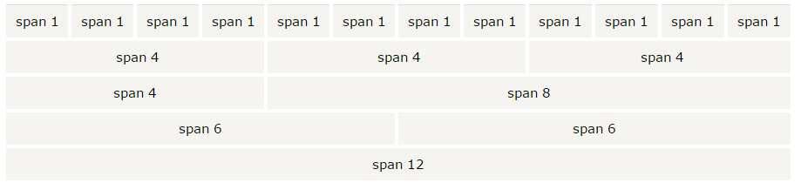

Slide 27
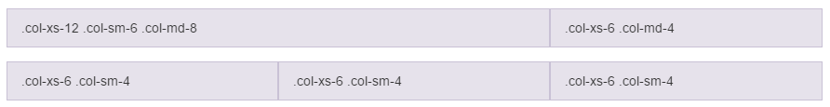

Slide 28
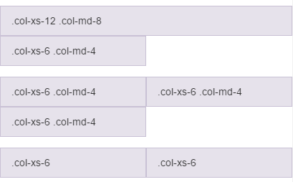

Slide 29
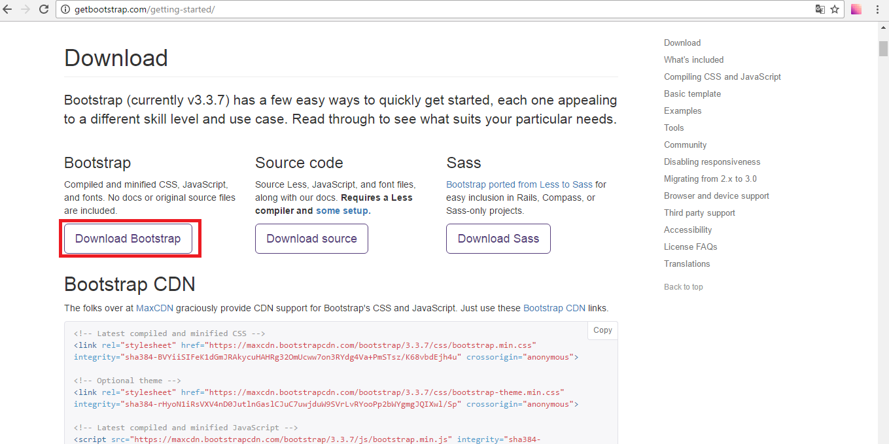
4.2. Using Bootstrap
Step 1: Go to (http://getbootstrap.com/getting-started/)
Step 2: Download file or get link CDN to use
  Download Boostrap

Slide 30
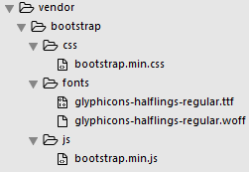

Slide 31
Step 3: Add bootstrap file to html

Slide 32
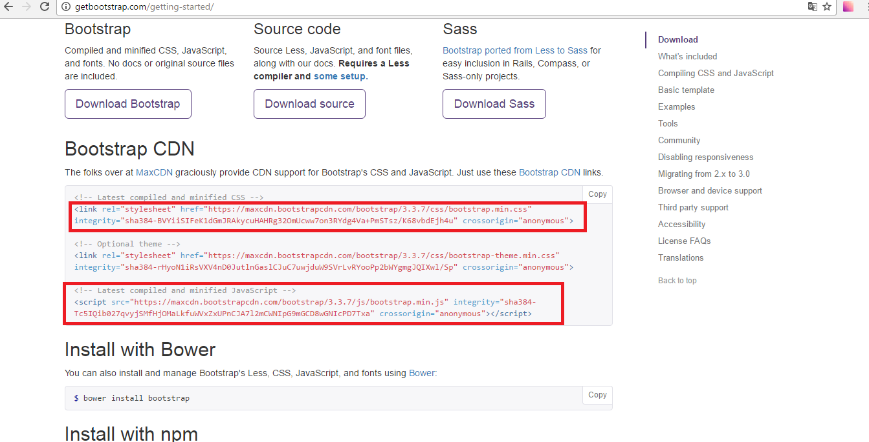
  Use CDN

Slide 33
Thank You

Slide 34
Q&A

