Slide 1
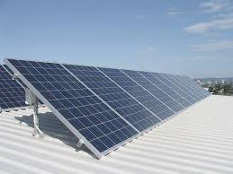
Solar PV System Simulation
Sreejaya, Suman, Vuthy
Fall 2016
DATA 604 - Simulation and Modeling Technique

Slide 2
Agenda
Introduction
Cost
Research Question
Data Preparation
Simulation
Summary
Future Work

Slide 3
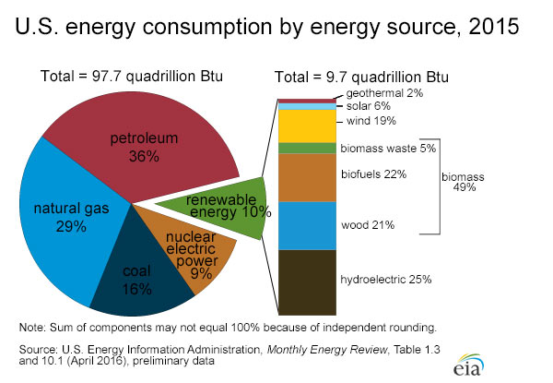
Introduction

Slide 4
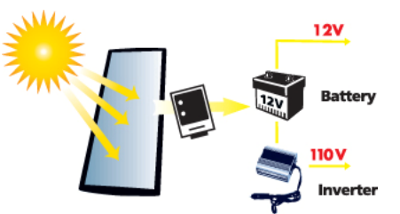
Introduction
As awareness of climate change increases, there is a growing trend to reduce reliance on fossil fuel. Renewable energy comes in many forms but we will focus our attention on solar power in this project. We will simulate various aspects of power generation with Solar Photovoltaic system and consider system size, power usage, and cost of obtaining a solar PV system.

Slide 5
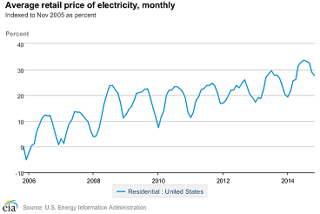
Rising costs
Cost of electricity will continue to trend upwards
Cost is cyclic but overall, trending upwards

Slide 6
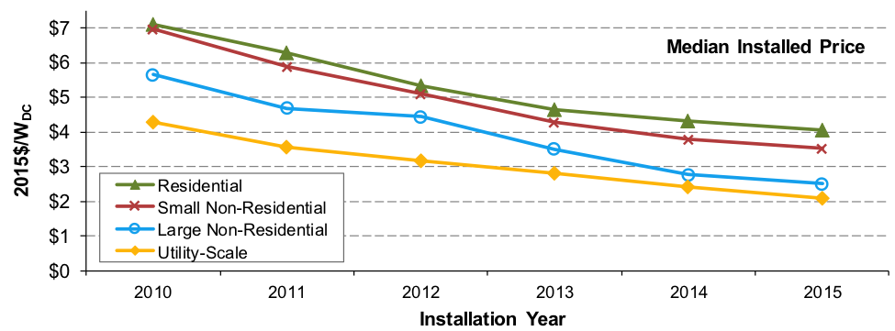
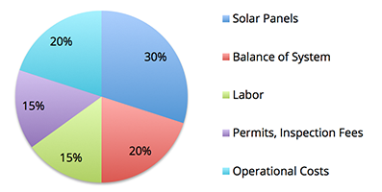
Declining PV costs
Cost per watt declining at a rapid pace
Fueled by declining panel prices
Still high because of ‘non product’ costs

Slide 7
Research Question
Should I invest in a solar PV system?
At what size will I completely offset my monthly/yearly bill?
How much can I expect to save?
How long is my payback period?
Simply put, if going with solar makes economic sense or not?

Slide 8
Data Preparation
Energy Preparation:
Daily Sun light: used monthly average sunlight data for NYC.
Number of Panels
kWh: kilowatt-hours, a solar panel system produce.
Derate Factor: Ratio of AC to DC
(http://rredc.nrel.gov/solar/old_data/nsrdb/1961-1990/redbook/sum2/94728.txt)
Energy Consumption:
Randomly picked the usage from the normally distributed overall monthly usage data of an average U.S. family (https://www.statista.com/statistics/183648/average-size-of-households-in-the-us/)

Slide 9
Challenges
Variations to the data based on location
Amount of sunlight
Electricity usage pattern
Warmer climate – air conditioner
Cooler climate – space heating
Electricity Cost
Simulating the solar panel circuit in Simio

Slide 10
Assumptions
NY data where possible
Peak sunlight only
No net metering
No battery for storage
Electricity usage as a daily average for a household

Slide 11
Simulation
Randomize Solar power Generation
New York sunlight amounts
Randomize Electricity Consumption
Average NY household usage
New York electricity prices
1000 replications for each panel size

Slide 12
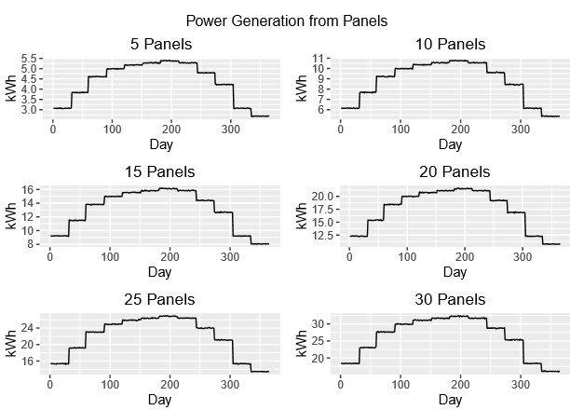
Simulation

Slide 13
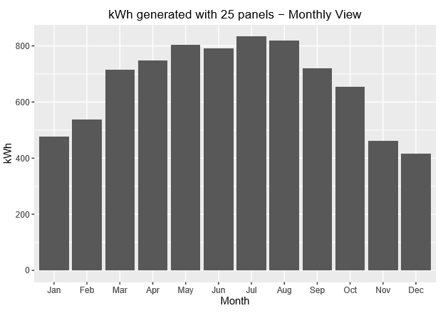
Simulation

Slide 14
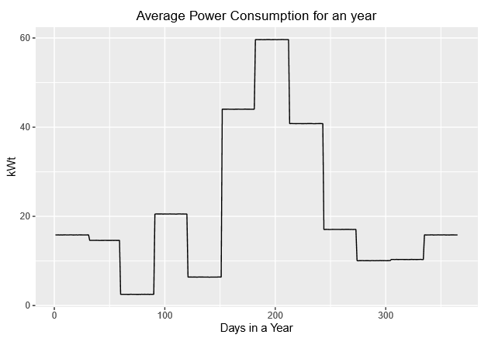
Simulation

Slide 15
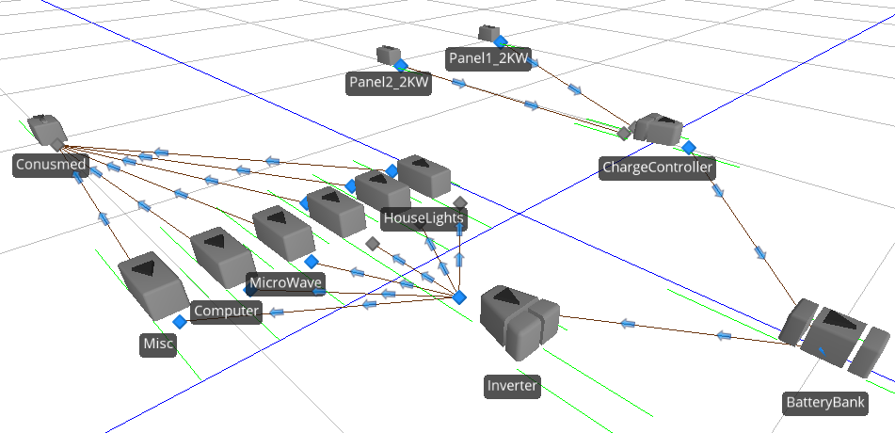
Simio

Slide 16
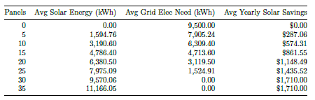
Summary
For the typical (suburban) New York family, a PV system consisting of 30 panels will be needed to virtually offset monthly/yearly electricity costs.

Slide 17
Future Work
More granular level for power consumption simulation
Breakdown of appliances
Family composition
Interactive application to change simulation parameters like zip code, appliances etc. to provide recommendation for number of panels needed, battery size, etc.
Shiny

Slide 18
References
National Renewable Energy Laboratory
http://rredc.nrel.gov/solar/old_data/nsrdb/1961-1990/redbook/sum2/94728.txt
U.S. Bureau of Labor Statistics
https://www.bls.gov/regions/new-york-new-jersey/news-release/averageenergyprices_newyorkarea.htm
Energy Information Agency
http://www.eia.gov/electricity/sales_revenue_price/xls/table5_a.xlsx

