Slide 1



Vaccum Project Document
2024.08.23
Version 0.0.1
Writer: Ms. Truong Quy

Slide 2
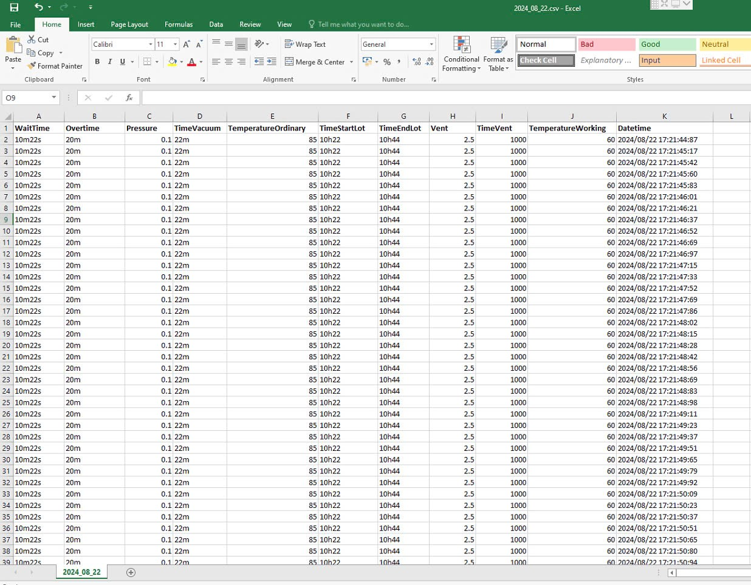
1. Data Excel File

Slide 3
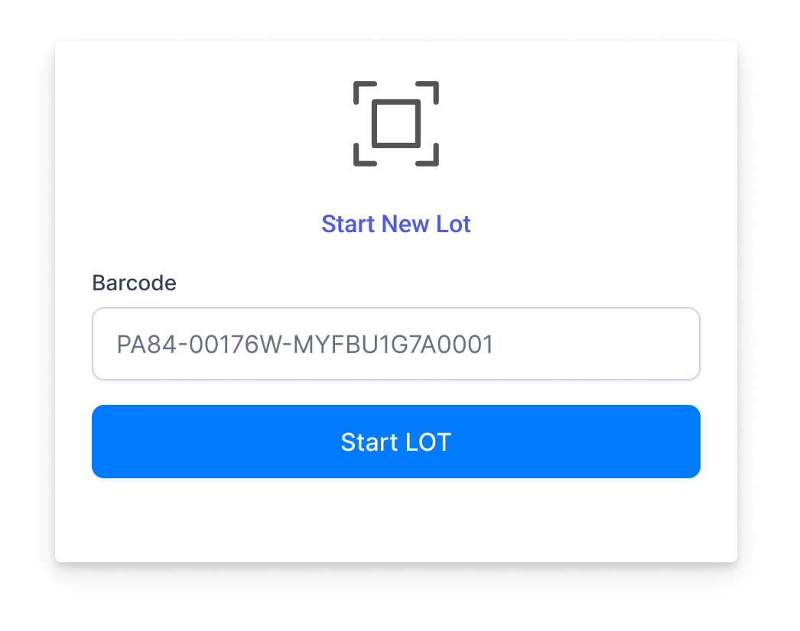

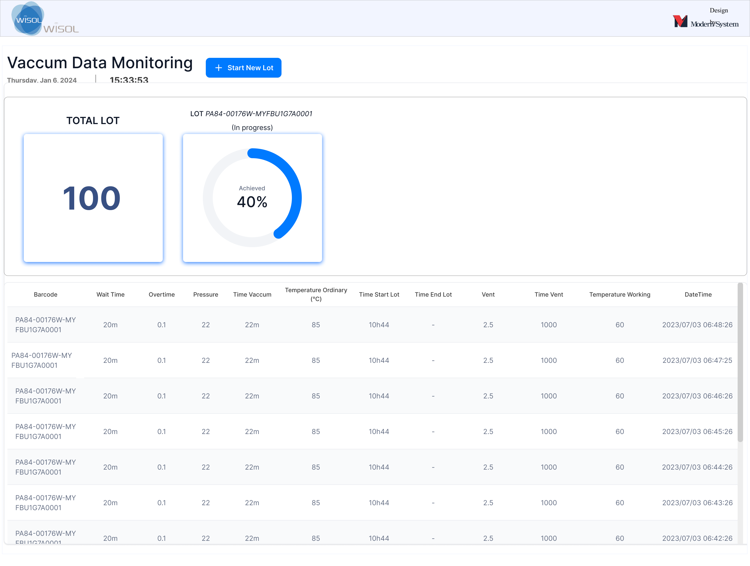
2. New Flow
Recognize barcode
Click to Start LOT
Scanning Barcode
Putting materials and closing the door
Starting LOT
Saving data
(each 3s once)
Database

Slide 4
감사합니다.

