Slide 1
From Data to AI
Building an Intelligent Customer Support Application
Morning talk · 2026
Notes:
SAY: Welcome everyone. This morning is the story and the concepts. This afternoon you will build the project yourselves in five notebooks. Everything you see today is something you will touch with your own hands later, so listen for the ideas and ask questions freely.
TIME: about 1 min

Slide 2





A day in a support team
Tickets that arrive every day
Questions the manager asks
TECHNICAL ISSUE
NUMBERS
"My headphones will not pair with my phone."
How many tickets did we get this week?
REFUND REQUEST
NUMBERS
"Where is my refund? It has been two weeks."
Which ticket type is slowest to resolve?
CANCELLATION REQUEST
KNOWLEDGE
"Please cancel my plan at the end of the month."
What should the agent tell this customer?
Numbers come from data. Answers come from knowledge. Today you learn how to get both.
WELCOME
‹#›
Notes:
SAY: Picture a company that sells devices. Every day customers write in. Three examples are on the left. A manager has questions about all of these tickets. Look at the three questions on the right. The first two need numbers: counting and averaging over thousands of tickets. The third needs knowledge: what should we tell this customer?
ASK THE ROOM: Which of the three questions could you answer with a spreadsheet today? Which one is hard?
TIME: about 2 min

Slide 3



Data and AI in one sentence
DATA
the facts we collect
rows, text, clicks, sensor readings
AI
software that finds patterns
and writes answers from them
DECISIONS
and ANSWERS
that people can trust
+
=
Garbage in, garbage out: AI is only as good as the data behind it, and the way we connect the two.
WELCOME
‹#›
Notes:
SAY: Data is the facts we collect: rows in a table, text in a ticket, a click on a page. AI, in this workshop, means software that finds patterns in that data and can write answers from it. Put them together and you get decisions and answers. The important warning is on the bottom strip: the AI is only as good as the data behind it and how we connect them. That is why the first half of the afternoon is about data, not AI.
ASK THE ROOM: Can you name one AI tool you used this week? What data did it need?
TIME: about 2 min

Slide 4


















The data landscape
WHERE IT COMES FROM
WHAT SHAPE IT HAS
WHERE IT LIVES
WHAT WE DO WITH IT
Lab 1
Lab 1
Lab 2
Apps, websites
Structured
Relational DB
Dashboards
clicks, orders
rows and columns
tables, queried with SQL
KPIs and charts
Sensors, devices
Semi-structured
Data warehouse
Machine learning
readings, logs
JSON, XML, logs
prepared for analysis
predict and classify
Lab 1
Lab 3
Lab 3
Tickets, emails
Unstructured
Data lake
AI assistants
customer messages
text, images, audio
raw files, any kind
answer from knowledge
Lab 3
Documents, media
Vector database
manuals, PDFs
search by meaning
Data comes in many shapes and homes. Knowing which tool fits which shape is the real skill.
WELCOME
‹#›
Notes:
SAY: Before any tool, a map of the data world. Data comes from many places: apps and websites, sensors, support tickets and emails, documents and media. It comes in three shapes: structured, in rows and columns; semi-structured, like JSON files and logs; and unstructured, like free text, images and audio. It lives in different stores: relational databases for structured data, data warehouses for data prepared for analysis, data lakes for raw files of any kind, and the newer vector databases for searching by meaning. And it feeds different uses: reports and dashboards, machine learning models, and AI assistants. The orange tags show where this afternoon fits: support tickets in a relational database, dashboards, and a vector database behind an AI assistant. Notice that almost every real company has all of this at once.
ASK THE ROOM: Where does the data of your favourite app live?
TIME: about 3 min

Slide 5
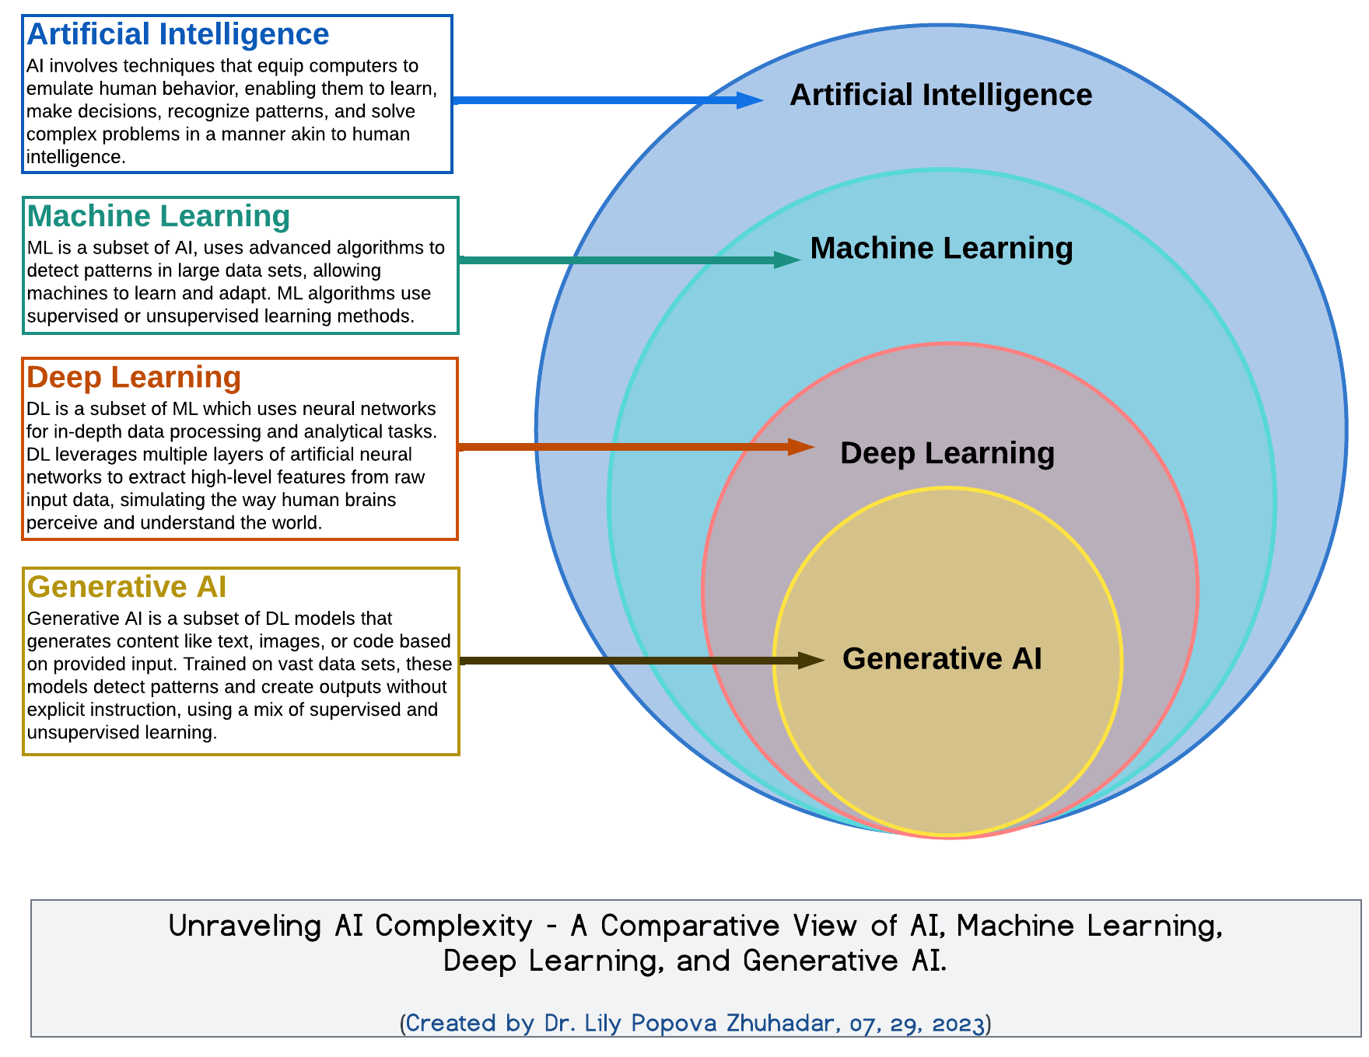




The AI landscape
Artificial intelligence
the umbrella: software that behaves intelligently
Machine learning
learns patterns from data instead of hand-written rules
Deep learning
many-layered neural networks
Generative AI
creates text, code and images: LLMs live here
This workshop: LLM + embeddings + RAG
WELCOME
Image: "Unraveling AI Complexity" by Lily Popova Zhuhadar, Wikimedia Commons, CC BY-SA 4.0
‹#›
Notes:
SAY: AI is a big umbrella, and the words are often mixed up. Artificial intelligence is the whole field: software that behaves intelligently. Machine learning is a part of it: instead of writing rules by hand, the computer learns patterns from data. Deep learning is a part of machine learning that uses many-layered neural networks. And generative AI, the large language models behind chat assistants, is a part of deep learning that creates new text, images or code. This workshop lives in the inner circles: we use a language model, embeddings, and retrieval, to answer from our own data. The diagram is from Wikimedia Commons under a Creative Commons licence; the credit is at the bottom.
ASK THE ROOM: Which of these four circles have you already used?
TIME: about 3 min

Slide 6




Why enterprises care about data
Better decisions
Competitive edge
Operational efficiency
Risk and compliance
Customer experience
Accurate data drives smarter, faster business decisions.
Harness data to stay ahead of market trends and customer needs.
Find bottlenecks early and automate repetitive work.
Know where sensitive data lives and follow privacy rules.
Use insights to deliver personalised, improved services.
Data is the cornerstone of digital transformation, new business models and innovation.
WELCOME
‹#›
Notes:
SAY: Why do companies invest so much in data? Five reasons. Better decisions: accurate data drives smarter, faster choices. A competitive edge: stay ahead of market trends and customer needs. Operational efficiency: find bottlenecks early and automate repetitive work. Risk and compliance: know where sensitive data lives and follow privacy rules. And a better customer experience: use insights to personalise and improve services. The line at the bottom is the big picture: data is the cornerstone of digital transformation, new business models and innovation. AI makes this more valuable, but also raises the stakes on data quality, which is the next slide.
ASK THE ROOM: Which of the five matters most for a support team?
TIME: about 3 min

Slide 7







Garbage in, garbage out
Dirty data
Wrong numbers
Wrong decision
AI repeats it
a ticket counted twice, missing IDs, "closed" and "Closed"
the closed rate and the counts are off
the team is staffed for the wrong problem
a confident answer from an old or wrong article
REAL-WORLD DATA PROBLEMS EVERY COMPANY MEETS
Poor data quality
Data silos
Data security
Inaccurate or incomplete data leads to flawed analysis and decisions.
Data stuck in separate systems is hard to find, join and trust.
Data must be protected from unauthorised access and use.
Good AI starts with good data. That is why Lab 1 comes first.
WELCOME
‹#›
Notes:
SAY: This is the rule to remember all day. If the data going in is dirty, the numbers coming out are wrong, so the decision is wrong. And with AI it gets worse, because a language model will repeat wrong or outdated information in fluent, confident sentences. Follow the chain with our own support example: the same ticket counted twice and a few missing ids make the closed rate wrong, so the manager staffs for the wrong problem, and an assistant answering from an old article tells customers something false. At the bottom, three real-world data problems that every company meets: poor data quality, data silos, and data security. Lab 1 is first this afternoon because everything else stands on it.
ASK THE ROOM: Where have you seen a wrong number lead to a wrong decision?
TIME: about 3 min

Slide 8
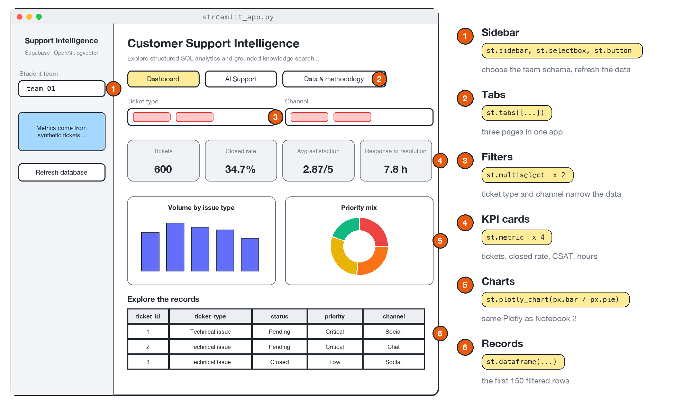

What you will build this afternoon
By the end of the day
A database
with your own cleaned support tickets
A dashboard
with KPIs and charts you can explain
An AI assistant
that answers from a knowledge base, with sources
WELCOME
‹#›
Notes:
SAY: This is the finished product, a small web app for a support team. On the left is the layout: a team selector, filters, KPI cards, charts, and a table. There is also a second tab with an AI assistant that answers from a knowledge base and shows which articles it used. You will not start from this. You will build the data, the charts and the AI search in notebooks, and then see how they come together in an app.
TIME: about 1 min

Slide 9

Overall picture
Where do data and AI fit, and who builds them?
Part 1 of 6 · The whole day
Notes:
SAY: Part one is the map. Before any detail, we place data and AI in the bigger picture: the ladder from data to decision, the layers of a system, the people in a team, and how a real project runs.
TIME: a few seconds

Slide 10

From data to decision
more value
ACTION
give agents a refund guide, track the time
INSIGHT
refund requests take the longest to resolve
INFORMATION
tickets per type, average hours
DATA
600 ticket rows
Each step needs a different skill: collecting, summarising, interpreting, acting.
PART 1 · OVERALL PICTURE
‹#›
Notes:
SAY: This ladder is the big idea of the day. Raw data is just rows. When we count and group it we get information. When we look at it carefully we find an insight, something that surprises or explains. And only when someone acts on it does it matter. The example is from our own ticket sample: refund requests take longest to resolve. Each step up needs a different skill, and the five labs climb this whole ladder.
ASK THE ROOM: What would YOU do if refunds really were the slowest?
TIME: about 2 min

Slide 11



The landscape in layers
Agents: an LLM that chooses between tools
Lab 5 (bonus)
In one day
we climb from the database to an AI agent.
Applications: web apps and chat interfaces
Lab 4
AI: embeddings, vector search, LLMs, RAG
Lab 3
data flows up
Analytics: SQL, KPIs, dashboards
Lab 2
Storage: relational databases, vector databases
Lab 1
Ingestion and ETL: extract, clean, load
Lab 1
Sources: CSV files, apps, sensors
PART 1 · OVERALL PICTURE
‹#›
Notes:
SAY: Real data and AI systems are built in layers, and data flows upwards. At the bottom are the sources: files, apps, sensors. Then ingestion and ETL, which cleans and moves data. Then storage in a database. On top of storage we do analytics: SQL and dashboards. Then AI: embeddings, language models, retrieval. Then applications, so that people can use it. At the very top, agents that choose tools. The orange tags show where each lab sits. In one day you will touch every layer except the very bottom.
ASK THE ROOM: Which layer do you think is the hardest to get right in real life?
TIME: about 2 min

Slide 12



Who does what in a real team
Data engineer
Data analyst
AI engineer
App developer
Business owner
Moves, cleans and stores the data
Answers questions with SQL and charts
Builds embeddings, RAG and agents
Ships a product people can use
Asks the questions, makes the decision
Lab 1
Labs 1 and 2
Labs 3 and 5
Lab 4
All labs
This afternoon you play each role for a few minutes.
PART 1 · OVERALL PICTURE
‹#›
Notes:
SAY: Nobody builds all of this alone. A data engineer moves and cleans the data. An analyst answers questions with SQL and charts. An AI engineer builds retrieval and agents. A software developer wraps it in an app people can use. And a business owner asks the questions and makes the decisions, which is where it all started. This afternoon you will play every role for a few minutes. That is on purpose: you will understand what each person needs from the others.
ASK THE ROOM: Which role sounds most like you?
TIME: about 2 min

Slide 13



How a real project runs
1
Define the problem
2
Get the data
3
Clean and model
4
Analyse
5
Build app and AI
6
Deploy and monitor
Phases 2 to 5: what you practise this afternoon
Cost
budget, API usage, people
Time
deadlines and trade-offs
Quality
accuracy, reliability, trust
You can never maximise all three at once: every project is a set of trade-offs.
Real projects spend a lot of effort on getting and cleaning data, long before any AI appears.
PART 1 · OVERALL PICTURE
‹#›
Notes:
SAY: Real projects follow roughly these six phases. First understand the problem: who needs what, and what does success look like? Then get the data, which is often the hard part. Clean and model it. Analyse it. Build the app or the AI. Then deploy and keep monitoring, because data and users change. Underneath is the iron triangle: cost, time and quality. You never maximise all three, so every project is a set of trade-offs. The orange bracket shows the phases you practise this afternoon.
ASK THE ROOM: Which phase do you think takes the longest?
TIME: about 2 min

Slide 14
Data foundations
Where does the data live, and how do we make it trustworthy?
Part 2 of 6 · You practise this in Lab 1
Notes:
SAY: Part two is about data. Where it lives, how it gets cleaned and loaded, and how we ask it questions with SQL. This is Lab 1 this afternoon.
TIME: a few seconds

Slide 15
Why databases, not spreadsheets?
 | Spreadsheet | Database
Many people at once | Edits collide, copies multiply | Built for many users at the same time
Rules | Any value in any cell | Types, required fields, keys, constraints
Size | Slows down on big data | Handles millions of rows
Questions | Manual filters and formulas | SQL: ask in a sentence-like language
Safety | Easy to overwrite by accident | Transactions, permissions, backups
A database is a shared, rule-enforcing, queryable home for data.
PART 2 · DATA FOUNDATIONS
‹#›
Notes:
SAY: A spreadsheet is a great tool for one person. The moment many people and many systems need the same data, problems start: copies diverge, anyone can type anything, and big files slow down. A database fixes these on purpose: it is built for many users, it enforces rules about what data is allowed, it handles millions of rows, and you question it with a language, SQL. Notice the last row: transactions and permissions are what make a database safe to share.
ASK THE ROOM: Have you ever had two versions of the same spreadsheet?
TIME: about 2 min

Slide 16
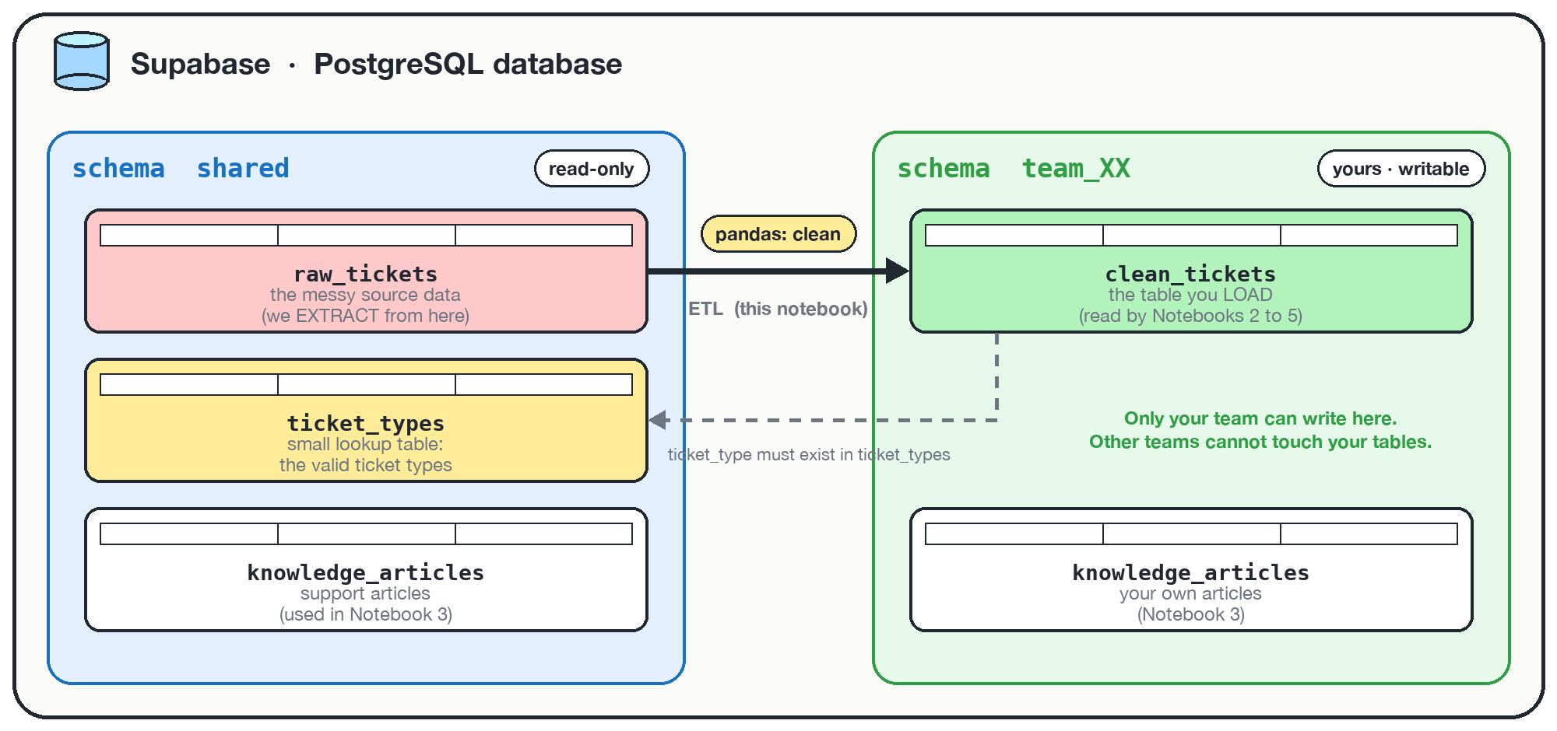
Tables, keys and schemas
Table
rows and columns of one kind of thing
Primary key
unique, never empty: identifies a row
Foreign key
must match a key in another table
Schema
a named folder of tables, with its own permissions
PART 2 · DATA FOUNDATIONS
‹#›
Notes:
SAY: Here is how our database is organised. A table is rows and columns. A primary key is a column whose value is unique per row, like a ticket id. A foreign key is a column that must match a primary key in another table, which is how tables connect and how the database refuses nonsense values. A schema is a named folder of tables. On the picture you see a shared schema everybody reads, and one private schema per team that only that team can write to. That is how thirty students can use one database without breaking each other.
ASK THE ROOM: Why might each team need its own schema?
TIME: about 2 min

Slide 17
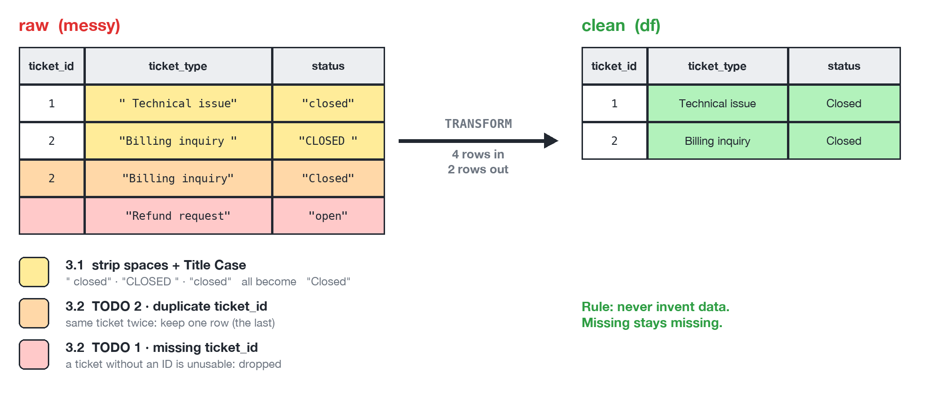
Dirty data is normal
Garbage in, garbage out: clean first, then analyse.
PART 2 · DATA FOUNDATIONS
‹#›
Notes:
SAY: Real data is never clean. On the left is a tiny raw table: stray spaces, three different spellings of Closed, the same ticket twice, and a ticket with no id. After cleaning, on the right, two trustworthy rows remain. If you skip this step, your counts are wrong and everything built on top, the dashboard, the AI, inherits the mistakes. This is the garbage in, garbage out rule, and it is why Lab 1 starts here.
ASK THE ROOM: Which of these four problems would you find hardest to spot in a huge table?
TIME: about 2 min

Slide 18
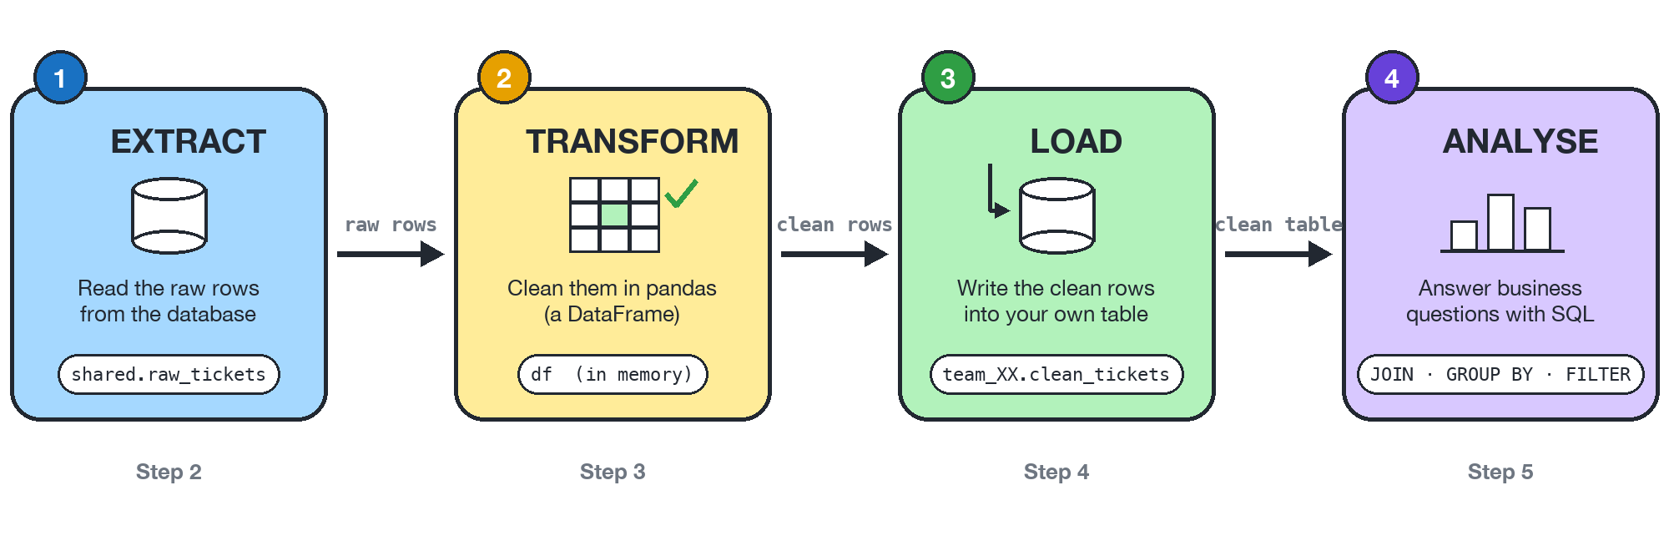
ETL: Extract, Transform, Load
Idempotent load (UPSERT)
insert or update: running it twice is harmless
Runs on a schedule
real pipelines repeat every hour or every night
PART 2 · DATA FOUNDATIONS
‹#›
Notes:
SAY: ETL is the standard name for moving data from where it is to where it is useful. Extract: read the raw rows. Transform: clean them. Load: write them into a table people can query. Then we analyse. Real pipelines run again and again, every night or every hour. So the load step must be safe to repeat: an UPSERT inserts a new row or updates an existing one, which means running it twice does no harm. The word for that is idempotent.
ASK THE ROOM: What would happen if a nightly load used a plain INSERT and ran twice?
TIME: about 2 min

Slide 19
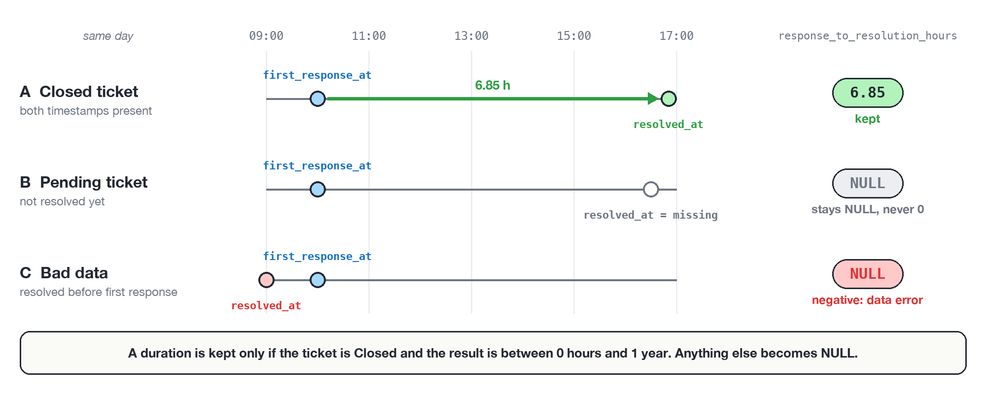
NULL is not zero
Unknown stays unknown: filling NULL with 0 makes every average lie.
PART 2 · DATA FOUNDATIONS
‹#›
Notes:
SAY: Three tickets on a timeline. The first one is closed and we can compute 6.85 hours. The second is still pending, so there is no resolution time yet. The third has bad data, resolved before the first response. Both of those must stay NULL, meaning unknown. If you fill unknown with zero, every average is dragged down and the dashboard lies. SQL averages skip NULL on purpose, so leaving NULL is the honest choice.
ASK THE ROOM: A ticket has no resolution yet. Is its resolution time 0 hours?
TIME: about 2 min

Slide 20
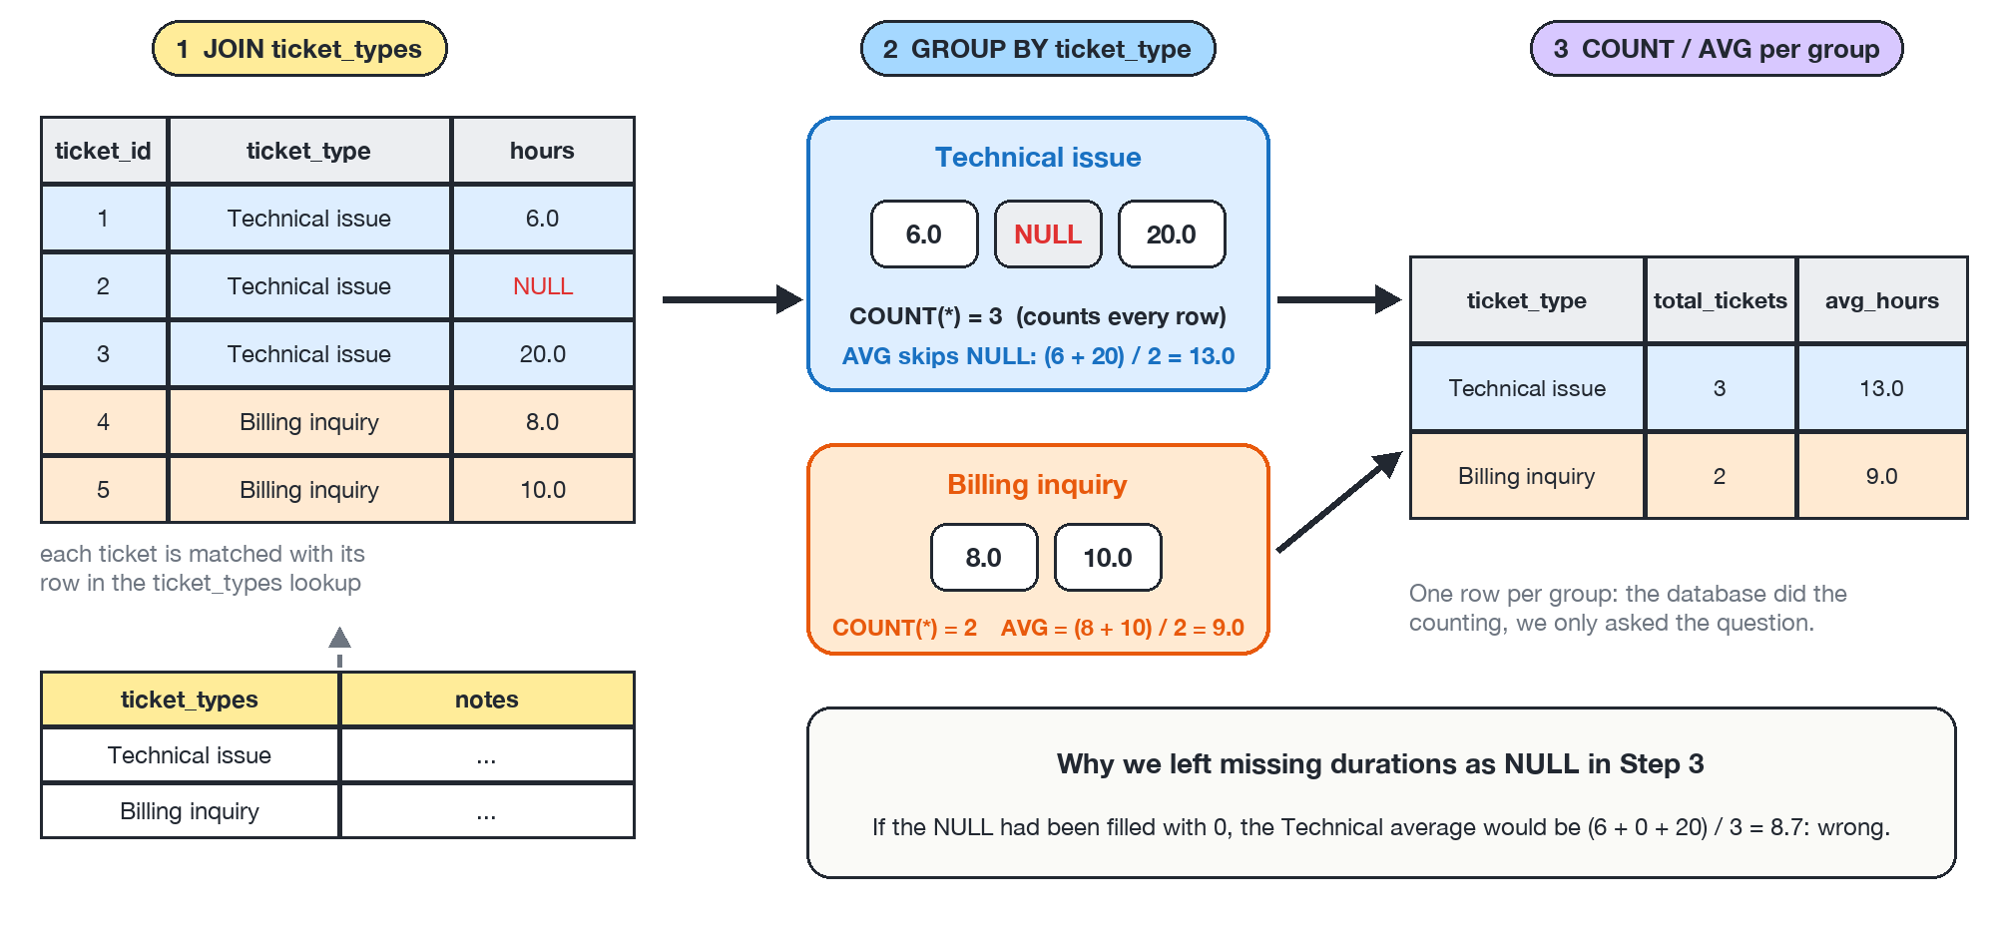
SQL: the language of questions
You describe the answer you want. The database does the counting.
PART 2 · DATA FOUNDATIONS
‹#›
Notes:
SAY: SQL lets you ask the database a question in a sentence-like language. In the picture: take the tickets, group them by ticket type, and count and average each group. Notice the NULL in the Technical group: the count includes it, the average skips it. JOIN connects two tables, GROUP BY makes the groups, and FILTER counts only some rows, which is how we get a closed rate. You do not tell the database how to count. You describe what you want.
ASK THE ROOM: Which would you rather do by hand: count 600 tickets per type, or write one SQL sentence?
TIME: about 2 min

Slide 21
From numbers to decisions
How do we turn numbers into something a manager can act on?
Part 3 of 6 · You practise this in Lab 2
Notes:
SAY: Part three: once the data is clean, how do we turn it into KPIs and charts people trust, and how do we say honestly what they show? This is Lab 2.
TIME: a few seconds

Slide 22




A KPI is a promise
600
Tickets
34.7%
Closed rate
2.87
Average CSAT (1 to 5)
7.8 h
Average resolution time
READ IT HONESTLY
READ IT HONESTLY
READ IT HONESTLY
READ IT HONESTLY
the whole sample
share of tickets with status Closed: not an SLA
only the 208 rated tickets, not all 600
only the 105 tickets that have a duration
A number without its caveat is a promise you cannot keep.
PART 3 · FROM NUMBERS TO DECISIONS
‹#›
Notes:
SAY: A KPI is one number that tells you how you are doing. Here are four from our own sample: 600 tickets, 34.7 percent closed, average satisfaction 2.87 out of 5, and 7.8 hours average resolution time. But every number needs an honest label. The closed rate is not an official service level agreement. The satisfaction average only counts rated tickets, 208 of 600. And the resolution time is averaged over only 105 tickets that have both timestamps. A number without its caveat is a promise you cannot keep.
ASK THE ROOM: Would you trust 2.87 out of 5 if you knew only a third of the tickets were rated?
TIME: about 2 min

Slide 23
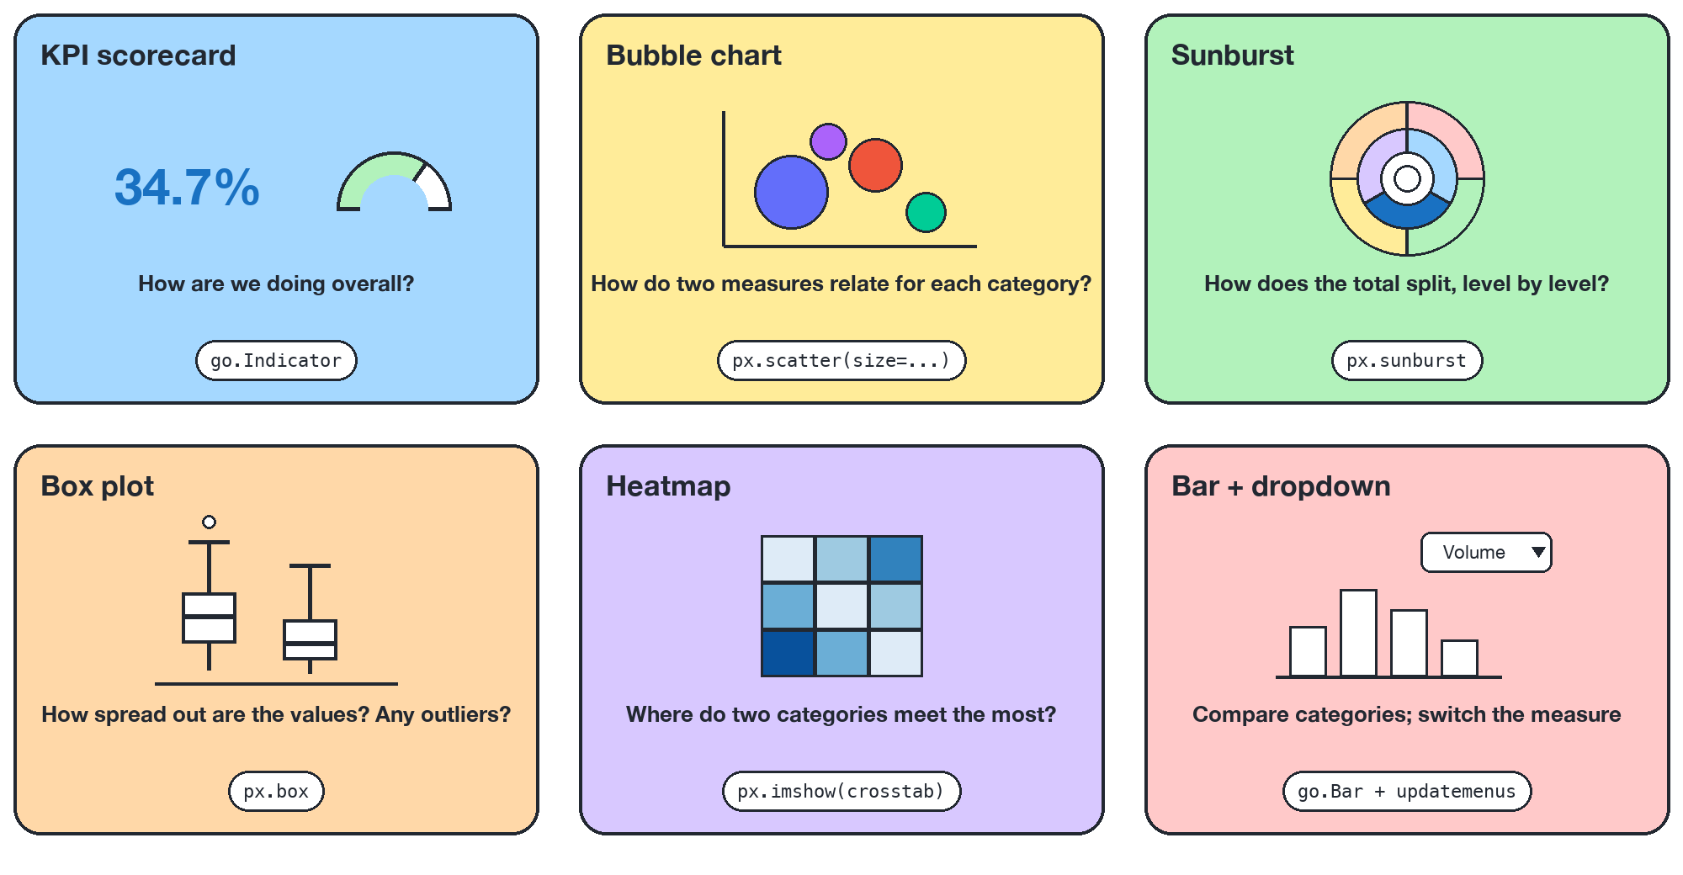
Pick the chart for the question
PART 3 · FROM NUMBERS TO DECISIONS
‹#›
Notes:
SAY: Start from the question, not from the chart. How are we doing overall? A KPI scorecard. How do two measures relate for each category? A bubble chart. How does a total split level by level? A sunburst. How spread out are the values and are there outliers? A box plot. Where do two categories meet most? A heatmap. And if you want to compare categories and switch the measure, a bar chart with a dropdown. You will build all six in Lab 2.
ASK THE ROOM: Which chart would you use to show how tickets split by channel?
TIME: about 2 min

Slide 24
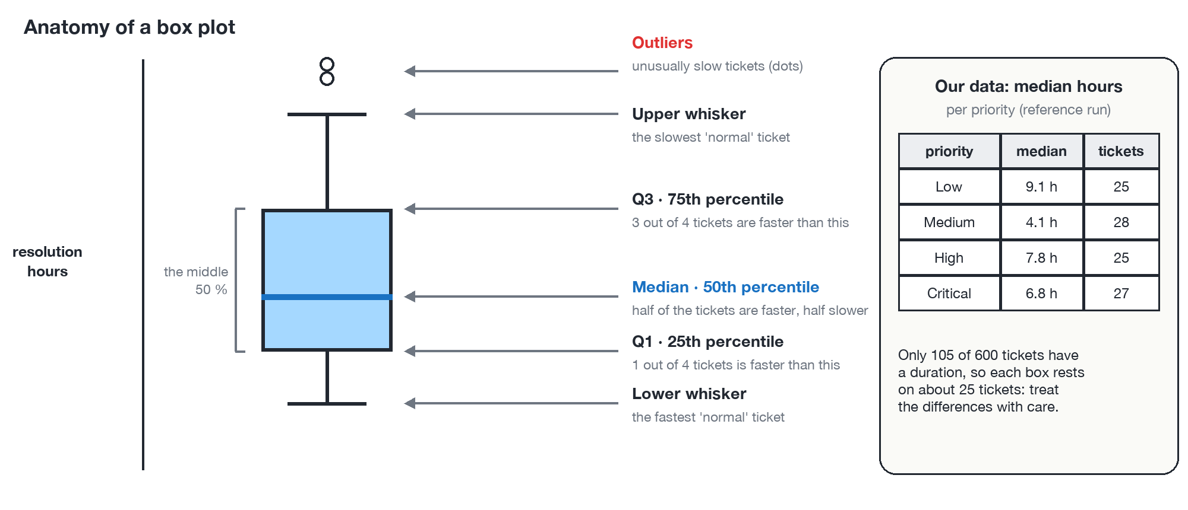
Averages hide stories
The mean says 7.8 hours. The box plot shows who waits much longer.
PART 3 · FROM NUMBERS TO DECISIONS
‹#›
Notes:
SAY: The average resolution time in our sample is 7.8 hours. But an average is one number. A box plot shows the whole distribution: the middle half of the tickets in the box, the median as the line, and unusually slow tickets as dots. On the right: the median time per priority. The numbers differ a lot, but remember each box rests on only about 25 tickets, so these are questions to investigate, not proven facts.
ASK THE ROOM: If the mean is 7.8 hours, can a customer still wait 20 hours?
TIME: about 2 min

Slide 25
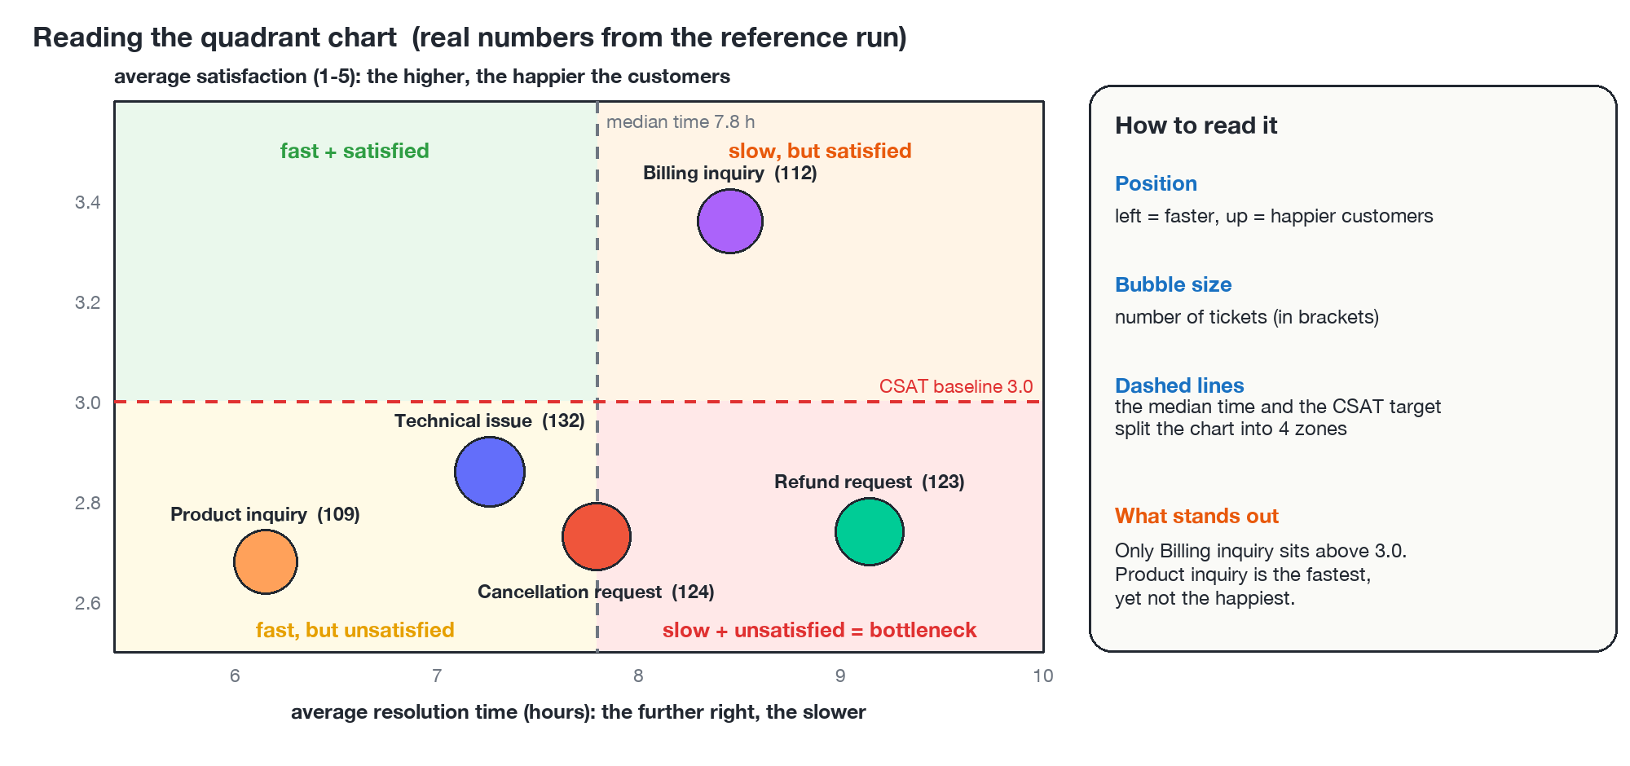
One finding, one caveat
Finding
Billing inquiry is the only type with average satisfaction above 3.0 (3.36).
Caveat
Ratings come from a few dozen tickets per type: small gaps may be noise.
PART 3 · FROM NUMBERS TO DECISIONS
‹#›
Notes:
SAY: This bubble chart puts speed against satisfaction for each ticket type. The dashed lines split it into four zones. Reading it honestly means saying two things. A finding says what the chart shows, with a number. A caveat says what it cannot tell us. Here: Billing inquiry is the only type above the 3.0 baseline. The caveat: satisfaction comes from a few dozen rated tickets per type, so small differences may be noise. This is the habit we want from every analyst.
ASK THE ROOM: What is a finding you can state from this chart, and what is the caveat?
TIME: about 2 min

Slide 26
AI behind the scenes
How can a language model answer from our own knowledge?
Part 4 of 6 · You practise this in Lab 3
Notes:
SAY: Part four is the AI core. What an LLM can and cannot do, what vectors and vector databases are, and how retrieval-augmented generation works. This is Lab 3, the longest lab.
TIME: a few seconds

Slide 27

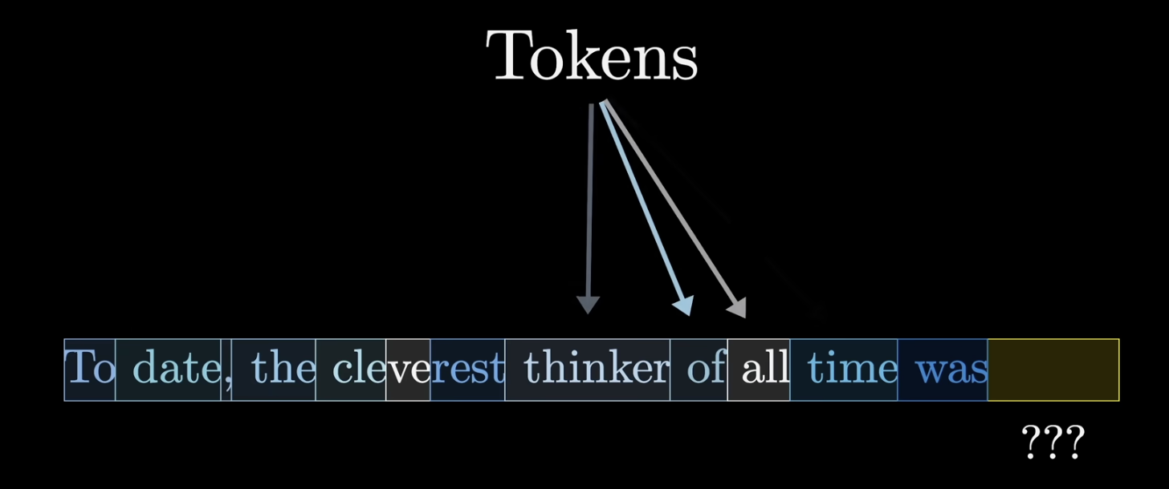


Words become tokens
A token is a piece of text
a whole word, part of a word, or punctuation
Each token becomes a number
then a vector the model can compute with
The model guesses the next token
that is its one job: the ??? at the end
An LLM does not read words: it reads tokens. Context limits and prices are counted in tokens too.
PART 4 · AI BEHIND THE SCENES
Image: video frame, 3Blue1Brown
‹#›
Notes:
SAY: A language model does not read words the way we do. It first cuts the text into tokens. A token is a piece of text: sometimes a whole word like "date" or "thinker", sometimes only part of a word, like "cle", "ve", "rest" in "cleverest", and punctuation such as the comma is its own token. Each token is then turned into a number, and then into a vector, the same idea you will see in the vector part later. The model looks at the whole sequence of tokens and has one job: guess the next token, the question marks at the end of the picture. Tokens matter in practice: the context window, the amount of text a model can read at once, and the price of an API call are both counted in tokens, not in words.
ASK THE ROOM: How many tokens do you think the sentence on the screen has?
TIME: about 3 min

Slide 28
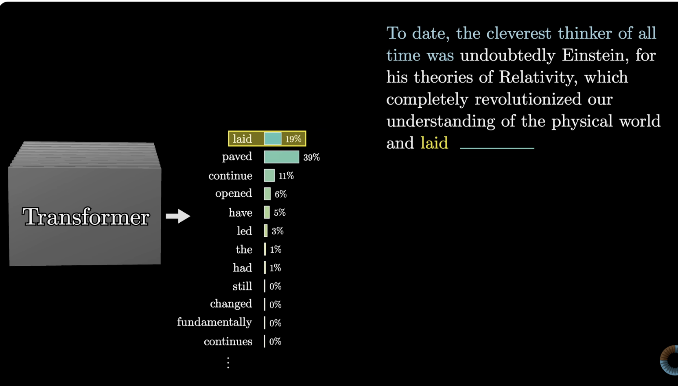
An LLM writes one token at a time
Read the text so far
1
as a sequence of tokens
The transformer scores every token
2
a probability for each possible next token
Pick one
3
not always the top one, so answers can differ
Add it and repeat
4
until the answer is complete
It predicts likely words, it does not look facts up. That is why it can sound sure and be wrong.
PART 4 · AI BEHIND THE SCENES
Image: video frame, 3Blue1Brown
‹#›
Notes:
SAY: Here is what happens inside. The text so far goes into a neural network called a transformer. Its output is not an answer but a list: a probability for every possible next token. In the picture, "paved" has 39 percent, "laid" 19 percent, "continue" 11 percent, and a long tail of very unlikely words. The system then picks one token, not always the most likely one, which is why the same question can give different answers. The chosen token, here "laid", is added to the text and the whole process repeats, token after token, until the answer is complete. This is the key to the next slides: the model produces likely words, it does not look facts up. That is why it can sound confident and be wrong, and why we will give it our own documents to read.
ASK THE ROOM: If the model picks the most likely word every time, will every answer be the same?
TIME: about 3 min

Slide 29








What an LLM can and cannot do
What it does well
What it cannot do alone
Writes fluent text
Knows nothing recent
it stops at a training cutoff date
Summarises long text
Has not seen your data
your articles and tickets are private
Follows instructions
Can be confidently wrong
this is called hallucination
Answers general questions
Reads limited text
the context window has a size limit
To use an LLM at work, we give it the right knowledge at the right moment.
PART 4 · AI BEHIND THE SCENES
‹#›
Notes:
SAY: A large language model predicts the next words, and is very good at it: it writes fluent text, summarises and follows instructions. But on its own it has limits that matter for a business. It was trained up to a cutoff date, so it does not know recent events. It has never seen your private data, for example your support articles. It can state wrong things confidently, which we call hallucination. And it can only read a limited amount of text at once, the context window. Everything in the AI part of the day is a way to work around those four limits.
ASK THE ROOM: Has an AI ever told you something confidently that turned out to be wrong?
TIME: about 2 min

Slide 30
Two kinds of data, two kinds of questions
 | Structured data | Unstructured data
Looks like | rows and columns | text, documents, images
Example | the tickets table | support articles
Best tool | SQL | embeddings and vector search
Typical question | How many refund tickets this week? | How do I fix Bluetooth pairing?
Superpower | exact counts and averages | finds meaning: "refund" is close to "money back"
SQL counts. Semantic search finds meaning. Real systems need both.
PART 4 · AI BEHIND THE SCENES
‹#›
Notes:
SAY: Structured data fits in rows and columns, like our ticket table. The right tool is SQL, and the questions are about counts and averages: how many refund tickets this week? Unstructured data is text, documents and images, like support articles. SQL cannot help when the customer writes "money back" and the article says "refund". For that we need to search by meaning, using embeddings and vector search. A good system uses both, and part of your skill is knowing which question needs which.
ASK THE ROOM: Which tool would you use for: how many tickets about Bluetooth did we get?
TIME: about 2 min

Slide 31
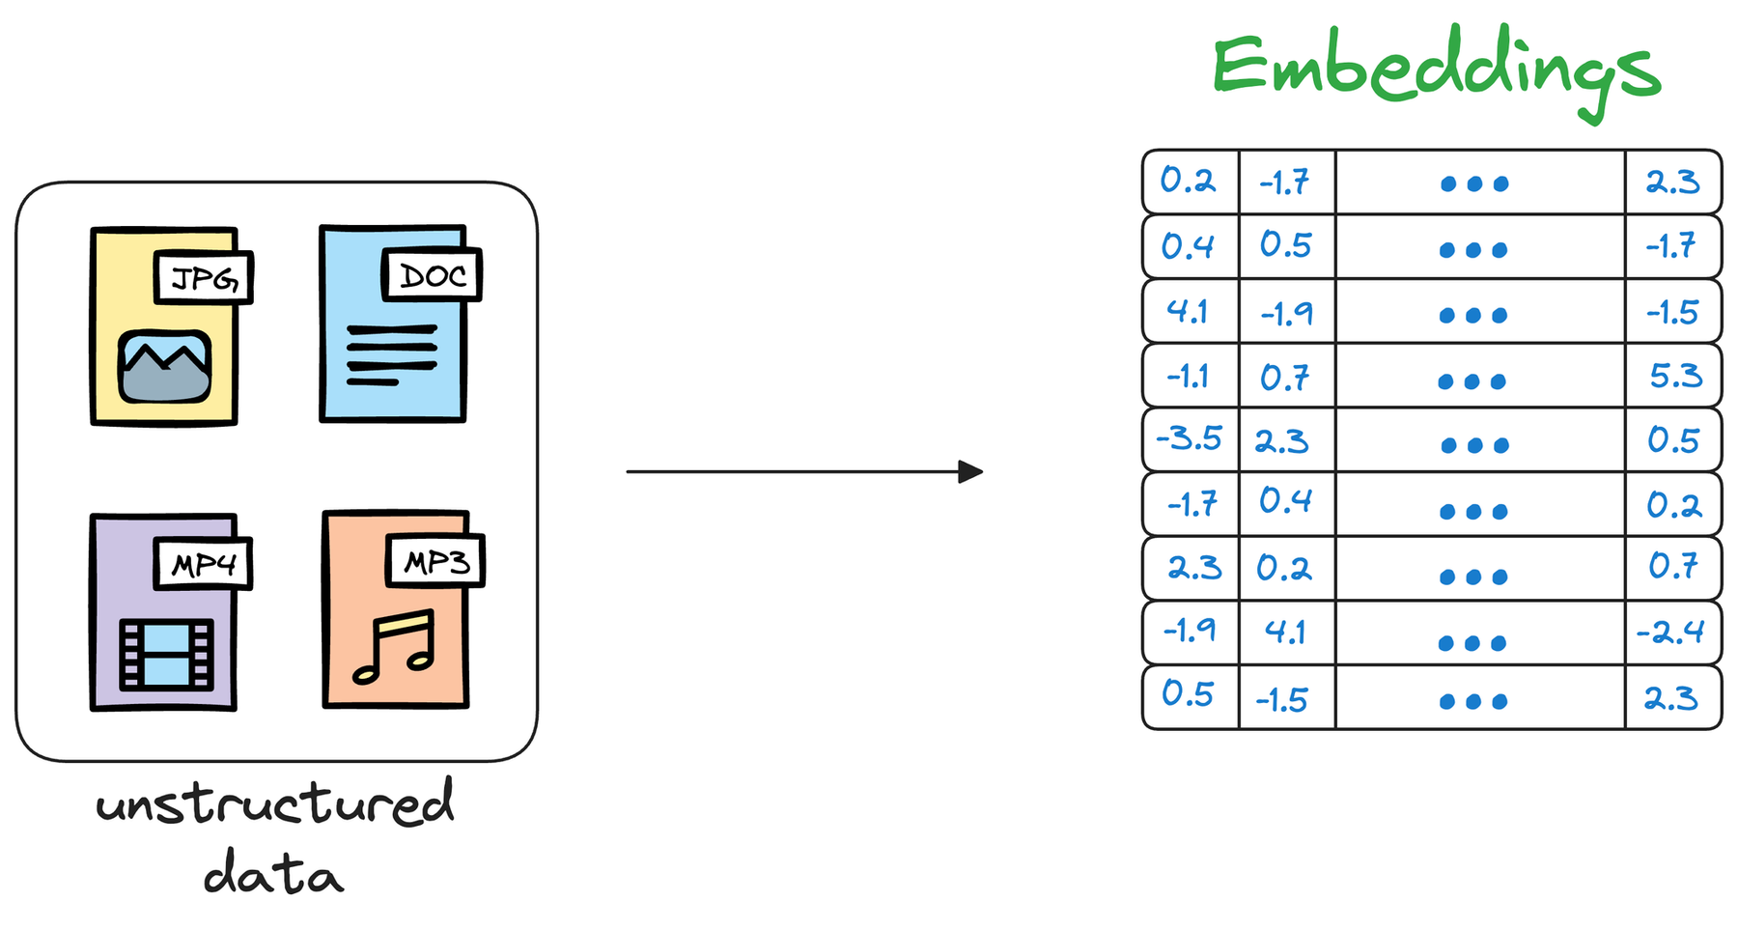
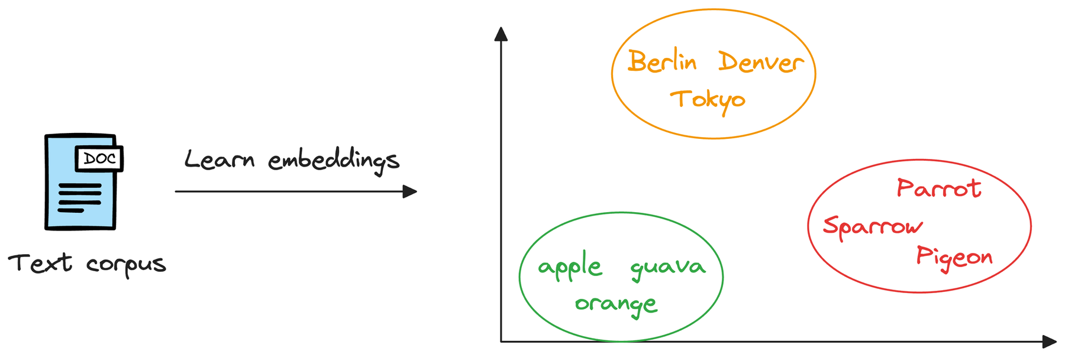
What is a vector?
1 Data becomes numbers
2 Similar meaning, nearby points
An embedding turns meaning into a position: similar meaning, nearby points.
PART 4 · AI BEHIND THE SCENES
‹#›
Notes:
SAY: A vector is just a list of numbers, for example 0.2, minus 1.7, 2.3. You can read it as a point in space: two numbers is a point on a map, three a point in a room, and the model we use gives 1,536 numbers, a point in a space we cannot picture. An embedding model turns text, an image or a sound into such a vector, and is trained so that similar meaning ends up at nearby points. On the right: fruits cluster together, cities cluster together, birds together. Nobody told the model these categories. In Lab 3 you will first play with a tiny two-dimensional version, then use the real thing.
ASK THE ROOM: If two sentences mean the same thing but use different words, should their vectors be close or far?
TIME: about 2 min

Slide 32

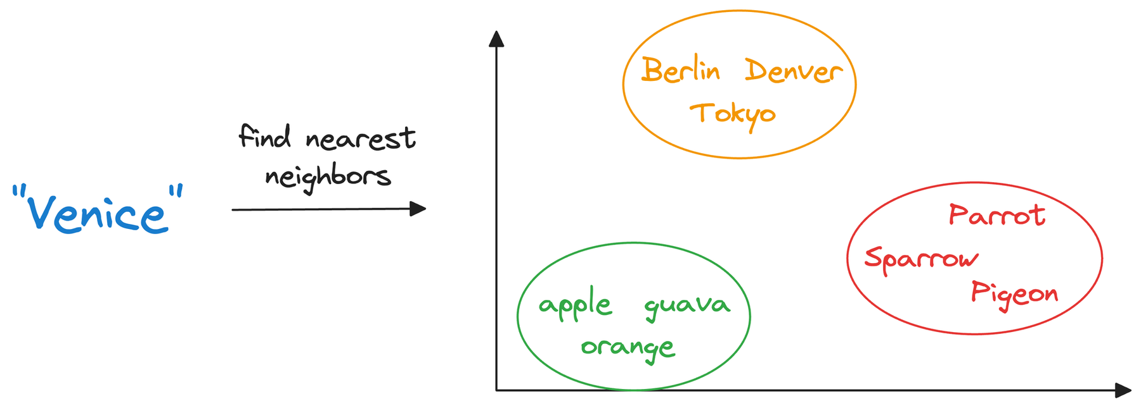
A vector database
Each row: vector + original data + metadata
A search returns the nearest rows
We search with the vector, and answer with the original text.
PART 4 · AI BEHIND THE SCENES
‹#›
Notes:
SAY: A vector database stores vectors so they can be searched by similarity. Each row holds three things: the vector itself, used for searching, the original data, which is what we give back, and metadata like an id or a category. On the right: the query is encoded with the same model, and the database returns the nearest stored vectors together with their original data. A normal database finds exact matches. A vector database finds similar meaning. In our lab the vector database is just PostgreSQL with the pgvector extension, so your vectors sit next to your normal tables.
ASK THE ROOM: Why do we need to keep the original text next to the vector?
TIME: about 2 min

Slide 33
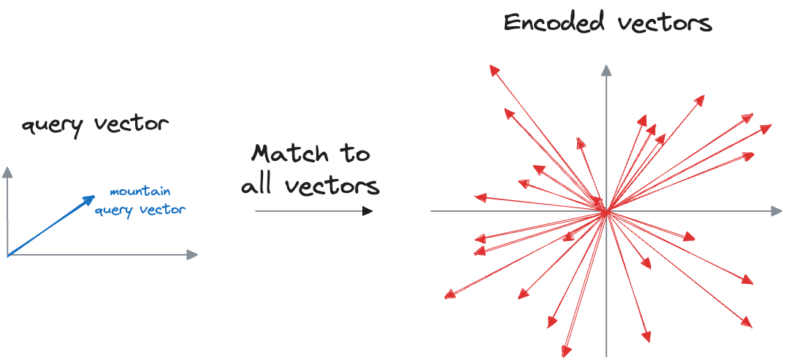
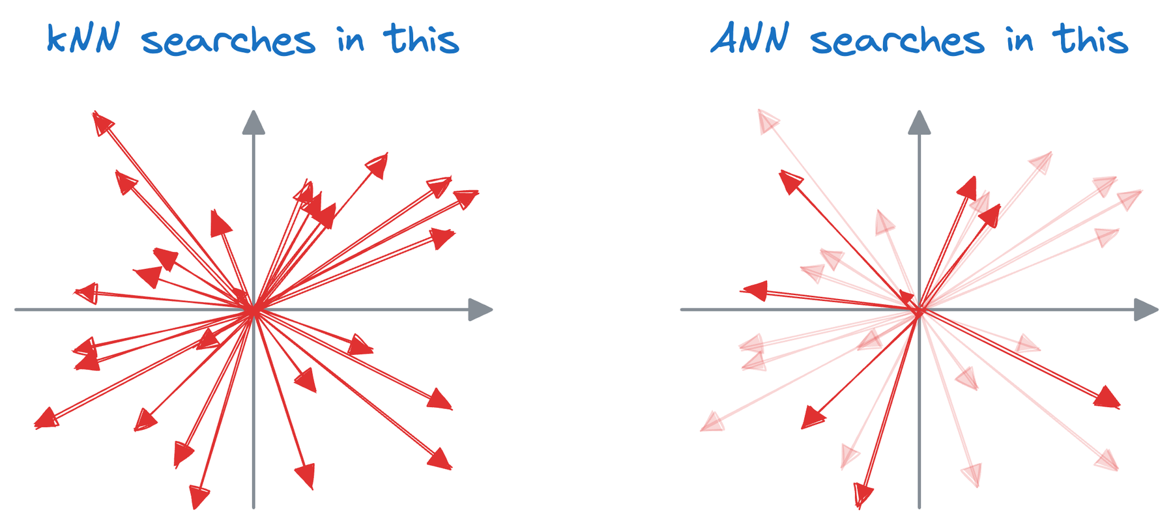
Searching millions of vectors
Exact: compare with every vector
kNN searches all, ANN only a neighbourhood
Approximate search trades a little accuracy for a lot of speed.
PART 4 · AI BEHIND THE SCENES
‹#›
Notes:
SAY: The simplest search compares the query with every stored vector. That works for the 19 articles in our lab, but a real system can hold millions of vectors, so one question could need billions of multiplications. Real vector databases build an index and use approximate nearest neighbour search: they look only inside a promising neighbourhood. It gives up a tiny bit of accuracy for a huge gain in speed.
ASK THE ROOM: What would you give up to make a search 100 times faster?
TIME: about 2 min

Slide 34
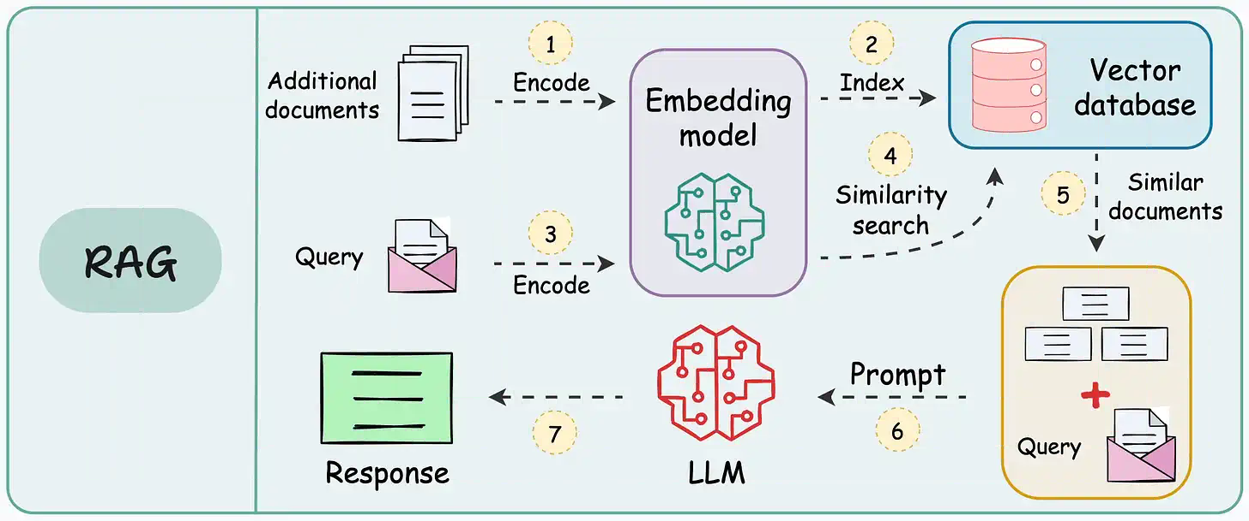
RAG in one picture
RAG = retrieve the right knowledge first, then let the LLM answer from it.
PART 4 · AI BEHIND THE SCENES
‹#›
Notes:
SAY: RAG stands for retrieval-augmented generation, and this is the whole idea. Documents are encoded by an embedding model and indexed in a vector database. When a question arrives, we encode it too, find similar documents, and put them together with the question into a prompt. The LLM then writes the answer from those documents. Retrieval gives the model the knowledge it lacks, so the answer is grounded in your sources. That is the pipeline you build in Lab 3.
ASK THE ROOM: Which of the four LLM limits from earlier does retrieval fix?
TIME: about 2 min

Slide 35
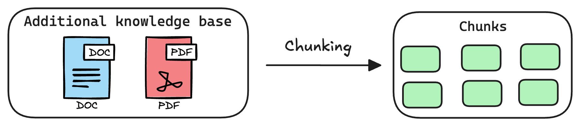
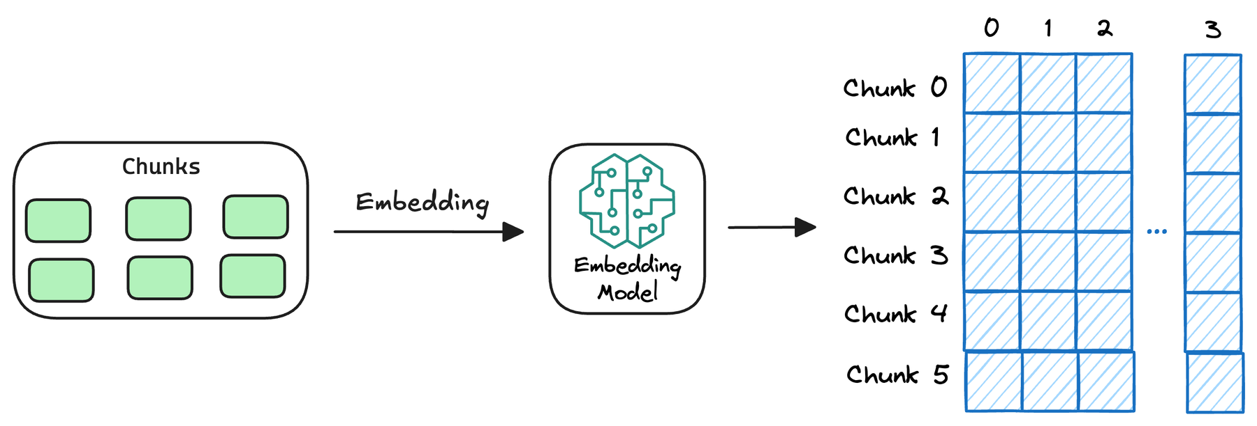
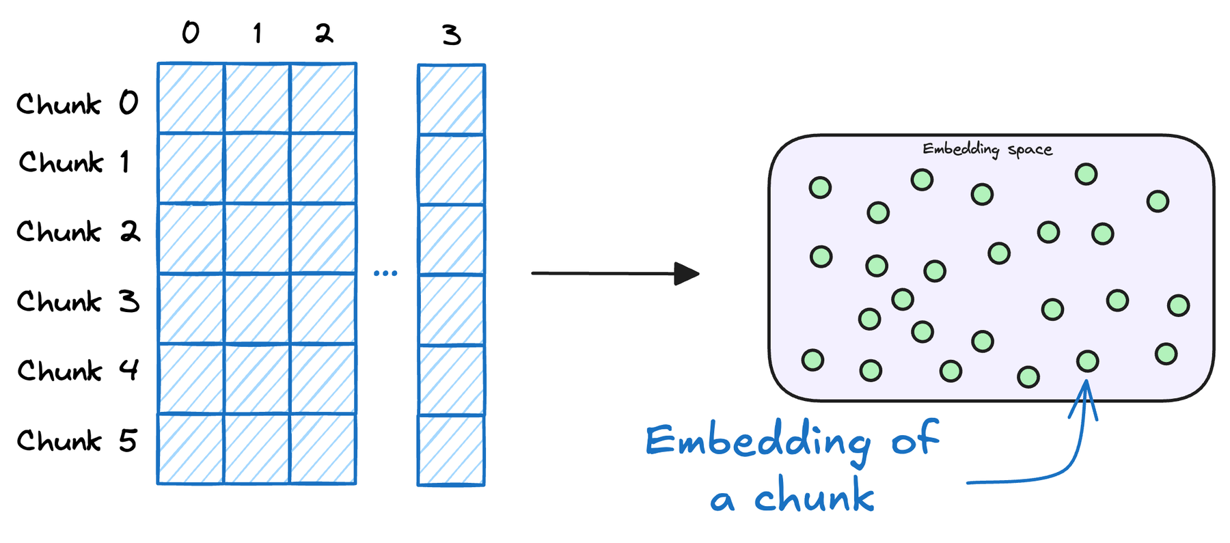
Phase A · Indexing: prepare the knowledge once
1 Chunk
Split big documents into small, focused pieces.
2 Embed
Turn each chunk into a vector with an embedding model.
3 Store
Save the vector, the original text and metadata in the vector database.
Small, focused chunks give sharper vectors and let us retrieve exactly the right passage.
PART 4 · AI BEHIND THE SCENES
‹#›
Notes:
SAY: RAG has two phases. First, indexing, done once. Step one: chunk. A large document must be split into pieces, because the embedding model has an input limit and because one vector for a whole document blurs every topic together. Step two: embed. Each chunk becomes a vector. Step three: store the vectors in a vector database together with the original text. In our lab the articles are so short that one article is one chunk, but you will still see a chunker with overlap in action.
ASK THE ROOM: Why not embed a 100-page manual as a single vector?
TIME: about 2 min

Slide 36
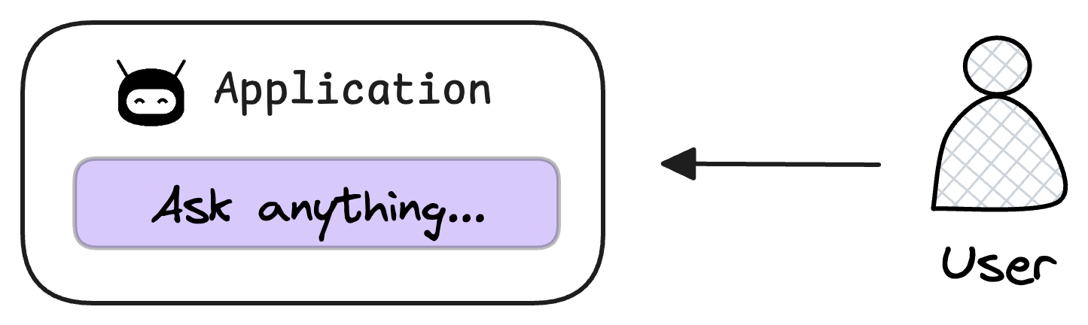
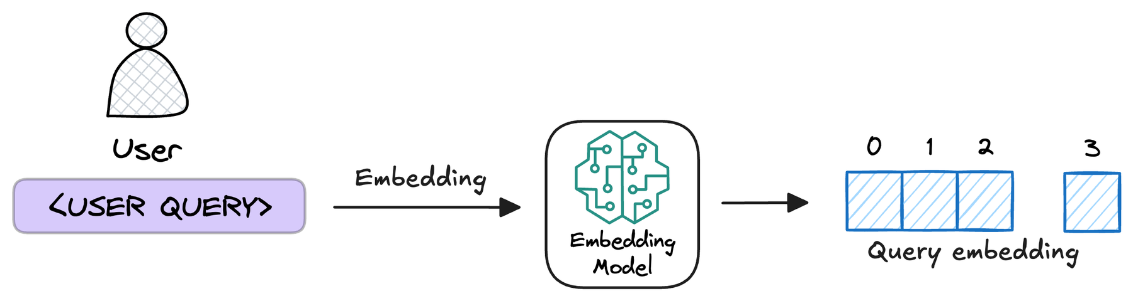
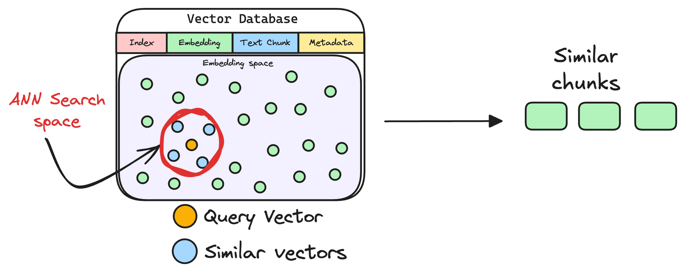
Phase B · Query (1 of 2): ask, embed, retrieve
4 Ask
The user types a question in the app.
5 Embed the question
Same embedding model as the chunks, or the vectors cannot be compared.
6 Retrieve
The database returns the k nearest chunks (approximate search).
The question becomes a vector, and the nearest chunks come back.
PART 4 · AI BEHIND THE SCENES
‹#›
Notes:
SAY: Then, for every question, phase B. Step four: the user asks. Step five: embed the question with the same model, because vectors from different models live in different spaces and cannot be compared. Step six: retrieve the top matching chunks from the vector database, the k nearest vectors. These are the candidates the LLM will read.
ASK THE ROOM: What breaks if the question is embedded with a different model than the articles?
TIME: about 2 min

Slide 37
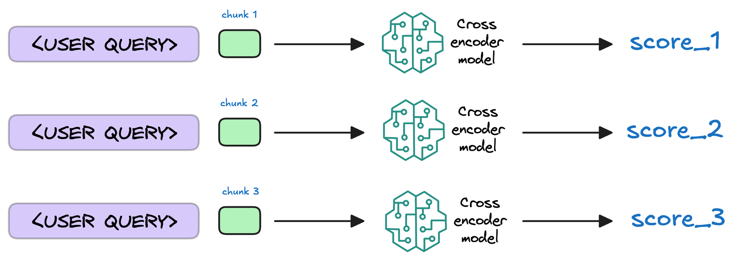
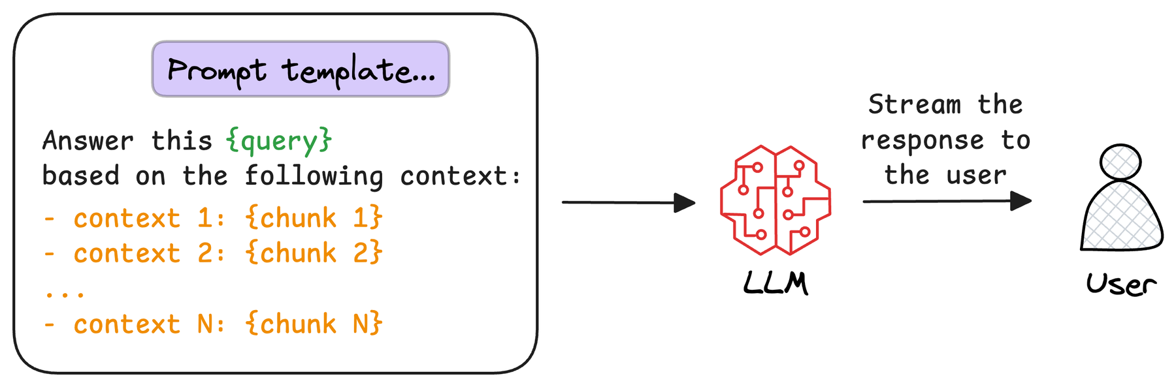
Phase B · Query (2 of 2): re-rank and generate
7 Re-rank (optional)
A cross-encoder scores each chunk together with the question. We skip this step in the lab.
8 Generate
A prompt with the question and the chunks goes to the LLM, which answers from them and cites sources.
The LLM answers from the retrieved chunks, and cites them.
PART 4 · AI BEHIND THE SCENES
‹#›
Notes:
SAY: Step seven is optional: a re-ranker, often a cross-encoder, reads the question together with each candidate chunk and sorts them better. Not every RAG app does this, and we skip it in the lab. Step eight: generate. A prompt template combines the question and the retrieved chunks, and the LLM answers only from them and cites its sources. This is where the grounding happens.
ASK THE ROOM: Why tell the model to answer only from the retrieved articles?
TIME: about 2 min

Slide 38




Why RAG still fails
Wording mismatch
Bad chunks
Needs counting
Wrong sources
the closest chunk is similar, but does not answer the question
ideas split in half, or two topics mixed in one chunk
"How many tickets?" is a SQL question, not a retrieval question
if the articles are wrong or old, the answer is too
Safe default: if the articles do not answer the question, say "I do not know".
PART 4 · AI BEHIND THE SCENES
‹#›
Notes:
SAY: RAG is powerful, not magic. It fails in recognisable ways. A question and its answer often use different words, so the most similar chunk is not always the one that answers. Bad chunking splits an idea in half or mixes two topics. Some questions need aggregation, like how many tickets, which retrieval cannot do at all: that is a SQL question. And if the retrieved articles are wrong or outdated, the answer will be too. The safest default is the bottom strip: if the articles do not answer the question, the model should say it does not know. You will test exactly that in Lab 3.
ASK THE ROOM: Which of these four would be hardest to detect in production?
TIME: about 3 min

Slide 39
Putting it together
How does it all fit, and what changes in the real world?
Part 5 of 6 · Recap before the labs
Notes:
SAY: Part five is a short recap. The whole flow in one picture, how to decide between SQL and RAG, and what a real project needs beyond a prototype.
TIME: a few seconds

Slide 40
The whole flow, and SQL or RAG?
SQL queries
Dashboard (Plotly)
Raw tickets (CSV)
ETL with pandas
Database (PostgreSQL + pgvector)
Web app (Streamlit) · Agent picks the path
Embeddings + vector search
LLM answer + sources
"How many refund tickets this week?"
SQL
"What is our refund policy?"
RAG
"Biggest ticket type, and how do I help it?"
Agent (both)
PART 5 · PUTTING IT TOGETHER
‹#›
Notes:
SAY: Now put everything together. Raw tickets are extracted, cleaned with pandas and loaded into the database. From the database, two paths: SQL feeds the dashboard with numbers. Embeddings and vector search feed the LLM with knowledge, so it can answer with sources. A web app brings both to users, and an agent can choose between the two paths on its own. At the bottom is the decision guide you will use all afternoon: counting and averaging is SQL, finding knowledge is RAG, and questions that need both are where an agent shines.
ASK THE ROOM: Which path would answer: what is our refund policy?
TIME: about 3 min

Slide 41





Before you ship it: a real-world checklist
Privacy
tickets can contain personal data: who may see and use it?
Keep learning
Practise SQL
Cost
API usage grows with users: set budgets and limits
JOIN, GROUP BY and window functions on real data
Evaluation
keep a test set of questions and check answers
Build a small RAG app
your own documents, with sources and a test set
Monitoring
watch quality, errors and cost after launch
Human in the loop
a person reviews answers that matter
Explore agents
add a tool, add a guardrail, inspect the trace
PART 5 · PUTTING IT TOGETHER
‹#›
Notes:
SAY: A workshop prototype and a real product are far apart. Before shipping, ask: does the data contain personal information, and are we allowed to use it this way? What will the API calls cost at ten thousand users? How do we measure whether answers are good: do we have a test set of questions? How do we monitor it after launch, and who reviews the answers that matter? These questions are as important as the code. On the right, three ways to keep learning after today.
ASK THE ROOM: Which of these five would a manager ask about first?
TIME: about 3 min

Slide 42
This afternoon: the project
What you will build, step by step.
Part 6 of 6 · Labs 1 to 5
Notes:
SAY: Part six is the bridge to the afternoon. The project, a preview of each lab, and a checklist so we start smoothly.
TIME: a few seconds

Slide 43
This afternoon: the project
Lab 1
Data, ETL and SQL
45 min
Lab 2
Dashboard
25 min
Lab 3
Embeddings and RAG
50 min
Lab 4
Streamlit app
40 min
Bonus
LangChain agent
+30 to 45 min
You work with
a real Kaggle customer-support dataset (600 tickets), a team database on Supabase, and a separate knowledge base of 18 fictional articles
Each lab shows
what the code does, why it is needed, and what you should see. Short coding tasks (TODOs) come with hints.
After the labs: a short review where you show your database, charts and AI answers.
PART 6 · THIS AFTERNOON: THE PROJECT
‹#›
Notes:
SAY: Now the project. You are building a Customer Support Intelligence Platform. It takes real support tickets from a Kaggle dataset and turns them into insights, and it answers support questions from a separate knowledge base. Five notebooks, each building on the last: forty-five minutes on data and SQL, twenty-five on the dashboard, fifty on embeddings and RAG, forty on the app, and an optional bonus on agents. Then a short review where you show what you made. Every notebook explains what it does and what you should see, so you can always check your own progress.
TIME: about 2 min

Slide 44










Your toolbox this afternoon
DATA
Python
pandas
PostgreSQL
Supabase
Kaggle
the language of all five labs
clean tables in memory
the relational database
hosted Postgres with pgvector
source of the ticket data
BUILD, SHARE AND AI
Plotly
Streamlit
Google Colab
OpenAI
LangChain
interactive charts
a script becomes a web app
runs the notebooks in your browser
embeddings and the LLM
the agent framework (bonus)
PART 6 · THIS AFTERNOON: THE PROJECT
‹#›
Notes:
SAY: These are the tools you will meet. Python is the language of every lab. pandas holds and cleans tables in memory. PostgreSQL is the relational database, and Supabase hosts it for us, with the pgvector extension for vector search. Kaggle is where the ticket data comes from. Plotly draws the interactive charts. Streamlit turns a Python script into a web app. Google Colab runs the notebooks in your browser, so nothing needs installing. OpenAI provides the embeddings and the language model. LangChain is the framework behind the bonus agent. You do not need to know any of them already: each lab explains the part you use.
ASK THE ROOM: Which of these have you used before?
TIME: about 2 min

Slide 45
Lab 1 · Data ingestion, ETL and SQL
Lab 1
Data ingestion, ETL and SQL
45 minutes
YOU BUILD
• Read raw tickets from the database
• Clean them in pandas, step by step
• Load them into your team table
• Query them with SQL
YOU WRITE
• TODO 1 and 2: drop rows with missing keys, remove duplicates
• TODO 3: hours from first response to resolution
• TODO 4: JOIN and GROUP BY by ticket type
• TODO 5: closed rate with FILTER
YOU WILL SEE
600 clean tickets in your own table, and SQL answers per ticket type.
PART 6 · THIS AFTERNOON: THE PROJECT
‹#›
Notes:
SAY: Lab 1 is the foundation, so please do not skip it: every other notebook reads the table you create here. You connect to the database, look at the schema, extract raw tickets, clean them in small steps, load them with an UPSERT, and then ask business questions with SQL. You write five short pieces of code: which columns must not be missing, how to remove duplicates, how to compute the resolution time, a JOIN with GROUP BY, and a closed rate. Each step tells you what you should see.
TIME: about 1 min

Slide 46
Lab 2 · Interactive dashboard
Lab 2
Interactive dashboard
25 minutes
YOU BUILD
• A KPI scorecard
• A bubble chart, a sunburst and a box plot
• A heatmap and a bar chart with a dropdown
YOU WRITE
• TODO 1: the closed-rate formula
• TODO 2: map columns to the bubble chart
• TODO 3: which column must not be empty (box plot)
• TODO 4: a crosstab for the heatmap
YOU WILL SEE
An interactive dashboard, and your own finding with its caveat.
PART 6 · THIS AFTERNOON: THE PROJECT
‹#›
Notes:
SAY: Lab 2 turns the table into pictures. You read your clean data back from the database, build the KPIs, and draw five kinds of chart with Plotly. Four small TODOs make you decide how numbers map to a chart. The most important part is the end: write one finding and one caveat about what you see. That habit is worth more than any chart.
TIME: about 1 min

Slide 47
Lab 3 · Embeddings and RAG
Lab 3
Embeddings and RAG
50 minutes
YOU BUILD
• A toy vector space you can see and move around
• Chunking, embedding and storing an article
• Vector search in PostgreSQL
• An LLM answer with sources
YOU WRITE
• TODO 0: find the nearest vectors yourself
• TODO 1: embed title and content
• TODO 2: the cosine-distance operator
• TODO 3: a grounded prompt
YOU WILL SEE
A question answered from articles, citing their IDs, and a refusal when it cannot.
PART 6 · THIS AFTERNOON: THE PROJECT
‹#›
Notes:
SAY: Lab 3 is the AI heart of the day. It starts with a tiny two-dimensional vector space, so you can see what similarity means. Then you follow the eight steps of RAG with real OpenAI embeddings and pgvector: embed a new article, search for the closest articles with SQL, and let the LLM answer from them, with citations. Finally you ask a question the knowledge base cannot answer, and watch the model refuse. You will need your own budgeted OpenAI key.
TIME: about 1 min

Slide 48
Lab 4 · Streamlit app
Lab 4
Streamlit app
40 minutes
YOU BUILD
• The complete app, generated in eight explained pieces
• A check that the file is valid Python
• Your own customisation
YOU WRITE
• Rename or add a KPI
• Change the default filters
• Explain why the question embedding goes to PostgreSQL
• Change the title or donut chart
YOU WILL SEE
A working app with a dashboard tab and an AI chat tab. The instructor runs it.
PART 6 · THIS AFTERNOON: THE PROJECT
‹#›
Notes:
SAY: Lab 4 shows how everything fits together in a real web app. The notebook writes the app file in eight pieces, each explained: settings, database access, the AI helpers, the sidebar, the dashboard tab and the chat tab. There are no blanks to fill, instead you change the app and see what happens. Remember that Streamlit runs as a separate server, so the instructor starts it, and Colab only generates the file.
TIME: about 1 min

Slide 49
Bonus · LangChain agent
Bonus
LangChain agent
30 to 45 extra minutes
YOU BUILD
• Two tools: ticket metrics and knowledge-base search
• A direct test of each tool, with no LLM
• An agent that chooses between them
YOU WRITE
• TODO 1: a question that needs the metrics tool
• TODO 2: a question that needs both tools
• Check the tool calls it made
YOU WILL SEE
Which tool the agent chose, with what arguments, and why.
PART 6 · THIS AFTERNOON: THE PROJECT
‹#›
Notes:
SAY: The bonus lab is optional and comes after the core labs. You turn your RAG code into a tool, add a second tool for ticket numbers, and build an agent that chooses. You test each tool by hand first, including an unsafe input that gets refused. Then you ask two questions and inspect what the agent actually did. The bonus is not required to complete the workshop.
TIME: about 1 min

Slide 50






Before you start this afternoon
Open the notebooks in Google Colab
Get your team details from the instructor
or local Jupyter if you prefer
team number, password, project reference, pooler host
Keep secrets in a .env file
Use your own budgeted OpenAI key
or type them when asked: never inside the notebook
never the instructor's master key
Run Lab 1 first
Stuck? Read "what you should see", then ask
the other labs read the table it creates
asking is part of the job
PART 6 · THIS AFTERNOON: THE PROJECT
‹#›
Notes:
SAY: A short checklist so the afternoon starts smoothly. Open the notebooks in Google Colab, or in local Jupyter. The instructor will give each team a number, a password, the project reference and the pooler host. Keep those in a .env file, or type them when the notebook asks, but never write them inside the notebook. Use your own budgeted OpenAI key for the AI labs, and never the instructor's master key. Run Lab 1 first, because the other labs read the table it creates. And if you get stuck: read the "what you should see" notes first, then ask. Asking is part of the job.
ASK THE ROOM: Any questions before we start?
TIME: about 2 min

Slide 51
Thank you
Questions? Then let us build it.
Notes:
SAY: Thank you. Take a short break, then we start Lab 1. Questions are welcome now or at any point this afternoon.
TIME: about 1 min

