Slide 1
Git Basics
Norbert Guta
CONFIDENTIAL | © 2020 EPAM Systems, Inc.

Slide 2

Agenda
1
Introducing Git
2
Git Basics
3
Branch
4
Remote Git
5
Git Hook
6
UseFul Resources

Slide 3
Introducing Git

Slide 4
What is Git
Git is a free and open source
Distributed version control system
Designed to handle everything from small to very large projects with speed and efficiency
Used for source code management, tracking changes in the source code
Enabling multiple developers to work together on non-linear development.
Linus Torvalds created Git in 2005 for the development of the Linux kernel.
Notes:
https://github.com/torvalds

Slide 5
Features of Git
Tracks history
Free and open source
Supports non-linear development
Creates backups
Scalable
Supports collaboration
Branching is easier
Distributed development

Slide 6
Team working before Version Control Systems
Developers copied their changes onto the server.
Any changes made to the source code were unknown to the other developers.
No transparency or history about changes.
There was no communication between the developers.
There was a chance to lose other’s changes.

Slide 7
Team working after Git
Every developer has an entire copy of the code on their local systems.
Any changes made to the source code can be tracked by others.
There is transparency, history about changes.
There is regular communication between the developers.
No data lost.

Slide 8
Git Basics

Slide 9
Configure Git
There are levels of Git config
Project
Global
System
Print config
Specific config
All configs
git config user.name "John Doe"
git config --global user.name "John Doe"
git config --system user.name "John Doe"
git config --global user.name
git config -l

Slide 10
Getting a Git Repository
Take a local directory that is not under version control, and turn it into a Git repository
Clone an existing Git repository from elsewhere or
supported protocols:
https://
SSH: `git://` or `user@server:path/to/repo.git`
git init
git clone https://github.com/libgit2/libgit2
git clone https://github.com/libgit2/libgit2 lib_git_project

Slide 11
`.git` folder
Inner folders
config
Description
HEAD
hooks/
logs/
info/
objects/
refs/

Slide 12
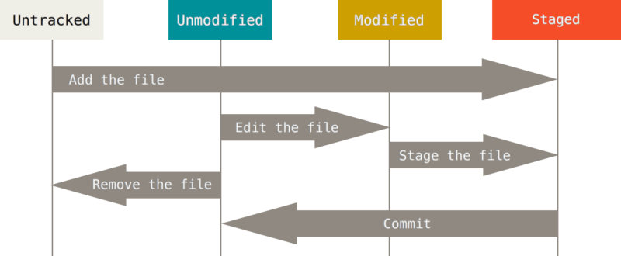
Recording changes to the Repository
Each file in the working directory can be in one of two states:
Tracked
Unmodified
Modified
Staged
Untracked
Figure 8. The lifecycle of the status of your files

Slide 13
Recording changes to the Repository
Tracking new files
Status check , short status
Staging modified files or
Ignoring files
Viewing your unstaged and staged changes vs
To unstage all the staged files
Committing your changes vs
Skipping the staging area vs
Removing files
Moving files vs
git status
git status -s
git add .
git add <file-name>
git diff
git diff --staged
git reset
git commit
git commit –m “commit message”
git commit -a
git commit -a –m “commit message”
git rm <file-name>
git mv file_from file_to
git mv file_from file_to -f

Slide 14
Viewing the Commit History
Check history
Format output
Format Styes
Full,
Fuller,
Format,
OneLine
git log
git log --pretty=<format-style>
git log --pretty=format:"%h - %an, %ar : %s"

Slide 15
Viewing the Commit History - Format Specifiers
Specifier | Description of Output
%H | Commit hash
%h | Abbreviated commit hash
%T | Tree hash
%t | Abbreviated tree hash
%P | Parent hashes
%p | Abbreviated parent hashes
%an | Author name
%ae | Author email
%ad | Author date (format respects the --date=option)
%ar | Author date, relative
%cn | Committer name
%ce | Committer email
%cd | Committer date
%cr | Committer date, relative
%s | Subject

Slide 16
Branch
Branch is a named, lightweight movable pointer/reference to commits.
Creating branch
Check outing branch
Creating and check outing
Naming strategy/conventions
Group name
feature, bugFix, hotFix, release
Id of the ticket
Short summary of the feature or bug, usually it matches with title of the ticket
git branch <new-unique-branch-name>
git checkout <branch-name>
git checkout -b <new-unique-branch-name>
<group-name>/<{ticket-id}_{short-summary}>

Slide 17
Branch
List branches
Removing branch
Deleting a branch does not mean the commits will be deleted too!
Renaming branch
Merging branch
Fast-forward
Non-fast forward
Long run Branch strategy
Git Stash
Create stash
List Stashes
Git stash
git branch –l
git branch –d <branch-name>
git branch --move <bad-branch-name> <corrected-branch-name>
git merge <branch-name>
git stash save <name>
git stash list
git stash apply <stash-id>

Slide 18
Remote Git

Slide 19
Branches
Remote branches
are in .git/refs/remotes
can be fetched/rebased/merged
Can be checked out
Can be tracked by a local branch
Local branches
can be: commited/pushed/rebased/merged
Local and remote branches are independent
Fetching
Pulling
Push
git fetch
git pull
git push
Notes:
Note for the `git push` command:
The name of the branch should be provided for the command if the branch is not uploaded earlier to the remote repository.
The git command looks like this:
`git push origin <name-of-the-branch>`

Slide 20
Git Hook

Slide 21
Git hook
A way to fire off custom scripts when certain important actions occur.
Client-side
Server-side
Triggered by operations such as committing and merging, while server-side hooks run on network operations such as receiving pushed commits.

Slide 22
UseFul Resources

Slide 23
Useful resources
Git documentation
https://git-school.github.io/visualizing-git/#free
https://learngitbranching.js.org/

Slide 24
demo

