Slide 1
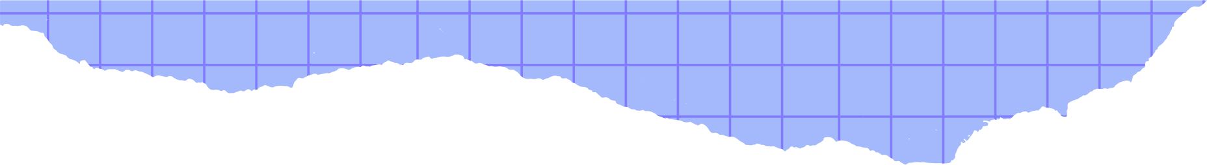




Present by Group 4
Week 10
FUNCTION

Slide 2
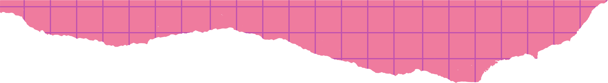

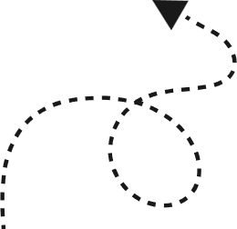
The team
Chheng Bunheang
Chheang Sovanpanha
Hourt Virakcheert
Kosal Sophanith

Slide 3



Content
Introduction
Function Declaration
Function Definition
Function Calling
Type of user-defined Function
Advantages

Slide 4

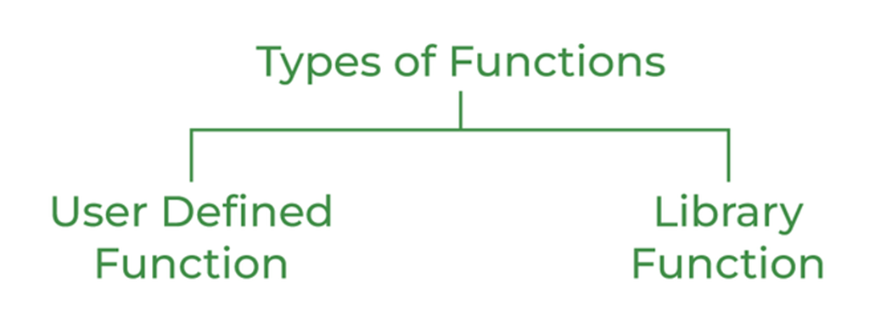
Introduction
A Function is a self-contained block of program statements that performs particular tasks.
Note: This lesson, We only focus on user-defined function

Slide 5
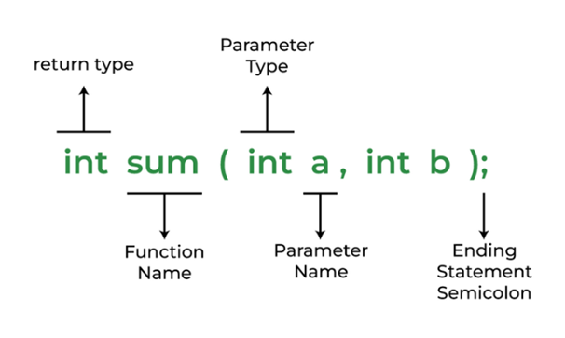
Function Declaration
Syntax:
return_data_type function_name (data_type variable1, ...); or
return_data_type function_name (data_type_list);
**Note: If the function does not return a value, the return type is
specified by the keyword void.
Syntax:
void function_name (data_type variable1, data_type variable2, ……);

Slide 6
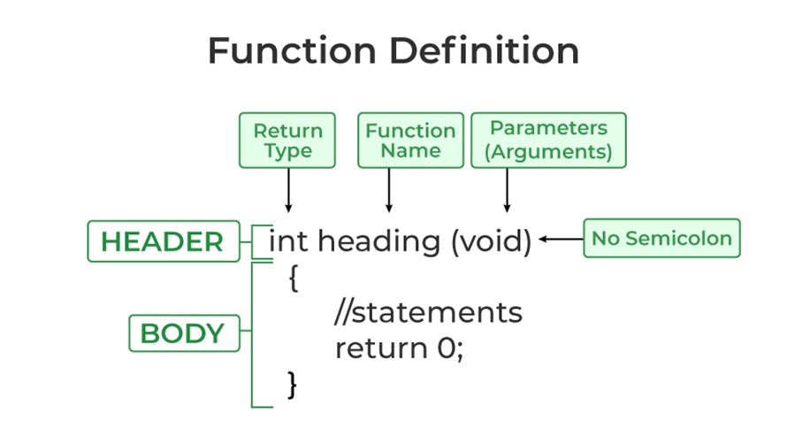
Function Definition
Syntax:
return_data_type function_name (data_type variable1, data_type variable2, ……) {
/* Function Body */
/* Return Statement */
}
Syntax return statement:
return expression; or
return (expression);
-Example
return x;
return (x + y);

Slide 7
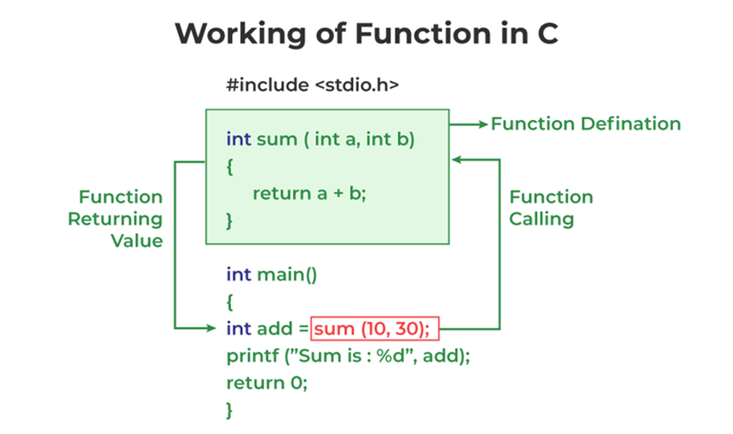
Function Calling
Syntax:
function_name(variable1, variable2,…); or
variable_name = function_name(variable1, variable2,…);
**Note: If there are no arguments(variable) to be passed
in the function, syntax will be :
function_name ( ); or
variable_name = function_name ( );

Slide 8
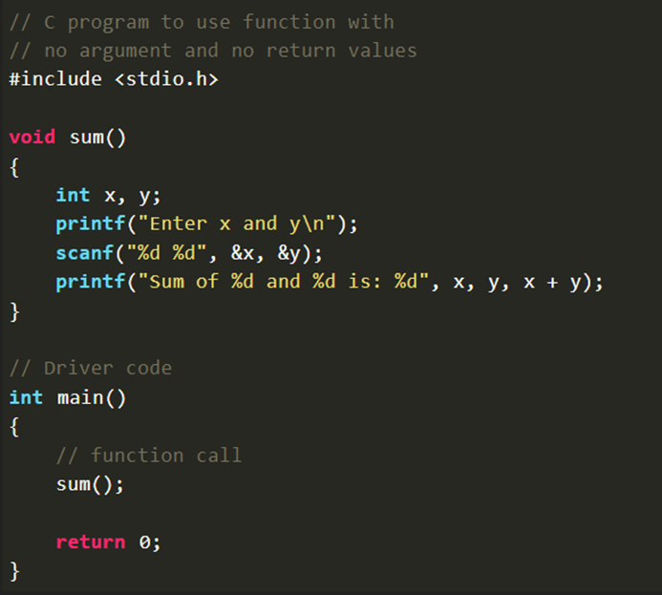
Type of user-defined Function
No arguments and no return values
Syntax:
void function_name () {
/* Function Body */
}

Slide 9
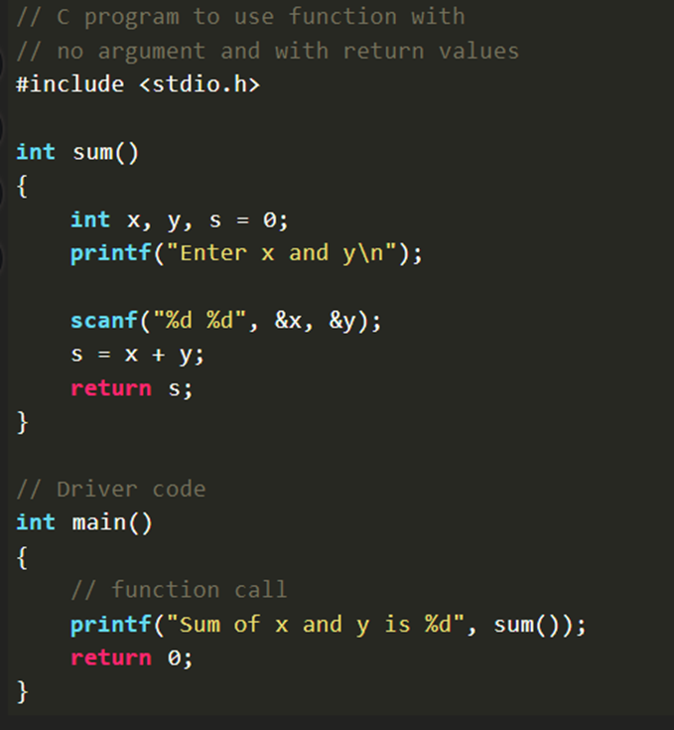
Type of user-defined Function
2. No arguments and return values
Syntax:
return_data_typefunction_name () {
/* Function Body */
/* Return Statement */
}

Slide 10
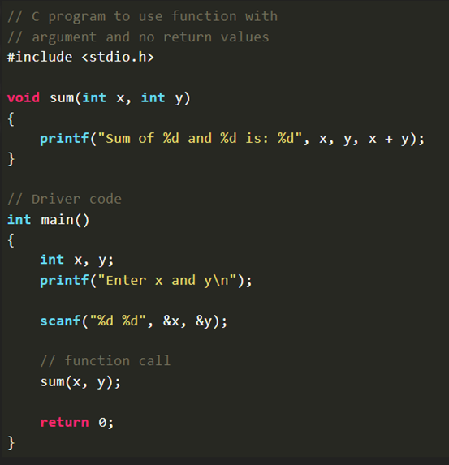
Type of user-defined Function
3. Arguments and no return values
Syntax:
void function_name (data_type variable1,
data_type variable2, ……) {
/* Function Body */
}

Slide 11
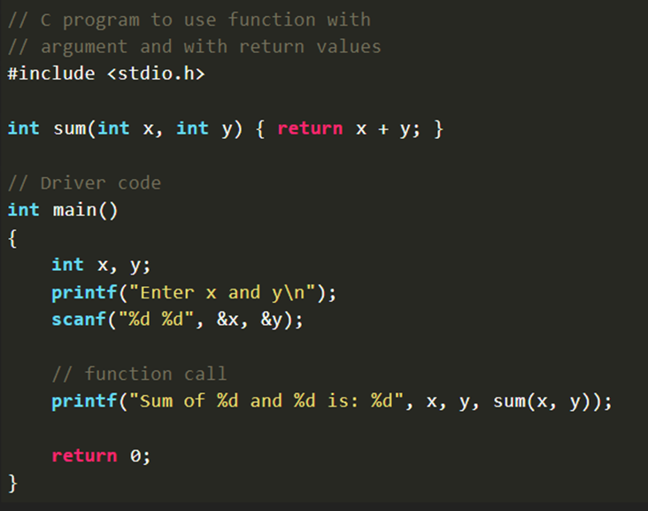
Type of user-defined Function
4. Arguments and return values
Syntax:
Return_data_typefunction_name (data_type variable1, data_type variable2, ……) {
/* Function Body */
/* Return Statement */
}

Slide 12
Avantages
Advantage of user-defined function
1. The program will be easy to understand, maintain and debug.
2. Reusable codes that can be used in other programs.
3. A large program can be divided into small modules. Hence, a large project can be divided among many programmers.

Slide 13
References
Dey,P., & Ghosh, M. (2013). Computer fundamentals and programming in C.
Greek of Geeks
Programiz

Slide 14
THANK
YOU!

