Slide 1
Mentor – Mentee
Training Plan
December 10, 2015
Mentor : Quy Lu
Mentee : Tien Nguyen
MCU Solutions 1 Group - MCU System Team
Frontend Design Department
Renesas Electronics Corporation

Slide 2
Outline
Introduction
Target of Role and Skill
Schedule
Activities

Slide 3
OUTLINE
Introduction
Target of Role and Skill
Schedule
Activities

Slide 4

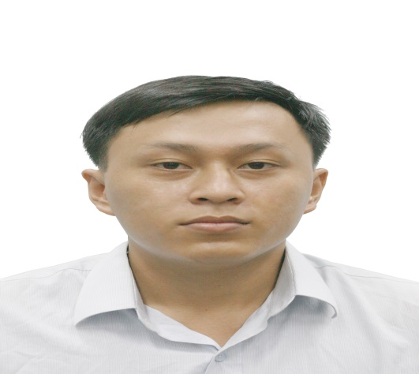
I - INTRODUCTION
Mentor
Name : Quy Lu
Code : 0842
Generation : 11G
Mentee
Name : Tien Nguyen
Code : 1606
Generation : 22G

Slide 5
OUTLINE
Introduction
Target of Role and Skill
Schedule
Activities

Slide 6
II - TARGET OF ROLES AND SKILL
Achieve level of functional verification: 2.67 (Main role)
Achieve level of functional design: 2.5 (Sub role)

Slide 7
OUTLINE
Introduction
Target of Role and Skill
Schedule
Activities

Slide 8
III - SCHEDULE

Slide 9
OUTLINE
Introduction
Target of Role and Skill
Schedule
Activities

Slide 10
IV- ACTIVITIES
Activities for 2 years

Slide 11
IV- ACTIVITIES
Training method:
- Investigate and practice old projects to have the basic knowledge and main method of each task.
- On job training.
Communication method:
Mentor
Mentee

Slide 12
IV - ACTIVITIES
Activities in 15S (06/Nov/2015 – 31/Sep/2016)

Slide 13
IV- ACTIVITIES – in 15S
1 - Functional Verification

Slide 14
IV – ACTIVITIES - in 15S
2 - Functional Design

Slide 15
IV- ACTIVITIES
Activities in 16K (01/Apr/2016 – 30/Sep/2016)

Slide 16
IV- ACTIVITIES – in 16K
1 - Functional Verification

Slide 17
IV- ACTIVITIES – in 16K
2 - Functional Design

Slide 18
IV- ACTIVITIES
Activities in 16S (01/Oct/2016 – 31/Mar/2017)

Slide 19
IV- ACTIVITIES – in 16S
1 - Functional Verification

Slide 20
IV- ACTIVITIES – in 16S
2 - Functional Design

Slide 21
IV- ACTIVITIES
Activities in 17K (01/Apr/2017 – 31/Oct/2017)

Slide 22
IV- ACTIVITIES – in 17K
1 - Functional Verification

Slide 23
IV- ACTIVITIES – in 17K
2 - Functional Design

Slide 24
www.renesas.com

Slide 25
Thank you for your attention!

