Slide 1


25G Mentor – mentee training plan
Mentor : DUONG QUANG DUC
Mentee : NHAM XUAN TUNG
25G Mentor – mentee training plan
Mentor : DUONG QUANG DUC
Mentee : NHAM XUAN TUNG
MID-TERM REPORT
Date : June 1st, 2017
Name: Nham Xuan Tung
CPU Sytem Design Group
Frontend Design 2 Department
APRIL 10th, 2018
TUNG NHAM
IP DESIGN 2 GROUP
MCU CORE & IP SOLUTION 2 SECTION
FRONTEND DESIGN 2 DEPARTMENT
HARDWARE ENGINEER DIVISION
RENESAS DESIGN VIETNAM CO., Ltd

Slide 2
Agenda
Training Plan Review 03
Current Status and Achievement 06
Difficulty and Solution 11
Next Training Plan 13
Appendix 15

Slide 3

TRAINING PLAN review

Slide 4
TRAINING PLAN review DETAIL PLAN
F: can work with full support
L: can work with little support
Role | Skill | Nov. 2017 | May. 2018 | Nov. 2018 | May. 2019
Common | Working flow | 2 | 3 | 3 | 3
 | Hardware manual investigation | 2 | 3 | 3 | 3
 | Risk/Issue management | 1 (F) | 1 (L) | 2 | 2
 | Task management | 1 | 2 | 2 | 3
 | Scripting Languages | 1 | 2 | 2 | 3
 | HLD tool evaluation (Stratus,etc) | 1 | 1 | 2 | 3
Average |  | 1.33 | 2 | 2.33 | 2.83
Design role | Design specification | 1 (F) | 2 | 2 | 3
 | Coding | 1 (F) | 1 (L) | 2 | 3
 | Code review | 1 (F) | 1 (L) | 2 | 3
Average |  | 1 | 1.33 | 2 | 3
Verification role | Documentation | 1 (L) | 2 | 2 | 3
 | Test items creation | 1 (L) | 1 (L) | 2 | 2
 | Prepare and build up environment | 2 | 2 | 2 | 3
 | Verification component | 1 (L) | 1 (L) | 2 | 3
 | Functional debug | 1 (F) | 1 (L) | 2 | 2
Average |  | 1.2 | 1.4 | 2 | 2.6
Level 1, 2, 3: Skill levels are defined by Renesas

Slide 5
TRAINING PLAN REVIEW TARGET CHART
Level
3
3
2.83
2.6
2.33
2
2
2
2
1.33
1.33
1.4
1.2
1
1
NOV. 2017
MAY. 2018
NOV. 2018
MAY. 2019
Common skills
Design role
Verification role
All values are average value of skill level

Slide 6
CURRENT STATUS AND ACHIEVEMENT

Slide 7
Achievement common skill
Role | Skill | Detail | Expected | Achieved
Common | Working flow | Understand working flow: 4 phases: PPDR -> PDR -> IDR -> FDR + Documents/Input/Output of each phase. Working flow real application on real project: E2x-ECM, U2A-ECM, SSGen, Stratus | 3 | 3
 | Hardware manual investigation | Gained many skills based on real projects which has joined one year ago: E2x-ECM, U2A-ECM, SSGen, Stratus Evaluation. + The way to get necessary information quickly, + Effectively INT, VRF creation with no lack of feature, function, operation,… | 3 | 3
 | Risk/Issue management | Avoid missing implementation by deep understanding hardware spec, peer review after each phase of design or verification; code review, document review,… Avoid misunderstanding by confirming with customer, other engineers. Evaluate, find countermeasure: Bug/issue report, improve verification flow. | 1 (L) | 1
 | Task management | Effectively arrange task to keep up schedule and cooperate with other members. Managing all aspects of a task, including its status, priority, time, resources, recurrence, dependency, notifications and so on. | 2 | 2
 | Scripting languages | Read, understand and can modify scripts for many usecases. Create scripts to build up test environment and improve productivity. Fluent with multi-languages: C-Shell, Perl, Python, … | 2 | 2
 | HLD tool evaluation (Stratus,etc) | Stratus evaluation with newest version to support designer. Understand Belize env structure, how to execute Stratus, DC, Amateras, SLEC and get SCAN, DFT result. Stratus settings, SLEC mapping settings, analyze to improve effective of design. | 1 | 1

Slide 8
achievement design role
Role | Skill | Detail | Expected | Achieved
Design role | Design specification | Design internal specification with: + Clearly information, no lack of functions, features. + Standard form, full components. + Contains fully detailed description of features will be implemented. + Easy for coding (Can map from design spec to sourcecode). | 2 | 2
 | Coding | Read, understand and can modify SystemC model code, SystemC for Behavioral Synthesis. Understand SystemC architecture, OOP characteristics, TLM 2.0, C/C++ structure/common library and can implement code for some design specs. Coding rule, coding style. Implement code for tool design by Perl, Python. | 1 (L) | 1
 | Code review | Check code based on coding rule, coding style and internal design spec. Trace code by walk-through method. | 1 (L) | 1

Slide 9
achievement verification role
Role | Skill | Detail | Expected | Achieved
Verification role | Documentation | Create verification documents clearly (specification, checklist, report,…): + Standard form, full components. + Checklist is easy to read and cover all testcases, categories are arranged reasonable and scientific. + Make USR easy to capture necessary information. | 2 | 2
 | Test items creation | Test items structure, know necessary test items Avoid missing in testcases Create test items for full coverage Generate test items from checklist. | 1 (L) | 1
 | Prepare and build up environment | Understand well environment structure (Unit test env, RESL-X, SCHEAP, SSGen Verification Env, SSGen regression test, Belize Env) Prepare unit test environment for verification. Create or modify scripts to build up or improve environment. | 2 | 2
 | Verification component | Can create/configure test module. | 1 (L) | 1
 | Functional debug | Effective bug/issue detection based on understanding well hardware spec (features, operations,…), test environment and test module. How to trace bug. Solution to fix. | 1 (L) | 2

Slide 10
CURRENT STATUS chart
Common skills
Working flow
HWM Investigation
Risk/Issue management
Task management
Scripting languages
HLD tool evaluation
Level
3
Design role
2
2
Design Specification
Coding
Code review
1.6
1.33
Verification role
1
Verification Specification
Test items creation
Environment preparation
Verification component
Functional debug
First year training
All values are average value of skill level

Slide 11
Difficulty and solution

Slide 12
DIFFICULTY AND SOLUTION
Skill | Difficulty | Solution
Risk/Issue management | Not fully understand customer requirement due to confirmation process or having issue in communication. Sometimes could not explain the technical issue clearly to get feedback or advice from mentor or experienced engineer. | Make CFM clearly before discussing with customer. Improve communication skill. Find out the way to explain the problem more effective. Get feedback and advice from mentor every face this issue. Apply the advice in next time.
Coding | Have not joined a real project as design role until now. The main task is verification, so the practice of coding is not much. | Join design task in High Level Design to get more experience in coding (SystemC, C/C++, Perl,…) Practice some design training projects and read materials continuously.
Code review | Have a little experience in design role or not yet a person in charge of code review task. | Read about coding rule, coding style. Review code for many projects of SLD & HLD.
Test items creation | Hard to avoid missing in testcases and create test items for full coverage. | Having a thorough grasp of hardware spec is one of important points to avoid missing testcases. Besides that, understanding implementation sourcecode and code coverage help to create testcases for covering all code lines.
Build up environment | Some environments are so complicated to understand the structure in a short time. Need to have general experience and knowledge to build up test environment with new structure. Lack of experience about Makefile, GNU and gcc compiler. | Self investigate Makefile, GNU and compiler. Refer to available environments, create Makefile and try to compile env, test pattern with various settings. Try to build verification environment from simple to complicated. That can help more understanding about existed environments.

Slide 13
Next training plan

Slide 14
Next training plan and target
Focus on HLD project with improving
in design role.
All values are average value of skill level
Level
Design Synthesizable SystemC model for some modules, optimize sourcecode, implement for complex functions.
Practice to improve coding skill, coding style.
Ability to use multilanguages: SystemC, C/C++, Perl, Python, C-shell.
Take on design task for some in-house tools enhancement. (SSGen, Erakis)
In Stratus evaluation: Can analyze the results and point out solution to optimize. Having a thorough grasp of Stratus configurations.
Besides that, continuously improve common and verification skills to achieve the target has planned.
3
3
2.83
2.6
2
1
Risk/Issue management: Level 2
Task management: Level 3
Build up environment: Level 3
Test items creation: Level 2
Second year training
Common skills
Design role
Verification role

Slide 15
appendix

Slide 16
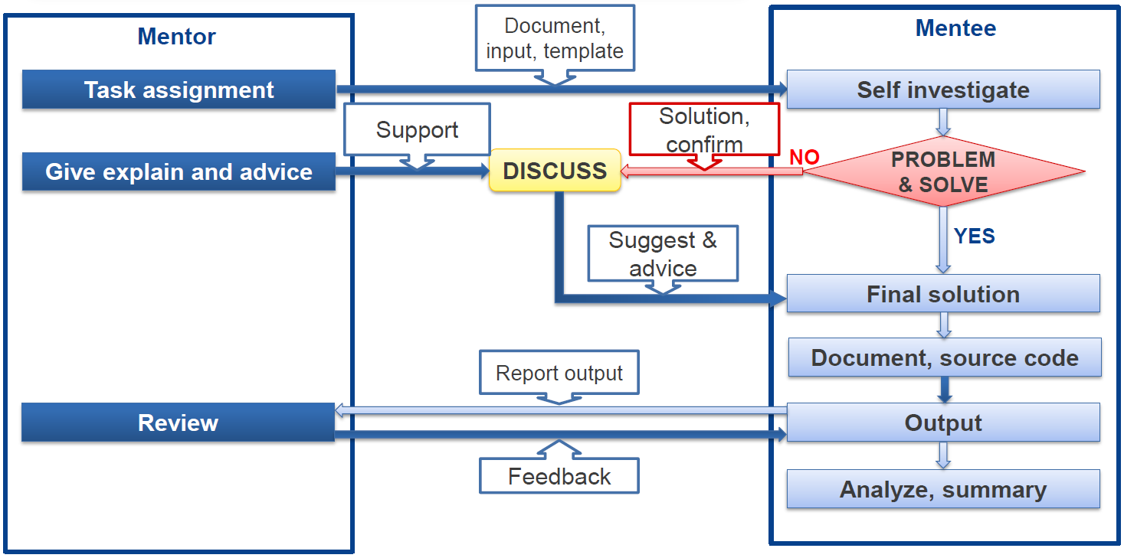
MENTOR – MENTEE INTERACTIVE

Slide 17
Renesas.com

