Slide 1
LightBikes
Final project presentation for RIT-ISTE-121.01
Felice Aprile
Justin W. Flory
Malcolm Jones
Timothy Endersby
License: CC-BY-SA 4.0

Slide 2
Introduction

Slide 3
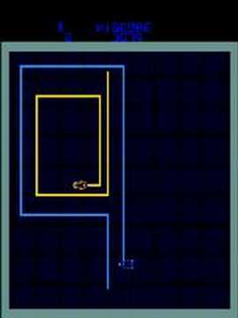
Welcome to the world of Tron
LightBikes based off of popular arcade game Tron (1982)
Two player game where players face off in arena with “bikes”
Players leave “walls of light” behind them as they move across arena
If a player hits a wall of light or arena border, they lose, game over
tl;dr: Multiplayer Snake
Our team replicated the original game

Slide 4
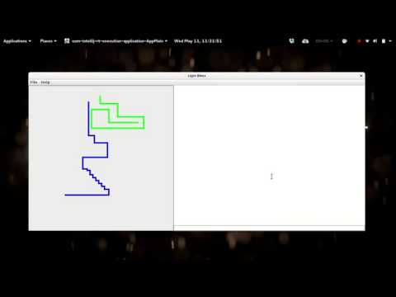
Excerpt from game

Slide 5
About project

Slide 6
Tools and resources used
Version Control System (VCS)
Git
GitHub Desktop (desktop.github.com)
Atlassian SourceTree (sourcetreeapp.com)
Integrated Development Environment (IDE)
All major operating systems (Windows, OS X, Linux)
Different development environments
IntelliJ
Eclipse
NetBeans
JGrasp
JavaDocs (for Java 8)

Slide 7
How does the code work?
Written in Java
Client and server are separated into packages
Uses Maven to build and handle dependencies
Uses threading, networking, and a variety of GUI concepts learned from the course
Client and server GUI managed by Swing
Networked client connections run on their own threads
Requires one server to host the game and two clients to connect to play the game

Slide 8
Best pieces
Game logic was handled well
Movement for the Bike objects is simple and the aim was to send as little data to the server as possible
Intention to prevent network latency as much as possible, which could affect gameplay
Even with some limitations of Swing, the GUI code is clean and efficient
Getting bike logic implemented inside of the GUI was difficult but was implemented well
Designed with a flexible API
You could add more changes to the client and not have to update the server for handling those changes
Leaves project open for future changes or design decision changes

Slide 9
Worst pieces
Game logic was limited to two players
Would have been better to leave the project flexible for more than two players (even though this was not how the original game was played)
GUI isn’t dynamic
Difficult to resize the window or adjust it for different display settings
Future change could be to allow window resizing, but the size of the actual playing area must not be altered
No acknowledgement that the client or server received packets / data
Would be better to have some kind of error sent or redundancy in place to handle failed communications that were not initiated by the player(s)
Chat client could use more optimization and support for multiple users
Making it possible for someone to connect to a “game lobby” where two players are playing, but multiple people can chat (like having spectators for your match)

Slide 10
Faults & successes

Slide 11
Faults
Gantt was used for project management but was not always followed in the beginning
Future projects, it would be best to keep other group members aware of their deadlines and tasks in the Gantt chart or another project management tool
Better plotting of tasks in the beginning would have improved workflow (i.e. using more specific tasks with smaller timeframes than larger tasks with longer timeframes)
Merging the changes made by different group members proved difficult
Merging with git assisted with this, but the work for the project was done in a “modular” fashion
Everyone worked on specific components and then we all “tied” them together towards the end
Better communication and collaboration on integrating components would have made working on project smoother

Slide 12
Successes
Using git allowed for easy collaboration asynchronously, letting us work on the project when we were not together without worrying about stepping on someone else’s toes
Despite troubles with merging, the code was compartmentalized and integrated relatively well with the other parts of the project
Worked together to minimize the number of conflicts that would happen later
Gantt chart became equally mapped to the work we were doing in the project closer to the end
Is a good representation and “deliverable” of work achieved during the span of the project

Slide 13
Questions? Comments? Concerns?

