Slide 1

REACT HOOKS

Slide 2
AGENDA
Introduction
Class Components
Function Components
Conclusion & demo
Notes:
What
Why => List why would we use hooks.
When

Slide 3
1. Introduction
A Hook is a special function that lets you “hook into” React state and lifecycle features from function components.
Some basic Hooks: useState, useEffect, useContext
Additional Hooks: useMemo, useReducer…

Slide 4
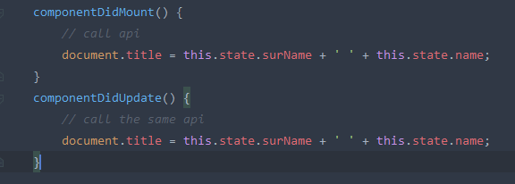
2. Class Components
Notes:
- Require you to restructure your components. - Cumbersome, code hard to follow. - With Hooks, Can be tested independently and reused.
- Hooks let you split one component into smaller functions based on what pieces are related (such as setting up a subscription or fetching data)
How this works, remember bind the event handlers… - Hooks let you use more of React’s features without classes.
Class is hard to Reuse stateful logic between components.
Complex components become hard to understand.
Classes confuse both people and machines.

Slide 5
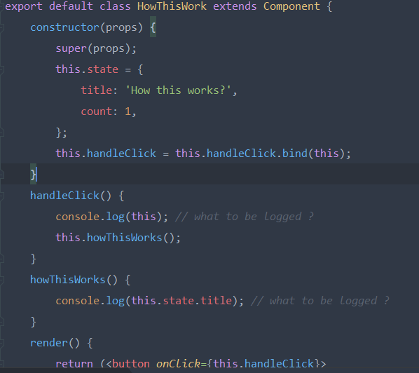
2. Class Components
What’s to be logged when clicks the button ?
Notes:
- Require you to restructure your components. - Cumbersome, code hard to follow. - With Hooks, Can be tested independently and reused.
- Hooks let you split one component into smaller functions based on what pieces are related (such as setting up a subscription or fetching data)
How this works, remember bind the event handlers… - Hooks let you use more of React’s features without classes.
Class is hard to Reuse stateful logic between components.
Complex components become hard to understand.
Classes confuse both people and machines.

Slide 6
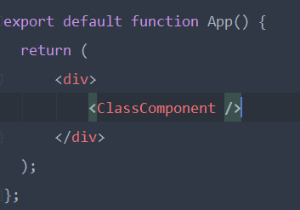
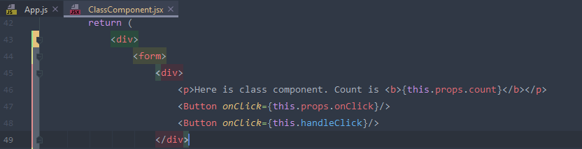
2. Class Components
Hold on, this.props did not passes to ClassComponent. How it works?
Notes:
- Require you to restructure your components. - Cumbersome, code hard to follow. - With Hooks, Can be tested independently and reused.
- Hooks let you split one component into smaller functions based on what pieces are related (such as setting up a subscription or fetching data)
How this works, remember bind the event handlers… - Hooks let you use more of React’s features without classes.
Class is hard to Reuse stateful logic between components.
Complex components become hard to understand.
Classes confuse both people and machines.

Slide 7
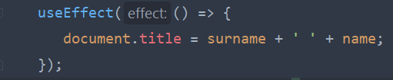
2. Function Components
Effect Hook lets you perform side effects in function components.
You can think useEffect Hook as componentDidMount, componentDidUpdate and componentWillUnmount combined
Notes:
- Require you to restructure your components. - Cumbersome, code hard to follow. - With Hooks, Can be tested independently and reused.
- Hooks let you split one component into smaller functions based on what pieces are related (such as setting up a subscription or fetching data)
How this works, remember bind the event handlers… - Hooks let you use more of React’s features without classes.
Class is hard to Reuse stateful logic between components.
Complex components become hard to understand.
Classes confuse both people and machines.

Slide 8
3. When to use Hooks?
If you write a function component and realize you need to add some state to it, previously you had to convert it to a class. Now you can use a Hook inside the existing function component.
Add state
Convert to class
Inside existing component

Slide 9
4. How to use Hooks?
4.1 Rules of Hooks - Only Call Hooks at the Top Level: Don’t call Hooks inside loops, conditions, or nested functions. - Only call Hooks from React functions or custom hooks : Don’t call Hooks from regular JavaScript functions.
Notes:
Combine with where questions.
Rules of hooks: - Ensure that Hooks are called in the same order each time a component renders. Make Hooks preserve the state of Hooks between multiple useState and useEffect. - Regular Js functions: ajax …. This rule ensure that all stateful logic in a component is clearly visible from its source code.

Slide 10
4. How to use Hooks?
4.2 Using The State Hooks.
Notes:
Combine with where questions.
Rules of hooks: - Ensure that Hooks are called in the same order each time a component renders. Make Hooks preserve the state of Hooks between multiple useState and useEffect. - Regular Js functions: ajax …. This rule ensure that all stateful logic in a component is clearly visible from its source code.

Slide 11
4. How to use Hooks?
useState
Notes:
Combine with where questions.
Rules of hooks: - Ensure that Hooks are called in the same order each time a component renders. Make Hooks preserve the state of Hooks between multiple useState and useEffect. - Regular Js functions: ajax …. This rule ensure that all stateful logic in a component is clearly visible from its source code.

Slide 12
4. How to use Hooks
1. useState
Notes:
Combine with where questions.
Rules of hooks: - Ensure that Hooks are called in the same order each time a component renders. Make Hooks preserve the state of Hooks between multiple useState and useEffect. - Regular Js functions: ajax …. This rule ensure that all stateful logic in a component is clearly visible from its source code.

