Slide 1

Asana
Website: https://asana.com/
History:
Founded in 2008 by Facebook co-founder Dustin Moskovitz and ex-engineer Justin Rosenstein, who both worked on improving the productivity of employees at Facebook. (Asana was named after a Sanskrit word meaning “yoga pose”)
Mobile support:
iOS
Android
Logo

Slide 2

Prices / Versions

Slide 3
Asana
Some features:
Project Management
Task Management
Agile Management
Work Tracking
Team solutions:
Engineering
Designers
Sales
HR
Marketing

Slide 4
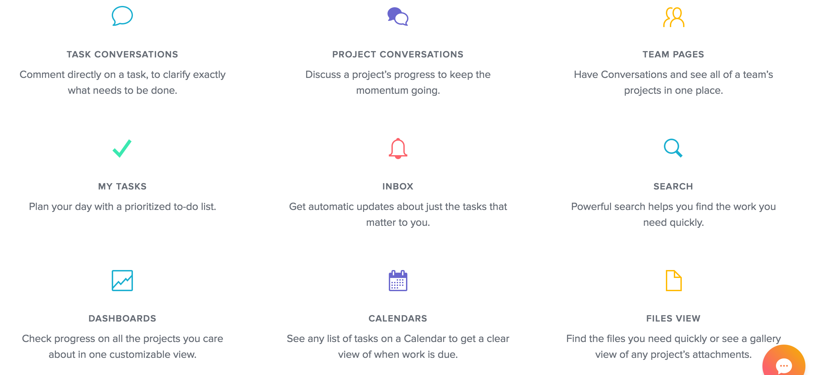


Slide 5
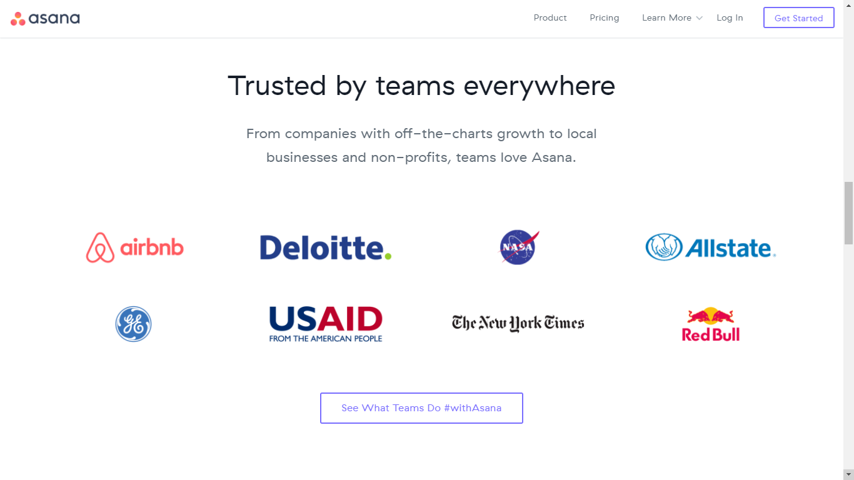

Slide 6
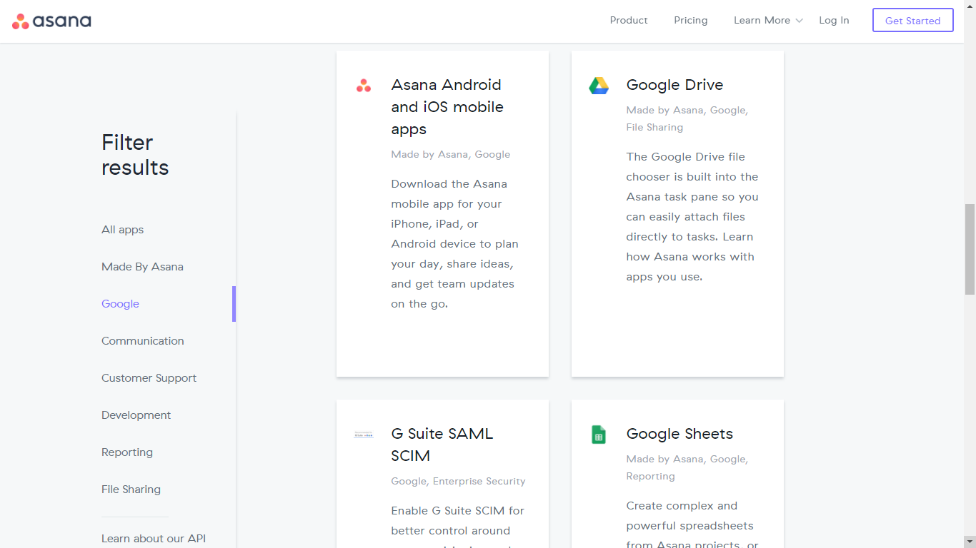
Integration

Slide 7
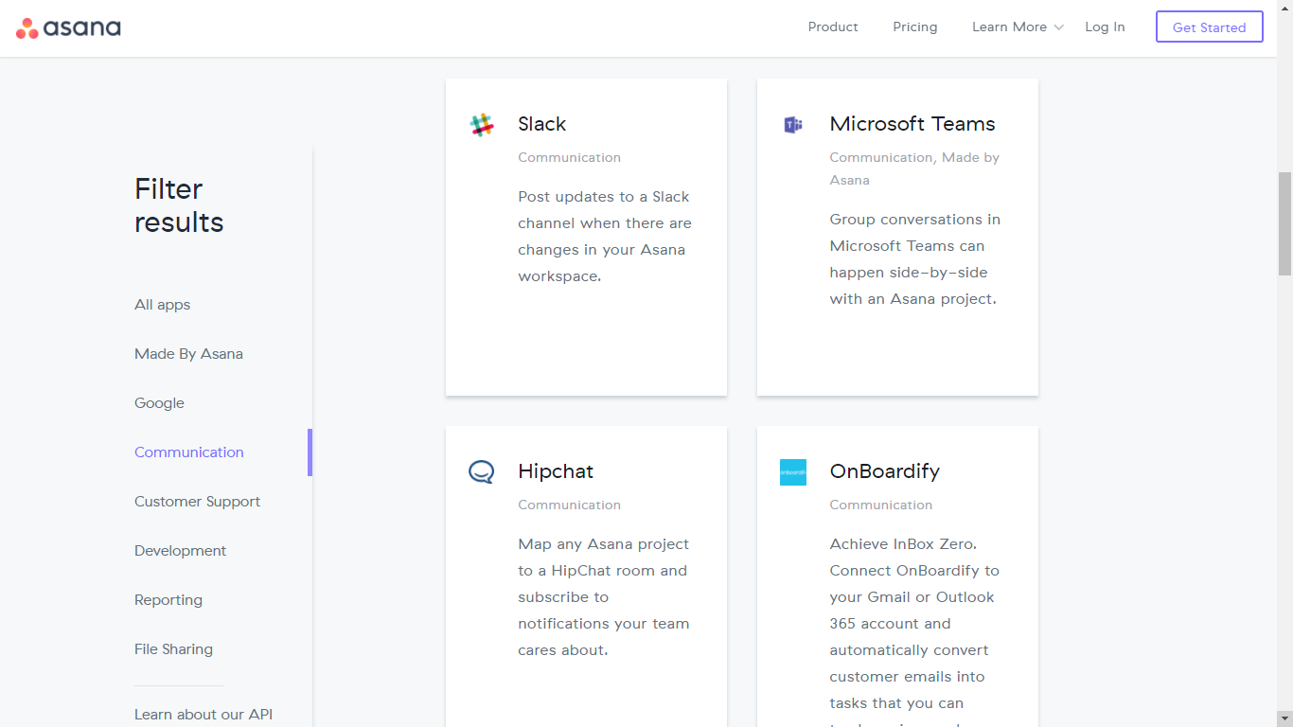

Slide 8
Asana
Awards:
On July 23, 2012, Asana announced a new round of funding — Peter Thiel and Founders Fund, along with existing investors Benchmark, Andreessen-Horowitz, and Mitch Kapor, have invested $28 million in Asana
According to a New York Times article and someone briefed on the funding, the investors valued the company at $280 million.
Group B comment:
Asana is a very good general purpose project management service, also support Agile and many other type of teams.

