Slide 1

Glip
Website:
www.glip.com
History:
In June 2015, RingCentral acquired Glip. Glip was acquired by RingCentral for an undisclosed amount.
Mobile support:
iOS
Android
Logo

Slide 2
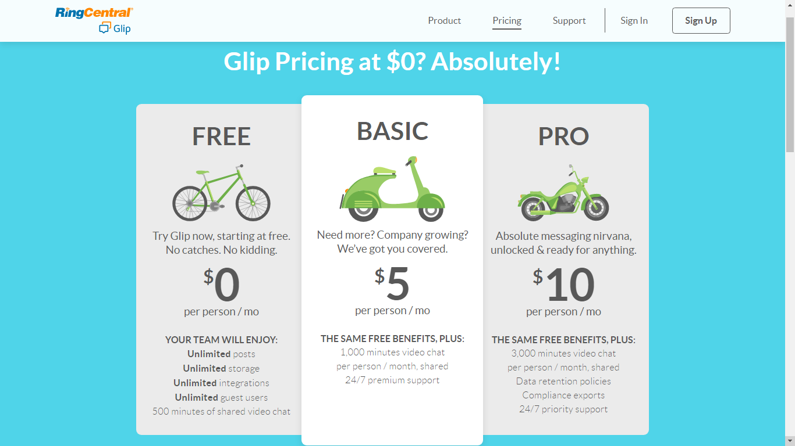
Prices / Versions

Slide 3
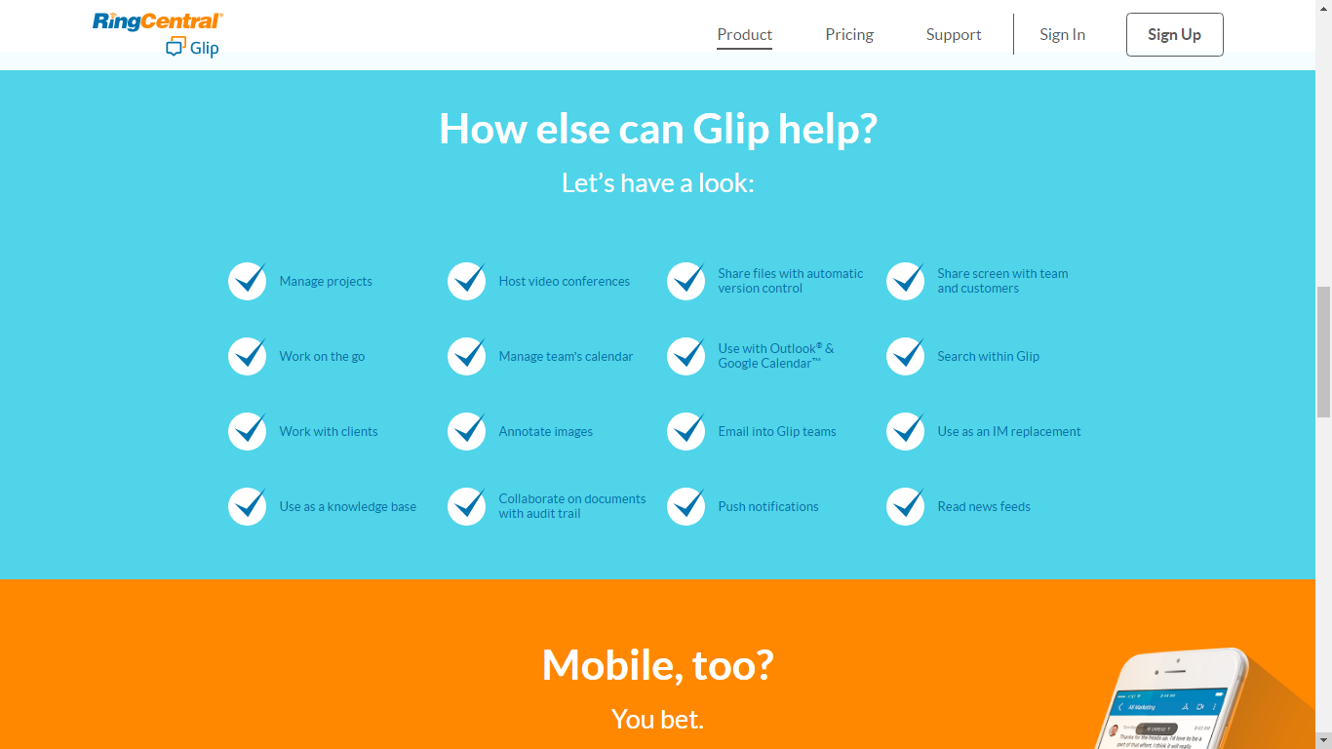
Features

Slide 4
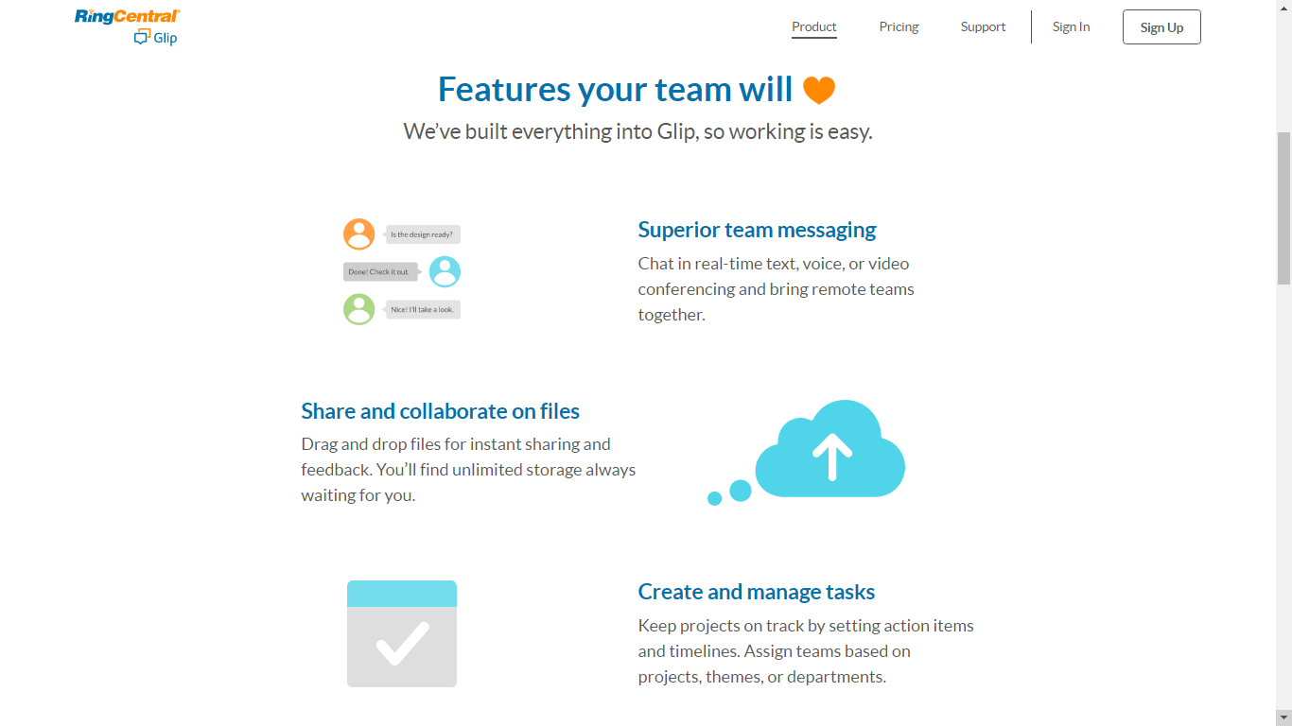

Slide 5
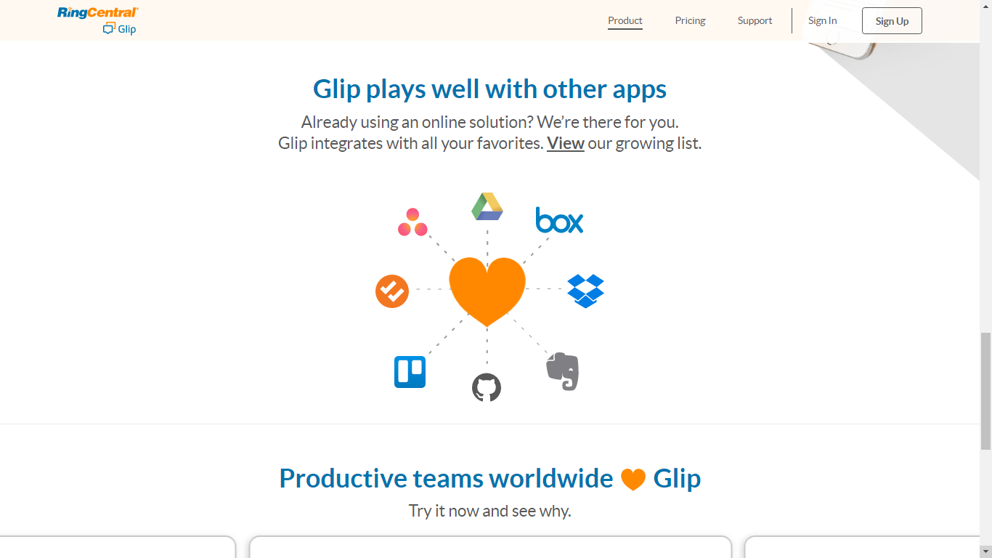
Integration

Slide 6
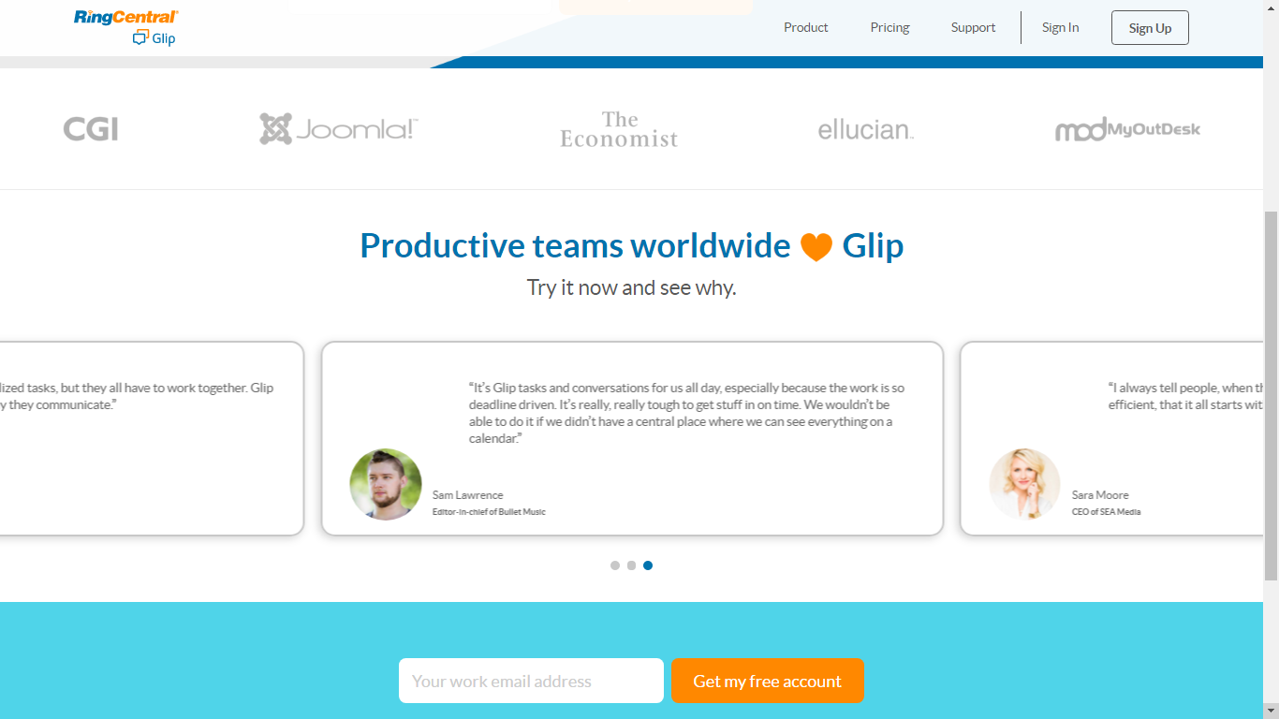
Integration

Slide 7
Glip
Awards:
Group B comment:
Glip is not just a team communication service, it also manage project, task, sharing screens.

