Slide 1

TAIGA
Website: https://taiga.io/
History: Taiga formally came with the creation of Taiga Agile, LLC in February 2014 that provided the formal structure for the Taiga project
Mobile support:
Android and iOS
Logo

Slide 2
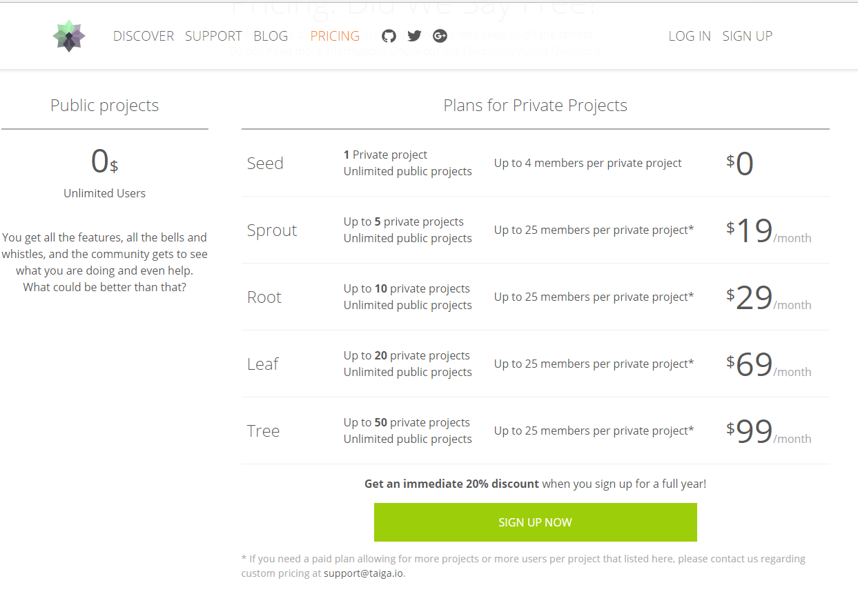
TAIGA

Slide 3
TAIGA
Some features:
Tool for project management
Support Scrum methology
KANBAN dashboard
Epic multiproject
Personal Dashboard
Multiplatform importers

Slide 4
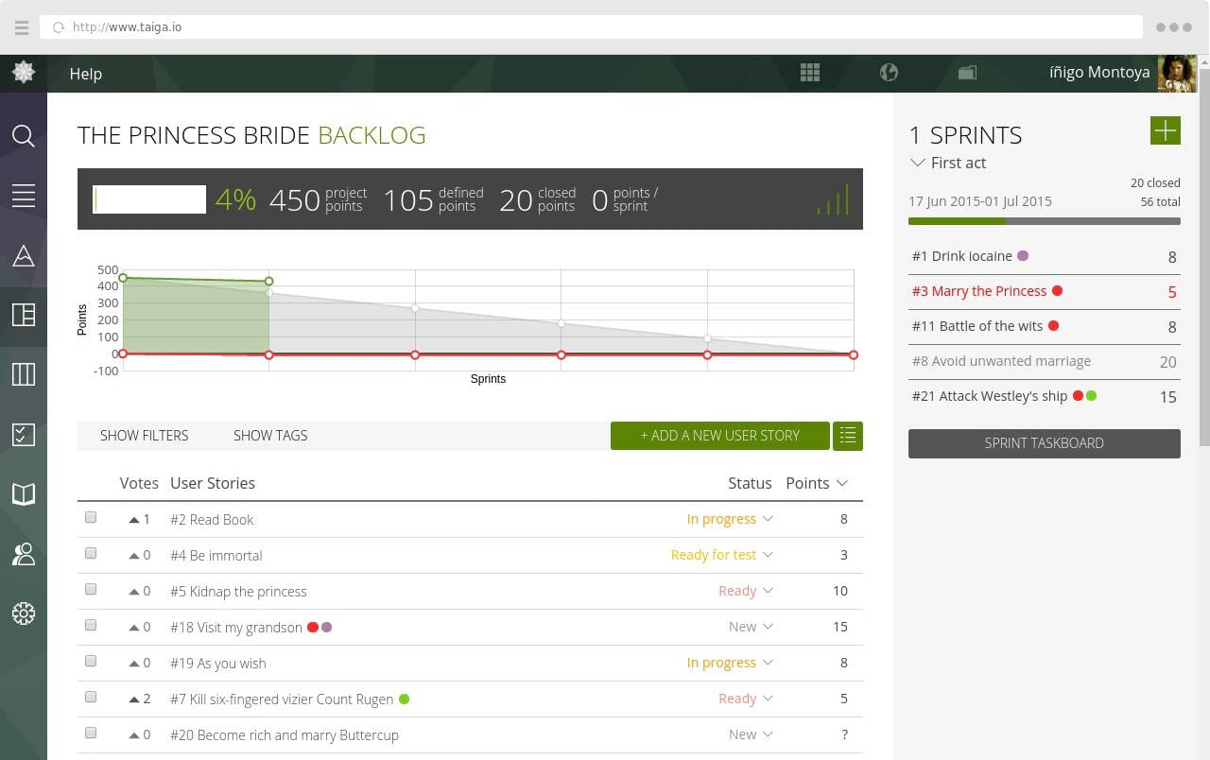

Slide 5
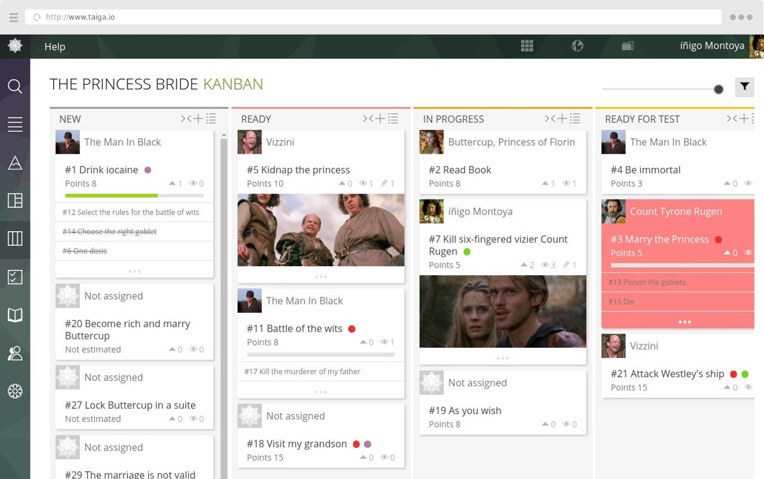

Slide 6
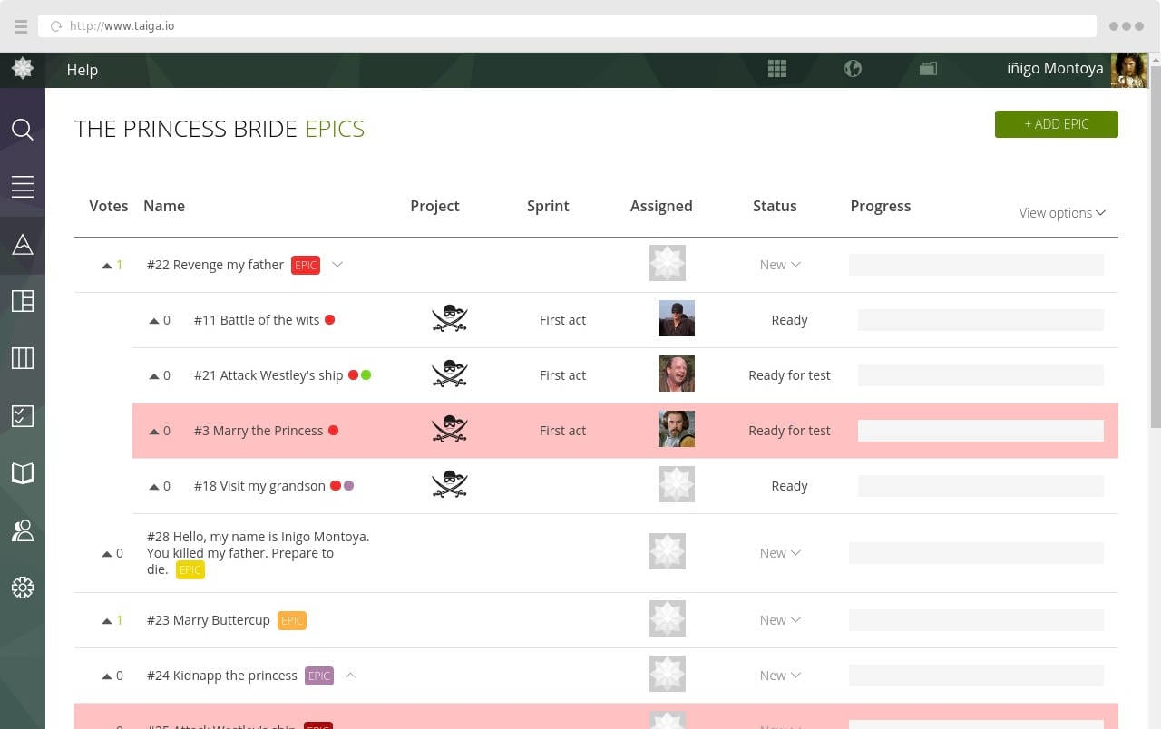

Slide 7
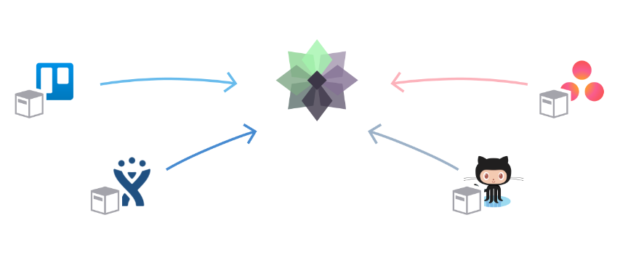

Slide 8
Taiga
Awards
Taiga won the 2015 Most Valued Agile Tool awarded by the Agile Portal.
It's been cited as one of "Top 10 open source projects in 2014" and "Top 11 project management tools for 2016" by Opensource.
Group B comment:
Taiga is one of the most popular Agile - SCRUM project management, task management service.

