Slide 1

Meistertask
Website: https://www.meistertask.com/
History: Establish in 2015
Mobile support:
Android and iOS
Logo

Slide 2
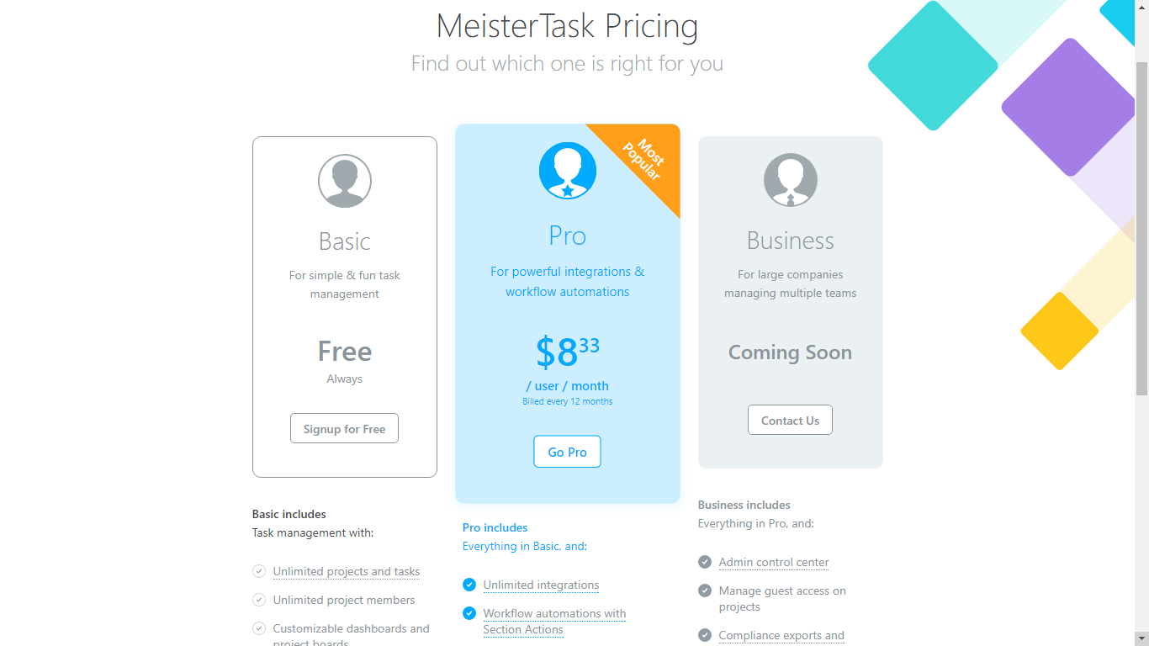
Meistertask

Slide 3
Meistertask
Some features:
Task management
Operating based on Smart, Agile & Visual
Support mind map
Support Multiple Communication
Personal Dashboard
Unlimited invitation members for project
Tracking member’s progress

Slide 4
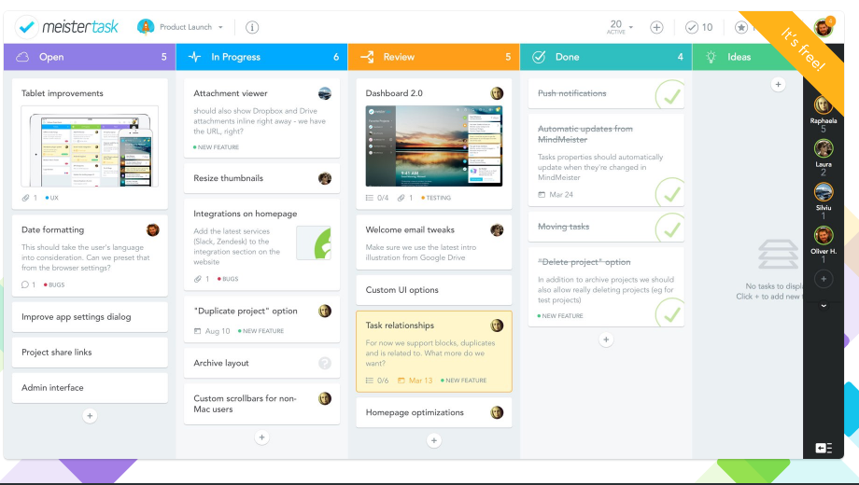

Slide 5
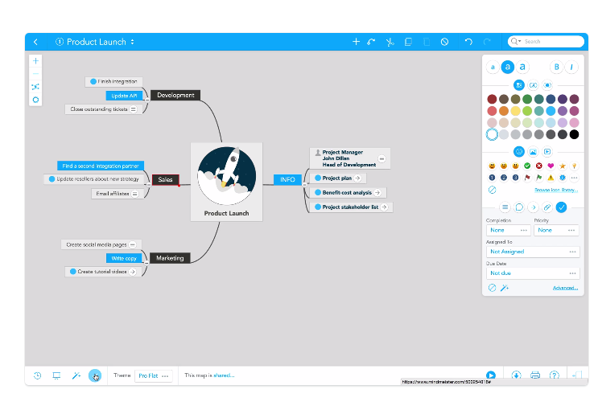
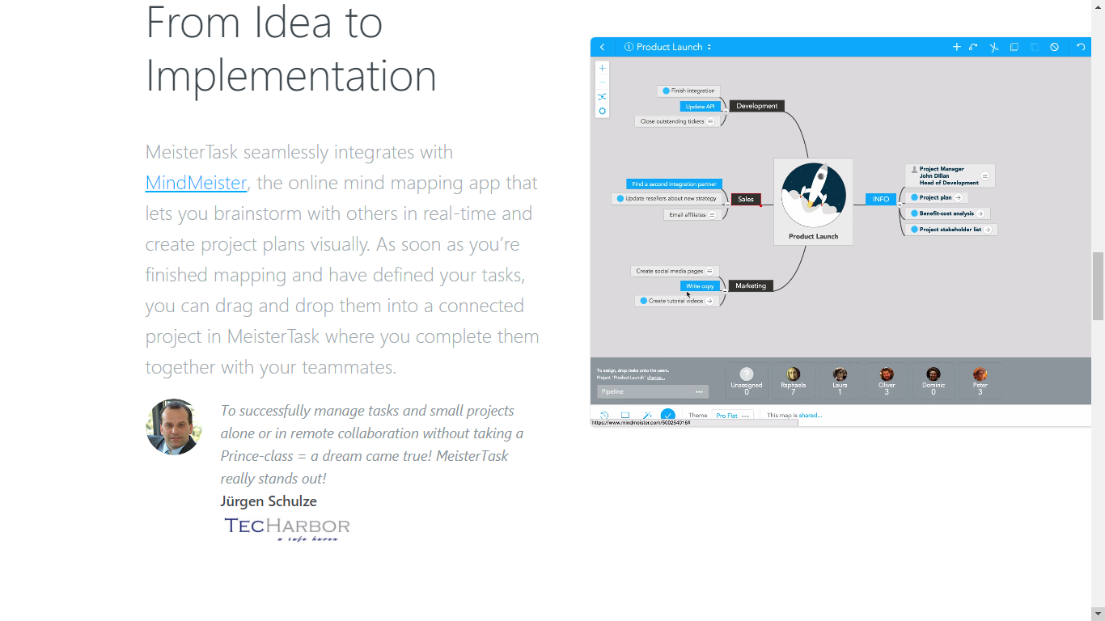

Slide 6
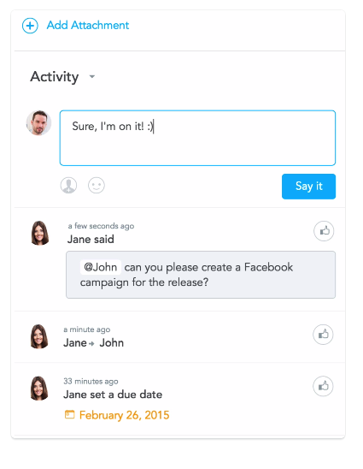

Slide 7

Meistertask

Slide 8
Meistertask
Awards:
Best app 2015 – App store
Best app 2015 – Google play
Group B comment:
Meistertask is growing rapidly. Support for Kanban board, real-time chat and Mind Manager.

