Slide 1

Skype
Website: https://www.skype.com/
History:
Made by Niklas Zennström and Janus Friis in 29/03/2003
Acquired by Microsoft in 10/05/2011
Price:
Free to use
Skype credit
Logo

Slide 2

Supported Devices
Windows
Ios
Linux
Android
iPhone
Windows phone
BlackBerry
Amazon Fire Phone
iPod touch
iPad
Andoird
Kindle Fire HD
Windows
Xbox One
Apple Watch
Android Wear

Slide 3
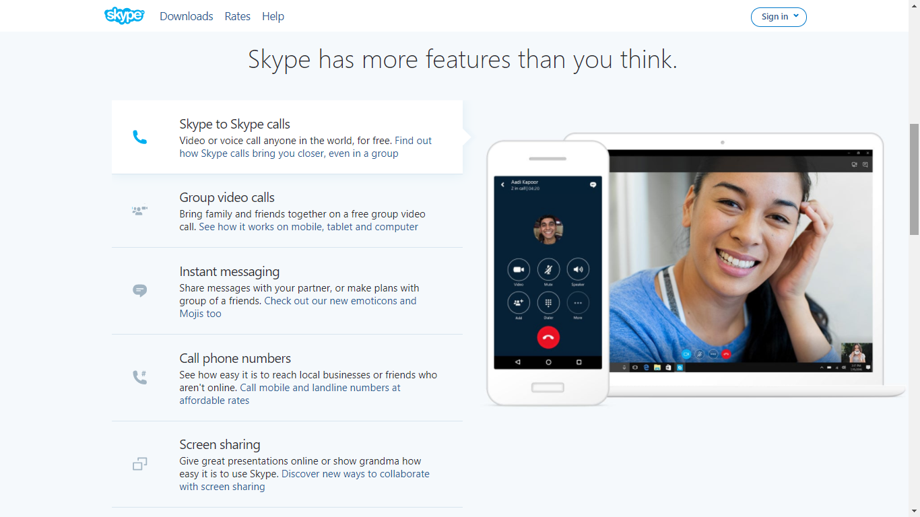
Skype

Slide 4
Skype
Some features:
SkypeIn (allows to receive calls to a local Skype phone number)
SkypeOut (used to call to non-Skype users with a low price ≥$0.025)
Message
Group call up to 25 users
Video Call
Share screens, photos, videos, documents, and files (up to 300MB)
Use directly at www.skype.com, doesn’t require account

Slide 5
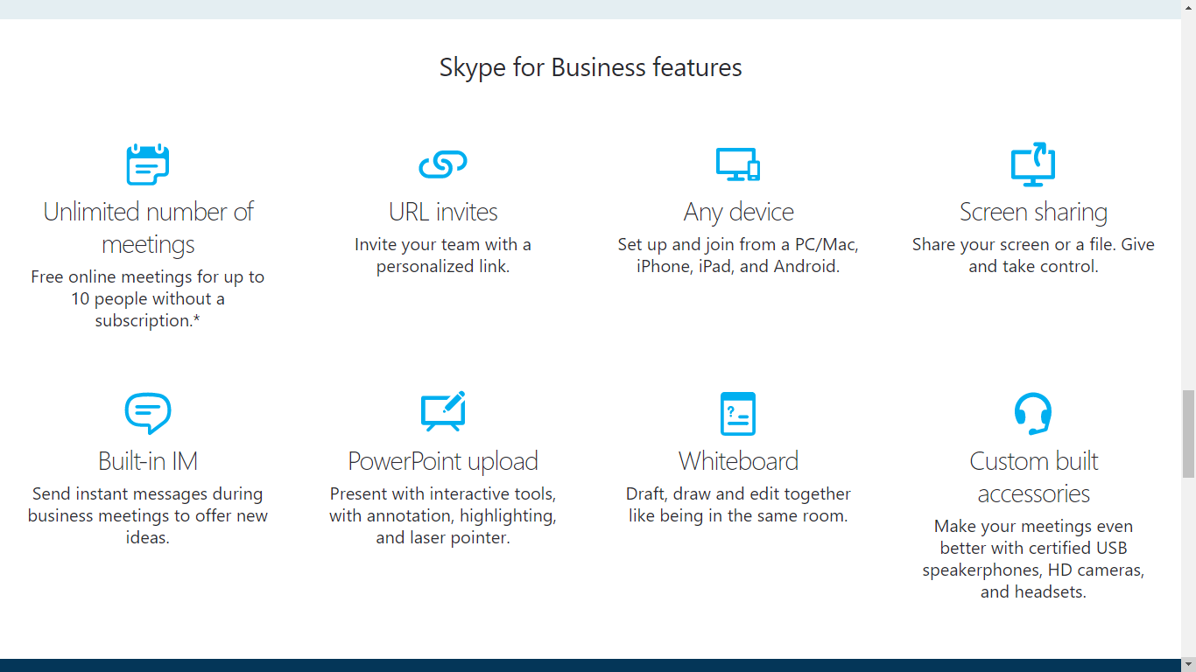
Skype

Slide 6
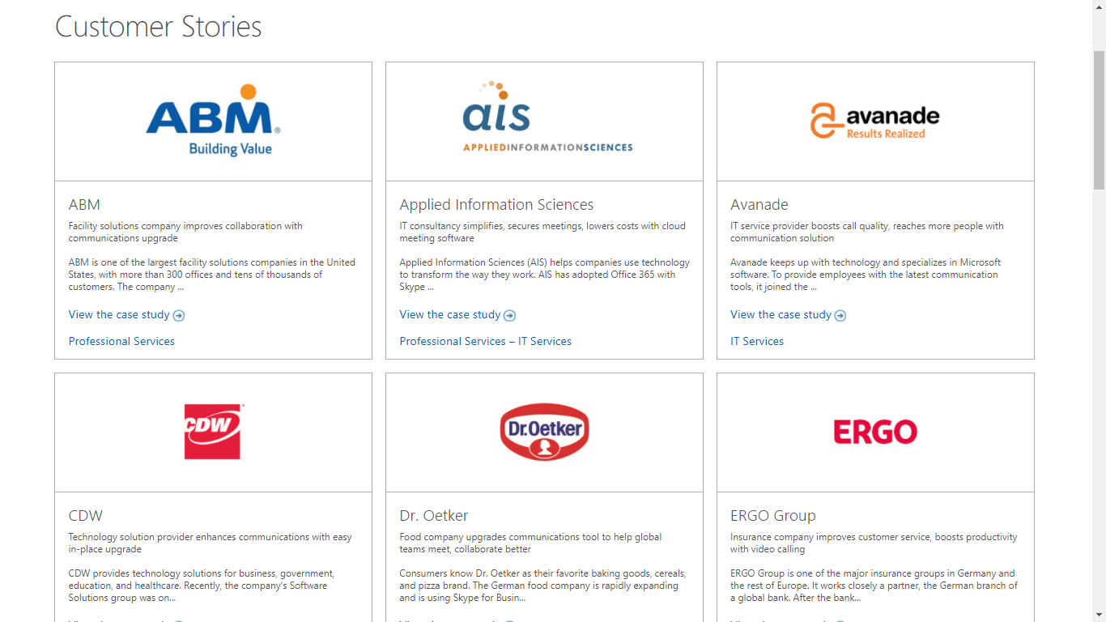
Skype

Slide 7
Skype
Awards
In September 2005, eBay acquired Skype for $2.6 billion.
Microsoft bought Skype in May 2011 for $8.5 billion.
Group B comment:
Skype is probably the most popular video call service in the market, with good performance.

