Slide 1
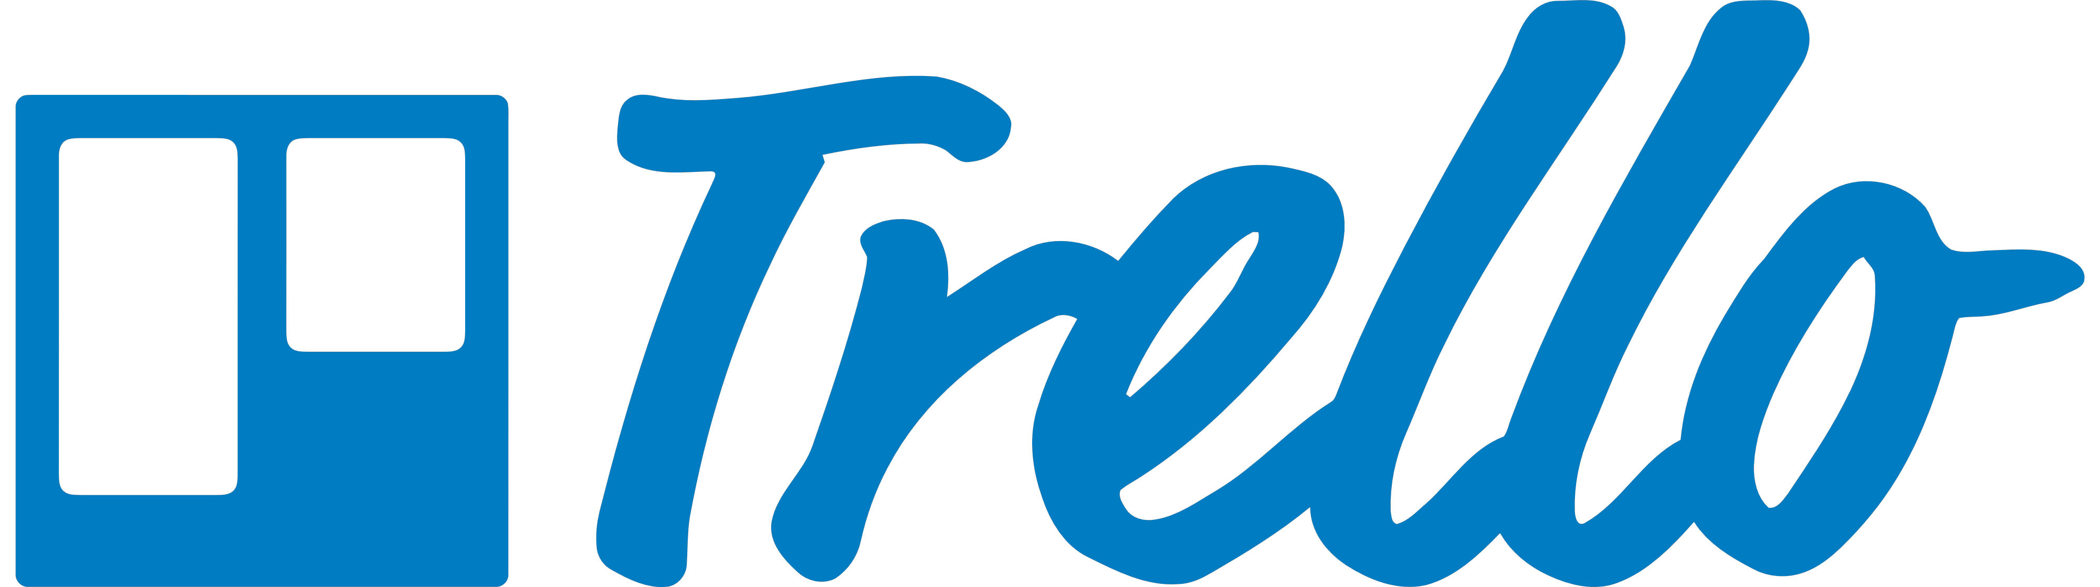
Trello
Website: https://trello.com/
History:
Made by Fog Creek Software in 2011
Acquired by Atlassian in 01/2017
Mobile Support:
Android, iOS
Logo

Slide 2
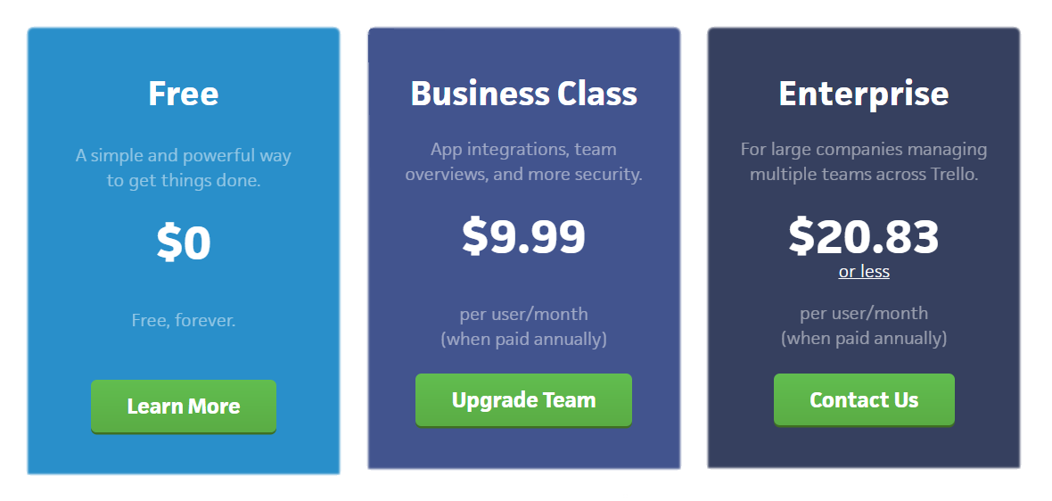
Trello

Slide 3
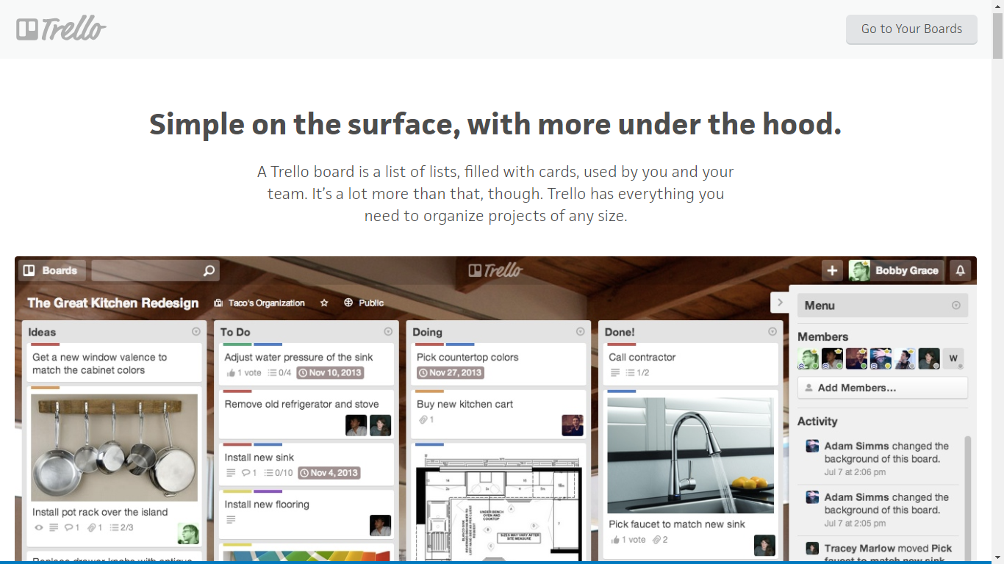
Trello

Slide 4
Trello
Some features:
Task management
Task planning
Task scheduling
Task tracking
Project tracking
Time tracking by project
Third party integration
Collaboration tools
Attach photos, drawings, sketches & mockups

Slide 5
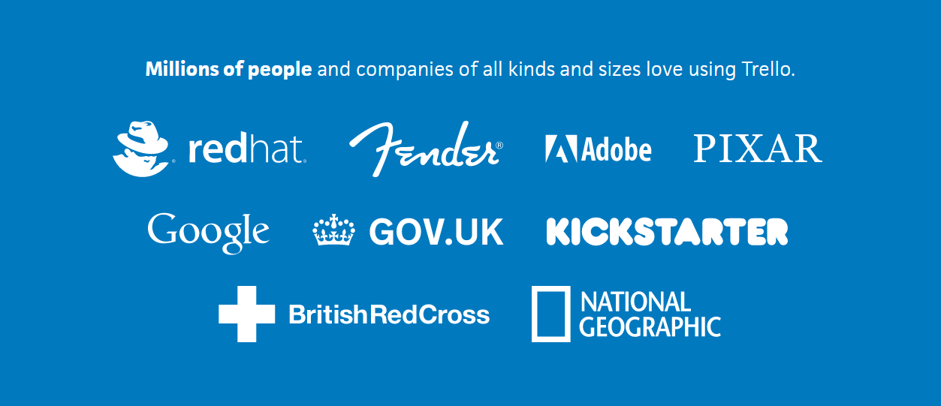
Trello

Slide 6
Trello
Awards
In July 2012, the site surpassed 500,000 users.
In December 2012 more than 1,000,000.
As of October 14, 2015, it had 10 million users.
On January 9, 2017, Atlassian announced its intent to acquire Trello for $425 million. The transaction was made with $360M in cash, while the remaining $65M was made with shares and options
Group B comment:
Trello is one of the best (probably the best) Kanban board supported-tool. Simple, easy to use, extraordinary performance, excellence UI/UX.

