Slide 1
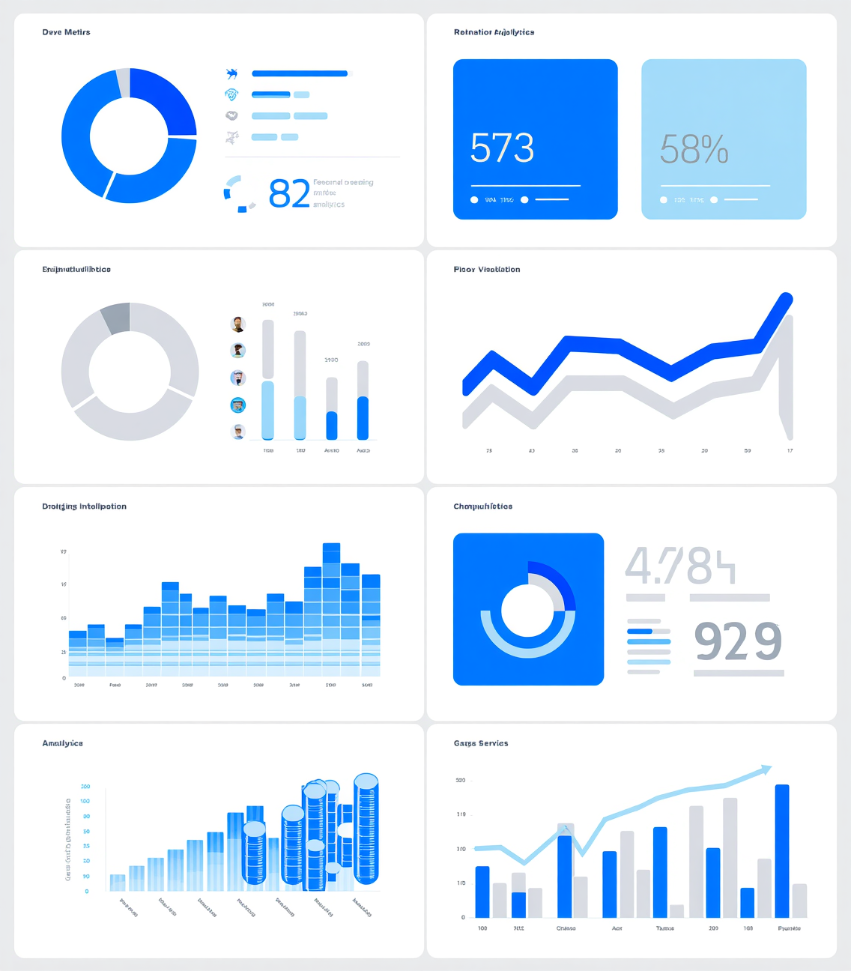
INTRODUCTION TO DATA CAREERS
Informational Interview Project
Nhan Ngoc Thach, Data Scientist
Notes:
Today, I will present my informational interview project.
My topic is about data science and data analysis careers, especially in healthcare.”

Slide 2

Introduction to the Informational Interview Project
Notes:
“I am interested in working with data in the future.
In this project, I focused on healthcare because it is an important field.
The purpose of this project is to understand job requirements, employers, and skills needed for a data career.”

Slide 3

Job Overview of Healthcare Data Roles
Salary: ~$112K/year (~$54/hour) (Median)
Entry-level: ~$60K–$75K (~$29–$36/hour)
High demand (+34%)
Notes:
Let's dive into the exciting world of healthcare data roles.
First, let's talk about the salary expectations. On average, professionals in this field earn around $112,000 per year, which breaks down to roughly $54 per hour.
For those just starting out, entry-level positions range between $60,000 and $75,000 annually, equating to about $29 to $36 per hour.
[Use a slightly upbeat tone to emphasize opportunity.]
Now, here's the best part: the demand for healthcare data professionals is expected to grow by an impressive 34%! This surge highlights the immense opportunities available for those entering the field.
[Conclude with a confident tone to inspire interest and enthusiasm.]

Slide 4



Essential Skills for Data Roles
Data Techniques
Programming
Statistical Knowledge
Data analysis
Identify trends
Interpret data
Python
SQL
Data tools
Statistics basics
Data modeling
Decision support
Notes:
To excellent in healthcare data roles, there are several essential skills you should focus on. Let's dive into these key areas.
First, data analysis is crucial. You need to be able to identify trends and interpret data effectively. This involves using various data techniques, such as Python and SQL, which are foundational tools in the industry. These tools help you to manage and manipulate data, providing clear insights that guide decision-making.
[Pause for a moment]
Programming, particularly in Python, is a skill that complements your data analysis abilities. It allows for more efficient data processing and modeling, enabling you to create decision support systems. Understanding the basics of statistics is also vital. Statistical knowledge provides the framework for data modeling and helps you make informed predictions based on your analyses.
In summary, mastering these essential skills—data analysis, programming, and statistical knowledge—will set you on a strong path in data roles. They are the building blocks that will enhance your ability to contribute effectively in this rapidly growing field.

Slide 5
Major Healthcare Employers
Mass General Brigham
Bachelor’s degree
SQL, Excel
Healthcare data
Analytical skills
Boston Children’s Hospital
Data-related degree
Python, Tableau
Attention to detail
Communication
Notes:
I conducted a comparative analysis of Mass General Brigham and Boston Children’s Hospital.
Both require candidates to have a bachelor's degree and technical skills like SQL or Python, along with strong analytical and communication abilities.
- Mass General Brigham offers a vast network and advanced research facilities, emphasizing collaboration and professional development.
- Boston Children’s Hospital focuses on specialized pediatric care and research, encouraging interdisciplinary collaboration to improve healthcare outcomes.
In both organizations, the ability to translate data insights into actionable strategies is essential, as the demand for skilled data professionals rises due to healthcare's digital transformation.

Slide 6
Focus on Healthcare Employers
Large healthcare systems
Millions of patients
Research & education
Patient care focus
Notes:
Healthcare employers play a crucial role in the industry by serving millions of patients, which necessitates robust data systems for efficient management of patient information. They also contribute to research and education, ensuring advancements in medicine. Central to their mission is the emphasis on enhancing patient care and outcomes through their operations and innovations.

Slide 7
LinkedIn Insights
10,000+ employees
166K+ followers
146 alumni
Large organization
Notes:
LinkedIn has over 10,000 employees and 166,000 followers, highlighting its extensive network for professionals. With 146 alumni, it fosters community engagement and supports professional development through access to industry insights. The discussion will focus on how real data generates diverse insights and the significance of problem-solving in business.

Slide 8
Key Lessons from Interview
Start with real data
Same data → different insights
Focus on problem-solving
Need business understanding
Notes:
“I also conducted an informational interview with Professor Ghosh.
From this interview, I learned several important lessons.
First, he started working with data during his research using statistical tools.
Second, the same data can give different insights depending on how we analyze it.
He also emphasized the importance of problem-solving and business understanding.
Finally, he highlighted that continuous learning is important for success in data-related careers.”

Slide 9
Thank You!
Thank you for listening

