Slide 1





NOIR MYSTERY
STORY ENGINE
AGENTIC AI PRESENTATION
Nhan Nguyen - Khoi Phan - Brent Thompson

Slide 2

WELCOME
Welcome to the Noir Mystery Story Engine. We built an agentic AI system that takes any crime scene description and turns it into a full noir detective story, powered by four coordinated AI agents that reason, retrieve, and write together. Think Sherlock Holmes, but built with PydanticAI.

Slide 3


01
THE PROBLEM
Why one prompt isn't enough
02
OUR SOLUTION
Meet the four agents
03
DEMO
TABLE OF CONTENTS
See it in action
04
EVALUATION
Did it actually work?

Slide 4

THE PROBLEM
A single prompt can't do everything
at once. It can't reason through
physical evidence step by step,
search a knowledge base of classic
detective literature, write an
atmospheric noir story from scratch,
AND remember clues across multiple
conversation turns.
These are four completely different cognitive tasks that require coordination. A real detective doesn't just look at a crime scene and immediately know the answer. They examine clues, consult case files, build a theory, write a report. That is exactly what our agents do.

Slide 5
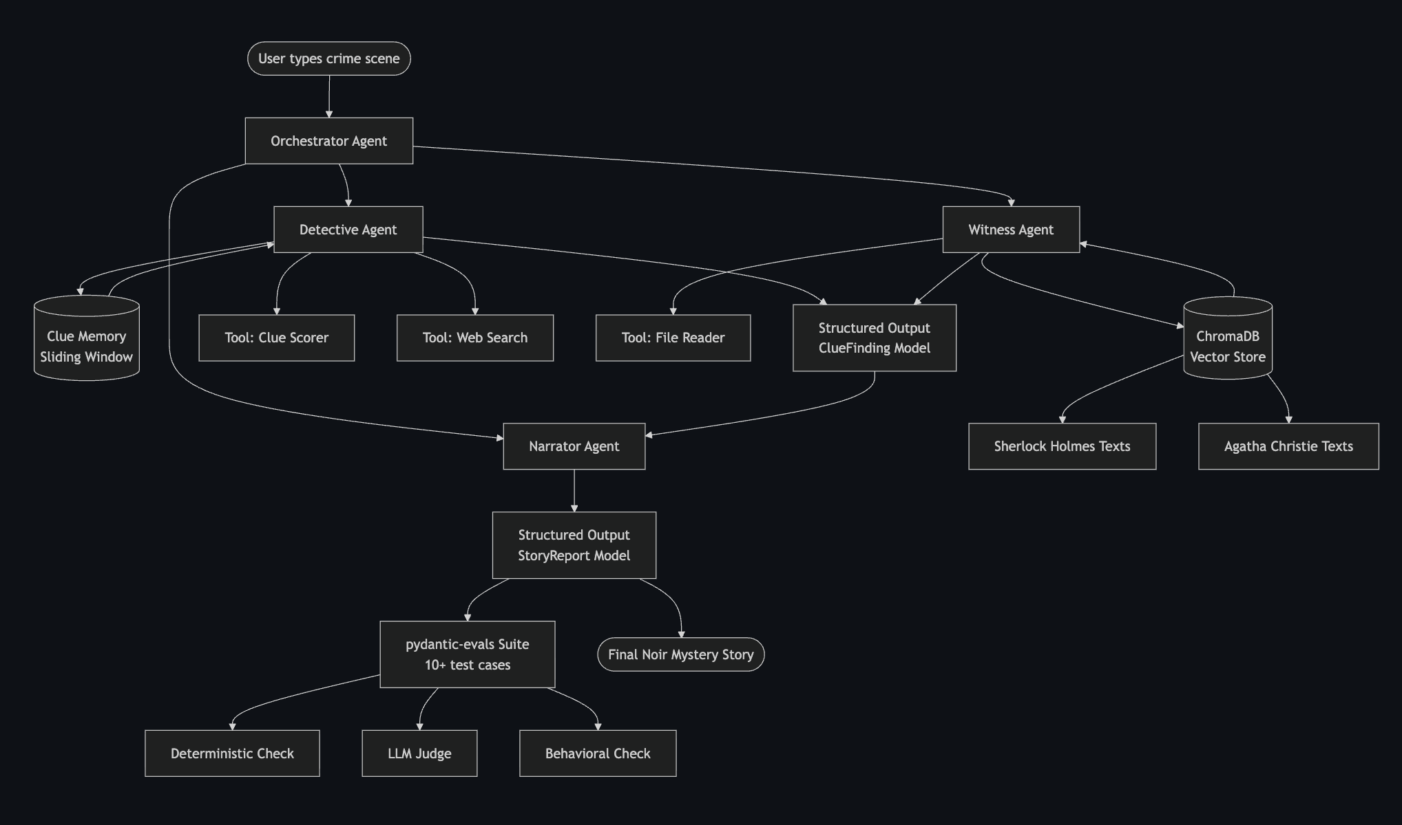
ARCHITECTURE DIAGRAM
User → Orchestrator → Detective + Witness → Narrator → Noir Story

Slide 6
TECH STACK
PYDANTICAI
CHROMADB
PYDANTIC-EVALS
Vector database storing
1,056 chunks from 4
classic detective novels
All LLM agents with
structured outputs and
agent-as-tool pattern
Evaluation framework
with 12 test cases and
3 evaluator types
claude-sonnet-4-6 via UCF LiteLLM Proxy
sentence-transformers all-MiniLM-L6-v2
Python 3.11 + httpx + python-dotenv

Slide 7

YOU TYPE A CRIME SCENE. FOUR AGENTS INVESTIGATE. ONE NOIR STORY COMES OUT THE OTHER END.
THE NOIR MYSTERY STORY ENGINE

Slide 8
EVALUATION RESULTS
🔍 STRUCTURAL CHECK
🕵️CLUES DISCOVERED
⚖️ NOIR QUALITY JUDGE
Deterministic evaluator
Behavioral evaluator
LLM judge evaluator
Checks title exists
Checks suspect named
Checks story length
Verifies 3+ clues found
Checks tool was called
Validates output model
Claude scores the story
Checks authentic noir style
Rates dramatic verdict
Score: 1.0/1.0
Score: 1.0/1.0
Score: 0.43/1.0

Slide 9
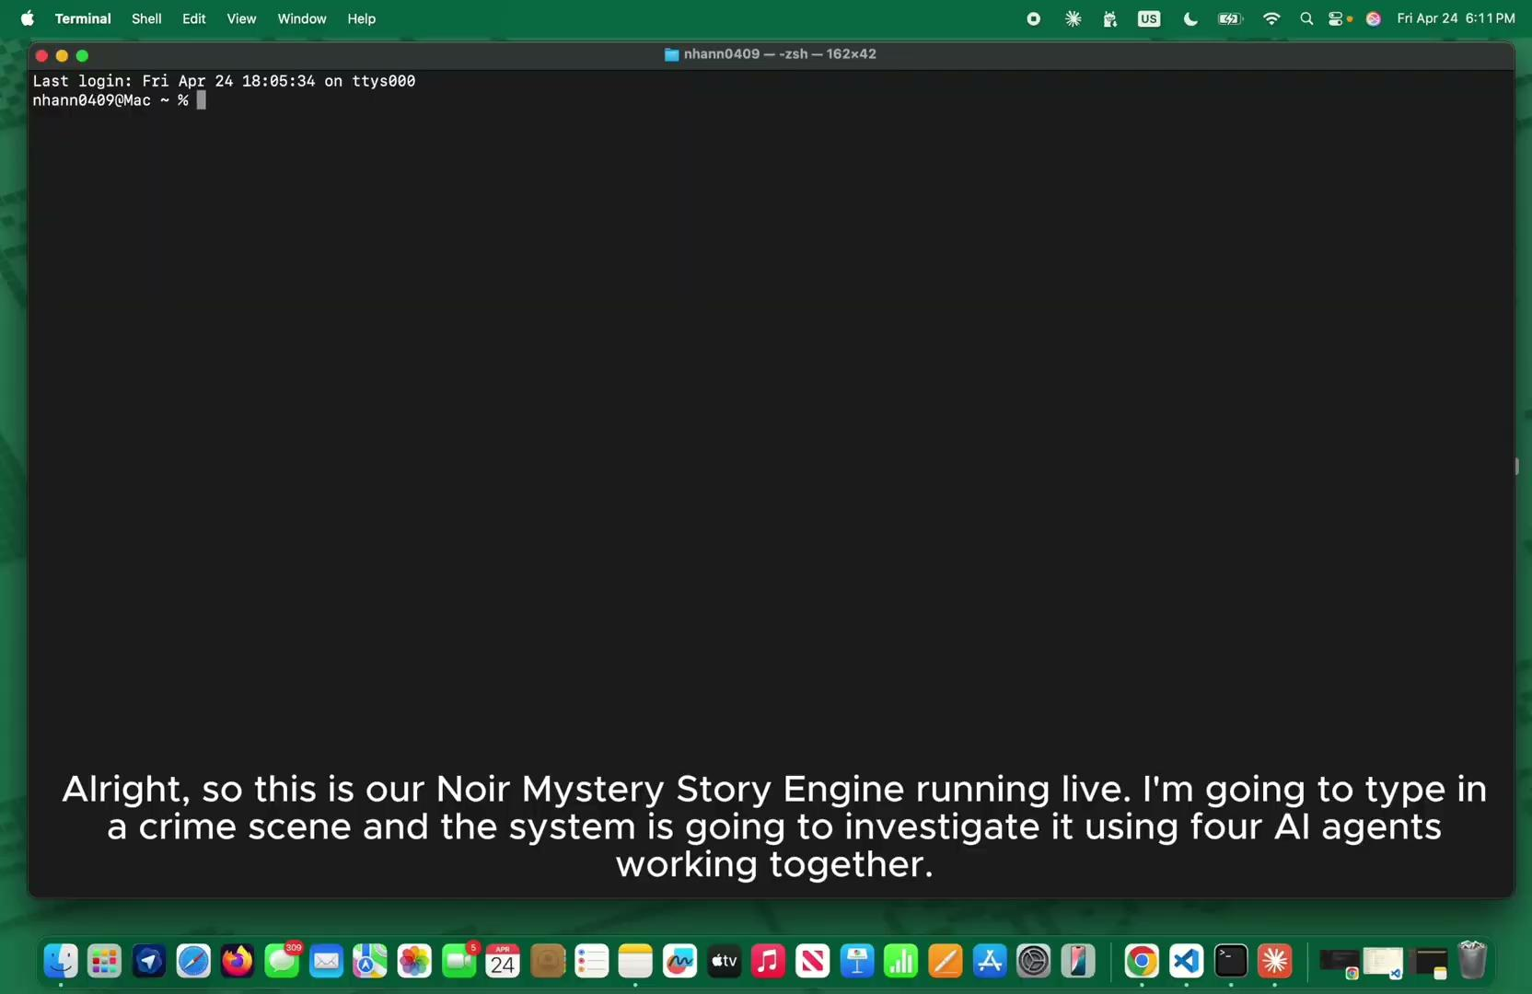

RECORDED DEMO

Slide 10
WHAT WE'D IMPROVE
ADD RETRY LOGIC
TUNE THE LLM JUDGE
2
1
5 eval cases hit rate limits. Auto-retry would prevent these from counting as failures.
The NoirQualityJudge scored 0.43 on average. We'd give it example outputs so it judges more reliably.
FRONT END WEB APP
EXPAND THE CORPUS
4
3
Add a webapp with noir theme so users can have the best experience
Add Dashiell Hammett and Raymond Chandler for richer noir style retrieval.

Slide 11






THE GAME IS AFOOT.
Thank you for watching the Noir Mystery Story Engine in action. Clone it, run it, give it your own crime scene.
github.com/NhanNguyen-SG/noir-mystery-engine
Any questions?

