Slide 1

Proposal
Architect

Slide 2

AgENDA
STARUP'S INFOMATION
CURRENT ARCHITECT
PROBLEMS
CLOUD AWS SOLUTION
CLOUD AWS ARCHITECT
HOW TO AWS RESOLE AND ADAPT BUSSINESS
MIGRATION TO AWS
COST ESTIMATION

Slide 3

1.Startup
AWESOME SMALL STARUP
BUSSINESS : IMPROVE SKILL READ – WRITE – LISTEN - TALK ENGLISH AT SOUTH ASIA
DOMAIN : EDUCATION , EDUTECH
PLATFORM : WEB APPLICATION, MOBILE APPLICATION
TEAM : 1 CEO + CTO, 1 FULLSTACK, 1 FRONTEND, 1 UI/UX

Slide 4
1.Startup
COMPLETED
MVP: WEB APPLICATION USE LAMP STACK
DEVELOPMENT STATE
LOCAL STATE
PROVISON
CLOUD IN PRODUCTION
USE LAMP STACK
SCALE ON DEMAND
EFFECTIVE COST
PREPARE TO LARGE BUSSINESS
FURTURE
API RESTFUL
MOBILE APPLICATION
SUPPORTING CHANNEL

Slide 5
2.CURRENT aRCHITECTURE
ONE SERVER HARDWARE :
CPU: Intel Xeon E-2224 (4C/4T, 3.40 GHz, 8MB)
RAM: 8GB DDR4-2666 UDIMM
HDD: 2TB 7200RPM SATA 3.5"
LAMP STACK:
OS LINUX SERVER : UBUNTU 18.04
WEB SERVER : APACHE SERVER 2.0
DATABASE: MYSQL 8.0
LANGUAGE: HTML, JAVASCRIPT, PHP

Slide 6

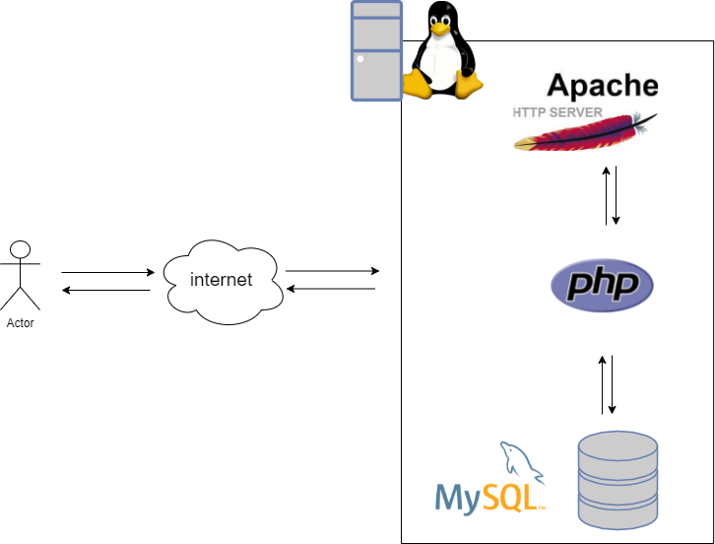
2.CURRENT aRCHITECTURE

Slide 7

3.Pain points
Their lack of provision for Disaster Recovery.
Their ability to configure their database and data access layer for high performance and throughput making the user experience in the browser very low latency even though a large portion of their user base will be from far away.
Effective distribution of load .
A self-healing infrastructure that recovers from failed service instances.
Security of data at rest and in transit.
Securing access to the environment as the delivery team expands.
An archival strategy for inactive objects greater than 6 months

Slide 8
3. technical Requirement
Web Appilcation run on browser : Chrome, FireFox, Safari, Microsoft Edge, Internet Explorer
FrontEnd : Angular Framework, HTML5/CSS , JavaScript
Backend : Laravel framework – PHP
Enviroment Webserver : XAMPP is the most popular PHP development environment
Moblie Application : React Native cross platform

Slide 9
3.Functional requirement
Anonymous user view limited lesson on website
Anonymous user take a test for talking with teacher on website
Anonymous user learn, check grammar , vocal on website
User can resgister / Login / Logout on website
As real user, user can track theirlearning process on website
Searching word, lesson ,on website

Slide 10
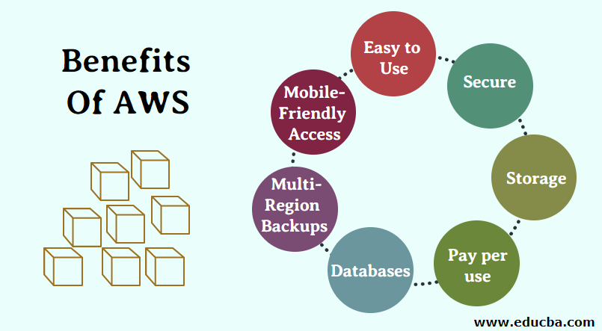
4. clOUD aWS sOLUTION
provide a manageable, secure, scalable, high performance, efficient, elastic, highly available, fault tolerant and recoverable architecture that allows the startup to organically grow.

Slide 11
4. Why AWS for a startup ?
AWS PROVIDE A NATURE SCALE WHEN SRARTUP GROW-UP
AWS PAY-AS-YOU PRICING MODEL KEEP INVESTMENT ELASTIC
EASY INCREASE/ DECREASE CAPABILITIES
AWS PROVIDE A METHOD FOR LOAD BALANCING REQUEST
HANDLE MANY MANY REQUEST/TRAFFIC LOADS FROM END USER
HANDLE UNPREDICTED REQUEST/TRAFFIC LOADS FROM END USER
AWS PROVIDE A METHOD MANAGEABILITY FOR DEVELOPMENT, RPODUCTION, MAINTENANCE
ON-DEMNAD RPOVISIONING OF RESOURCE IN AWS IMPROVE SOFTWARE LIFE-CYCLE STATE
COST EFFECCTIVE

Slide 12
4. Why AWS for a startup ?
AWS PROVIDE A NATURE SCALE WHEN SRARTUP GROW-UP
AWS PAY-AS-YOU PRICING MODEL KEEP INVESTMENT ELASTIC
EASY INCREASE/ DECREASE CAPABILITIES
AWS PROVIDE A METHOD FOR LOAD BALANCING REQUEST
HANDLE MANY MANY REQUEST/TRAFFIC LOADS FROM END USER
HANDLE UNPREDICTED REQUEST/TRAFFIC LOADS FROM END USER
AWS PROVIDE A METHOD MANAGEABILITY FOR DEVELOPMENT, RPODUCTION, MAINTENANCE
ON-DEMNAD RPOVISIONING OF RESOURCE IN AWS IMPROVE SOFTWARE LIFE-CYCLE STATE
COST EFFECCTIVE

Slide 13
5. WE RECOMEND CLOUD aws ARCHITECTURE INCLUDE 4 TIERS
1. NETWORK TIER
Manage external/internal network configuration and security group via AWS ROUTE 53, Availability Zone, ELB, Elastic IPs,Security Groups
Responsible for access to website/webserver/appserver from internet
2. WEB SERVER TIER
Manage Webserver via AWS EC2 , AMI Images
Configuration and maintenance Webserver instance and load balacing Web request
3. APP SERVER TIER
Manage Appserver via AWS EC2 , AMI Iamages
Configuration and maintenance Appserver instance and load balacing App request
4. DATABASE TIER
Manage Database server and data via AWS RDS , AWS Elastic Block Store - EBS
Configuration and maintenance the backend database request, access, security, performance ...

Slide 14
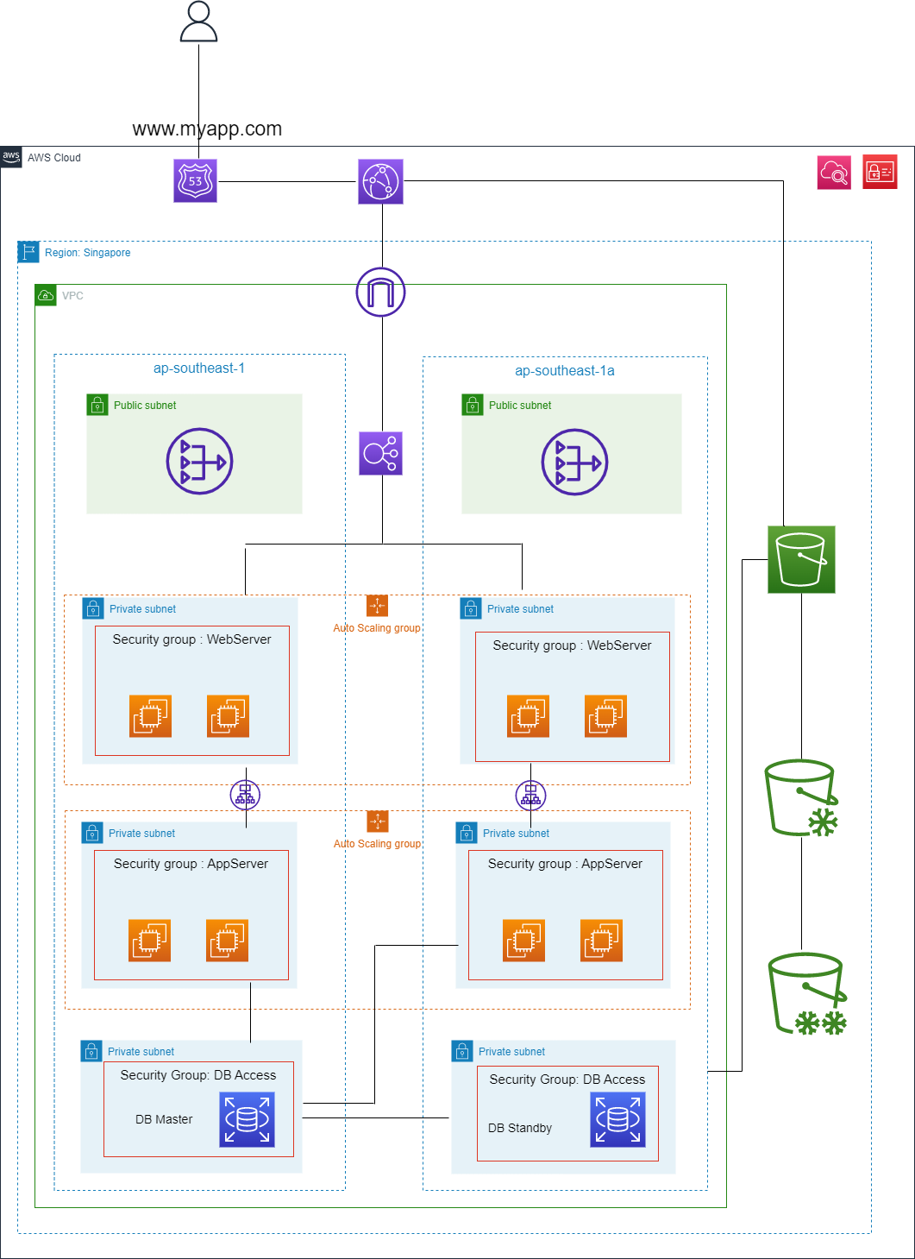

Slide 15
6. HOW TO AWS RESOLE AND ADAPT BUSSINESS
END USERS
1. No Downtime webstie
We deloyed 2 AZ , the architecture can hanlde failure ,fault tolerant and recoverable
2. Faster reponses
Hosting website with AWS ROUTE 53, request will direct nearesst location.
Via AWS CloudFront and S3 make static file load faster
3. Security User Data
Every tier configure a Security Group that define rule allow or deny method, protocol access between tiers. From WebServer to AppServer, AppServer to Database
By HTTPS, user data will be protect in transit over network

Slide 16
6. HOW TO AWS RESOLE AND ADAPT BUSSINESS
SYSTEM, INFRASTRUCTURE SIDE
1. Rapid Provisioning
With EC2 instances, you can spin up numbers of VM instances
Handel peak load via Auto Scaling Group
2. Automation distribution of load
With ELB, the architect handle load request user ,and user experience improved
3. Monitoring Service
With AWS CloudWatch monitoring health service EC2
AWS Cloudtrail could record the people who operating the resource. We could use it to audit the operations and track member for security issues.
IAM for identify and access management
Designing roles with access token or MFA for people who need to access the resources

Slide 17
4. HOW TO AWS RESOLE AND ADAPT BUSSINESS
4. Data Aministration
ESB help your storage volumes,snapshot …
AWS S3 store data and archived to Gracier by Object Lifecycle Management.
5. Database Aministration
RDS for data storage : The ec2 servers would read and write the master mode RDS in one AZ, another slave mode RDS in different AZ is standby to synchronize the data and prepare to serve when the master is down.

Slide 18
7. Migration to AWs
Bring domain to ROUTE 53
Upload static file S3
Configure the CloudFront to deliver the S3 contents
Configuration NAT, INTERNET GATEWAY, SECURITY GROUP
Spin up EC2 , AMI, Database
Ship code to AWS EC2
Configure the Database Migration Service to sync the self-hosted MySQL to RDS
Switch the main domain to the ELB

Slide 19
8. Cost Explorer
Amazon Elastic Block Storage (EBS)
30 GB x 0.12 USD x 1 instances = 3.60 USD (EBS Storage Cost)
EBS Storage Cost: 3.60 USD
Amazon Elastic Block Storage (EBS) pricing (monthly): 3.60 USD
EC2 instance
Amazon EC2 Instance Savings Plans instances (monthly): 77.96 USD
Cpus : 4
Ram : 16
t4g.xlarge
Pricing strategy
EC2 Instance Savings Plans
Reservation term : 1 yeas
Amazon EC2 Instance Savings Plans instances (monthly): 77.96 USD
Amazon Elastic Block Storage (EBS) pricing (monthly)
3.60 USD
Amazon EC2 Instance Savings Plans instances (monthly)
77.96 USD
Total monthly cost: 81.56 USD

Slide 20
8. Cost Explorer
RDS Instance : db.m1.large, vCPU: 2, Memory: 7.5 GiB Development : Multi AZ
Pricing model : On-demand
1 instance(s) x 0.58 USD hourly x (100 / 100 Utilized/Month) x 730 hours in a month = 423.4000 USD
RDS MySQL cost (monthly): 423.40 USD
Storage for each RDS instance
30 GB x 0.276 USD x 1 instances = 8.28 USD (EBS Storage Cost)
Storage pricing (monthly): 8.28 USD
Amazon RDS for MySQL estimate
RDS MySQL cost (monthly): 423.40 USD
Storage pricing (monthly) :8.28 USD
Total monthly cost: 431.68 USD

Slide 21
8. Cost Explorer
AWS ELB : Number of Application Load Balancers (1)
Monthly: 41.76 USD
CloudFront 1TB Free Tier
S3 Glacier : pay-as-you

Slide 22
8. Cost Explorer
TOTAL COST : 4 EC2 + 1 ELB + 2 RDB + 1CloudFront + S3
Monthly cost: 1,231.38 USD
12 months cost: 14,776.56 USD
Cost Estimation : Link
cost change base on number EC2, RDB, ELB , Cloudfront, and access S3 Glacier

Slide 23

Thank you!

