Slide 1
Python Training
Mid-Term Project

Slide 2
Background – Context of The Dataset
The Dataset is about patient encounters with patient demographics information such as date of birth, death flag, gender, ethnicity, race, and geographic information such as Zip code, where each row represents a unique encounter
What makes this dataset interesting is it has the number of days the patient stayed in the hospital which can also be calculated as the date difference between admission date and discharge date in days.
This dataset also has the number of days the patient stays in Intensive Care Unit (ICU).
The dataset also has a section for Medicare Severity Diagnosis Related Groups (MSDRG) such as Medical and Surgical groups.
Based on my understanding, this dataset is generated from VIZIENT System
Notes:
$10.2M CMS Penalty 2019 represents a significant impact to organization – just among CMS patients, not include impact across managed care readmissions,
$1.9M reduction in penalty using tools and performance improvement projects that were developed, though we still have gaps across system in terms of teams/data/tools
Readmissions data across system has different owners, definitions/caveats, timing of updates (CMS, Vizient, Covered Lives/ACO) (planned/unplanned, same site not the system, some data show non-MHHS sites), timing between index to readmission. Latency in lags of when data are updated across platforms. (we have several different dashboards and teams reporting out on readmissions w/in our organization)
In order to perform more robust analysis of readmission drivers, we need data on cross-enterprise readmissions.
There is a high Degree of complexity when pairing index to readmission encounters
index and readmission pairs (when does it start/ when does it end, each pair)
facility to facility transfers (make sure to adequately count or exclude so that it not a negative impact on reported data or in dashboards)
data set support index to readmit analyses – very complicated to pull together and map the index to readmission on same line of data to support flexible reporting – need more on readmission encounter to better understand why pts are coming back

Slide 3
Problems in The Dataset
Dataset data types should align with the values
It will be better if Zip code has only 5 digits - so it needs cleaning
Ethnicity column has a room for improvement - to make it precise and clean
It will be helpful if We have Patient Age in the Dataset
Vizient_Sub_Service_Line can be split up into Vizient_Service_Line and Sub Service Line
It will be more helpful if Vizient MSDRG is split up into code and description
The categorical variables such as Ethnicity, Sex, Race, and SECTION need to be converted into Dummy Variables to make this Dataset ready for Advanced Statistical Analysis
Notes:
$10.2M CMS Penalty 2019 represents a significant impact to organization – just among CMS patients, not include impact across managed care readmissions,
$1.9M reduction in penalty using tools and performance improvement projects that were developed, though we still have gaps across system in terms of teams/data/tools
Readmissions data across system has different owners, definitions/caveats, timing of updates (CMS, Vizient, Covered Lives/ACO) (planned/unplanned, same site not the system, some data show non-MHHS sites), timing between index to readmission. Latency in lags of when data are updated across platforms. (we have several different dashboards and teams reporting out on readmissions w/in our organization)
In order to perform more robust analysis of readmission drivers, we need data on cross-enterprise readmissions.
There is a high Degree of complexity when pairing index to readmission encounters
index and readmission pairs (when does it start/ when does it end, each pair)
facility to facility transfers (make sure to adequately count or exclude so that it not a negative impact on reported data or in dashboards)
data set support index to readmit analyses – very complicated to pull together and map the index to readmission on same line of data to support flexible reporting – need more on readmission encounter to better understand why pts are coming back

Slide 4
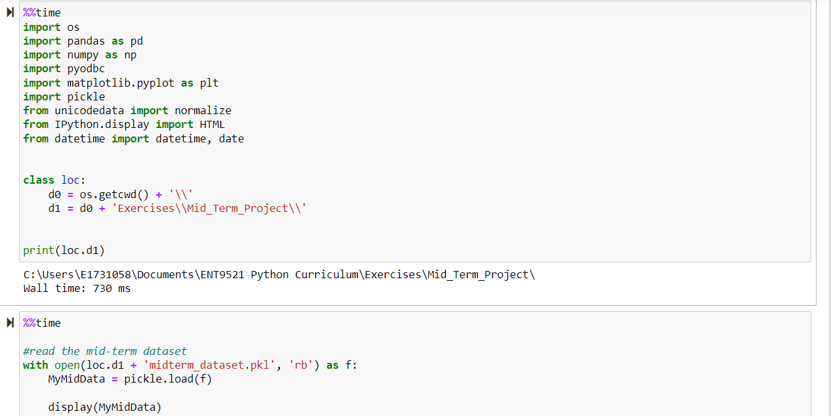
Step 1: Reading The Dataset
The Dataset was provided in pickle format
To load the file into python, I had to import the pickle library first
The following screenshot depicts the work done to load the file into Python:
Notes:
Numerator:
--VIZIENT_ENCOUNTERS has all inpatient visits
--Use CTEs to create two temp tables—index and readmit
--Join them in a final table using MRN
--Filter out same-encounter matches, backward matches, not <30 days, not meeting minimum days to readmit, not meeting minimum time to readmit
Numerator: Common Table Expressions
Method of creating a temporary table for use in a query
Join two instances of VIZIENT_ENCOUNTERS table using MRN
Use WHERE and HI Transformations to filter encounters
Denominator: Vizient Executive SL Dashboard Dataset
Master Vizient dataset for encounter-level data
Exclusion Criteria: provided by Vizient
Final data model left joins numerator to denominator

Slide 5
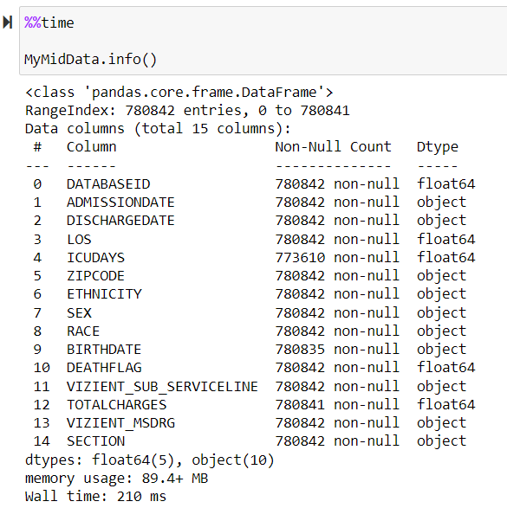



Step 2: Data type Standardization
The screenshot below shows the dataset has 780,842 records and 15 columns with number of non-null records in each column plus their data types
I had to standardize the data types for the following columns: See code at the screenshot numbers in the Jupyter Notebook:
DATABASEID to int64
ADMISSIONDATE to datetime64[ns]
DISCHARGEDATE to datetime64[ns]
BIRTHDATE to date
DEATHFLAG to int64
Notes:
One view we have now – that we have never had access to before – is to see where each readmission is going to in our system – across all of the Vizient inpatient encounters across our entire MHHS system – we can now track them and start giving teams information to help them dig into these details easily
There is functionally added to show where it’s true for facility to facility admission so you can see that gap to your campus vs across the org (animation appear on click)
so immediately for MOSH you can see a lot of readmissions cases are going to different hospitals in our same system – and for MOSH that may make sense but what could we differently to manage those patients post discharge to avoid an inpatient readmission – like could we better redirect to the physician clinic vs ER and then getting admitted as an inpatient – whereas before may have had a false feeling of security that only 37.5% of cases are readmissions when the reality is that it is a lot higher and they are going to other MHHS facilities
Same visual is now available for service lines and focused populations such as sepsis or CHF – where we know we have historically the biggest issues for our organization
Secondly – the other very existing feature is the ability to toggle between index and readmission characteristics (next slide)

Slide 6
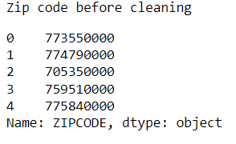
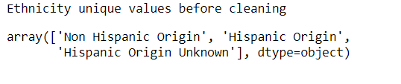

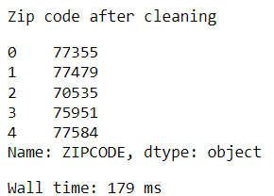
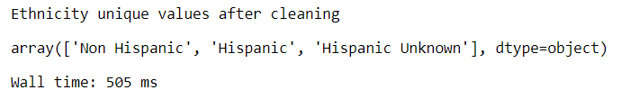
Step 3: Data Standardization Continued …
Zip Codes Before Cleaning:
Ethnicity Unique Values Before Cleaning:
Zip Codes After Cleaning: Code -
Ethnicity Unique Values After Cleaning:
Code -
Notes:
Secondly – the other very existing feature is the ability to toggle between index and readmission characteristics (next slide)
For example on the index I want to know, as patients leave a service line and go home but end up coming back and going to the ICU – that would mean a different strategy of discharge home planning and support – what impact would that have on our organization ?
Historically that means a lot of manual work and almost no flexibility – but now, can pick an index category (service line) and a readmission category (icu status) and also limit to home discharges on the index
These are all of the ways you could now toggle automatically between index and readmission characteristics
We also have added in functionally to see the top ten areas driving readmission with patient level details to support case and chart reviews (not shown here for interest of time to present today)

Slide 7
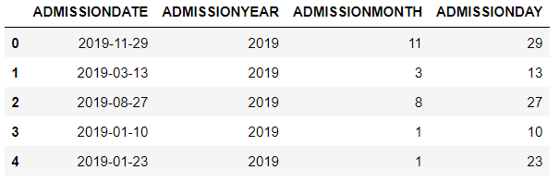
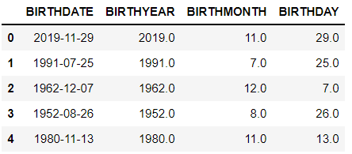

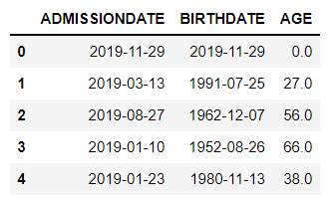

Step 4: Patients’ Age Calculation During Admission
Logic:
Calculating the patients’ age when they first admit to the hospital
I need to have the year, month and day extracted from the standardized Admission Date and Discharge Date columns first
See code here
To calculate the age, I subtracted the birth year from the admission year and then if the admission month have not passed birth month, I subtract one as their birth date is yet to come
See code here
The following screenshots show the glimpse of the results
The age calculation logic has been validated by testing fake data in an online age calculation tools
Notes:
Secondly – the other very existing feature is the ability to toggle between index and readmission characteristics (next slide)
For example on the index I want to know, as patients leave a service line and go home but end up coming back and going to the ICU – that would mean a different strategy of discharge home planning and support – what impact would that have on our organization ?
Historically that means a lot of manual work and almost no flexibility – but now, can pick an index category (service line) and a readmission category (icu status) and also limit to home discharges on the index
These are all of the ways you could now toggle automatically between index and readmission characteristics
We also have added in functionally to see the top ten areas driving readmission with patient level details to support case and chart reviews (not shown here for interest of time to present today)

Slide 8
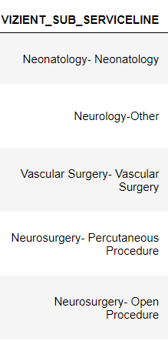
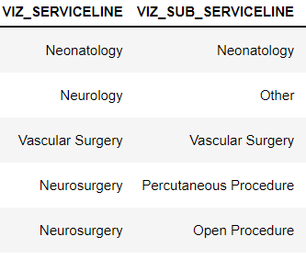
Step 5: Splitting up Columns
Vizient Sub Service Line
Before Splitting:
Vizient Sub Service Line After Splitting:
Again, this is something I thought it was important to do but it may also depend on how the end user wants to use the dataset.
See code here:
Notes:
Secondly – the other very existing feature is the ability to toggle between index and readmission characteristics (next slide)
For example on the index I want to know, as patients leave a service line and go home but end up coming back and going to the ICU – that would mean a different strategy of discharge home planning and support – what impact would that have on our organization ?
Historically that means a lot of manual work and almost no flexibility – but now, can pick an index category (service line) and a readmission category (icu status) and also limit to home discharges on the index
These are all of the ways you could now toggle automatically between index and readmission characteristics
We also have added in functionally to see the top ten areas driving readmission with patient level details to support case and chart reviews (not shown here for interest of time to present today)

Slide 9
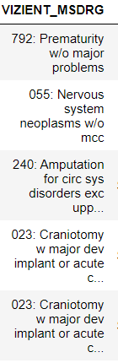
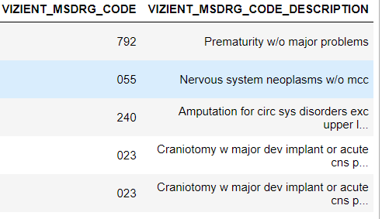
Step 5: Splitting up Columns Continued …
VIZIENT MSDRG
Before Splitting:
VIZIENT MSDRG After Splitting:
As we can see, the screenshot on the left has code and description in one cell. I do believe that having the code and description in separate columns would help for further analysis using this dataset
See code here:
Notes:
Secondly – the other very existing feature is the ability to toggle between index and readmission characteristics (next slide)
For example on the index I want to know, as patients leave a service line and go home but end up coming back and going to the ICU – that would mean a different strategy of discharge home planning and support – what impact would that have on our organization ?
Historically that means a lot of manual work and almost no flexibility – but now, can pick an index category (service line) and a readmission category (icu status) and also limit to home discharges on the index
These are all of the ways you could now toggle automatically between index and readmission characteristics
We also have added in functionally to see the top ten areas driving readmission with patient level details to support case and chart reviews (not shown here for interest of time to present today)

Slide 10

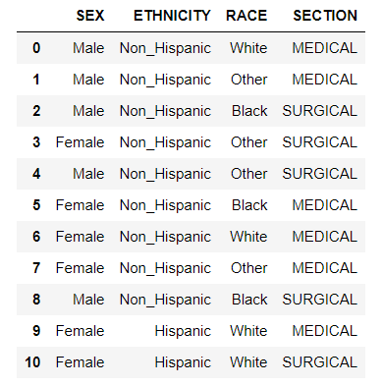
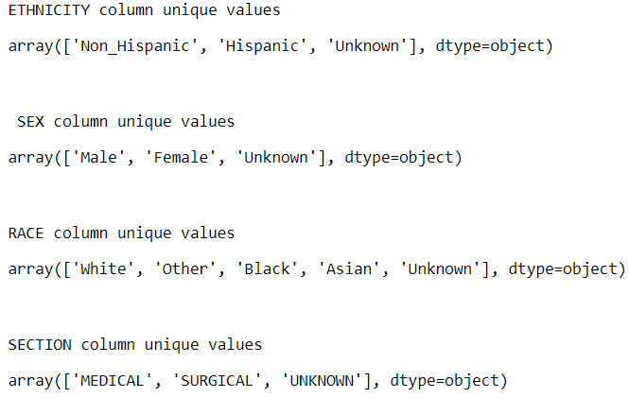
[May be Bonus? ]: Creating Dummy Variables
What is A Dummy Variable?
A dummy variable is a binary variable that indicates whether a separate categorical variable takes on a specific value
Let’s see some examples from our dataset:
The screenshot below shows the unique values we have for all the categorical variables that we see on the left. I have made few adjustments on the values for convenience purposes (e.g. Non_Hispanic instead of Non Hispanic)
Notes:
Secondly – the other very existing feature is the ability to toggle between index and readmission characteristics (next slide)
For example on the index I want to know, as patients leave a service line and go home but end up coming back and going to the ICU – that would mean a different strategy of discharge home planning and support – what impact would that have on our organization ?
Historically that means a lot of manual work and almost no flexibility – but now, can pick an index category (service line) and a readmission category (icu status) and also limit to home discharges on the index
These are all of the ways you could now toggle automatically between index and readmission characteristics
We also have added in functionally to see the top ten areas driving readmission with patient level details to support case and chart reviews (not shown here for interest of time to present today)

Slide 11
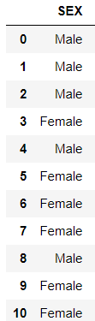
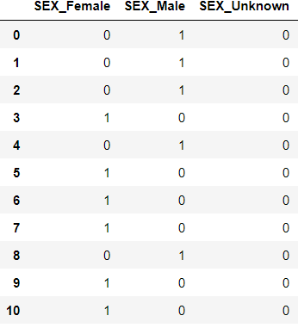

Creating Dummy Variables Continued
When we create dummy variables, what happens is that, the unique values in our categorical variables become column names prefixed by the original column names, and their values will be either 1 or 0.
Index 0 is Male, and we can see on the right that we have 1 in Male but 0 in Female as well as in Unknown.
See code Starting at
Until the end of the Notebook
Notes:
Secondly – the other very existing feature is the ability to toggle between index and readmission characteristics (next slide)
For example on the index I want to know, as patients leave a service line and go home but end up coming back and going to the ICU – that would mean a different strategy of discharge home planning and support – what impact would that have on our organization ?
Historically that means a lot of manual work and almost no flexibility – but now, can pick an index category (service line) and a readmission category (icu status) and also limit to home discharges on the index
These are all of the ways you could now toggle automatically between index and readmission characteristics
We also have added in functionally to see the top ten areas driving readmission with patient level details to support case and chart reviews (not shown here for interest of time to present today)

Slide 12
Conclusion and Recommendation
The original data needs some cleaning and standardization before jumping into statistical analysis
We can do a handful of simple and advanced statistical analysis using this dataset
Few examples of analysis we can do include but not limited to
Patient length of stay in the hospital by gender, age groups, race and ethnicity
Stratifying the patients who stayed in ICU by Service line and determine which department we would pay more attention in terms of volume
Stratifying the patients who stayed in ICU by the demographic categorical variables
Looking at the distribution for specific variables in the dataset
And much more …
Notes:
Secondly – the other very existing feature is the ability to toggle between index and readmission characteristics (next slide)
For example on the index I want to know, as patients leave a service line and go home but end up coming back and going to the ICU – that would mean a different strategy of discharge home planning and support – what impact would that have on our organization ?
Historically that means a lot of manual work and almost no flexibility – but now, can pick an index category (service line) and a readmission category (icu status) and also limit to home discharges on the index
These are all of the ways you could now toggle automatically between index and readmission characteristics
We also have added in functionally to see the top ten areas driving readmission with patient level details to support case and chart reviews (not shown here for interest of time to present today)

Slide 13
Q & A
Thank you!
Questions?

