Slide 1

Team 56: Fall Detection
Bi-Weekly Update 2 Nhan Nguyen, Justin Haryanto
Sponsor: Krishna Gadepally TA: Swarnabha Roy, Dalton W. Cyr
Notes:
30 seconds

Slide 2
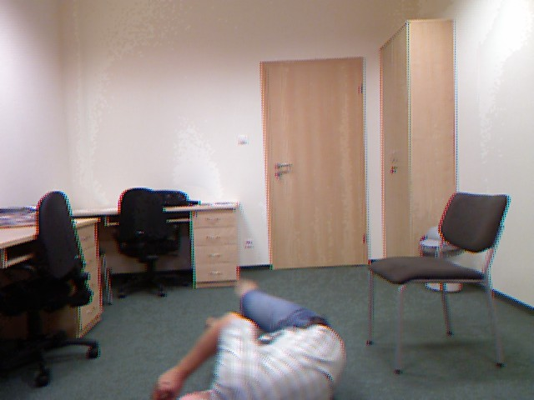
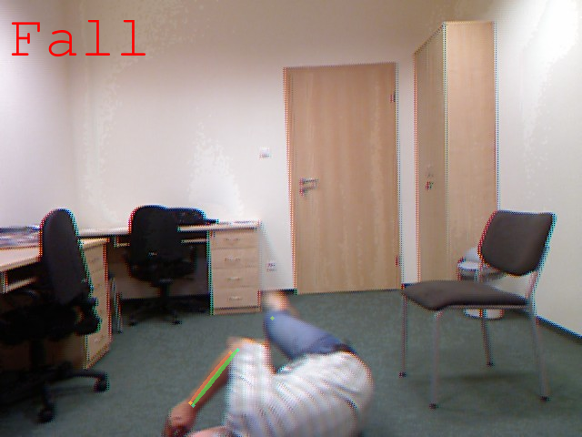
Project Summary
Problem
Design a video-based fall detection system
Solution
Convert video to a useable images
Apply bounding boxes and key points on people in images using pose estimation
Determine if a fall has occurred using Random Forests and CNN machine learning models
Notes:
30 seconds

Slide 3
Project/Subsystem Overview
Live Video
Video Processing
& Pose Estimation
Datasets
Random Forests
CNN
Justin
Nhan
UI
Notes:
45 seconds

Slide 4
Project Timeline
Not Started
In Progress
Finished
Live Video
Video Processing
& Pose Estimation
Datasets
Random Forests
CNN
UI
Notes:
30 seconds

Slide 5
Fall Detection
Nhan Nguyen
Accomplishments since 403 20 hrs of effort | Ongoing progress/problems and plans until the next presentation
Coded a program for modifying data sets for training and testing models | Continue to train random forest and CNN model further. Having issues with using Alphapose in google colab Plan to modify Alphapose code for integration with pre-trained Fall Detection system

Slide 6
Fall Detection
Nhan Nguyen
Studied fall detection models accuracies when trained and tested with more data sets.
Models are being improved before integration.
Combined Data | RF Accuracy | CNN Accuracy
Datasets: 1 | 100% | 84%
Datasets: 1-2 | 100% | 72%
Datasets: 1-3 | 99% | 36%
Datasets: 1-4 | 97% | 44%

Slide 7
Externals
Justin Haryanto
Accomplishments since 403 20 hrs of effort | Ongoing progress/problems and plans until the next presentation
Found potential UI options to integrate with Google Colab Learned how to make a UI using Anvil Collected fall detection datasets for use in training | Collect more datasets from one more source By next review, all collected datasets processed and ready for use in training

Slide 8
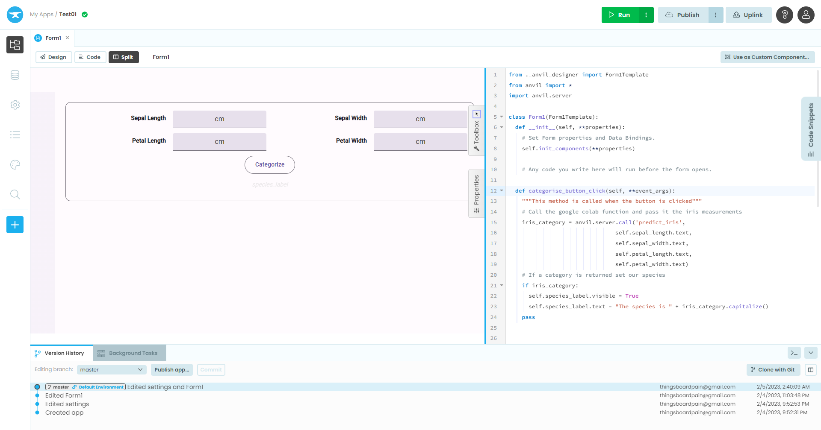
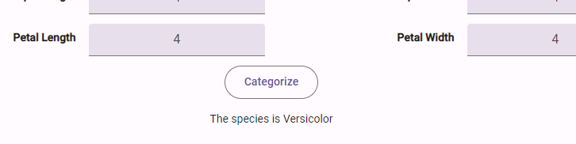
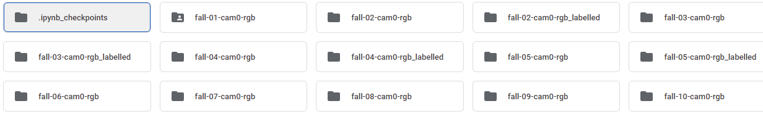
Externals
Justin Haryanto

Slide 9
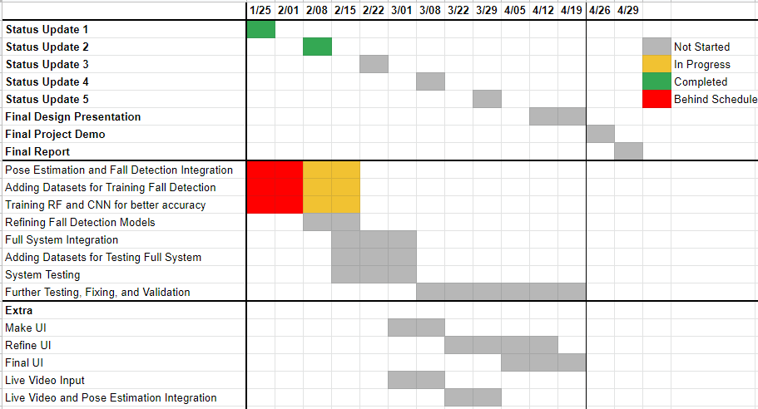
Execution Plan

Slide 10
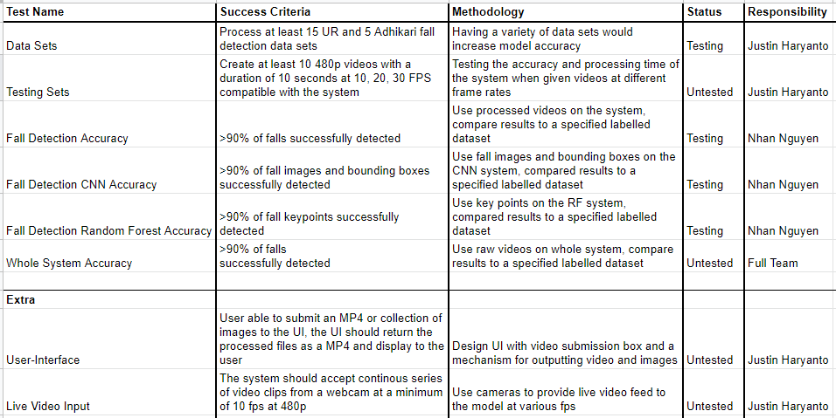
Validation Plan

Slide 11
Thank You
Notes:
30 seconds

