Slide 1

Team 56: Fall Detection
Bi-Weekly Update 3 Nhan Nguyen, Justin Haryanto
Sponsor: Krishna Gadepally TA: Swarnabha Roy, Dalton W. Cyr
Notes:
30 seconds

Slide 2
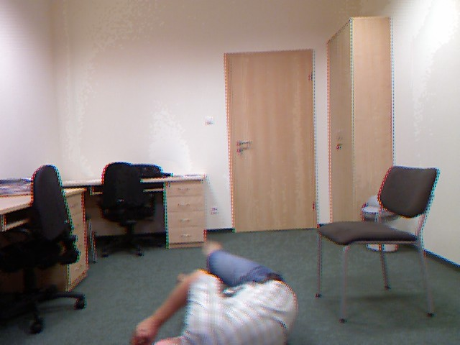
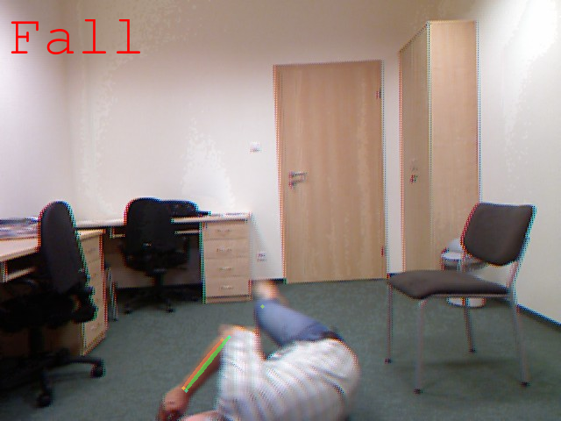
Project Summary
Problem
Design a video-based fall detection system
Solution
Convert video to a useable images
Apply bounding boxes and key points on people in images using pose estimation
Determine if a fall has occurred using Random Forests and CNN machine learning models
Notes:
30 seconds

Slide 3
Project/Subsystem Overview
Live Video
Video Processing
& Pose Estimation
Datasets
Random Forests
CNN
Justin
Nhan
UI
Notes:
45 seconds

Slide 4
Project Timeline
Not Started
In Progress
Finished
Video Input
Video Processing
& Pose Estimation
Datasets
Random Forests
CNN
UI
Notes:
30 seconds

Slide 5
Fall Detection
Nhan Nguyen
Accomplishments since last update 28 hrs of effort | Ongoing progress/problems and plans until the next presentation
Coded a program for modifying new data sets for training and testing models Basic integration of the Fall Detection System with Pose Estimation System Figured out a better training/testing plan for the models: N Folds Cross Validation | ML Models needs further refinement On-going training on the old and new data sets

Slide 6
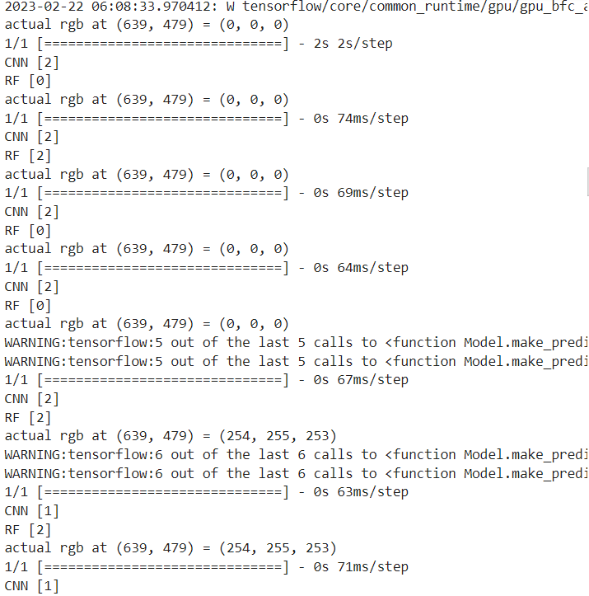
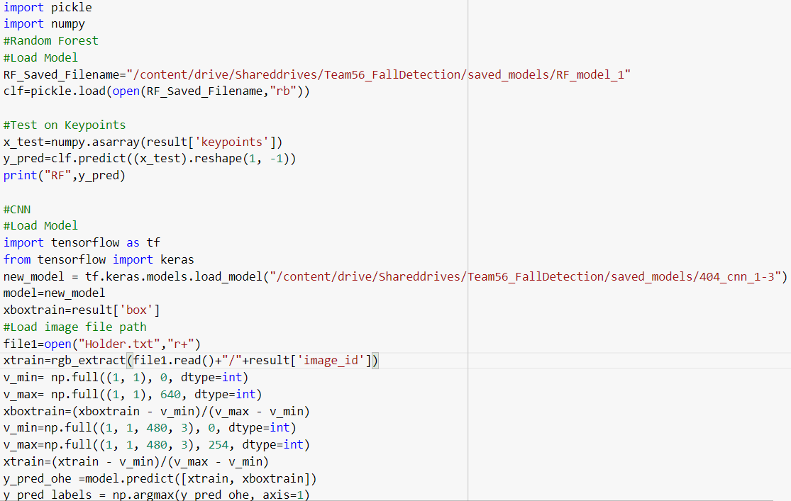
Fall Detection
Nhan Nguyen
Basic ML models is being integrated with Alphapose

Slide 7
Externals
Justin Haryanto
Accomplishments since last update 17 hrs of effort | Ongoing progress/problems and plans until the next presentation
Got a total of 30 UR Fall datasets and 10 Adhikari Fall datasets Phone can now be used as a webcam instead of the one built into the laptop | Create video testing sets Start working on UI to allow the user to submit images and videos

Slide 8
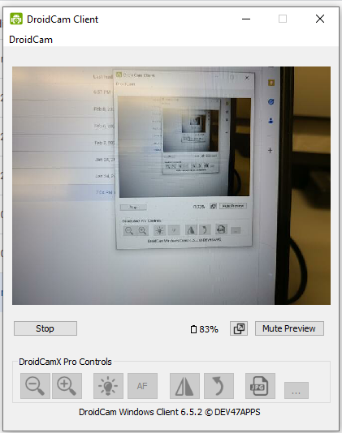
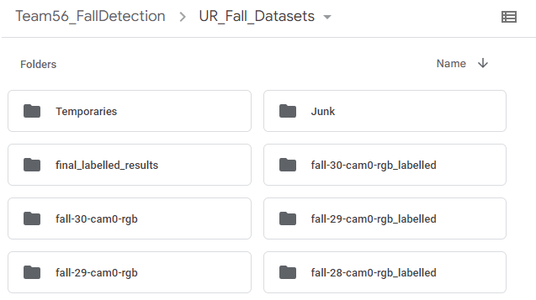
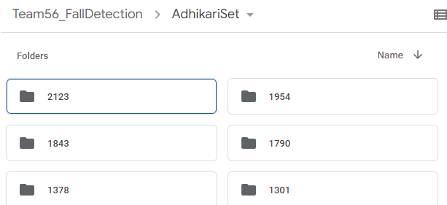
Externals
Justin Haryanto

Slide 9
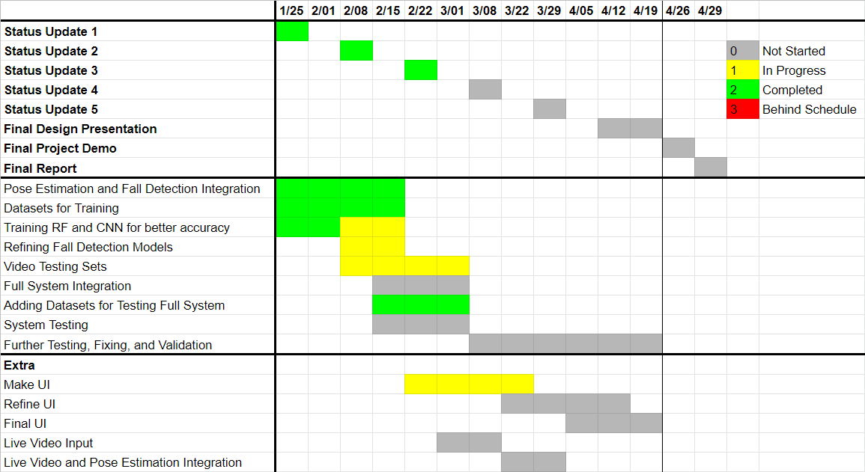
Execution Plan

Slide 10
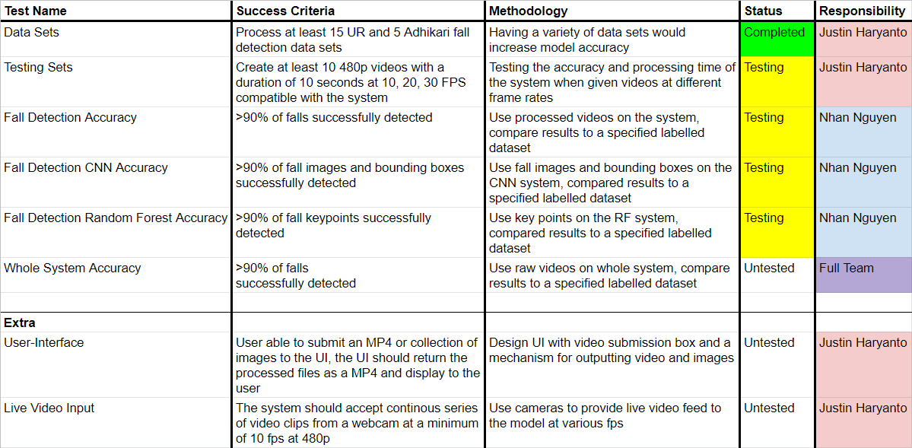
Validation Plan

Slide 11
Thank You
Notes:
30 seconds

