Slide 1

Team 56: Fall Detection
Bi-Weekly Update 4 Nhan Nguyen, Justin Haryanto
Sponsor: Krishna Gadepally TA: Swarnabha Roy, Dalton W. Cyr
Notes:
Michelle

Slide 2
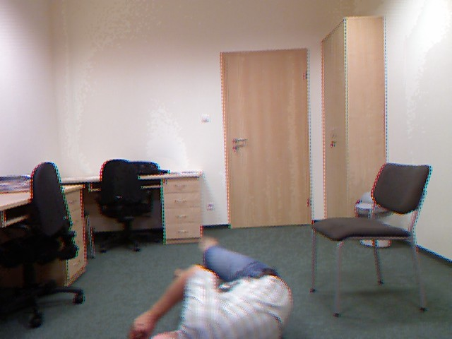
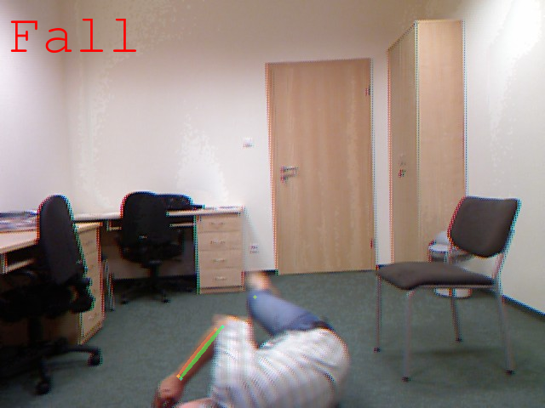
Project Summary
Problem
Design a video-based fall detection system
Solution
Convert video to a useable images
Apply bounding boxes and key points on people in images using pose estimation
Determine if a fall has occurred using Random Forests and CNN machine learning models
Notes:
30 seconds

Slide 3

Integrated System Diagram
Website UI
Upload File
Post Result
Google Colab
User
Send File
Pose Estimation
Upload Result
Send Processed Data
Fall Detection

Slide 4
Project Timeline
Not Started
In Progress
Finished
Live Video
Video Processing
& Pose Estimation
Datasets
Random Forests
CNN
UI
Notes:
30 seconds

Slide 5
Fall Detection
Nhan Nguyen
Accomplishments since last update 21 hrs of effort | Ongoing progress/problems and plans until the next presentation
Trained and tested random forest Model with a 80/20 train-test split with all of the UR Fall datasets and some of the new Adhikari Fall Datasets Assisted in setting up the foundation for the UI with Justin | Faced issues with training CNN due to running out of RAM ONGOING testing of the integrated Fall Detection ML models and Pose Estimation System ONGOING model refining Plan to integrate Fall Detection and Pose Estimation System with UI

Slide 6
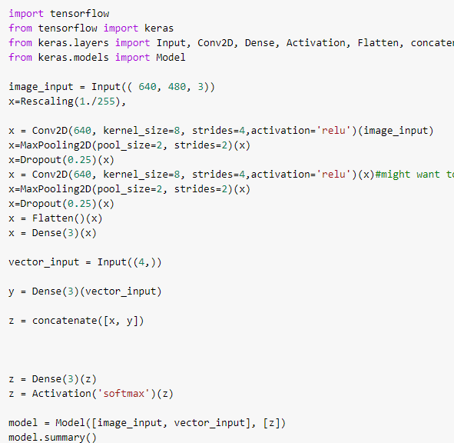
Fall Detection
Nhan Nguyen
Dataset | RF Accuracy
All UR Fall Datasets | 0.84%
Five Valid Adhikari Fall Datasets | 0.66%
Combined Datasets | 0.64%

Slide 7
UI Integration
Justin Haryanto
Accomplishments since last update 21 hrs of effort | Ongoing progress/problems and plans until the next presentation
Organized a time with the Judo instructor to use their facility Developed a list of falls to record and tested some at home Prototyped basic website | Host a website UI locally (for now) that facilitates file upload Connecting the website to Google Drive (for now) Plan to integrate UI with fall detection system Recording test falls

Slide 8
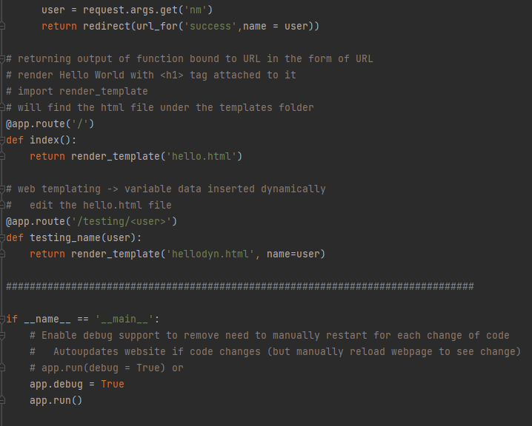
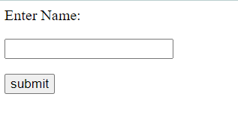
UI Integration
Justin Haryanto

Slide 9
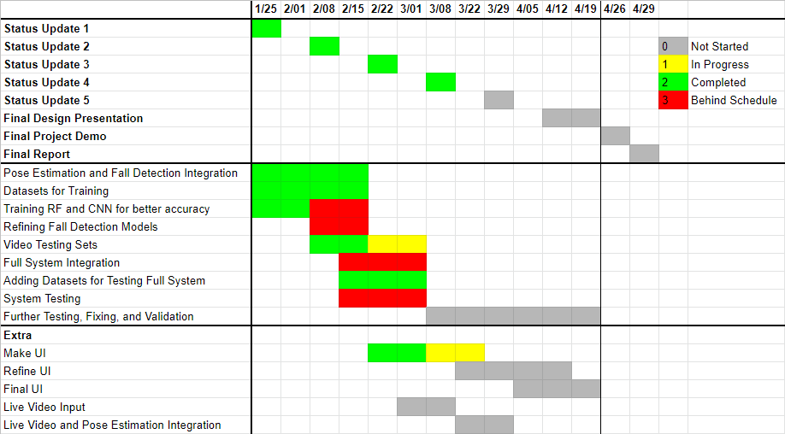
Execution Plan

Slide 10
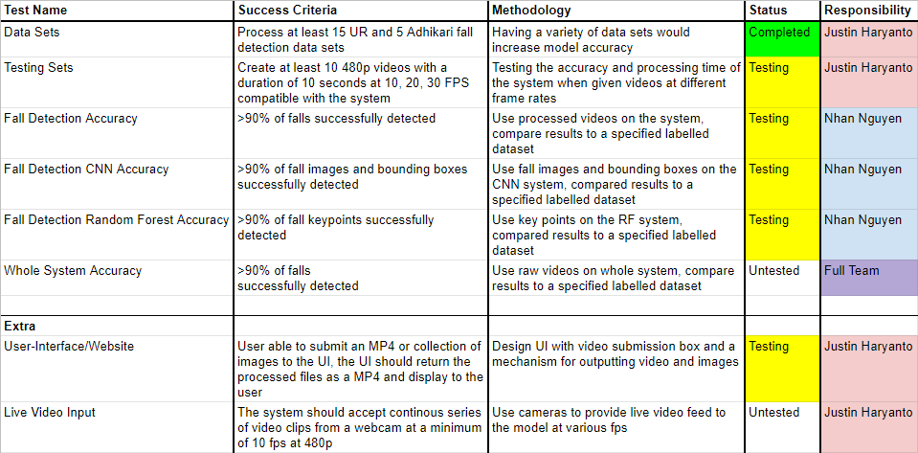
Validation Plan

Slide 11

Thank You
Notes:
30 seconds

