Slide 1
Event Sourcing
Storing State Through Change

Slide 2
Table of contents
01
02
03
04
05
06
Introduction
How It Works
Benefits
Store state changes as a sequence of events
Rebuild state by replaying immutable events
Auditability, scalability, flexibility, and system integration
Challenges
CQRS
Applications
Complexity, eventual consistency, and event versioning
Separate command and query for performance
Used in finance, e-commerce, and tracking

Slide 3
01
Introduction
Store state changes as a sequence of events

Slide 4
Event sourcing is a software architectural pattern in which the state of an application is determined by a sequence of events. Each event represents a change in the system's state, and the current state can be reconstructed by replaying these events in order. This approach differs from the traditional method, where only the current state is stored, often in a relational database.

Slide 5
Overview
Sequential Event Logging
These events are stored sequentially, forming a log or journal of actions that have occurred
State Reconstruction via Replay
The status of the program can be restored at any moment by replaying these events
Ideal for Data-Critical Domains
It is frequently utilized in fields like finance and e-commerce where precise historical data are essential

Slide 6
01
How It Works
Rebuild state by replaying immutable events

Slide 7
Core Concepts and Components
Events: These are permanent records of system state changes. In addition to representing a particular action or occurrence, each event includes all the relevant information required to rebuild the system's state at the moment of the event.
Event Store: The stream of events produced by the system is sustained by the event store, a robust data store. It guarantees that the sequence of events is maintained by storing them in the order in which they were received.
Aggregate: For the purposes of processing commands and producing events, an aggregate is a logical collection of linked domain objects that are handled as a single unit. The system's state changes and business logic are contained in aggregates. In the event store, each aggregate is linked to a distinct stream of events.

Slide 8
Core Concepts and Components
Command: Clients or other system components can issue commands, which are requests or instructions to carry out particular tasks. Aggregates process commands by validating them, applying business logic, and, if the command is approved, generating the appropriate events.
Projection: Projections are read models created from the stream of events kept in the event store that shows the system's current state. Projections are used to give effective access to data for reporting and querying.
Event Bus: An event bus is a messaging infrastructure that makes it easier for various system components to communicate about events. It enables components to respond asynchronously to particular event types and subscribe to them.

Slide 9
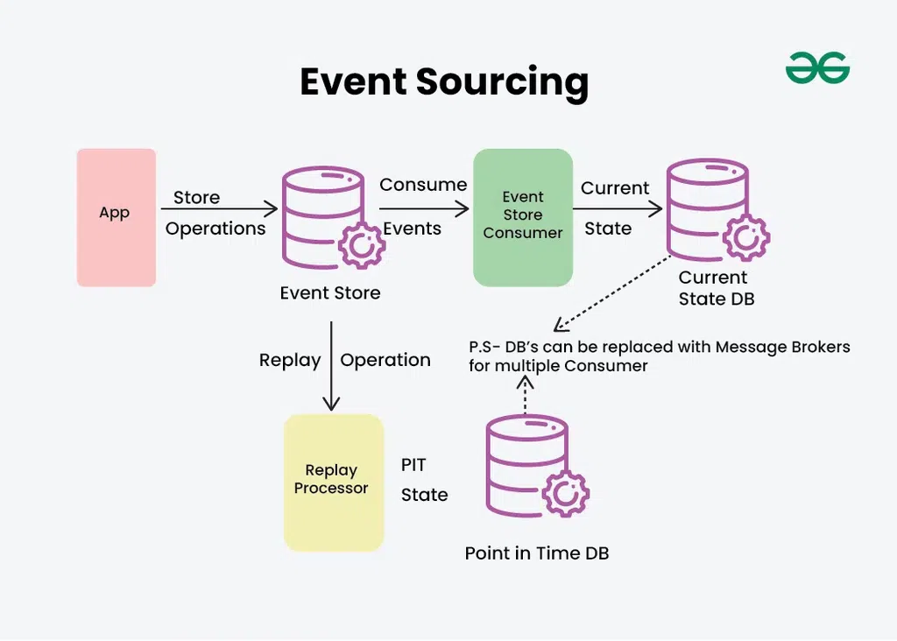

Slide 10
Work Flow
The user interface sends a command to the command handler
Command Issued
The command handler retrieves historical events from the event store and reconstructs the current state
State Rebuilt from Events
Step
Business logic is executed, generating new events
Business Logic Executed
New events are appended to the event store and dispatched to event handlers to update read models or integrate with other systems
Events Stored and Dispatched

Slide 11
Software Requirements for Implementing
Append-Only Event Store
Separation of W/R
Infrastructure for Replay, Snapshot, Async Processing
Stores immutable events in chronological order
Write to the event store, read from event-driven, updated read models
Enables fast state reconstruction, efficient event handling, and scalability

Slide 12
01
Benefits
Auditability, scalability, flexibility, and system integration

Slide 13
Benefits
Audit Trail: Provides a complete log of all changes, useful for auditing, debugging, and compliance
Projection: Append-only operations help avoid resource locking, improving performance in write-heavy systems
Flexibility: Enables creation of various read models from the same set of events, optimized for specific queries
Integration: Events can be dispatched to other systems, supporting event-driven architecture and reducing component coupling
State Rehydration: The state can be reconstructed at any point in time by replaying events, useful for historical analysis or recovery

Slide 14
01
Challenges
Complexity, eventual consistency, and event versioning

Slide 15
Challenges
Complexity: Requires a different mindset and more complex infrastructure than traditional CRUD methods
Eventual Consistency: Read models are updated asynchronously, leading to delays before the latest state is reflected
Versioning: Requires strategies for handling changes in event structure as the system evolves
Querying: Querying the event store directly can be inefficient, often requiring the use of CQRS to maintain separate read models
Storage: Storing all events can lead to large data volumes, though snapshots can help mitigate this

Slide 16
01
CQRS
Separate command and query for performance

Slide 17
CQRS (Command Query Responsibility Segregation) is a design pattern that separates the write operations (commands that change state) from the read operations (queries that retrieve data). This separation aligns naturally with event sourcing, where the write side focuses on producing and storing events, and the read side builds optimized views from those events.

Slide 18
Combined
Write Side (Command Side)
Read Side (Query Side)
Accepts commands
Applies business rules and logic to handle these commands
Emits events
Appends events to the event store
Subscribes to the event stream
Builds and updates read models (denormalized, optimized data for querying)
Can have multiple models tailored to specific query needs (e.g., dashboard, list view)

Slide 19
Benefits
Scalable Reads and Writes: Each side scales independently.
Optimized Data Access: Read models are designed for specific query patterns.
Improved Maintainability: Clear separation of concerns.
Easier Auditing and Debugging: All state changes are event-driven and traceable.

Slide 20
01
Applications
Used in finance, e-commerce, and tracking

Slide 21
Event Sourcing finds applications in diverse domains and use cases where tracking and analyzing historical data is crucial

Slide 22
Use case
Account Operations: The system creates related events whenever a consumer does an action that impacts their account, like making a deposit, taking money out of their account, moving money to another account, or changing personal data.
Event Logging: elevant details including the kind of operation, the amount involved, timestamps, and any additional metadata required to recreate the account's status are contained in each event.
Event Processing: These events are consumed by event handlers or processors, who then alter the status of the impacted accounts appropriately. For instance, the account balance is increased if a "Deposit" event is noted. The balance is reduced if a "Withdrawal" event is recorded.
Scalability and Resilience: Event Sourcing distributes event processing over several nodes, enabling the bank's system to scale horizontally. The system can recover by replaying events from the event storage to restore the status of accounts in the event of malfunctions or outages.

Slide 23
Real-World Application
Financial Systems: To keep an unchangeable record of transactions, account activity, and compliance events, banking and financial institutions use event sourcing
Healthcare Records: Electronic health record (EHR) systems use event sourcing to document patient contacts, treatment histories, and medical procedures
Supply Chain Management: Event sourcing is used in supply chain and logistics management to track inventory movements, shipping updates, and supply chain interruptions
E-commerce Platforms: Event sourcing is a useful tool for e-commerce applications to record customer interactions, order fulfillment processes, and inventory changes. This makes it feasible to track orders, offer customized recommendations, and examine customer behavior in order to boost sales and customer satisfaction.
Gaming and Virtual Environments: Event Sourcing is used in virtual worlds and multiplayer online games to record player movements, game state changes, and in-game purchases.

Slide 24
When to Use Event Sourcing Pattern
It's good for apps with complicated rules that need to keep track of how things change over time.
It helps when you need a complete history of changes for legal reasons or audits.
Useful for systems that need to save old data, like financial information.
Helps your app bounce back quickly from problems by replaying past events.
Works well in systems with separate parts (like microservices) that need to communicate without being tightly linked.

Slide 25
When not to Use Event Sourcing Pattern
Simple Applications: If an application just needs to track the most recent state and doesn't require a thorough history or audit trail, Event Sourcing may introduce needless complexity.
High Storage Costs: Event Sourcing stores every change as an event, which can lead to high storage costs, especially if there are frequent updates or changes.
Complex Data Consistency Needs: Managing consistency across multiple events can become challenging, especially when coordinating data between different services or systems.
Performance Sensitivity: Replaying events to rebuild the state can slow down performance in applications where quick data retrieval is essential.

Slide 26
Implementation Considerations
Snapshotting: To reduce the time required for state reconstruction, snapshots can be used to store the state at a specific point in time.
Event Ordering: Ensure events are processed in the correct order, especially in distributed systems, using timestamps or sequence numbers.
Immutability: Events must be designed to be immutable, meaning repeated application should not alter the state beyond the first application.
Large Data Management: Strategies are needed to manage large volumes of event data, such as archiving or compression.

Slide 27
Resources
Event Sourcing - Martin Fowler
Event Sourcing Pattern - Microsoft Learn
Pattern: Event Sourcing - Microservices.io
Microservices with CQRS and Event Sourcing - Viblo.asia

