Slide 1

The Battle of Neighborhoods IBM Data Science Capstone Project
Phan Nhat Hoang Nguyen

Slide 2
Motivation
Suppose a person considers to leave Toronto and reallocate to New York because of her change in job location.
Now, she has been used to Toronto lifestyle for a longtime. She may like to go to Mexican restaurants for breakfast, maybe she loves to visit some kinds of park in the weekends.
Now, he would more like to choose a neighborhood in Manhattan which has all the amenities he was used to in a close proximity.

Slide 3
Objective
Applying k-mean clustering algorithm to cluster the neighborhood based on their similarities in different amenities and venues.
For defining success we will try to figure out the optimal cluster size by doing some exploratory data analysis on different clusters and trying to observe their similarities.

Slide 4
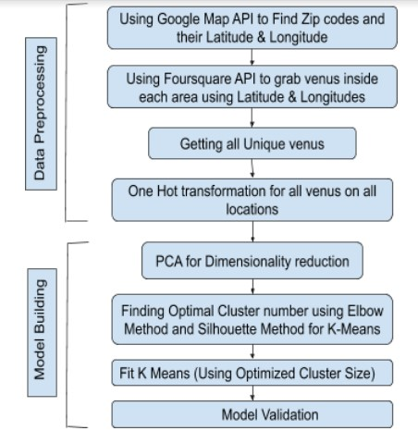
Workflow
Neighborhood segmentation workflow chart

Slide 5
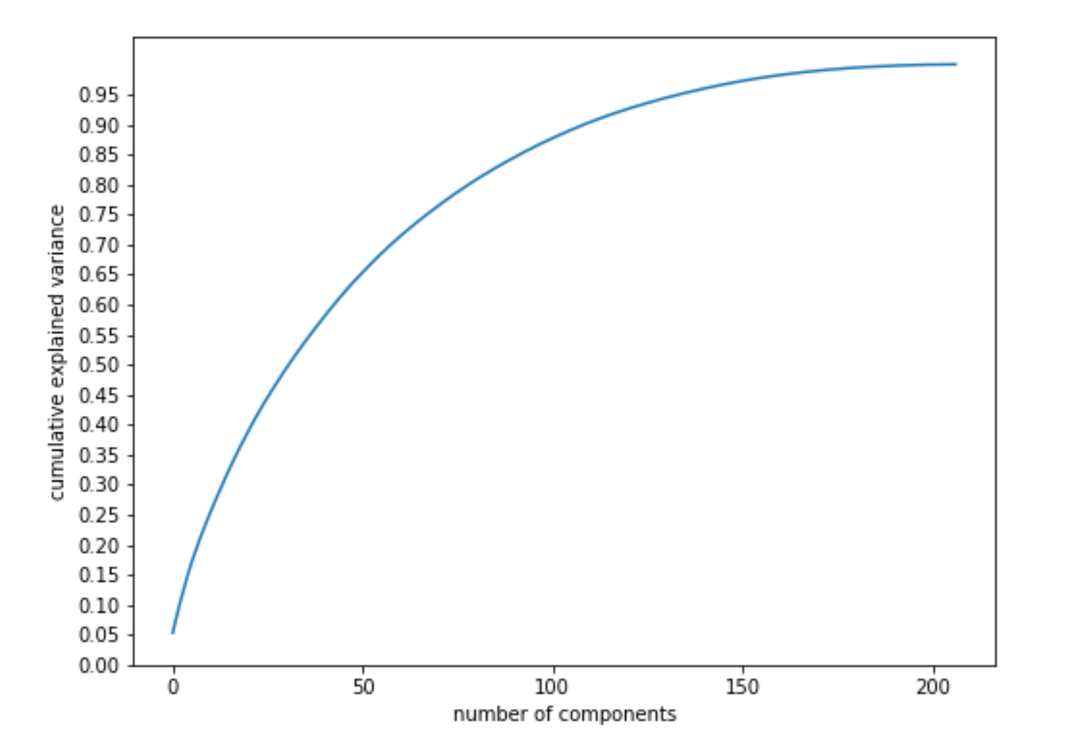
Selecting Principal Components
Use Principal Component Analysis (PCA) as a dimensionality reduction tool to reduce a large set of features to a smaller set that still contain most of information.

Slide 6
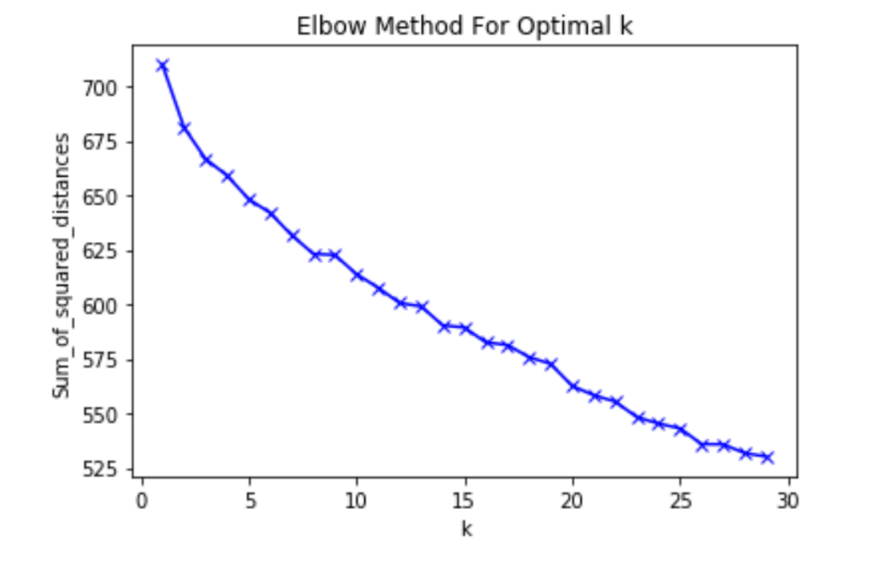
Elbow Method
Choosing a small value of K that still have a low SSE, and the elbow usually represents where we start to have diminished return by increasing K.

Slide 7
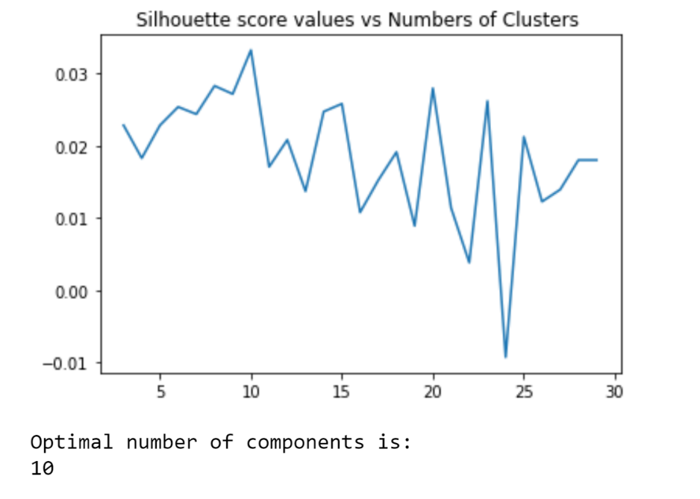
Silhouette Method
Measure how close each point in a cluster is to the points in its neighboring clusters. It is a neat way to find out the optimum value for K during K-Means clustering.

Slide 8
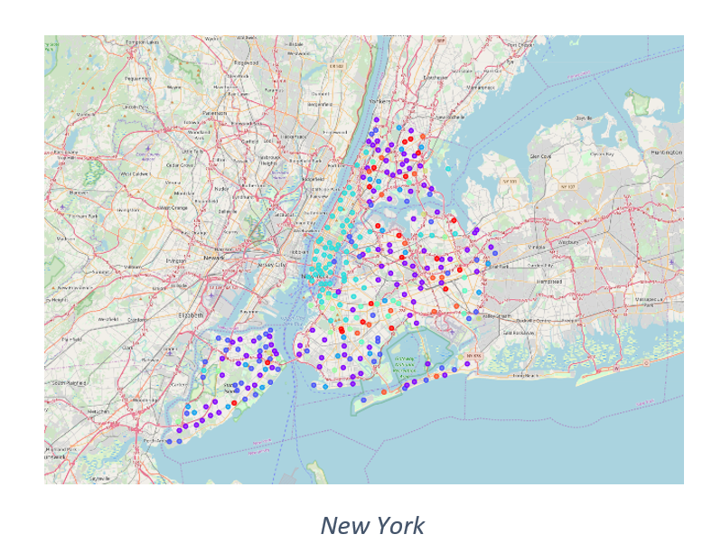
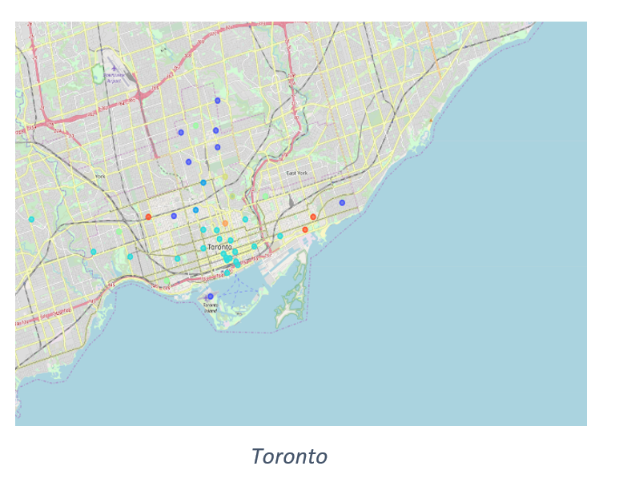
Clusters Visualization
Create folium maps to obtain a visual perception of how the clusters look on the map when plotted on the map of the two cities, New York and Toronto.
The neighborhoods with the same color would belong to the same cluster, that means these neighborhoods share the similarities.

Slide 9
Conclusion
The project work was only done on the zip codes of New York and Toronto, which includes 339 zip codes each having 150 features even after dimensionality reduction with PCA. The problem is that we have a huge feature space but limited number of samples. We can collect data from entire United States and Canada, which will make our dataset well balanced.
From figures, we can spot certain outlier in our data. In future we will try to filter out those outliers for more robust clustering.

Slide 10
Discussion
Since this was an unsupervised clustering work, we have many different approaches can be adopted in order to achieve better results. This project was only done a small dataset, having more samples may results in a better clustering.
Through this project, we can cluster the similar neighborhoods in many different cities around the world, which means helping people make a good decision when they consider moving to another cities.

Slide 11

Thank you

