Slide 1
Coupling WRF/FLUENT to simulate the complex terrain
2013-01-03

Slide 2
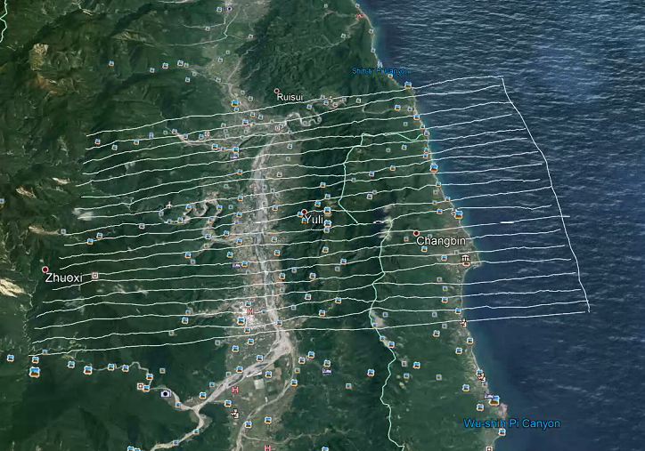
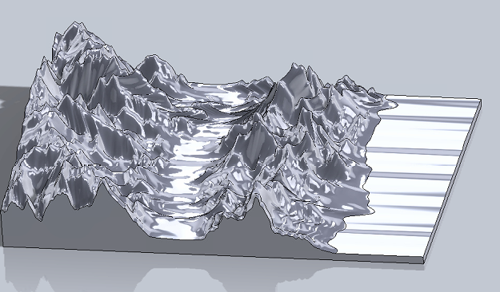
1. Yuli township
Google map
Solidwork
26 km
130 m
36 km
180 m

Slide 3
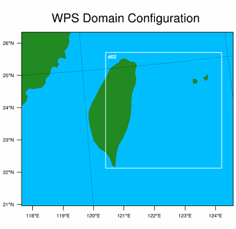
1. Yuli township
WRF
Input: 2016-01-01_00:00:00
dx:dy = 3000:3000 (horizontal resolution)
Interpolation WRF result along high level (z direction):
1. 40-1000 m (22 points) <=> (4-100m) in FLUENT
2. 40-1500 m (25 points) <=> (4-150m) in FLUENT
400 km
Wind-direction : South_East
400 km

Slide 4
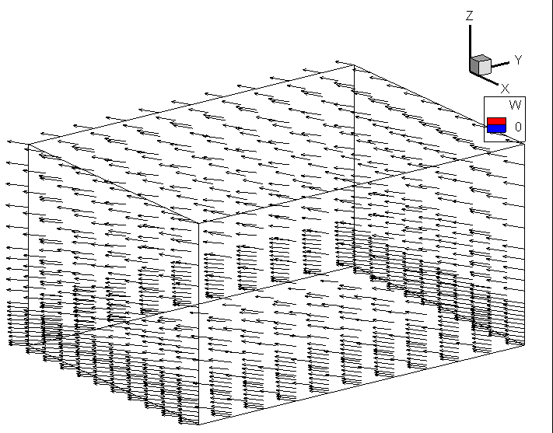
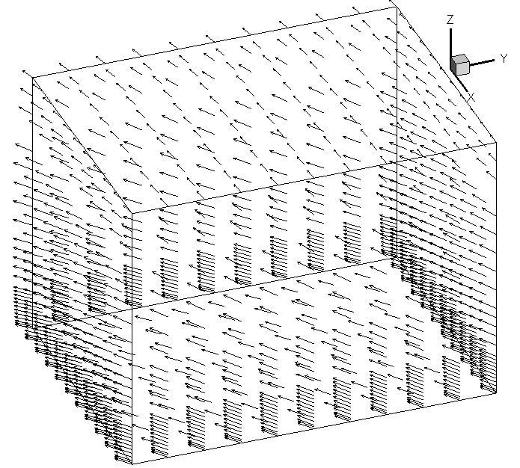
1. Yuli township
WRF result_ high level is 100m
Wind direction : South-East
WRF result_ high level is 150m
Wind direction : South-East
Z=150m
Z=100m
x=130 m
y=180 m
x=130 m
y=180 m

Slide 5
Location of Yuli township in the Google map
CFD domain
26 km
Yuli town ship (longitude,latitude)=(121.377034 , 23.389822)
Find location of Yuli town ship (longitude,latitude) in WRF data
X
36 km

Slide 6
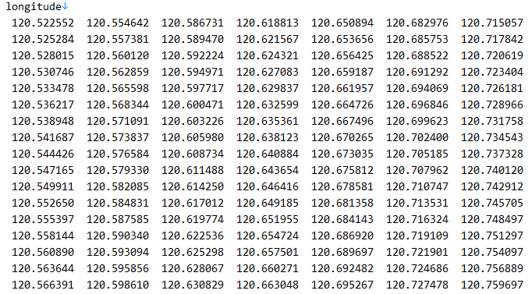
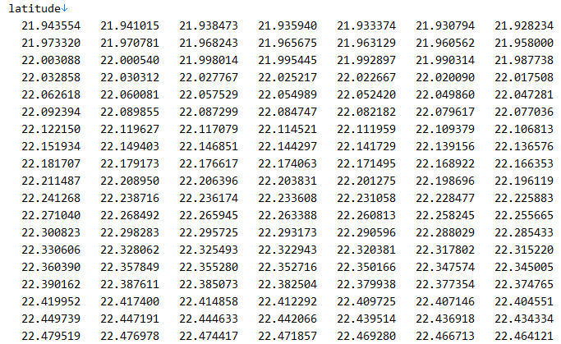
Location of Yuli township in the WRF
WRF includes: longtitude, latitude files. We seek location of Yuli in here
From WRF

Slide 7
Location of Yuli township in the WRF
In WRF data (Longtitude,latitude)=(u,v,w)
WRF domain
WRF domain
(Log,lat)
(Log,lat)
(Log,lat)
(u,v,w)
(u,v,w)
.
.
.
.
.
.
.
.
.
(u,v,w)
.
.
.
.
.
.
.
.
.
.
.
.
.
.
.
.
.
.
.
.
.
.
.
.
.
.
.
.
.
.
.
.
.
.
.
.
.
.
.
.
.
.
.
.
.
.
.
.
.
.
.
.
.
.
.
.
.
.
.
.
.
.
.
.
.
.
.
.
.
.
.
.
.
.
.
.
.
.
.
.
.
CFD domain is contained Yuli (x) inside
CFD domain
x
x
X
(Log,lat)
(Log,lat)
(Log,lat)
(u,v,w)
(u,v,w)
(u,v,w)
This one is expressed in next slide

Slide 8
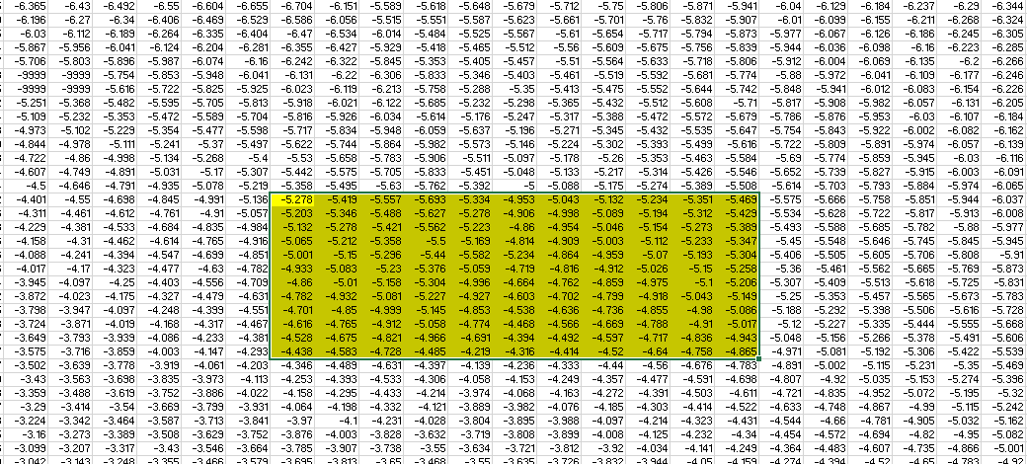
Location of Yuli township in the CFD
Choice velocity in yellow region for CFD to run
Whole WRF data domain
11 points
CFD data domain
11 points

Slide 9
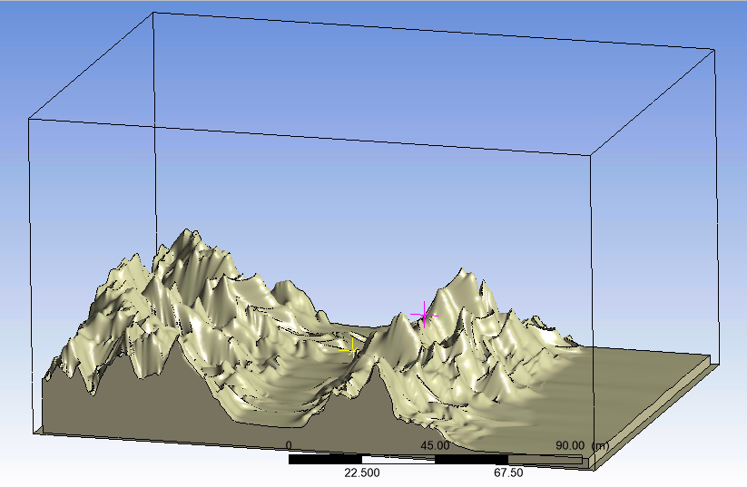
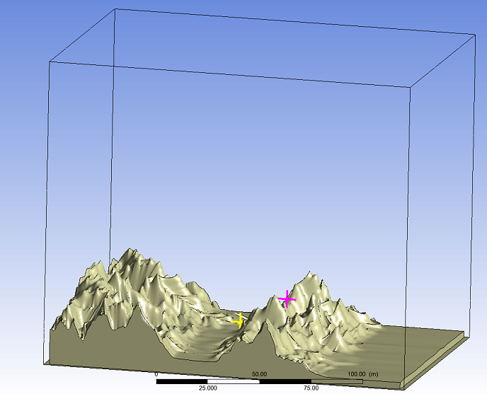
1. Yuli township
Yellow point (50,75,10)
Pink point (50,98,23)
Z_100m
Z_150m
150 m
100 m
130 m
180 m

Slide 10
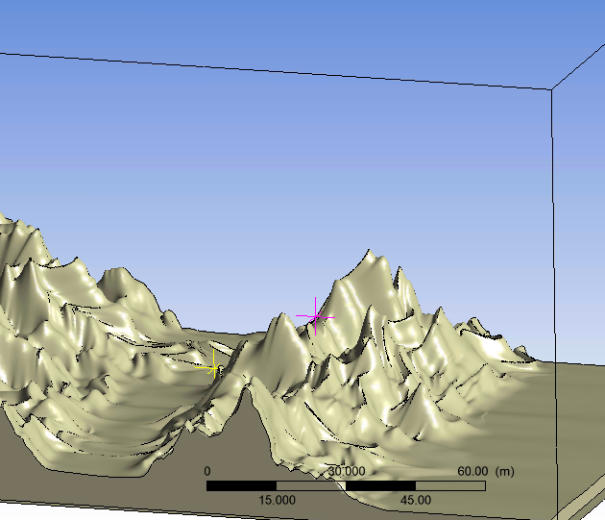
1. Yuli township
P1
P2
B.C : pressure outlet_west, velocity inlet_east, the rest_wall

Slide 11
1. Yuli township
P1
P2
B.C : 1. velocity inlet at south, east, west, north
Top_symmetry

Slide 12
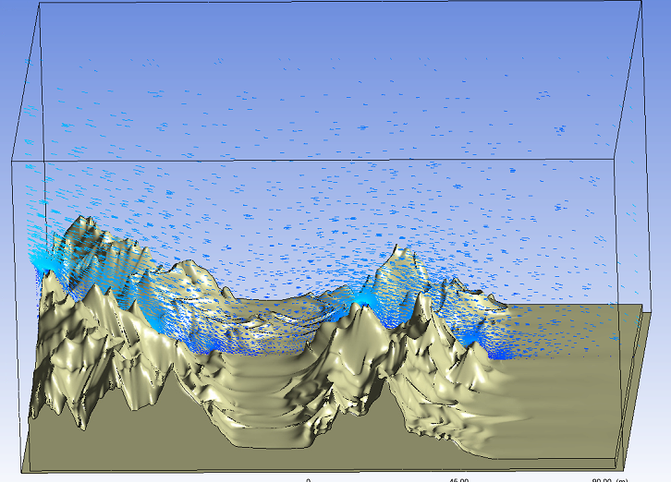
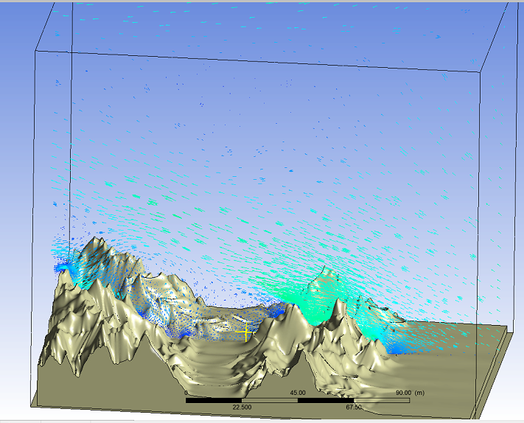
1. Yuli township
Z=100_pressure oulet
Z=150_pressure oulet

