Slide 1
Bioinformatics internship
Session twenty three

Slide 2
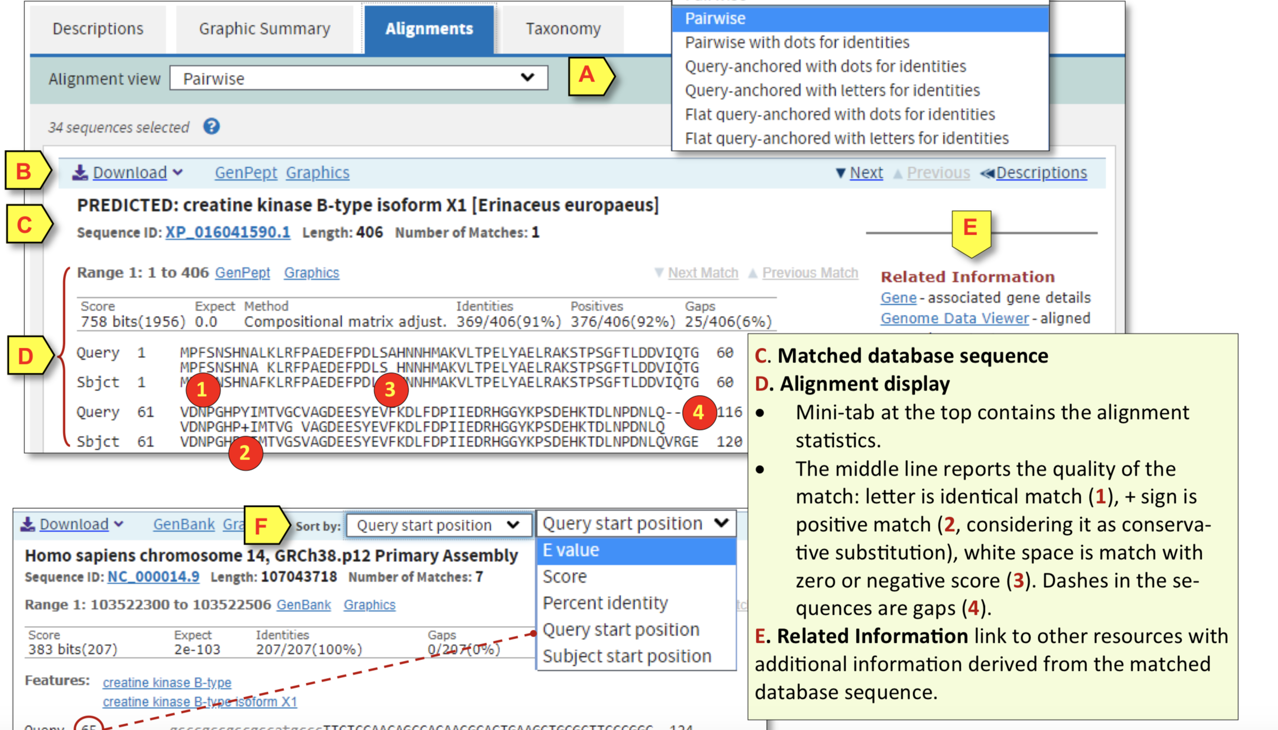
Recap
BLAST
Data give and output
What is important

Slide 3
Motif finding – its back!
Lets chat about our project goals

Slide 4
Let's understand code
Having shared my code:
please unscramble the comments so that they make sense
Remove comments that don’t belong
Run code and find the single line feed (the bug in the code)
Remove/ solve

