Slide 1


POKER GAME SIMULATOR WITH EXPECTIMINIMAX ALGORITHM
A Presentation by Group 7
Nadira Halim Himla 2221920642
Sajiah Islam Chowdhury 2212447642
S. Anam Ridwan Shanto 2022563042
Mohammad Robiul Islam Hasib 1911677642
Isnat Hossain Rijon 2211203042
CSE440 | SECTION 1

Slide 2

Why Poker Breaks Classical Search
Imperfect Information
Minimax Falls Short
Assumes no
randomness in
future states.
Opponent hole
cards are private
Randomness
Community cards
are dealt randomly.
Group 07 | Section 01 — Nadira Halim Himla • Sajiah Islam Chowdhury • S. Anam Ridwan Shanto • Mohammad Robiul Islam Hasib • Isnat Hossain Rijon

Slide 3
How the system is built
User
Tkinter GUI
Expectiminimax
AI
AI Decision
Updated
Game State
Game Engine
Hand Evaluator
Group 07 | Section 01 — Nadira Halim Himla • Sajiah Islam Chowdhury • S. Anam Ridwan Shanto • Mohammad Robiul Islam Hasib • Isnat Hossain Rijon

Slide 4
How the AI Makes Decisions
Using the Expectiminimax Algorithm
MAX
Node Types
MAX - AI's turn
MIN
fold = -π
MIN - Opponent's turn
CHANCE - Random card dealt
CHANCE
CHANCE
LEAF — Final Score
LEAF
LEAF
LEAF
LEAF
P(oᵢ) = 1/k at each CHANCE branch
Group 07 | Section 01 — Nadira Halim Himla • Sajiah Islam Chowdhury • S. Anam Ridwan Shanto • Mohammad Robiul Islam Hasib • Isnat Hossain Rijon

Slide 5
What We Built On Top of the Core Engine
AI Features
Adaptive Opponent Modeling
Live Decision Log
Monte Carlo Chance Sampling
Application Features
Difficulty Levels (Easy/Hard/Medium)
Hand History Export
Win-Rate & Statistics
Tkinter GUI
Group 07 | Section 01 — Nadira Halim Himla • Sajiah Islam Chowdhury • S. Anam Ridwan Shanto • Mohammad Robiul Islam Hasib • Isnat Hossain Rijon

Slide 6

Putting It to the Test
200 hands per matchup, seats alternated
The Result
99.5% vs Random
50.5% vs Rule-based
54.0% vs Always-call
Group 07 | Section 01 — Nadira Halim Himla • Sajiah Islam Chowdhury • S. Anam Ridwan Shanto • Mohammad Robiul Islam Hasib • Isnat Hossain Rijon

Slide 7
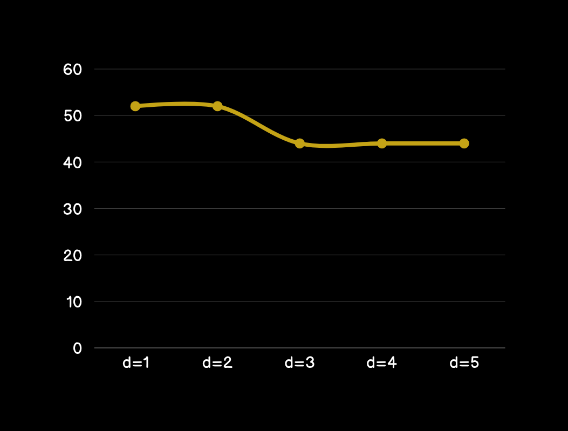
Depth Doesn’t Help
Reason
Folding is mathematically ruled out : the AI can't ever choose it
Deeper search just reorders two options, not real improvement
Time cost jumps 64x for no real gain
Group 07 | Section 01 — Nadira Halim Himla • Sajiah Islam Chowdhury • S. Anam Ridwan Shanto • Mohammad Robiul Islam Hasib • Isnat Hossain Rijon

Slide 8
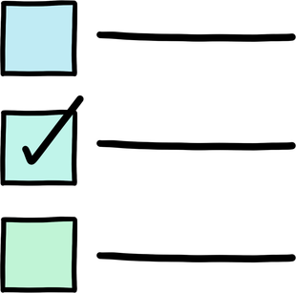
Conclusion & Future Work
Conclusion
The search works correctly and scales as expected but it's held back by an evaluation function that makes folding impossible and depth ineffective.
Future Work
Fix the evaluation function, merge the two hand evaluators, and connect the opponent model to the search.
Group 07 | Section 01 — Nadira Halim Himla • Sajiah Islam Chowdhury • S. Anam Ridwan Shanto • Mohammad Robiul Islam Hasib • Isnat Hossain Rijon

Slide 9



Group 07 | Section 01 — Nadira Halim Himla • Sajiah Islam Chowdhury • S. Anam Ridwan Shanto • Mohammad Robiul Islam Hasib • Isnat Hossain Rijon

