Slide 2
Bike ProteKt’s Strategic Entry into Germany’s Online Insurance Sector
- BikeProtekt is a start-up based out of Germany.
- Aspires to enter the Bike Insurance Market.
- Bike ProteKt would like to conduct a competitor analysis on Check24.com
- The goal is to study competitors and inform the development of competitive insurance products.
-Criteria
-Cost of Bike
-Assistance
-Segment
-Rating
-Price
-Provider
-Location
-Product_Variant
-Product_category
-Month
Company Background
Project Objectives
Data Parameters

Slide 3
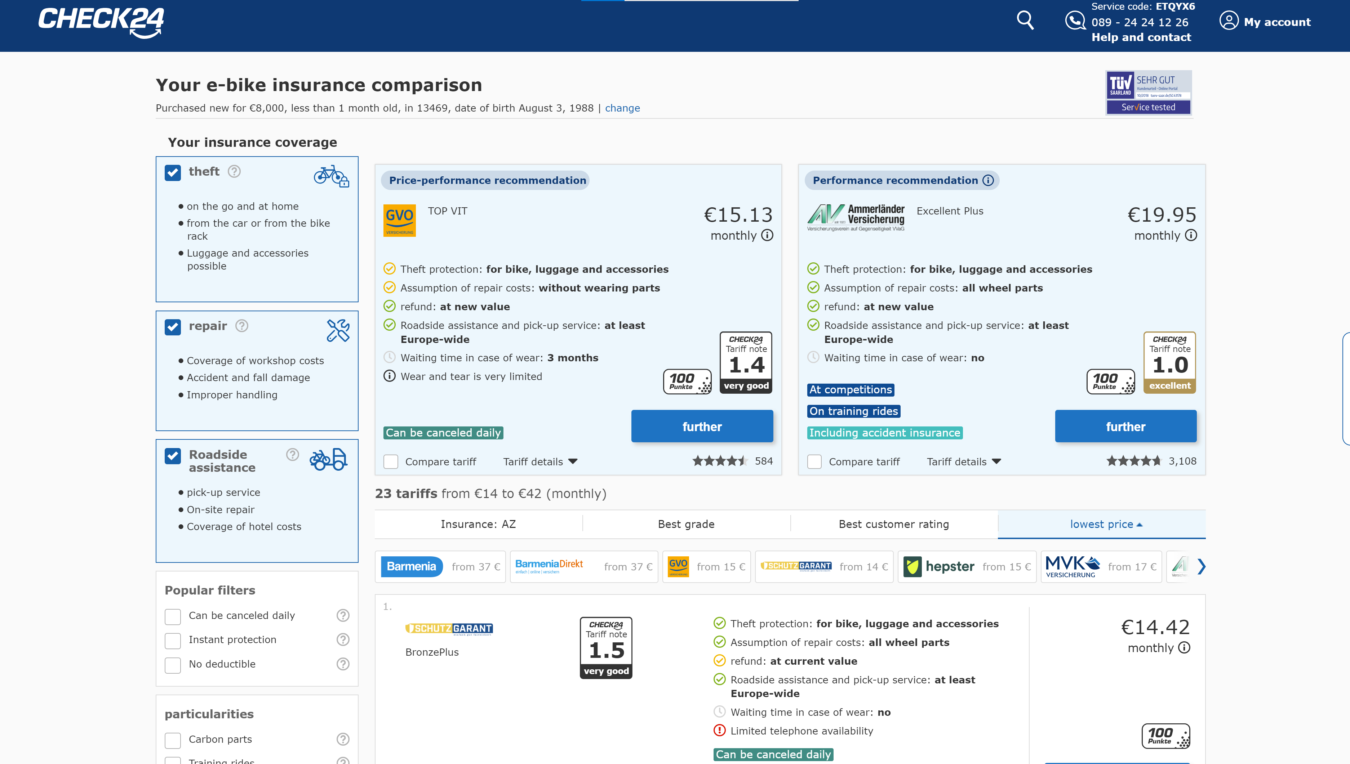
Check24.com – The largest comparison portal in Germany
For budget-conscious customers
For high-end customers
For price-sensitive customers

Slide 4
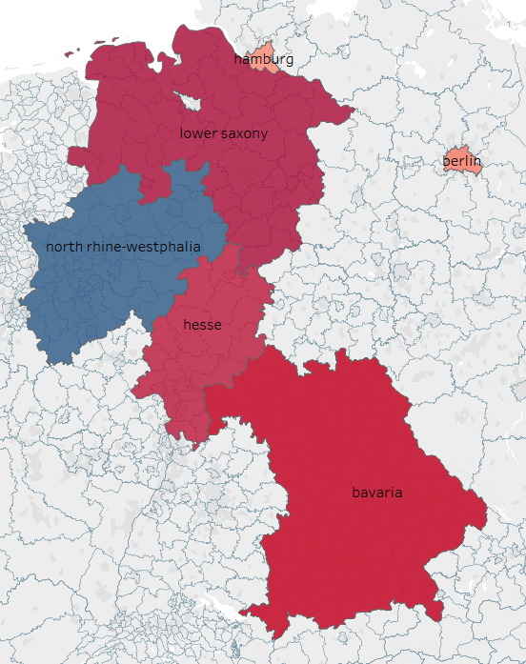
Analysis approach that led to conclusion
Clean/Structure
Conclude/
Recommend
1
2
3
4
5
Extract Data
Visualize Data/
Models
Predict

Slide 5
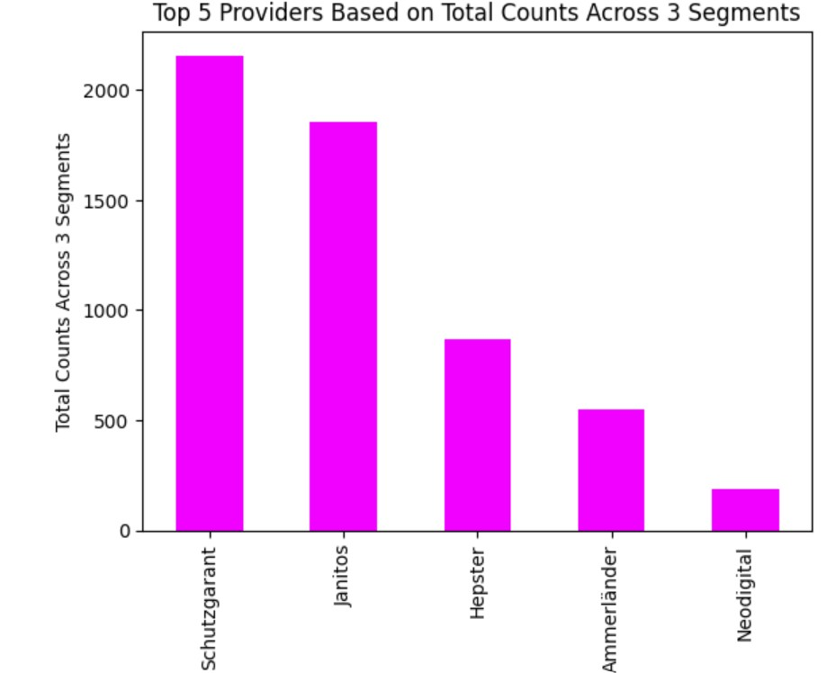
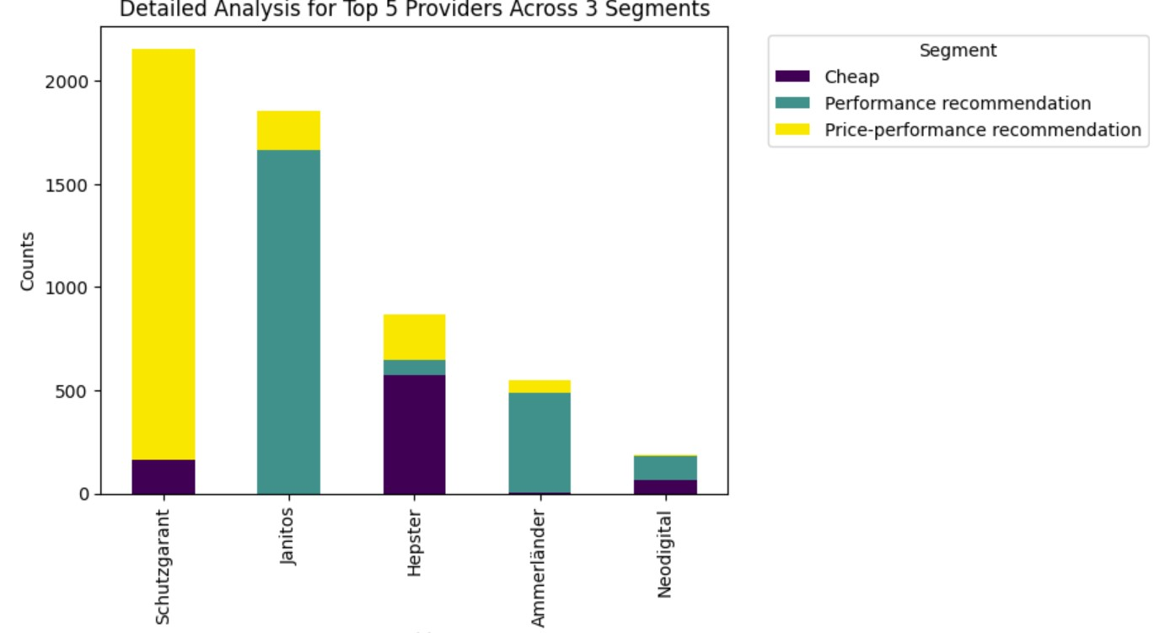
Identification of top 5 competitors

Slide 6
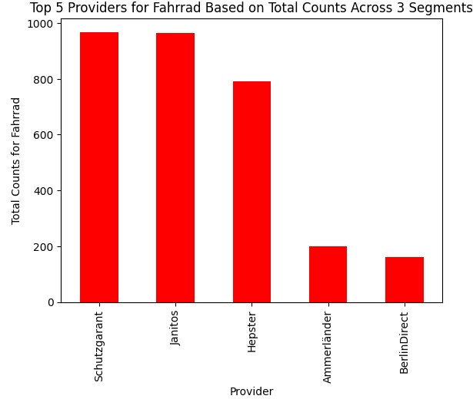
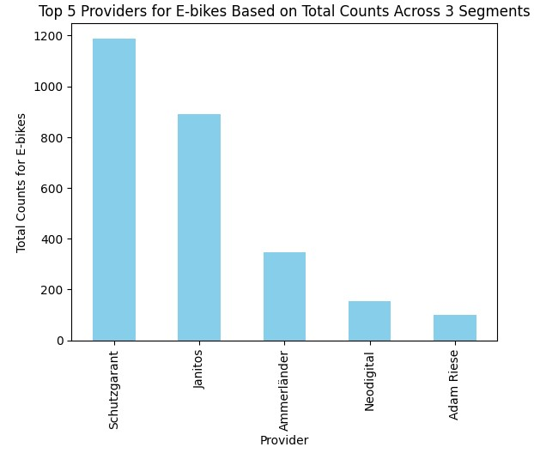
Competitors shift based on the focus area (Bikes vs. E-Bikes)

Slide 7
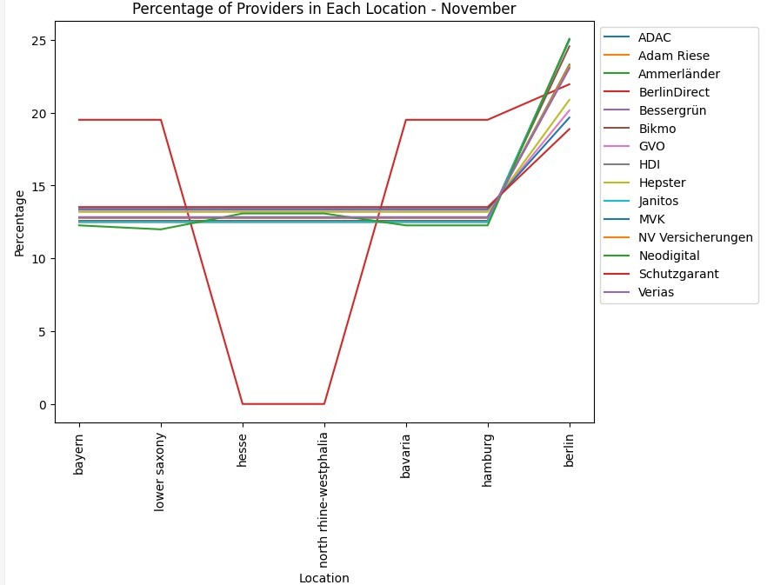
Competitors present in different location

Slide 8
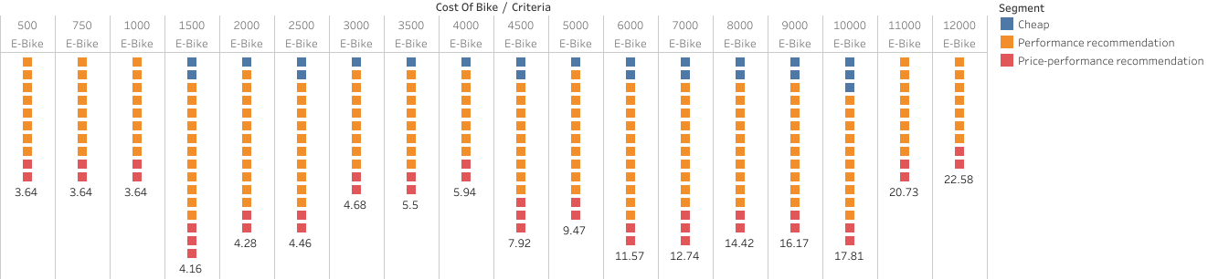
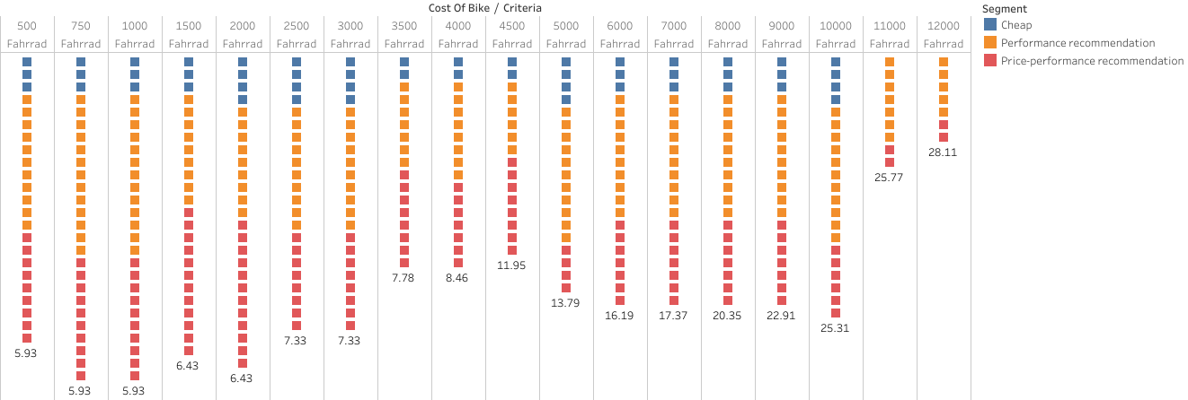

Slide 9
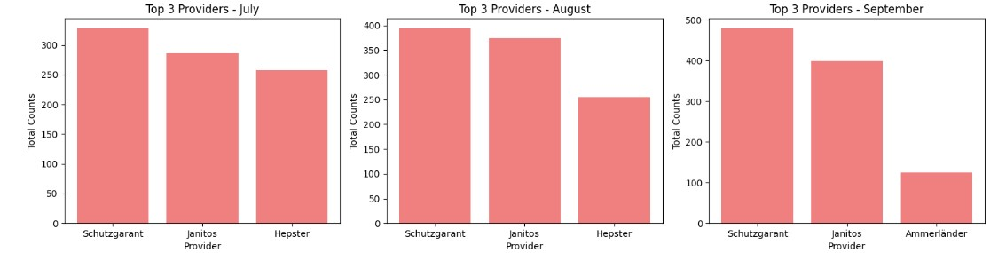
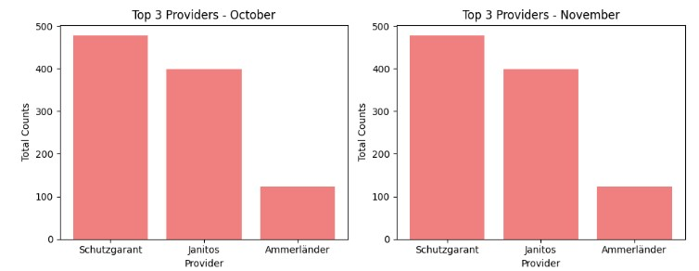
Top 3 competitors‘ M-o-M position shift

Slide 10

Models:
Linear Regression
KNN Regression
Random Forest

Slide 11
Recommendation of product variants and prices
Recommending to launch 3 products with a price 5% less than the competitors‘ price across Bike and E-Bike

Slide 12

Conclusion:
Identified top providers:
Notable changes in ranking:
Strategic market entry:
Key takeaway:

Slide 13

Next Steps:
Further Analysis Required:
Crucial Strategy Refinement:
Implementation Plans:

Slide 14


