Slide 1
Accident Data Analysis
by Senda & Priyanka

Slide 2
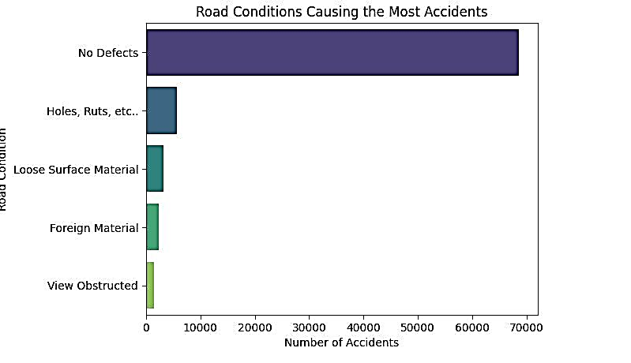
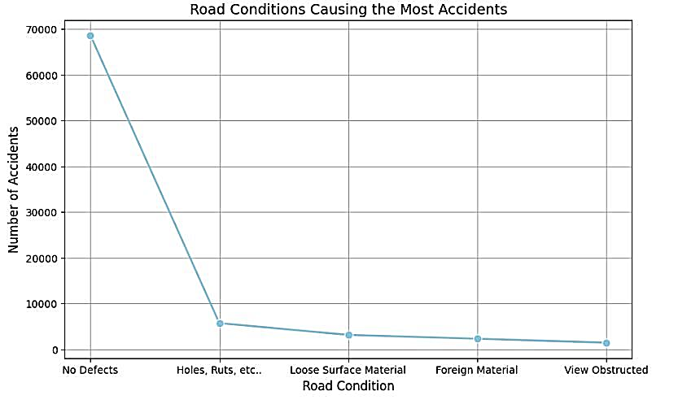
Top 5 Road Conditions with the most accidents
The number of accidents is found to be highest for the road condition with no defects, around 68K
Holes, Ruts, etc. accounted for close to 6K number of accidents which was also the second-highest
The last three road conditions resulting in road accidents were the following:
Loose Surface Material: around 3k
Foreign Material: around 2.5k
View Obstructed: around 1.5k

Slide 3

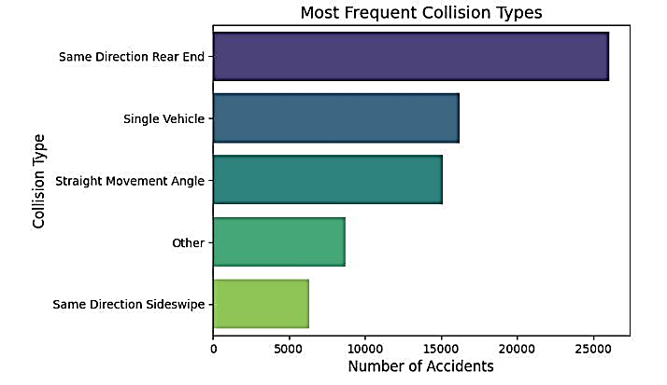
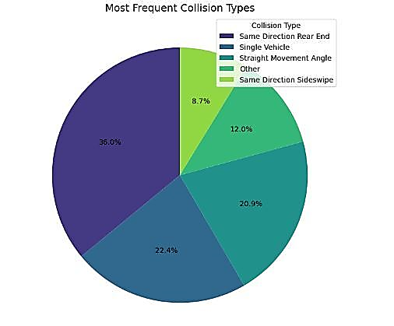
Top 5 most frequent Collision Type
About 36% of road accidents were reported due to Same Direction Rear End which is also the highest among all other collision types
Single Vehicle collision type accidents have been around 23%
Straight Movement Angle, Same Direction sideswipe and Other collision types have been reported at 20.9%, 8.7% and 12.0% respectively

Slide 4
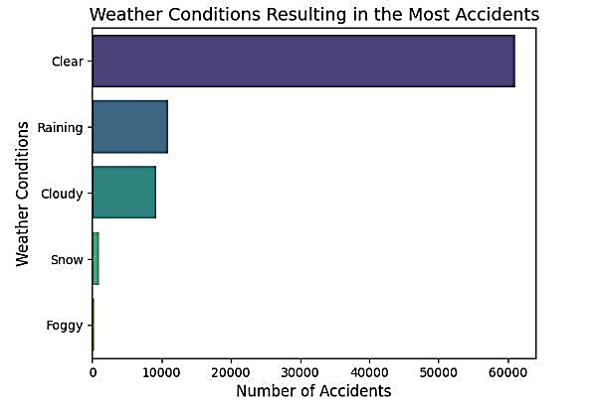
Top 5 most frequent Weather Conditions
The most number of accidents happened when the weather conditions were Clear, around 61K
The next two inline that resulted in the most number of accidents were with the weather conditions Rainy & Cloudy which are very close to each other, around 11K and 9K respectively
Snow and Foggy weather conditions reported the least number of accidents among the identified top 5 with around 900 and 400 respectively

Slide 5
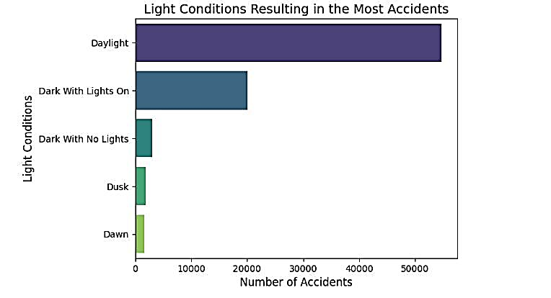
Top 5 most frequent Light Conditions
The number of accidents was found to be highest during daylight which was close to 55K
Roads with lights on during the dark had the second-highest number of accidents which was around 20K
The last three light conditions resulting in road accidents were the following:
Dark with No Lights: 3K
Dusk: around 2K
Dawn: around 1.6K

Slide 6
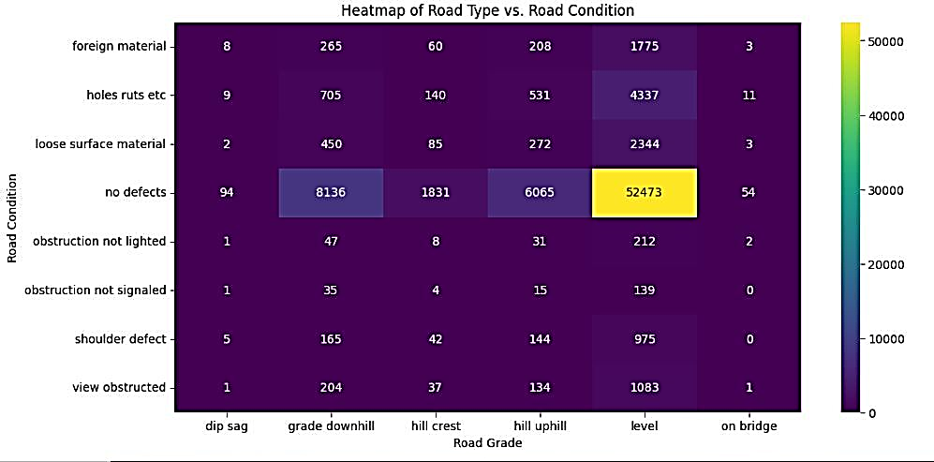
The most frequent Road Condition and Road grade
The highest number of accidents happened when the road condition was with no defects and when the road grade was levelled
The second and the third highest number of accidents also belong to the road conditions with no defects, in the road grade ´downhill and hill uphill respectively
Holes ruts etc road condition saw the next (fourth highest) set of accidents when the road grade was levelled
Finally, the last one which made it into the top 5 was the road condition with loose surface material and road grade levelled

Slide 7
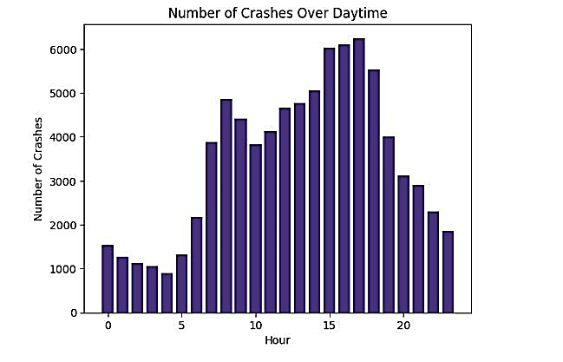
Number of crashed changes over daytime
The most number of accidents happened between 15:00 hrs and 18:00 hrs
The least number of accidents happened at 04:00 hrs.
Over 90% of the accidents happened between 08:00 hrs and 20.00 hrs

Slide 8
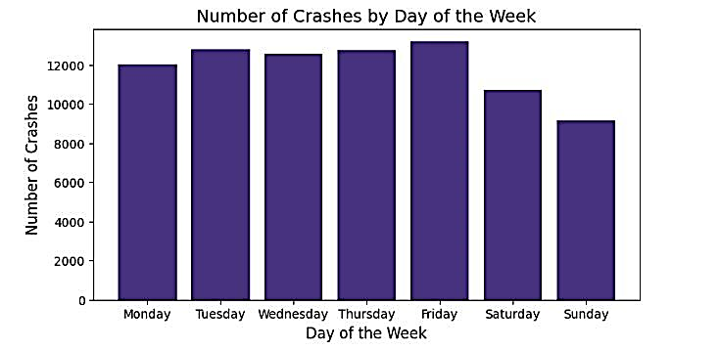
Number of crashes by day of the week
Very little variation in the number of accidents is found from Mon-Fri
Sat and Sun saw the least number of accidents comparatively
Out of all the most number of accidents happened on Fridays

Slide 9
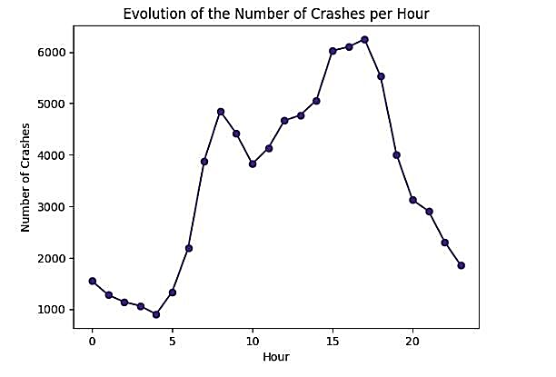
Evolution of crashes per hour
The most number of accidents happened between 15:00 hrs and 18:00 hrs
The least number of accidents happened at 04:00 hrs.
A significant surge in accidents is noticeable after 05:00 hrs. Similarly, a drop in accidents is visible after 17:00 hrs.
Over 90% of the accidents happened between 08:00 hrs and 20.00 hrs

Slide 10
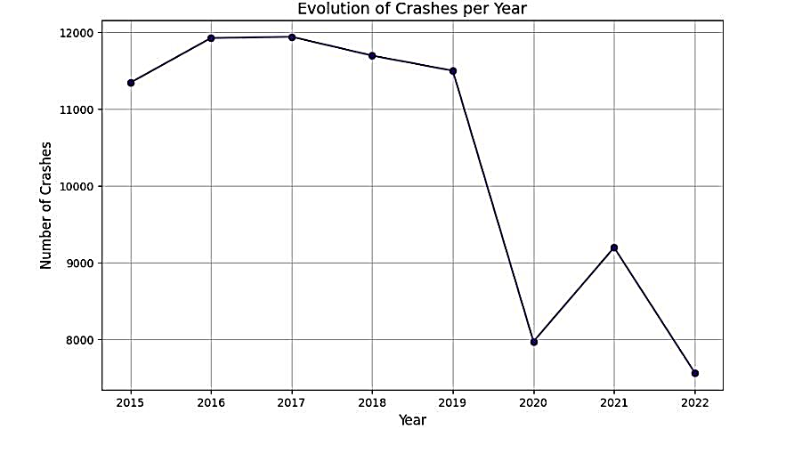
Evolution of crashes per year
The number of crashes remained almost the same from 2016 to 2017. However, a decline in the number of crashes is visible from 2017 onwards up until 2020
After a steep drop in the number of accidents from 2019 to 2020, we saw another surge in 2021
2022 has been the year with the lowest crashes

Slide 11
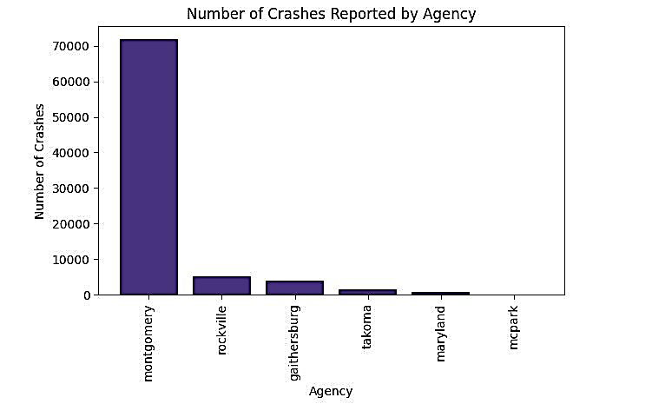
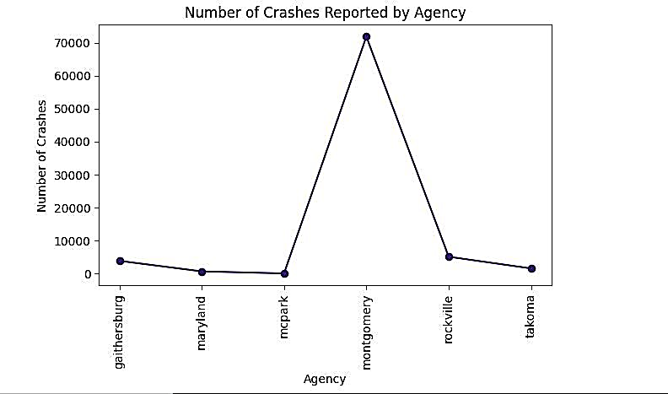
Number of crashes reported by Agencies
Montgomery has been reporting the highest number of crashes, more than 70k among all agencies
All the other agencies have been reporting the crashes below 10K each
The reporting of all the agencies combined is less than Montgomery agency alone

Slide 12
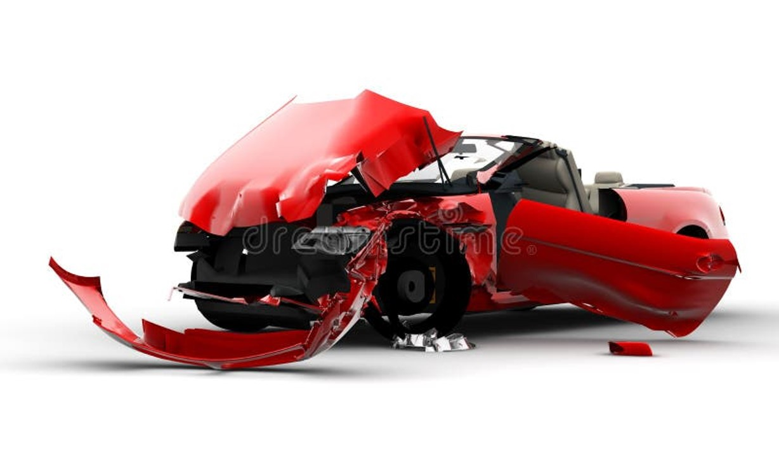
Thank You

