Slide 1
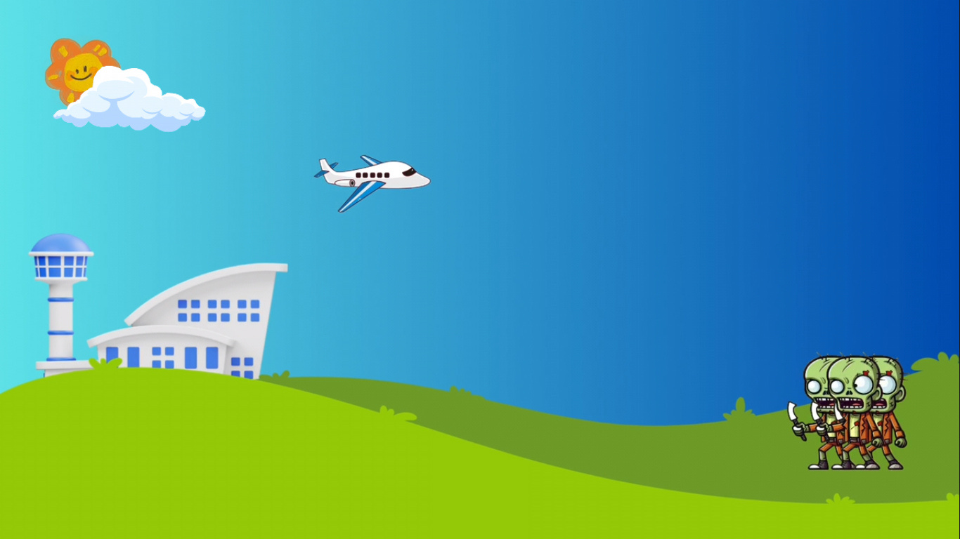
ZOMBIATOR
Final Project Software 2
Group 6
Group Members
1. Nhi Dinh
2. Lihini Hewage
3. Jiayue Zheng
4. Kamonnun Silarat

Slide 2
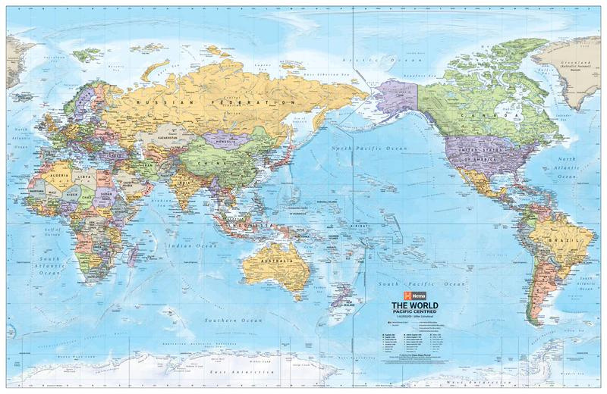

CONTENTS
1
IDEA OF THE GAME
2
DEMO OF THE GAME -> SHOW GAMEPLAY
3
4
DATABASE SOLUTIONS
4
4
GAME DEVELOPMENT PROCESS
5
FURTHER DEVELOPMENT IDEAS

Slide 3
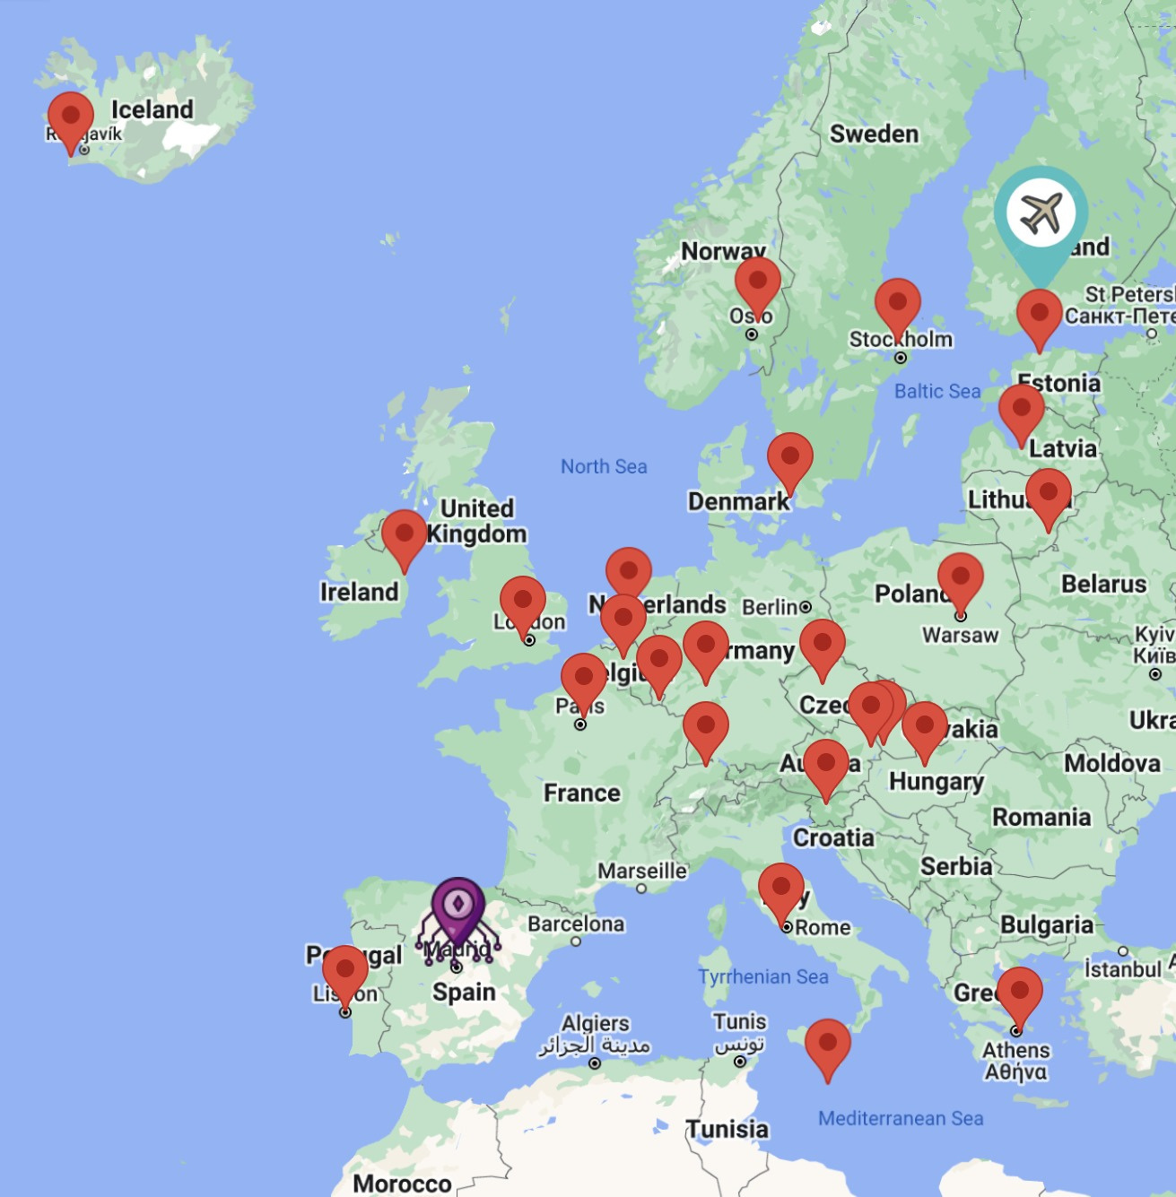
GAME IDEA
Map:
Show the location of the airports in 26 countries that need to be rescued
Your journey starts at Helsinki, Finland and ends at Madrid, Spain.

Slide 4
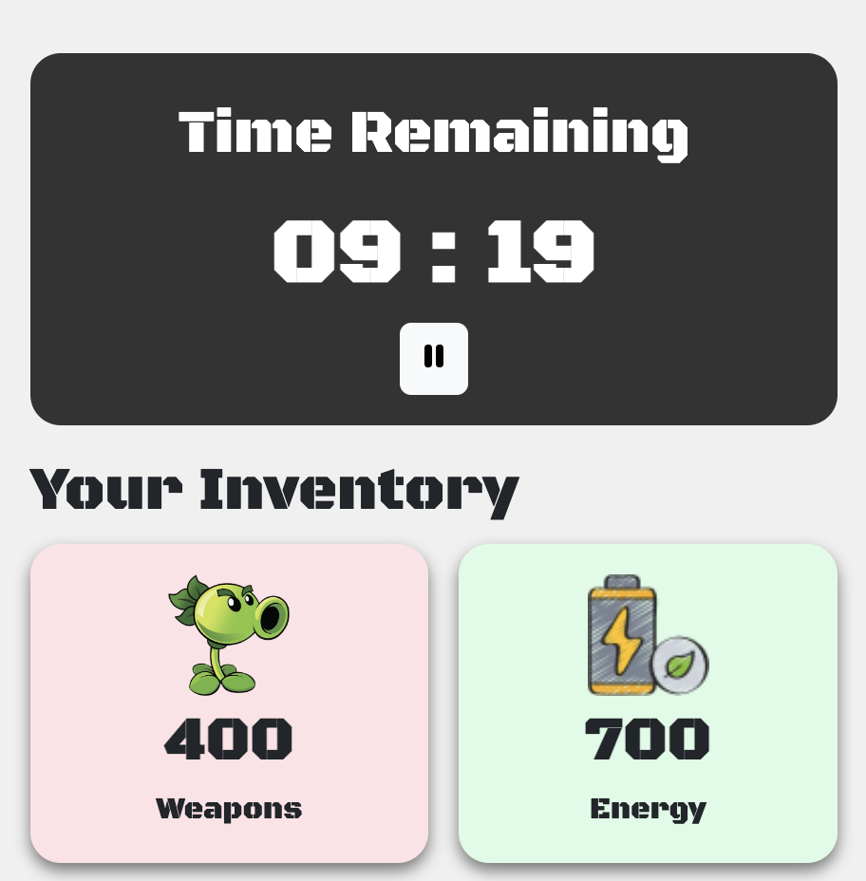
GAME IDEA
Resources:
Start with 400 weapons and 700 energy and 10 minutes countdown
Use to complete the mission in each airport
Collect enough weapons, energy and 5 numbers for last mission in Madrid
Run out of weapons, energy or time
-> Game over

Slide 5
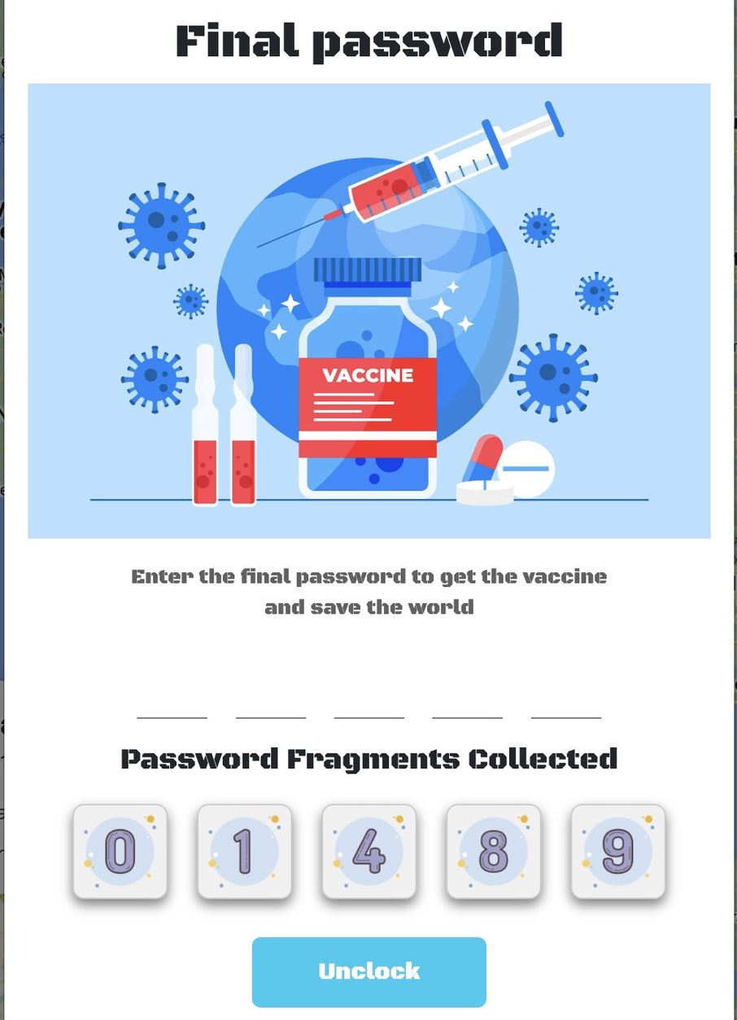
GAME IDEA
Final password:
After completing the final mission in Madrid, Enter the password with 5 numbers (0-9) in ascending order
Enter for 5 times only
Guess correctly -> get the anti-zombie vaccine and save the world
Guess wrong after 5 times -> Game over

Slide 6
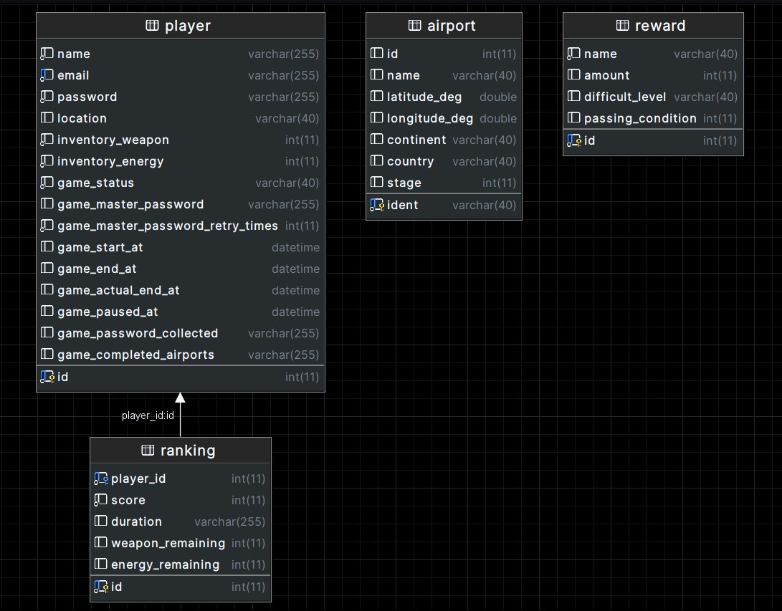
DATABASE SOLUTIONS

Slide 7

GAME DEVELOPMENT
PROCESS
Step 1
Update game requirements, change gameplay by removing money, adding timer countdown, password for final mission, and modifying rules for more interesting and simpler gameplay
Step 2
Involve designing the game layout and components using PTS and Adobe Illustrator, using materials from Freepik, pictures from Google Search, animations, buttons, and the game's logo

Slide 8
GAME DEVELOPMENT
PROCESS
Step 3
divided the project into 2 parts:
UI: was created using HTML and CSS, with Bootstrap being used in some popups
Database and Backend: The database was modified for a web browser game, using Python, Flask, and Python-dotenv for the backend. Flask-Login manages user authentication and sessions, while Flask-SQLAlchemy simplifies database operations by allowing Python objects to interact with the database.
Step 4
Implement JavaScript part for the game to create interaction between the player and the game interface
Step 5
Perform testing and fix bugs to ensure game performance

Slide 9

FURTHER DEVELOPMENT IDEAS
Improve the animations and audios of the game in each mission
Add more types of reward, e.g. mission support item and expand the rescue region to Asia with a new kind of mission
Research new techniques to reduce the map loading time

Slide 10

THANK YOU
THE END

