Slide 1
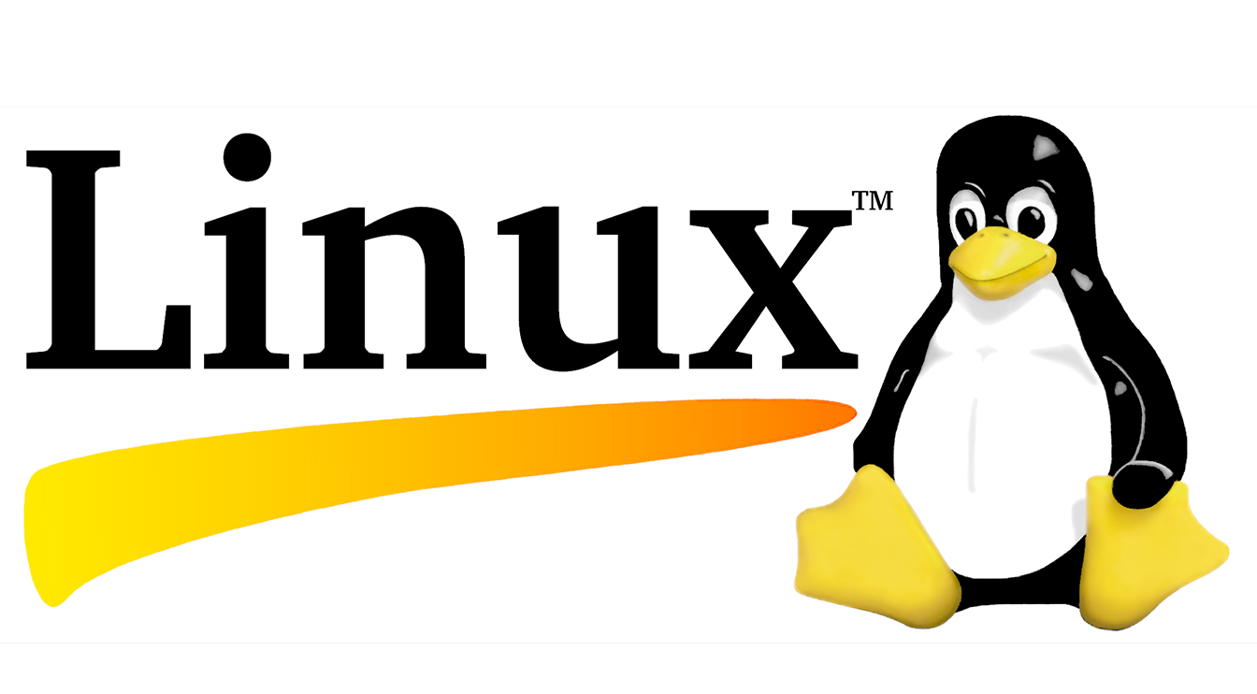
Introduction to...
Lecture 2: What is Linux?
Instructors:
Josh Bruton
Or Hanoch
Devon Jarvis
Nathan Michlio
Meir Rosendorff

Slide 2
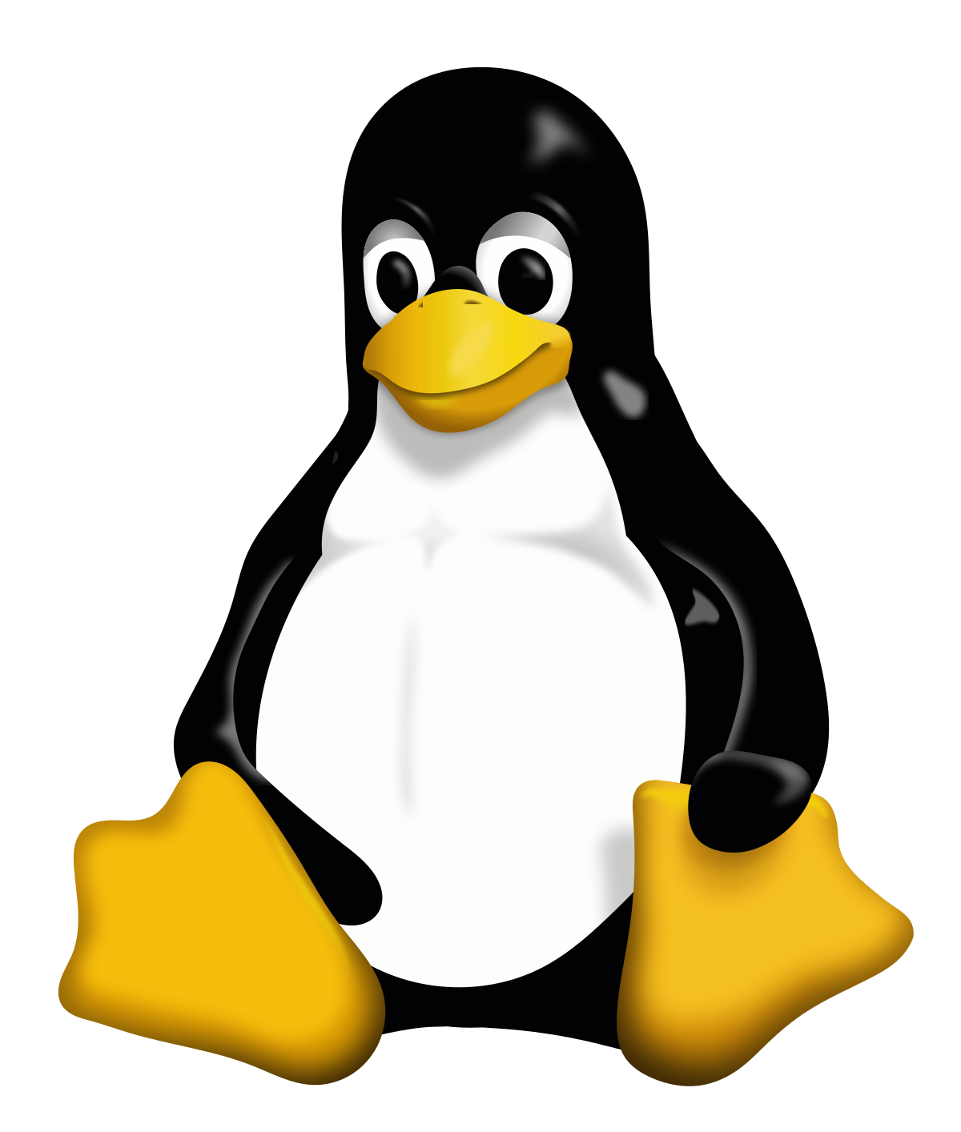
Administration Details
Our Names: Josh, Or, Devon, Nathan, Meir
Email address: projectonion@protonmail.com
Lecture Times:
Monday and Thursday @ Lunch (13:30 – 14:15)
Recommended Reading: http://linuxcommand.org/
Our Forum: https://github.com/Project-Onion/Intro_To_Linux_Course/issues

Slide 3
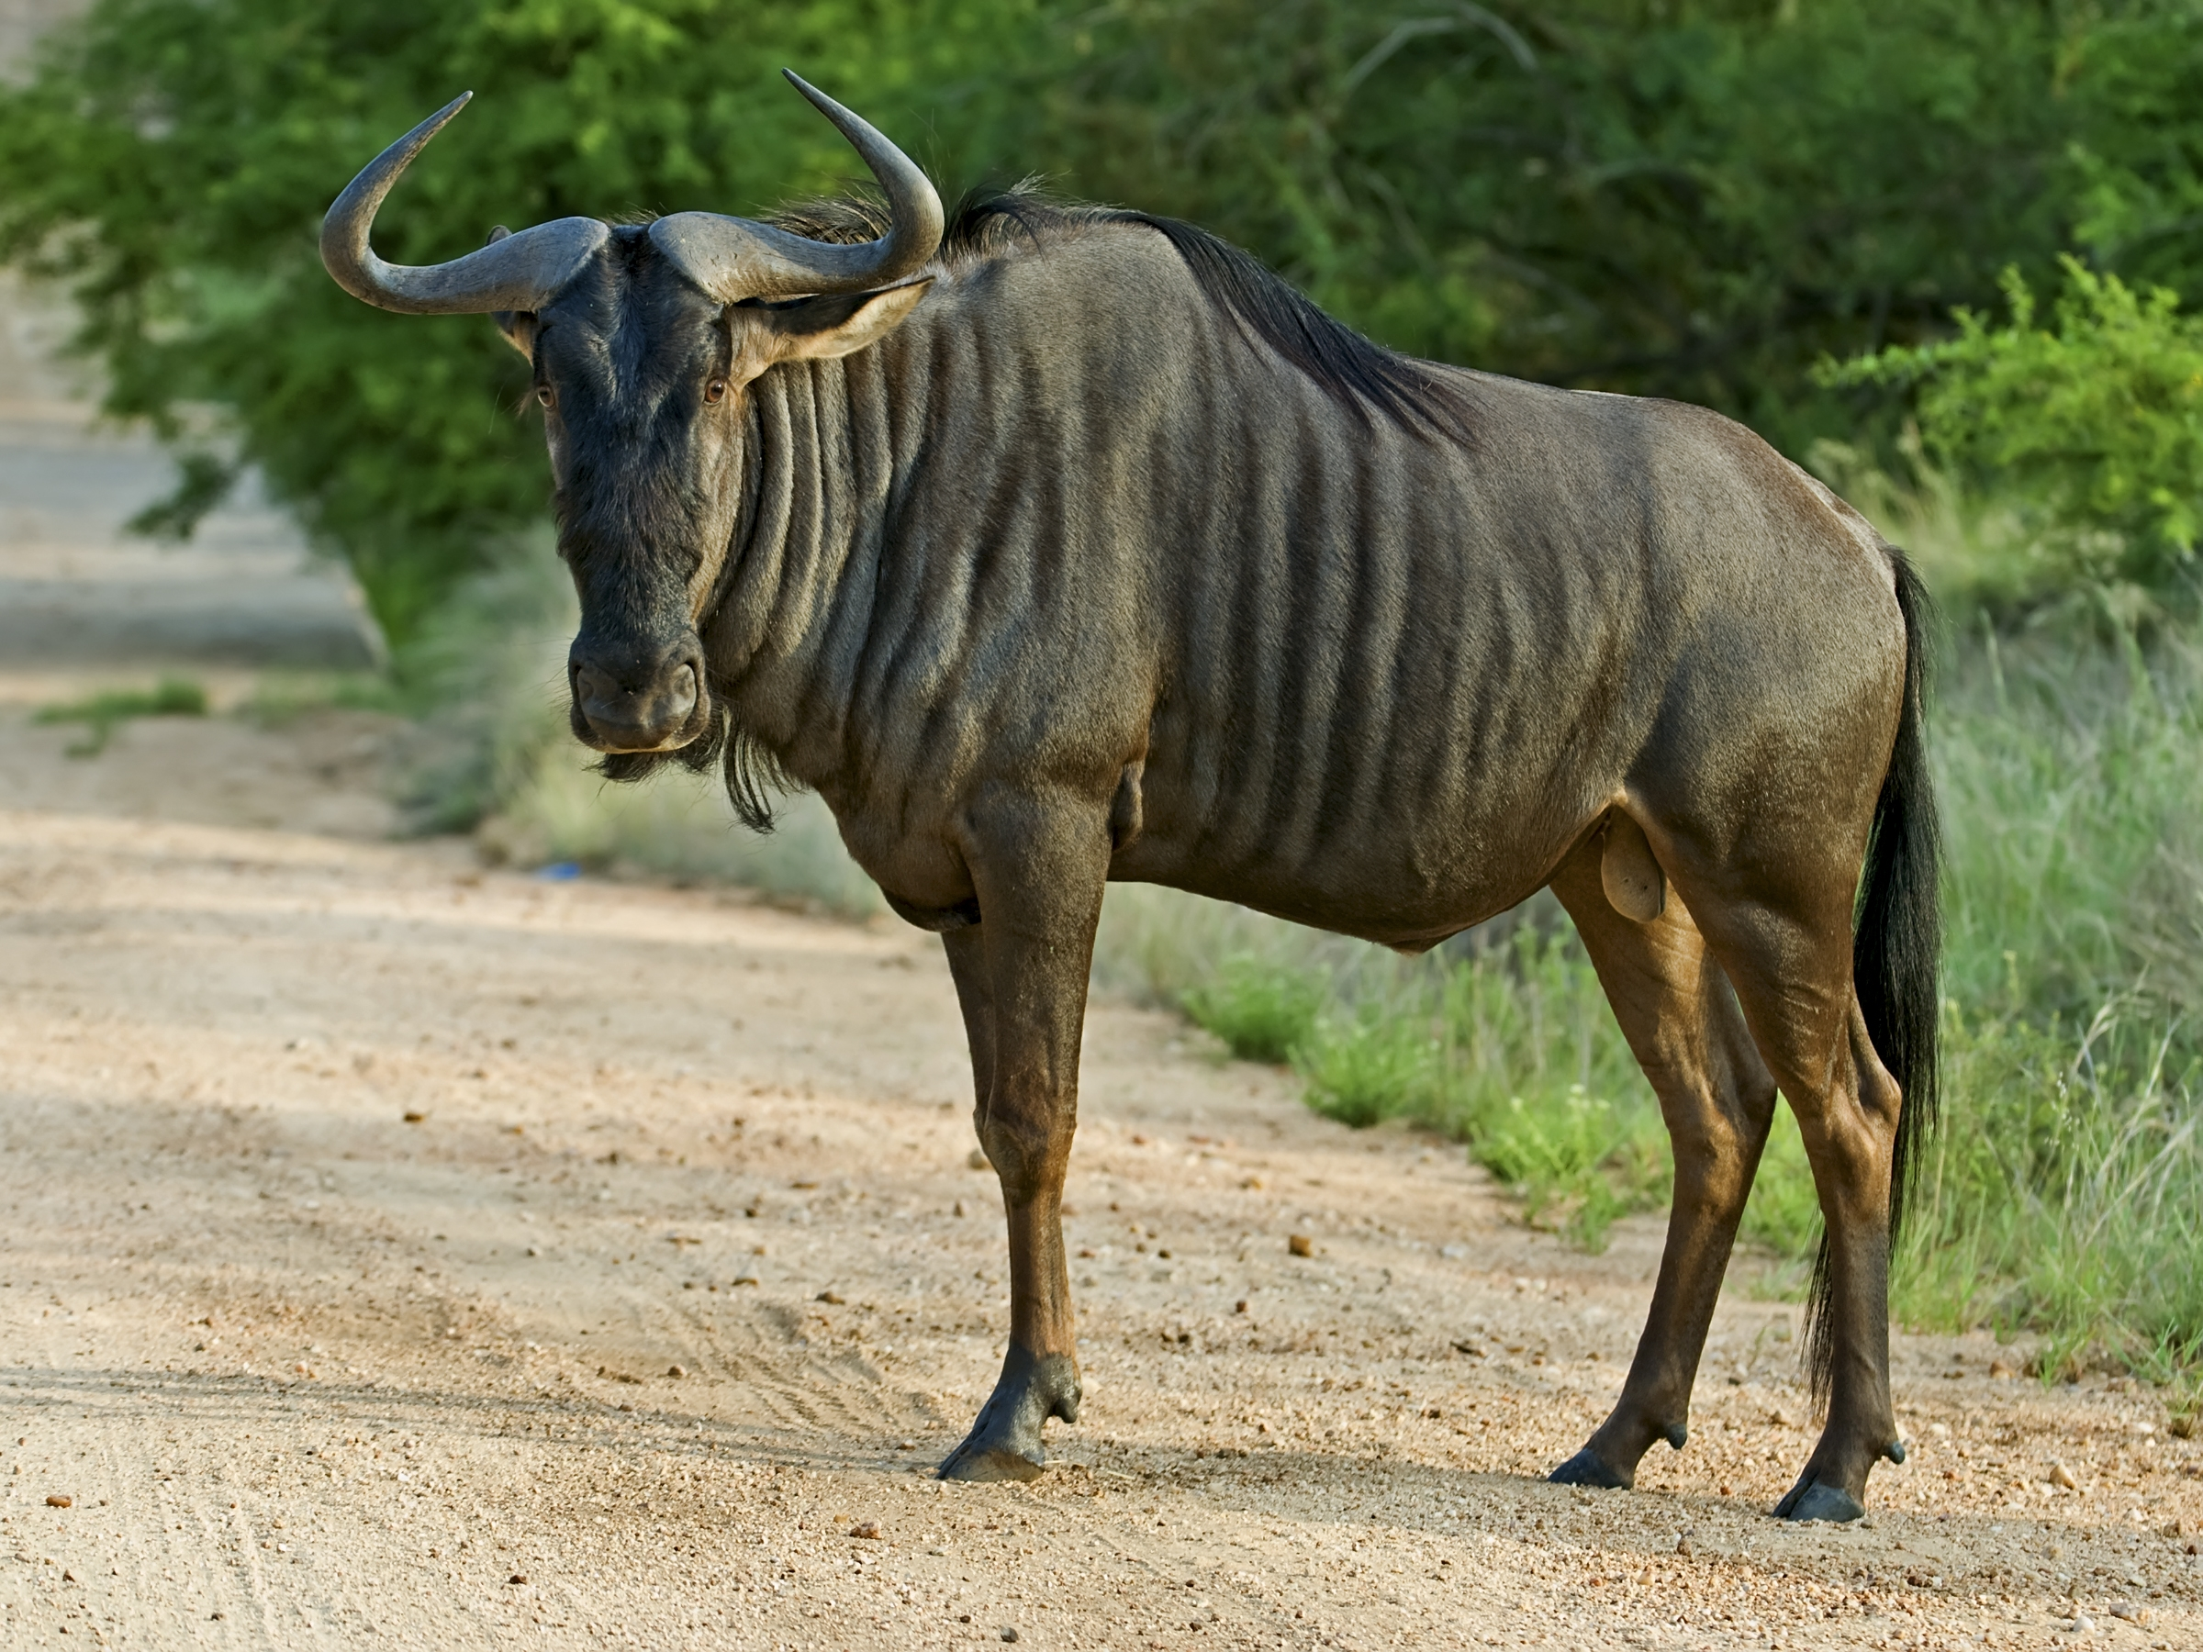
GNU WTF!?

Slide 4
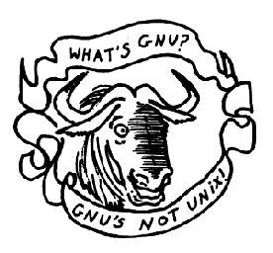
Whats GNU? Is it Unix?
GNU- GNU’s Not Unix
Started by Richard Stallman in 1983
Goal - create a complete Unix-compatible software system composed entirely of free software
Free as in freedom – not as in beer!
Complete without kernel (sort of...)
Notes:
In 1984, AT&T divested itself of Bell Labs; freed of the legal obligation requiring free licensing, Bell Labs began selling Unix as a proprietary product, where users weren't legally allowed to modify Unix. The GNU Project, started in 1983 by Richard Stallman, had the goal of creating a "complete Unix-compatible software system" composed entirely of free software. Work began in 1984.[34] Later, in 1985, Stallman started the Free Software Foundation and wrote the GNU General Public License (GNU GPL) in 1989. By the early 1990s, many of the programs required in an operating system (such as libraries, compilers, text editors, a Unix shell, and a windowing system) were completed, although low-level elements such as device drivers, daemons, and the kernel, called GNU/Hurd, were stalled and incomplete.[35]

Slide 5

Speaking of kernels...
Linux kernel developed by Linus Torvalds in 1991
Open-source (GPL v.2)
Linux is just a kernel
Fun fact: originaly Linux was named Freax
Notes:
MINIX was created by Andrew S. Tanenbaum, a computer science professor, and released in 1987 as a minimal Unix-like operating system targeted at students and others who wanted to learn the operating system principles.
In 1991, while attending the University of Helsinki, Torvalds became curious about operating systems.[39] Frustrated by the licensing of MINIX, which at the time limited it to educational use only,[38] he began to work on his own operating system kernel, which eventually became the Linux kernel.
Torvalds began the development of the Linux kernel on MINIX and applications written for MINIX were also used on Linux. Later, Linux matured and further Linux kernel development took place on Linux systems.[40] GNU applications also replaced all MINIX components, because it was advantageous to use the freely available code from the GNU Project with the fledgling operating system; code licensed under the GNU GPL can be reused in other computer programs as long as they also are released under the same or a compatible license. Torvalds initiated a switch from his original license, which prohibited commercial redistribution, to the GNU GPL.[41] Developers worked to integrate GNU components with the Linux kernel, making a fully functional and free operating system.
Linus Torvalds had wanted to call his invention "Freax", a portmanteau of "free", "freak", and "x" (as an allusion to Unix)
In order to facilitate development, the files were uploaded to the FTP server (ftp.funet.fi) of FUNET in September 1991. Ari Lemmke, Torvalds' coworker at the Helsinki University of Technology (HUT), who was one of the volunteer administrators for the FTP server at the time, did not think that "Freax" was a good name. So, he named the project "Linux" on the server without consulting Torvalds.[43] Later, however, Torvalds consented to "Linux".

Slide 6
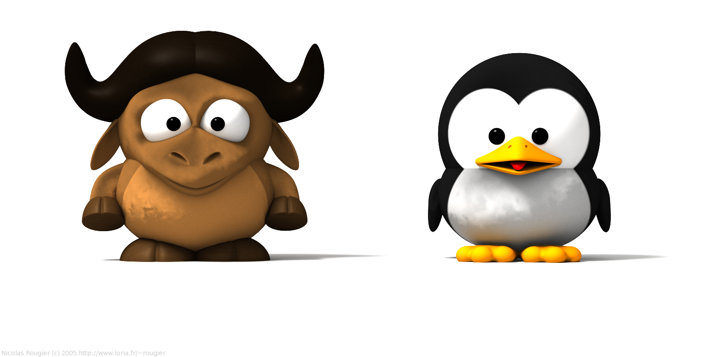
But if anyone asks..
“GNU/Linux” = “Linux”

Slide 7
But if anyone asks..
“GNU/Linux” = “Linux”

Slide 8

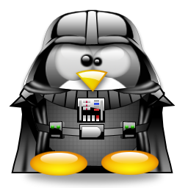






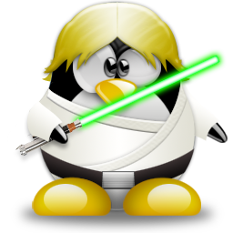

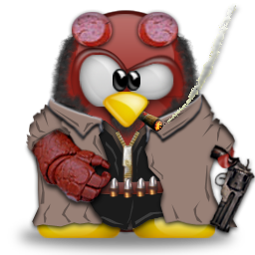
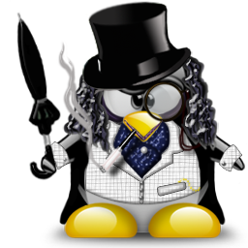
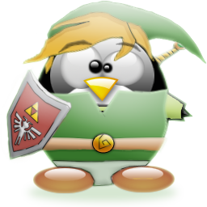


Linux has many forms

Slide 9
Forms?
These forms are called Linux distributions – or distros, for short
Different projects “fork” different distros to create new ones and customize them the way they see fit.
  This is possible due to the open-source nature of Linux
  Forked distros are called derivatives of there parent distro
There are 100’s of different distros – too many to count!

Slide 10
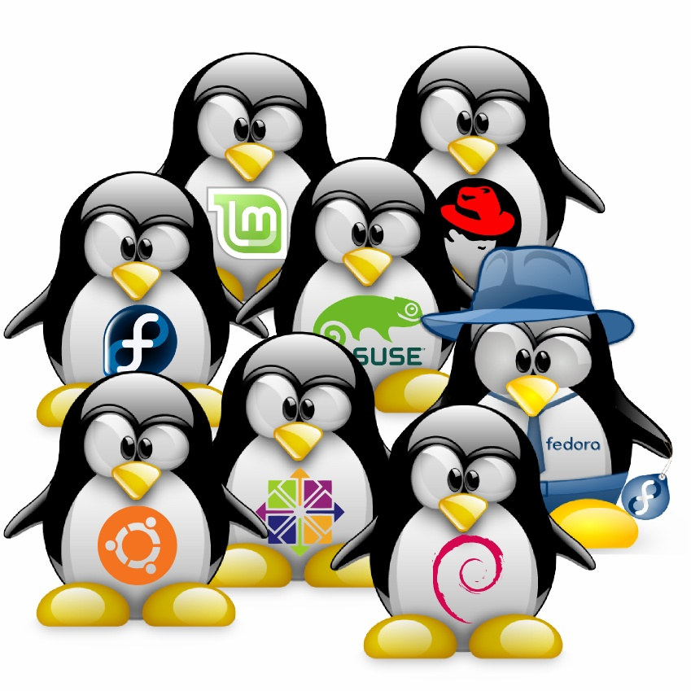
Popular Distros
Mint
Suse
Red Hat (RHEL)
Fedora
Fedora again?
Ubuntu
CentOS
Debian
* Can anyone guess what the Ubuntu logo stands for?

Slide 11
But What’s the Difference?
Each distro picks and chooses its own features, such as:
  Package Managers, repositories, and file formats
  Desktop environments
  Default and pre-installed programs
  Different file system structures
  Driver support (easily seen NVIDIA graphics drivers)
  Other things..

Slide 12
Say what?
Basically different distributions may look different and have some different tools and commands
How does this apply to me?
  For now, you care about the tutorials you will find while searching online for help
  Most tutorials will apply to most distributions
  However it is always best to follow tutorials that are distro specific, or at least derivative specific, as some things may vary between distributions.
Don’t stress - as you use Linux more you will become more familiar with the differences

Slide 13
So what do we use?
Labs – Xubuntu 16.04
  A fork of Ubuntu based on the XFCE desktop environment
  Popular for personal use due to its user friendliness
Computer Clusters – CentOS / RHEL
  Centos is a RedHat (RHEL) derivative
  Minimalistic and efficient
Personal use – Traditionally Ubuntu
  In order to not get confused when you start we recommend Ubuntu – It has a good community and tutorials + it’s what the labs use
  But...

Slide 14
Distro Hoping is Fun!
For The more adventurous
  Even when distro hopping, - starting with an Ubuntu derivative like Linux Mint (or others) is recommended in order to avoid confusion
  The more you gain experience the more confidant you will feel trying out new distros.
  Seeing what different distros have to offer can be exciting and help keep your computing expirience fresh!
Note: This is not an objective opinion, in fact Or is the only distro hopper amongst the instructers and he forced this slide in...

Slide 15
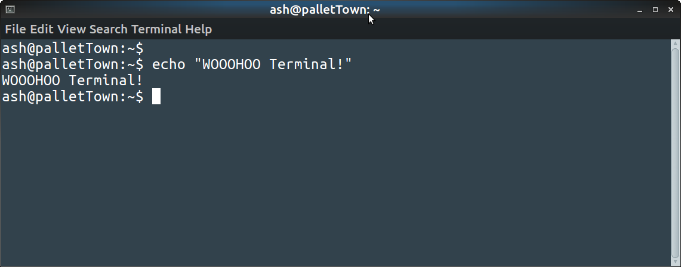
But no matter the distro
The Linux terminal is there!

Slide 16
Big whoop.. so what?
Everything and more can be done from the terminal!
A lot of things can even be done easier and faster through the terminal
There are many things that are hard – if not impossible – to do without the terminal
+ it makes you look cool..

Slide 17

Ok, so what is it?
Terminal – A window to the shell
Shell??
  A user interface for access to an operating system's services
  The thing that processes commands and returns output
Is there more than one shell?
  Yes! Zsh, ksh, ash are some Unix shells.
  But the most common shell – and what we use – is BASH!
BASH
  Bourne Again Shell
  Developed by GNU in 1989 to replace the Unix Bourne Shell

Slide 18

Questions?

Slide 19
How can I start?
3 Options?
  Install Linux on a virtual machine (VM) using VirtualBox
  Dual Booting – installing Linux alongside another operating system
  Full format – take no prisoners! Wipe your hard drive and install Linux exclusivly!

Slide 20

How can I start?
3 Options:
Install on a Virtual Machine (VM) via VirtualBox
Dual-boot – install linux alongside another operating system
Full format – Format your computer entirly!

