Slide 1

Introduction to...
Lecture 4: Processes
Instructors:
Josh Bruton
Or Hanoch
Devon Jarvis
Nathan Michlo
Meir Rosendorff

Slide 2

Here is a comic

Slide 3
Sudo
A program that allows users to run programs with superuser permissions.
It originally stood for "superuser do”
You put “sudo” in front of another command and it will usually request a password
Configurations found in “/etc/sudoers”

Slide 4
Time to try:
Open a terminal on the lab computer and type:
  “sudo apt-get install toilet”
  .
  .
  .
  .
  .
  .
  .
  DENIED

Slide 5
Time to try again
We set up a high performance cluster upstairs for you guys to play around with (and destroy)
But how does that help you here?
You can take the elevator to the 3rd floor?
Or...

Slide 6
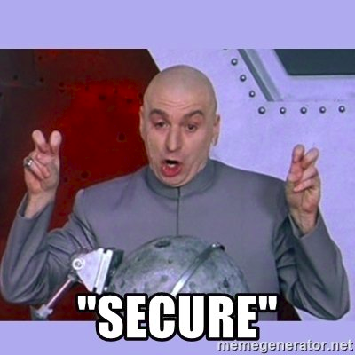
ssh
Stands for “secure shell”
You’ve used something
similar with the
“scp” command
“ssh” allows remote login to a computer across a network

Slide 7

ssh
Syntax:
  “ssh <user>@<ipaddress>”
The IP address is the address of the computer you are attempting to access.

Slide 8
Experiment
Type either:
  “ssh root@ip1” for an ubuntu terminal
  Or
  “ssh root@ip2” for a centos7 terminal
Then:
  “adduser __newUserName__”
  “su __newUserName_”
  “sudo apt-get install toilet”

Slide 9
scp
Stands for “secure copy”
Follows the same logic as “ssh”
Syntax:
  “scp <user>@<ip address>:<remote_filepath> <local_filepath>
Copies a file from a remote computer onto your computer over a network

Slide 10
Final Exercise
Spend the rest of the time experimenting on the cluster you ssh’ed into upstairs.
First person to break the computer wins!
It may be harder than you think

