Slide 1

Introduction to...
Lecture 5: Directories & Users
Instructors:
Josh Bruton
Or Hanoch
Devon Jarvis
Nathan Michlo
Meir Rosendorff

Slide 2
Linux Users
Permissions = Security
  Not allowing just anyone to do everything and break stuff.
  Letting only the people you want to access particular files access them.
  We don’t want want Sarah from accounting to mess up with the kernel!
  The main advantage of having separate users is removing root user permissions from normal users, thus preventing accidental or intentional damage. As well as preventing users from modifying other users files if permissions are correctly set
Separation = Happy
  Different users have their own files, and don’t want other users to see them.
  When you ssh into my laptop I would preffer you not look at my secret plans to take over *redacted*.
  The other advantage is the home folders mentioned previously. Users each have their own home folder allowing them to work and customise the system themselves, as they see fit, without affecting anyone else.

Slide 3
ls -l, too much info?
Permissions
Owner
Size in bytes
Size in bytes
File/
Directory name
Amount of Directories inside
Group
Directory indicator

Slide 4
Reading permissions
Owner
permissions
Everyone
permissions
Group
permissions
r – reading
  Includes opening, copying, and anything
w – writing
  Includes editing the file and editing
x – executing
  Running the file (if it is a script or program or something)

Slide 5
Yes, we need to explain files...
What are Files
  Files are considered to be anything that can have data read and/or written to it.
  This means that all directories are also files.
  Linux takes this a step further and considers devices (i.e. the cpu, hard drives, gpu, etc..) to be files too
    This means you interact with them at a low level in the same way as normal files when sending and reading data.

Slide 6
Directory Structure Cont.
Linux Install
  The linux directory structure applies to whichever drive has a linux distribution installed, other drives or folders themselves may have a different directory structure.
Linux Directory Structure
  As seen previously with ‘ls -l /’
  Similar amongst distributions, certain files for the operating system belong in certain places.
  Different places also have different access permissions, controlled in the form of users.

Slide 7
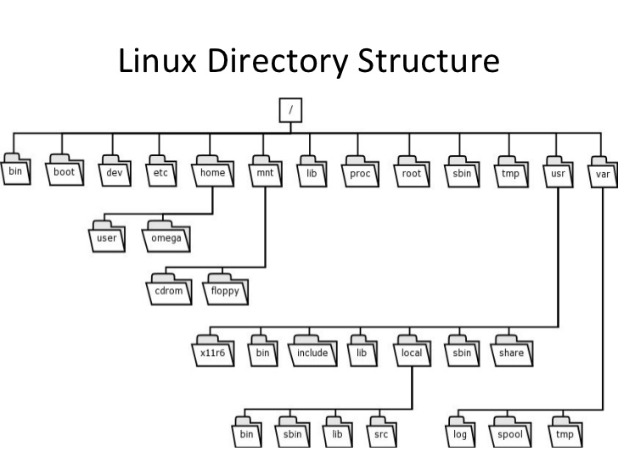

Home sweet ~/
/home
  home is the location of user directories, all similar to the seperate root user directory
  Includes:
    Desktop
    Documents
    Downloads
/root
  The root users home folder
  The admin known as the root user, has full access to all files and folders, meaning full access to all ‘commands’ which remember are programs/executables.

Slide 8
File System vs. Structure
File System
  The format that the operating system sees the files in. of all files stored on separate a storage drives, in terms of 1s and 0s.
  Can be different on different partitions of a hard drive.
  Limits things like the number of files that can be in a folder or the max file size.
File System Structure
  The way files are organised on the drive (in our case for linux), on top of and independent of the file system.
  Can be called the Linux Directory Structure.
    The directory structer is widely called the file system structure – this is wrong, but it is what we will use as well
    To reduce confusion we this is the phrase we will use, but remember the difference between file system and file system structure!
  Linux distributions use the Filesystem Hierarchy Standard (FHS) file system structure, orignally from Unix and maintained by the Linux Foundation.
    Different distributions might slightly change the base FHS

Slide 9
Linux Directory Structure

Slide 10
Directory Structure
/
  This is the root folder of the directory structure of any currently active drive.
What is in /?
  ‘ls -l /’
What does all of this mean?
  This lists all the files in the root directory
  Along with metadata on all of the files
    Creation Data, Access Permission, File Types, File Size, Owner

Slide 11
~/Desktop – FINALLY!
The current home folder is aliased (shortcuted) by ~/ and depends on the current logged in user.
  Normally ~/ is a shortcut to /home/<user_name>
  For example in the user “meowth”
    ~/Desktop = /home/meoth
    ~/Documents/nothingSpecial/snatchPikachu.cpp =
    /home/meoth/Documents/nothingSpecial/snatchPikachu.cpp
  In the lab computers our personal home folders (not vmuser) are kept on a server.
    Run `pwd` in your home directory (~/) and see where it is
    The output is the server where your home folder is and where in that server your folder is kept.

Slide 12
Excercise 1a
Go to your home directory (hint cd).
Use `ls -l` to find out:
  What permissions do you have on your Desktop directory?
  What permissions do other people have on your Desktop directory?
Start going around the file system, where do different users have ownership over files?

Slide 13
Excercise 1b
Try accessing a different users Desktop, what happens?
How can you switch between users in terminal? Remember – Google is your best friend!
  Try switching between vmuser and your user.
    You will be prompted to enter a password, remember the password for vmuser is vmuser, don’t share your own account’s password!

Slide 14
Other Directories in /
/dev
  Devices, like cpu, hard drives, gpu, etc.
/proc
  Information about processes and other system information
/etc
  Configuration Files, used to change the default behavior of the system.
/usr
  Unix System Resources, not “USeR”
  Secondary level, containing similar folders but for read-only user data. Contains the majority of installed multi-user utilities and applications
    eg. /usr/bin /usr/lib

Slide 15

Even More Directories in /
/boot
  Files needed to boot the operating system, eg. bootloader, kernal
/bin & /sbin
  Location of Binaries or rather executables / programs
  bin is default executables for all users (eg. cat, ls, cp...)
  sbin is for essential system binaries (eg. shutdown, fsck...)
/lib & /lib64
  Common programs needed by other programs, known as libraries
/opt
  Optional full applications – some programs install here.

Slide 16

less cat?
Before we start excersises we need to learn one more command – cat!
`cat` lets you see the contents of a file in the terminal.
`less` lets you see the contents of a file in a scrollable way.
Examples:
  `cat /etc/issue`
  `less /bin/ls`

Slide 17
Excersise 2
Google is your best friend! Let it help you find the files you need to look at to find the following (and note which directory everything is in):
  Which CPU is in your computer?
    BONUS: How much memory (RAM) does your computer have?
  What is your computers hostname?

Slide 18
Excercise 2 - Answer
CPU?
  `cat /proc/cpuinfo`
Memory?
  `cat /proc/meminfo`
Hostname?
  `cat /etc/hostname`

Slide 19
Excercises
Google how to find the name of the currently logged in user.
Back to ‘ls -l’
  Find 2 different files each with a different owner.
Use ‘su <user>’ to switch users
  If you are logged in as vmuser switch to your user, or vice-versa, and then back again.
    You will be prompted to enter a password, remember the password for vmuser is vmuser, don’t share your own account’s password!
DON’T DO THIS NOW
  but if needed in future, you can use passwd to change your account password.

