Slide 1
Rainbow Prediction

Slide 2
Problem
The Rainbow’s store manager wants to know which customers are likely to purchase next month so he can prepare his marketing campaign based on transaction info
We can define this problem into classification model: “Predict customer churn in next month”

Slide 3
Exploratony Data Analysis
Link: https://github.com/NhuanTDBK/purchase-prediction/blob/master/EDA.ipynb

Slide 4
Approach
How often the user reordered items
Time between orders
Last purchase order
Features based on order sizes (min,max,mean,median,std)
How many of the user’s orders contained no previously purchased items
Ratio of reorder items
Stats last 1,2,3,7,14,30 days user’s order (min,max,mean,median,std)
Quantity
Number of products

Slide 5
Churn purchase
user_id label

Slide 6
Modeling
We use dataset
from 2018/02/01 to 2018/05/31 for training samples
from 2018/06/01 to 2018/06/30 for testing samples
Number of training samples: 27996
Number of testing samples: 9106
Metric: ROC AUC
K-Fold Cross Valition: K=5

Slide 7
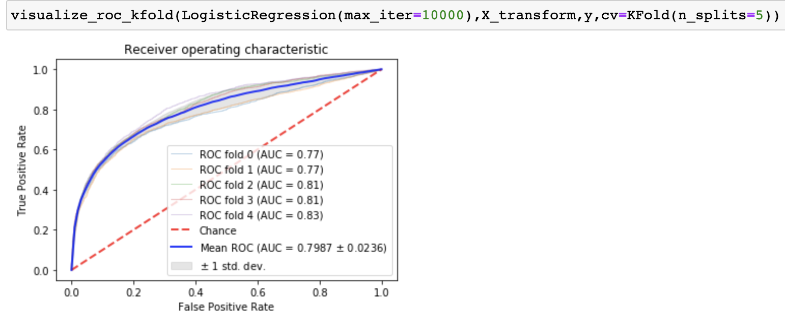
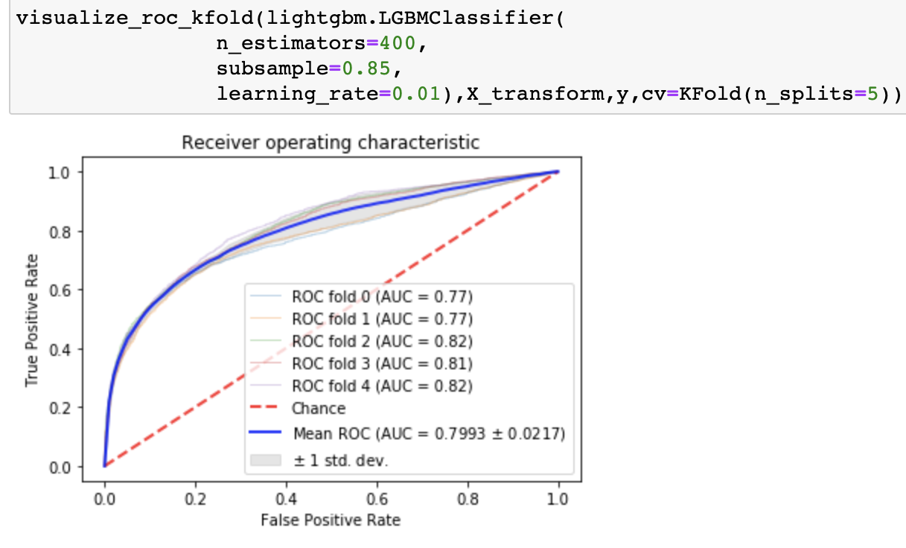
Results
Gradient Boosting Decision Tree (lightgbm)
ROC on test: 0.821
Logistic Regression
ROC on test: 0.561

Slide 8
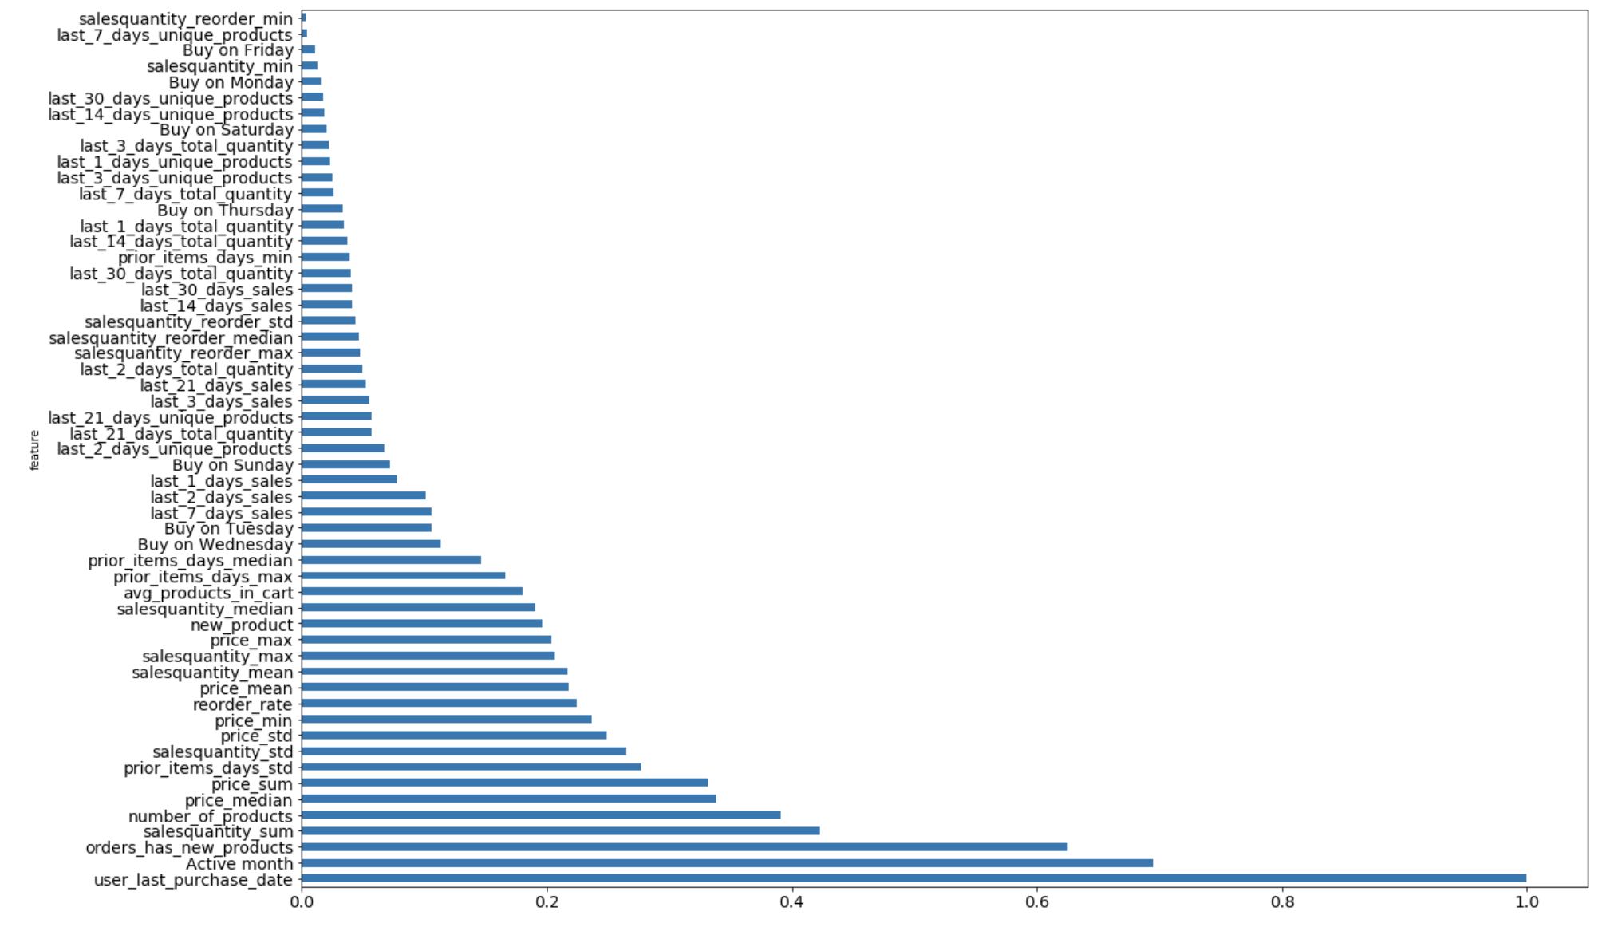
Results – Features Importance

Slide 9
Which customers should send email?
Based on model result, we can identify which customers that are at-risk of churning or unlikely to make a purchase. By estimating the probability of churn rate, we can segment users and target specific segmentation.
Risky:
Model is not tackled to item features and <user,item> features. It will be limited the pattern of users that’s affected to buying behaviors
Model is not tackled to customer demographic features

Slide 10
Conclusion
Need to test the accuracy of model in production
Feature Engineering about items features, user x item features
Using neural network embedding for modeling

