Slide 4
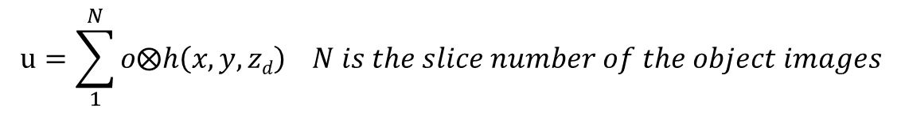
Final goal
x
Amplitude
Phase
…
…
z
Propagation distance : z_{d}
Object: o
Wavefield: u
$$u=\sum_{1}^{N}{o\text{⨂}h\left(x,y,zd\right)} N is the slice number of the object images$$
u: complex wavefield that is known
h: free-space propagation impulse response
Problem: given u and h, to find o

Slide 5
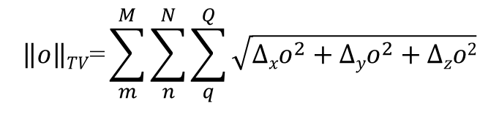
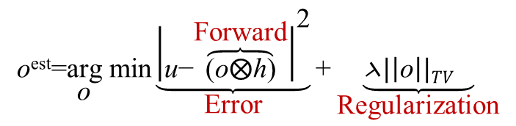
Previous implementation
$$\underset{\text{o}}{\text{o}\text{est}\text{=}\text{arg} \text{min}}{\underset{\text{Error}}{\underbrace{{\left|\text{u}\text{−}\overset{\text{Forward}}{\overbrace{\text{(}\text{o}\text{⨂}\text{h}\text{)}}}\right|}^{\text{2}}}}}{\text{+}\underset{\text{Regularization}}{\underbrace{\text{⋋}{|\left|\text{o}\right||TV}^{}}}}$$
$$\underset{}{\left\|o\right\|TV\text{=}\sum_{m}^{M}{\sum_{n}^{N}{\sum_{q}^{Q}{\sqrt{{∆xo}^{2}+{∆yo}^{2}+∆zo2}}}}}$$
M, N, Q are the pixel numbers along x,y and z axis
Complex values are converted to real with:
u=[u_{Re} ; u_{Im}]
o=[o_{Re} ; o_{Im}]
h=[h_{Re} ; h_{Im}]
And inversely converted to complex before the forward and backward propagation.
Solving algorithm:
J. Bioucas-Dias, M. Figueiredo, “A new TwIST: two-step iterative shrinkage/thresholding algorithms for image restoration”,
IEEE Transactions on Image Processing, December 2007.

Slide 6
New implementation with GlobalBioIm
Target images
Complex field
Reconstructions
Wrong

Slide 7
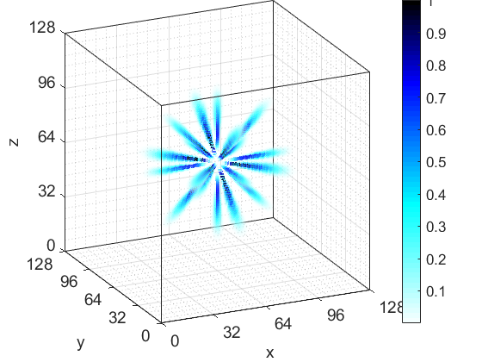
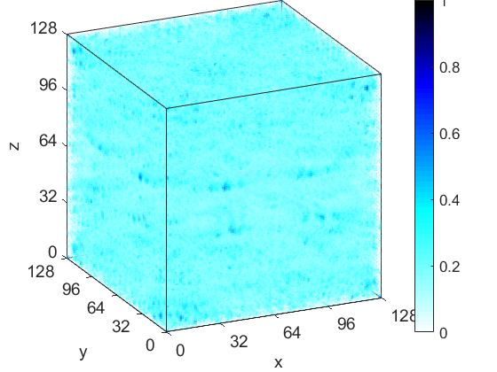
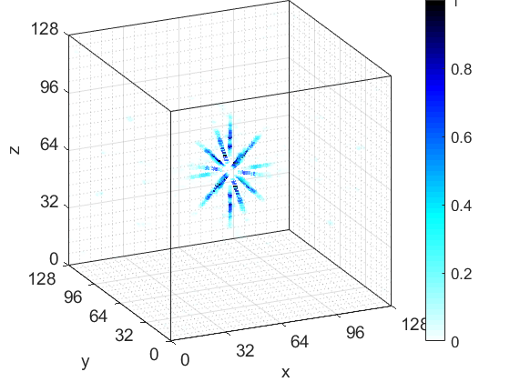

Slide 8
