Slide 1
HEALTHATHON 2026
OncoFollow
Proactive follow-up for cancer patients - built so no one
slips through the cracks after treatment ends.
Team
Venkatesh R · Naveen Krishnaa
healthathon.reskilll.com

Slide 2
THE PROBLEM
Cancer follow-up depends on memory, not a system
Cancer care doesn't end at treatment. Survivors need structured, long-term follow-up for years - recurrence surveillance, side-effect monitoring, treatment adherence - because early recurrence detection is one of the strongest predictors of survival.
WHY IT MATTERS
Cancer patients
Survival odds depend directly on timely surveillance - a missed window can mean a recurrence caught too late.
● Oncologists managing hundreds of patients track follow-ups by memory, spreadsheets, or calendar reminders
● Follow-ups slip through the cracks silently - there is no alert when a patient simply doesn't come back
● When a patient does return, doctors must reconstruct a complex treatment history from scattered notes
Oncologists
Already stretched by one of the most severely understaffed oncology systems in the world - there's no time to manually track every patient.
OncoFollow · Healthathon 2026
2

Slide 3
OUR SOLUTION
OncoFollow
Proactively identifies cancer patients who are due or overdue for follow-up, prioritises by clinical urgency, and automatically reaches out - grounded in the doctor's own notes, not a generic message.
1
2
3
Analyse
Prioritise
Reach Out
Reads each patient's treatment record and cancer-specific follow-up schedule to determine what's due.
Ranks overdue patients by clinical urgency - not just by how many days have passed.
Sends a personalised reminder, drafted from the doctor's own short notes on that patient.
OncoFollow · Healthathon 2026
3

Slide 4
BUILT AROUND THE DOCTOR
A short note, not a full chart
After every visit, the doctor leaves one short note. That's the entire context OncoFollow needs to draft a personalised, relevant reminder - and the same note lets the doctor recall a patient's status in seconds before the next call, instead of digging through a full record.
EXAMPLE NOTE
"6-month post-op check: no recurrence signs, patient reports mild fatigue, continuing follow-up imaging schedule as planned."
GENERATED REMINDER
"Hi - it's time for your 6-month follow-up. Your last check showed no signs of recurrence, which is great. Let's get your next scan scheduled."
OncoFollow · Healthathon 2026
4

Slide 5
HOW IT WORKS
From a doctor's note to a patient's reminder
Doctor's
short note
AI Agent reads
patient notes
Cedar checks:
is this allowed?
Personalised
reminder sent
Every arrow above is a real, checked decision - the agent only reads notes and sends a follow-up-kind
message because Cedar's policy allows exactly that, and nothing else, on every single call.
OncoFollow · Healthathon 2026
5

Slide 6
HOW WE'LL BUILD IT
Technology
Strands Agents SDK
Cedar
Open-source agent framework - reads patient notes and drafts each follow-up message.
Policy-based authorization. The agent may only read notes and send a reminder - enforced on every action, not assumed.
NoSQL store + OpenSearch
Scheduling workflow
Patient, note, and follow-up records; fast note search so a doctor can recall a patient's status in seconds.
Tracks each patient's due date and triggers outreach automatically when it arrives.
SMS / WhatsApp
Python
Delivery channel for the personalised reminder - reaching patients where they already are.
Backend services tying the pipeline together.
OncoFollow · Healthathon 2026
6

Slide 7
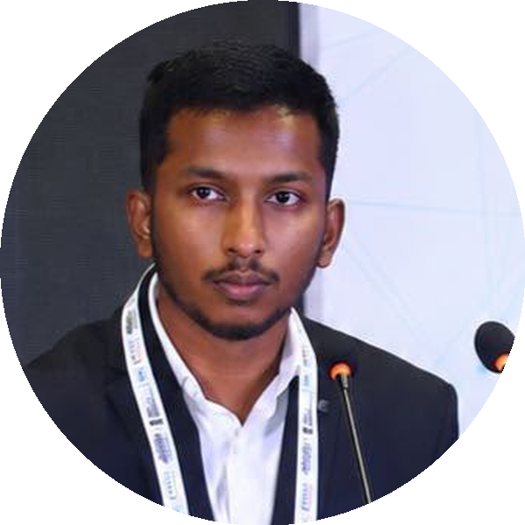
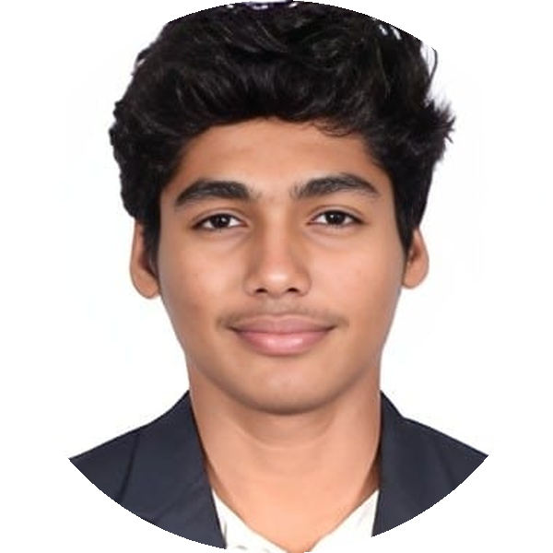
TEAM
Who's building this
Venkatesh R
Naveen Krishnaa
Transformers & LLM serving, RLHF / alignment, ZK-SNARKs, distributed inference. Architected Laminaa's chain-agnostic agent across 10 networks. 8+ hackathon wins, ₹30L+ in prizes.
Production data engineering - ETL, Kafka, Airflow, Elasticsearch - with RAG / GenAI and cloud (Azure, GCP). B.Tech AI & ML, CGPA 9.04. HimaShield GLOF system, awarded ₹5L by MeitY.
OncoFollow · Healthathon 2026
7

Slide 8
WHAT'S NEXT
From reactive care to proactive follow-up
● Follow-up windows and risk scoring tuned per cancer type and treatment stage
● Care-team roles beyond the treating doctor, with Cedar extended cleanly to each one
● Two-way outreach - a patient can reply, not just receive
OncoFollow
Venkatesh R · Naveen Krishnaa

