Slide 1

Continuous Integration Maven, Docker, & Cloud

Slide 2
AGENDA
What is Continuous Integration(CI)
Intro to Maven?
Intro to Docker?
Intro to Microservices
Intro to Cloud

Slide 3
Goals
To learn enough fundamentals to understand the basic concepts and interoperability of these topics so that you can explore further post-Tech Elevator.

Slide 4

Continuous Integration/Deployment (CI/CD)

Slide 5
WHAT IS CI / CD?
Continuous integration(CI) and continuous deployment(CD) is a set of ideas, processes, and capabilities that enables software changes to be delivered to users in a timely, repeatable, and secure manner
The goal is to create a standardized and automated process for developing, packaging, testing and deploying applications.

Slide 6
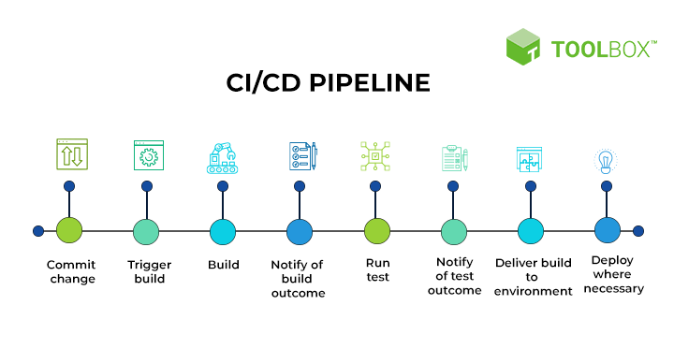
WHAT IS CI / CD?

Slide 7
Intro to Maven

Slide 8

WHAT IS MAVEN
Apache Maven is a set of tools and utilities that helps development teams:
Manage software builds (mvn commands)
Manage libraries and dependencies (pom.xml)
Maintain a matter of convention (directory structure)
Documentation (javadoc)
Plus other things: https://maven.apache.org/maven-features.html

Slide 9
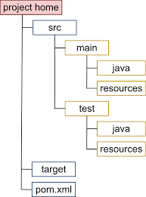
MAVEN DIRECTORY STRUCTURE
Convention > Configuration

Slide 10
Maven Dependency Management

Slide 11

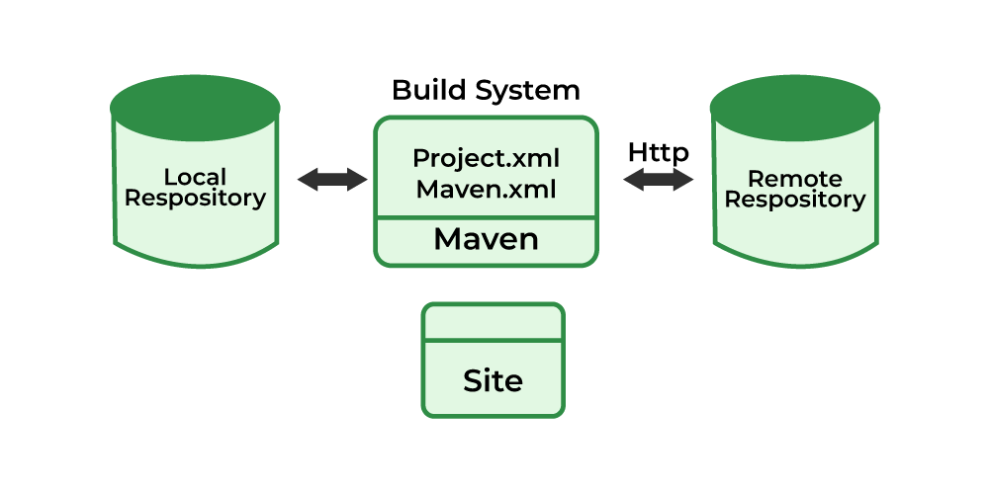
Maven Architecture
Central Repo or Mirrored Repos
pom.xml
C:\Users\Student\.m2
* These ARE NOT git repos, these are Maven repos (contain jar files, etc)

Slide 12
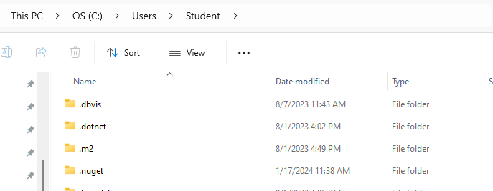
Local Repository
your user directory
Can you find yours on your machine? Note: .m2 may be a hidden file on your system.
Note to self: Show this in class

Slide 13
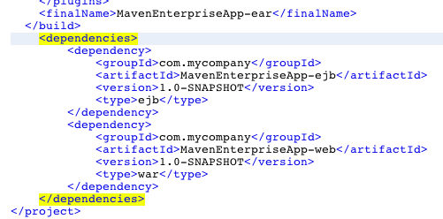
Project Object Model (pom.xml)
Contains the information related to the project which is built or to be built in. It contains all the necessary information about the configuration details, dependencies included and plug-ins included in the project.

Slide 14
How to install Maven
(Hint: it may already be installed)

Slide 15
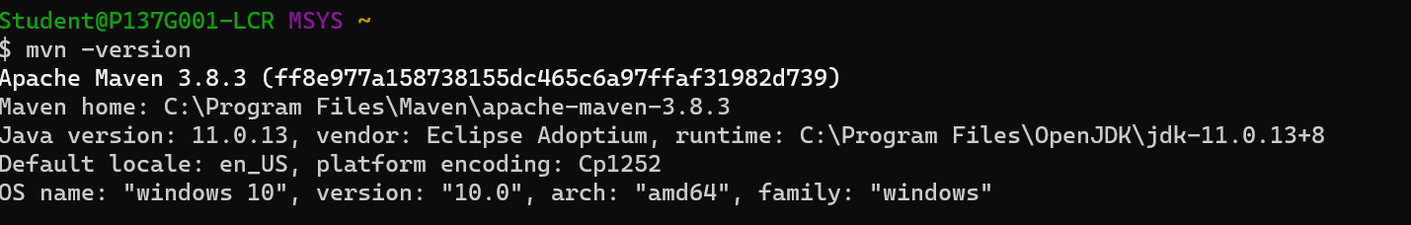
Verify Maven is installed
Open a terminal program like gitbash, or terminal
Run ‘mvn -version
** If you get an error, you may need to install Maven on your computer to use the command line: https://maven.apache.org/ or add to path variable to access the command line. Full install tutorial →https://phoenixnap.com/kb/install-maven-windows

Slide 16
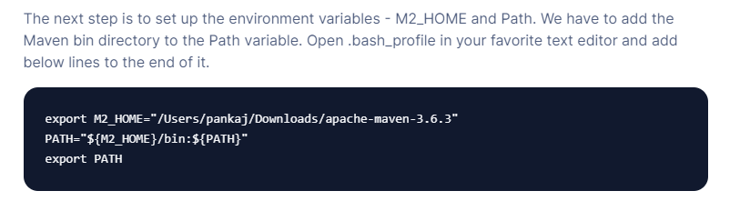
Adding to the system path (mac)
You have to relaunch terminal to pick up changes. You may or may not have a .bash_profile file. If not create one, BUT make sure you have the leading dot and make sure you create a backup if there is an existing one before changing this file.

Slide 17
How to set up a Maven project
Spring Initialzr (if using Spring)
Using IntelliJ (basic projects)
Modify existing existing projects

Slide 18
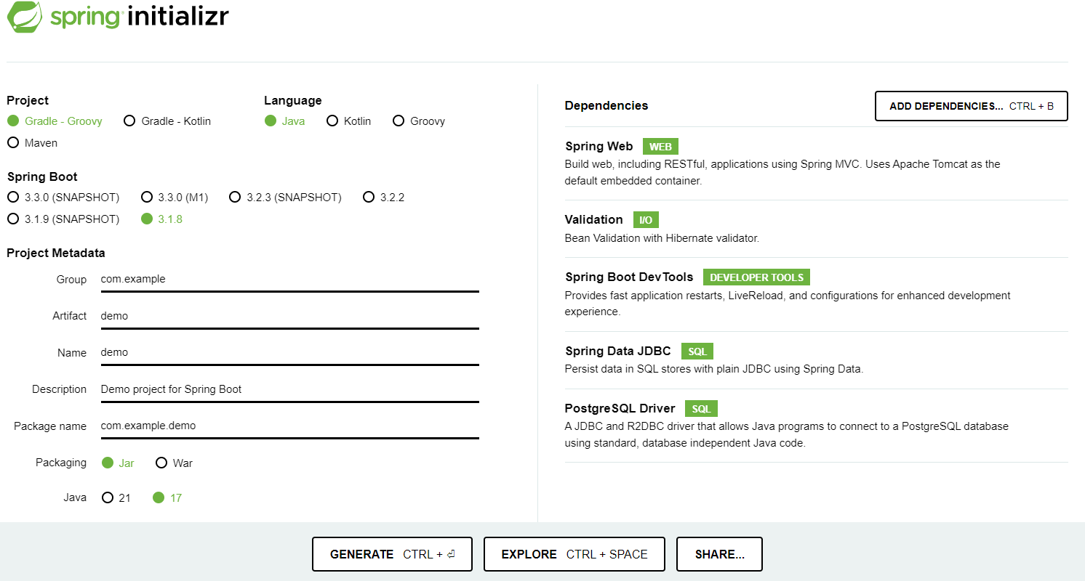
Option 1
https://start.spring.io/

Slide 19
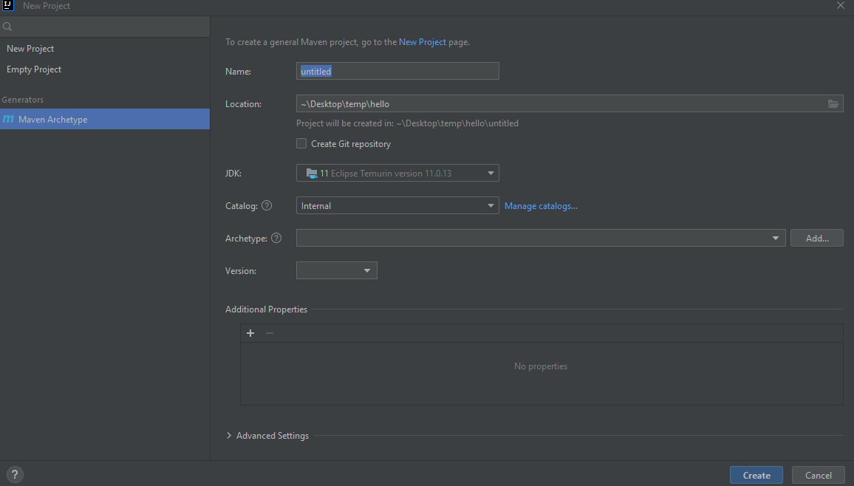
Option 2
Basic Projects - IntelliJ can create “basic” Maven applications
org.apache.maven.archetypes:maven-archetype-quickstart

Slide 20
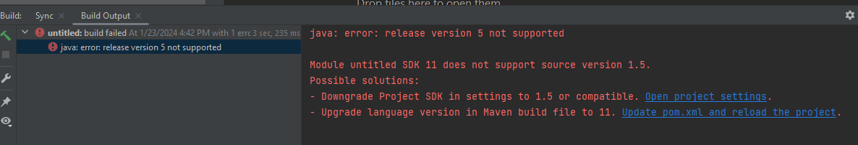
Option 2 (continued)
Creating the project will build the structure for a basic java application.
However, when running App.java you may get the following error:
org.apache.maven.archetypes:maven-archetype-quickstart
If you do, you need to add the maven build plugin to your pom.xml (See resources slide). After adding, right-click on pom.xml → Maven → reload project. Now App.java should run

Slide 21
Option 3 (copy from existing project)
E.g. Use final capstone project as a template In the workplace, we rarely build pom.xml from scratch
This is what most dev’s do. Honestly is it usually a less pain in the a$$

Slide 22
Common Maven Commands
mvn clean: Removes all the generated build output from the target directory.
mvn compile: Compiles the source code into class files.
mvn test: Executes unit tests.
mvn package: Packages the compiled classes into a JAR file.
mvn install: Installs the JAR file into the local Maven repository.
mvn clean install: Combines the above steps: clean, compile, test, package, and install.

Slide 23
Common Maven Commands
mvn clean: Removes all the generated build output from the target directory.
mvn compile: Compiles the source code into class files.
mvn test: Executes unit tests.
mvn package: Packages the compiled classes into a JAR file.
mvn install: Installs the JAR file into the local Maven repository.
mvn clean install: Combines the above steps: clean, compile, test, package, and install.
Let’s build a jar file: mvn package

Slide 24
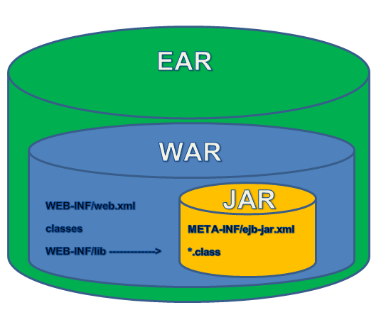
Java Deployment / Packaging

Slide 25
Running a java program
java -jar untitled-1.0-SNAPSHOT.jar org.example.App Steve If your application includes more than one jar, you may have to use the -cp options, or you could use the maven exec plugin to do something like: mvn exec:java -Dexec.mainCLass="org.example.App"
^^^ This last one won’t work without adding/configuring another plugin. Only showing so you know it exists.

Slide 26
Maven Resources

Slide 27
Build plugin
</dependencies>
<build>
<plugins>
<plugin>
<artifactId>maven-compiler-plugin</artifactId>
<version>3.1</version>
<configuration>
<source>11</source>
<target>11</target>
</configuration>
</plugin>
</plugins>
</build>
</projects>

Slide 28
Dependencies
<dependencies>
<dependency>
<groupId>org.junit.jupiter</groupId>
<artifactId>junit-jupiter-api</artifactId>
<version>5.9.1</version>
</dependency>
<dependency>
<groupId>org.junit.jupiter</groupId>
<artifactId>junit-jupiter-engine</artifactId>
<version>5.9.1</version>
</dependency>
<dependency>
<groupId>org.junit.vintage</groupId>
<artifactId>junit-vintage-engine</artifactId>
<version>5.9.1</version>
</dependency>
</dependencies>

Slide 29
Manifest for jar file..
<plugin>
<groupId>org.apache.maven.plugins</groupId>
<artifactId>maven-jar-plugin</artifactId>
<version>2.4</version>
<configuration>
<archive>
<manifest>
<mainClass>org.example.App</mainClass>
</manifest>
</archive>
</configuration>
</plugin>

Slide 30
DOCKER

Slide 31
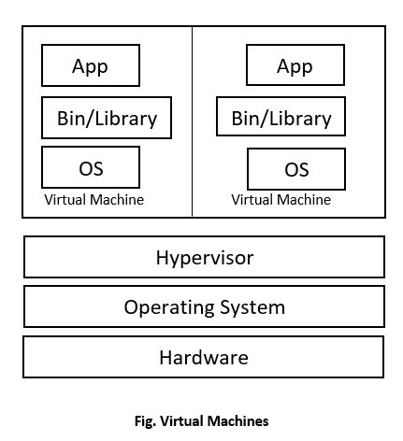
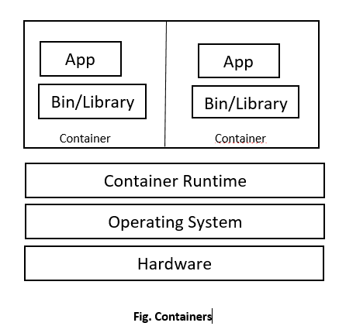
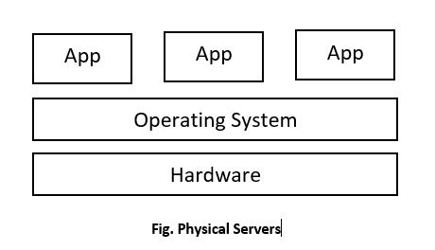
Before we talk about Docker …

Slide 32
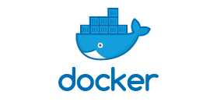
What is Docker?
Docker is an open-source platform for developing, delivering, and running applications.
Docker detaches applications from infrastructure, through its container approach.

Slide 33
What are containers?
Containers provide loosely, isolated environments that can run concurrently on a host. They run in the Docker Engine Containers can be shared, or deployed rapidly in servers or in the cloud. Containers are highly portable and lightweight.
Cloud deployments use containers to “scale” an application as demand increases, and reclaim resources as instances are removed when demand decrease. (Containers can be loads in seconds vs minutes(VMs))

Slide 34
Other terminology you should know:
Docker File → A Dockerfile is a text file containing instructions for building your source code. It is used to build a docker image. Docker Image → Docker images are read-only templates that contain instructions for creating a container. A Docker image is a snapshot or blueprint of the libraries and dependencies required inside a container for an application to run * Kubernetes → Kubernetes is a portable, extensible, open source platform for managing containerized workloads and services. (Kubernetes is not part of Docker per se, but often used in projects to manage deployment)

Slide 35
Docker Desktop or command line

Slide 36
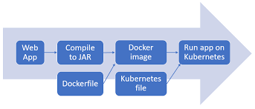
Java Deployment Example w/Docker
Maven
Kubernetes, is an open-source system for automating deployment, scaling, and management of containerized applications.
or

Slide 37
Microservices

Slide 38
What are microservices?
Microservices is an architectural style for developing applications as a collection of smaller, independent services.
Each service runs in its own process and communicates with other services and clients using lightweight protocols, such as HTTP or messaging.

Slide 39
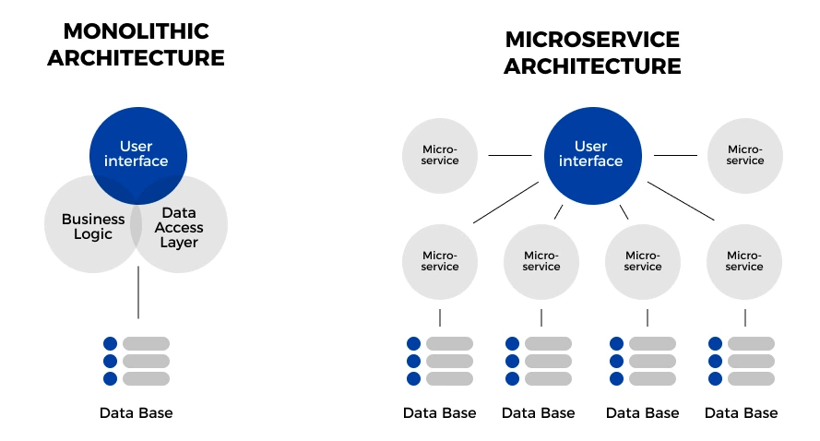

Slide 40
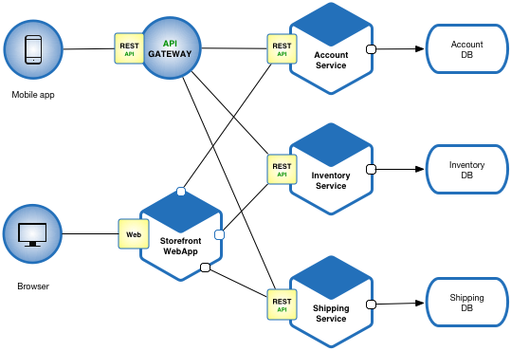

Slide 41
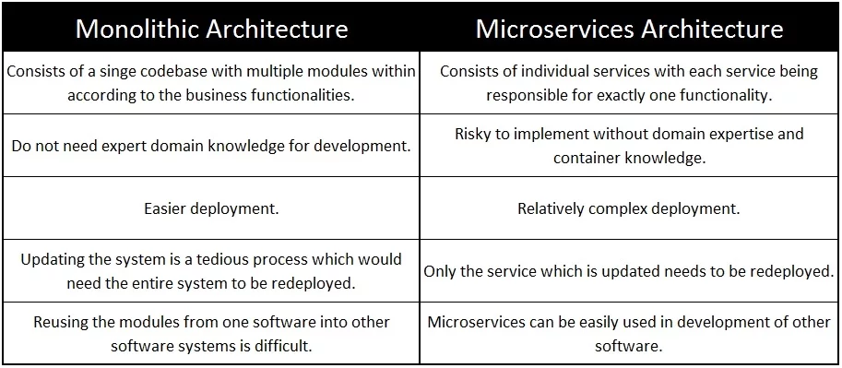

Slide 42
Cloud

Slide 43
What is Cloud Computing?
The delivery of different services through the Internet which includes tools and applications such as data storage, servers, databases, networking, and software. Usually a pay for use model with flexible capacity. No need to invest in a data center, servers, or other resources,

Slide 44
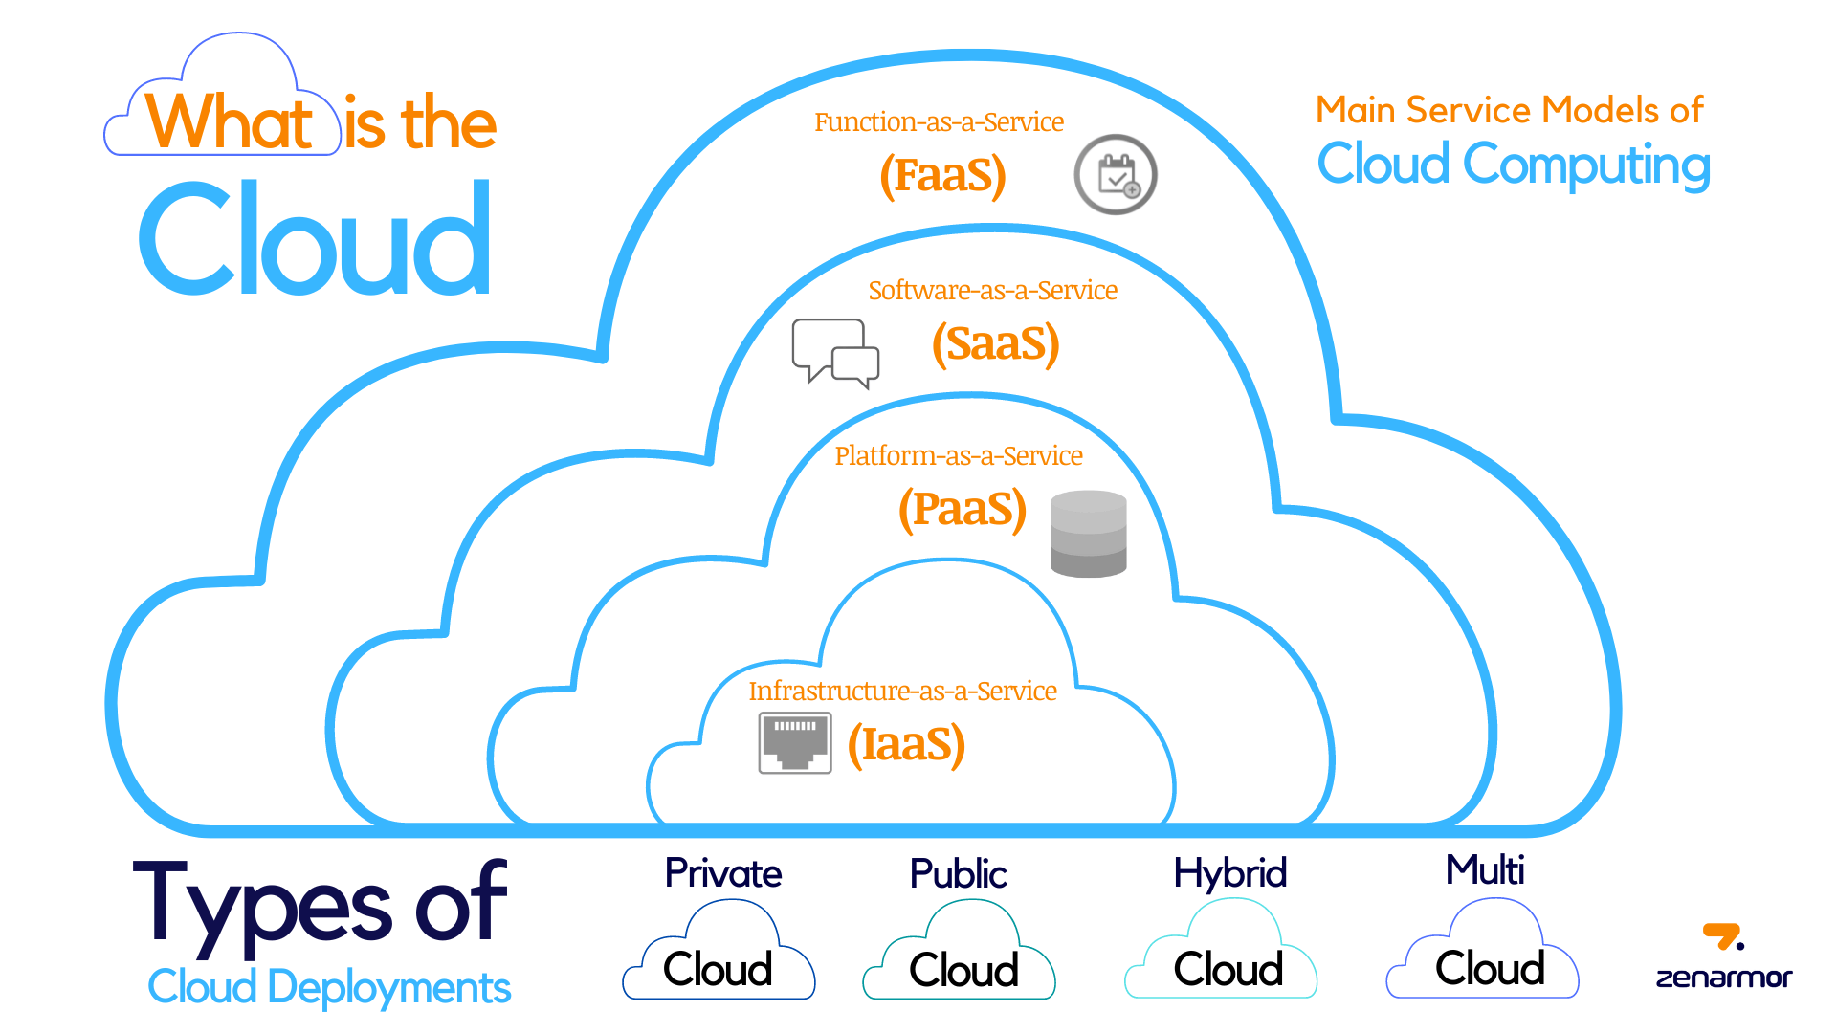

Slide 45
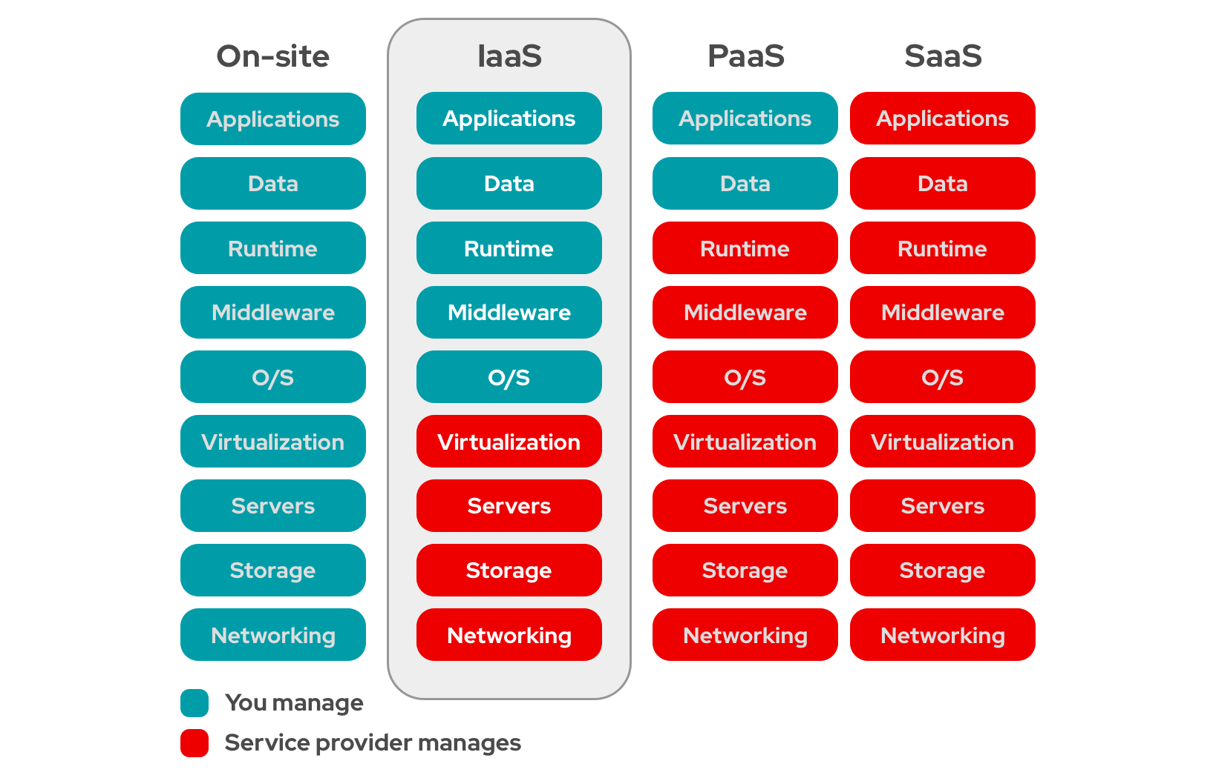
Common type of cloud offerings

Slide 46
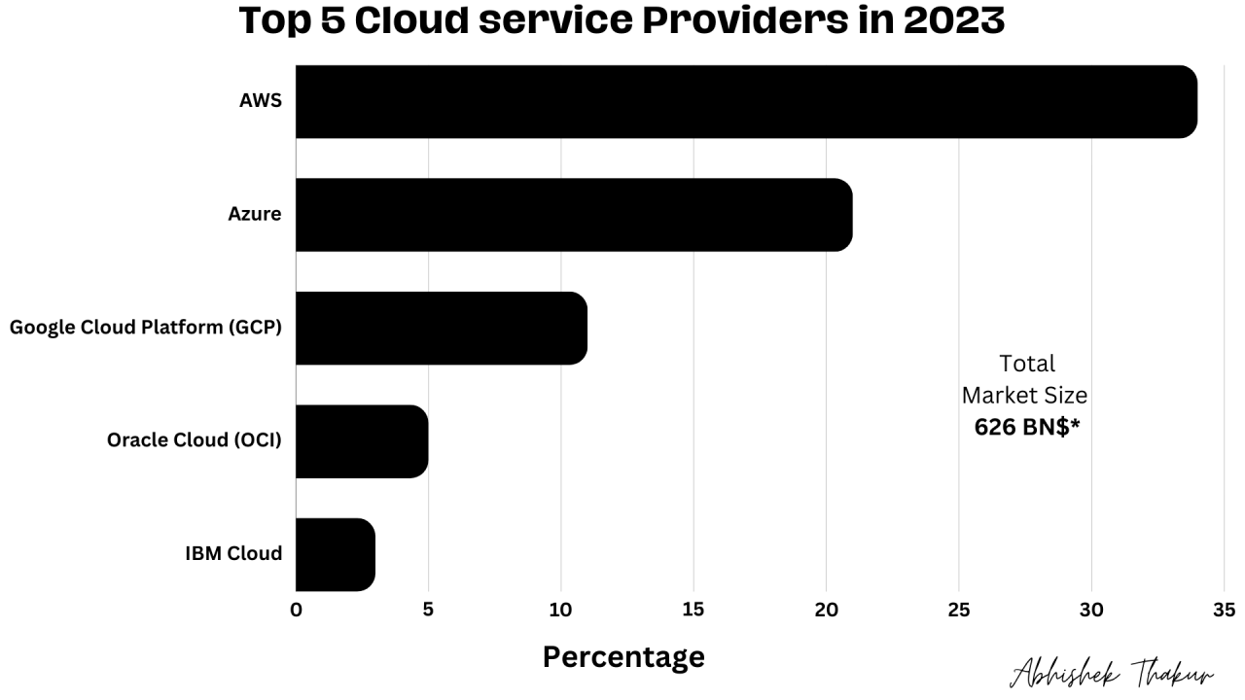

Slide 47
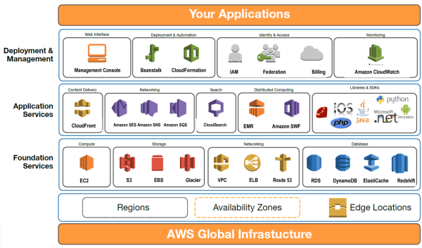

Slide 48
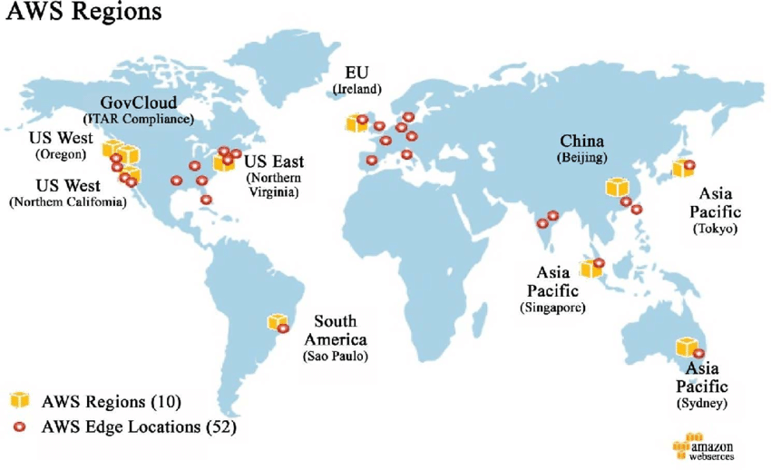

Slide 49
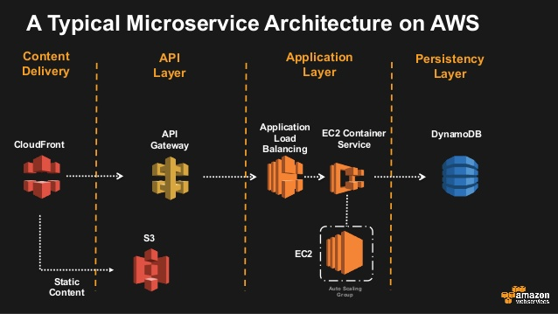

Slide 50
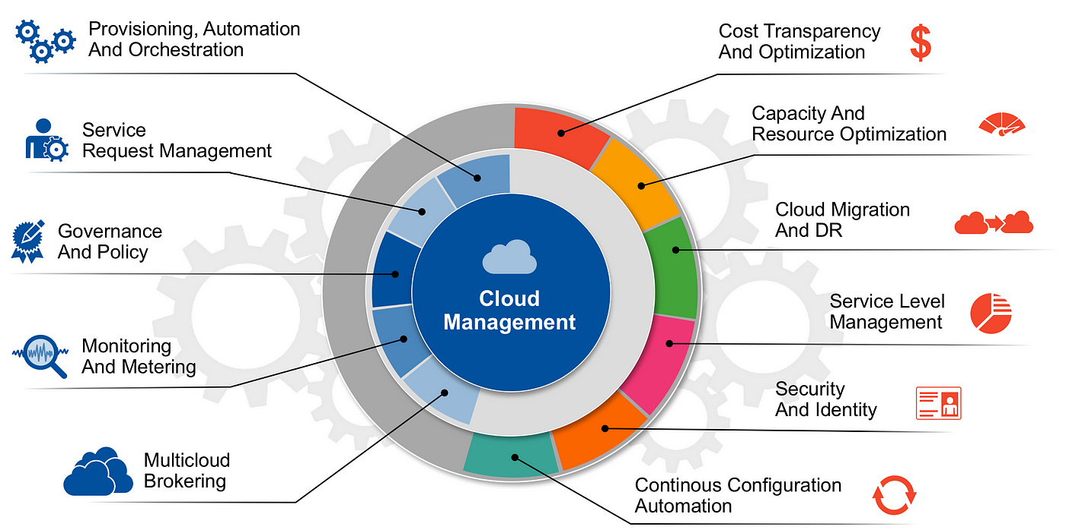

Slide 51
HAPPY CODING!

