Slide 1


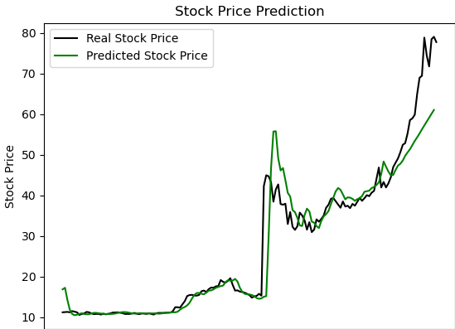
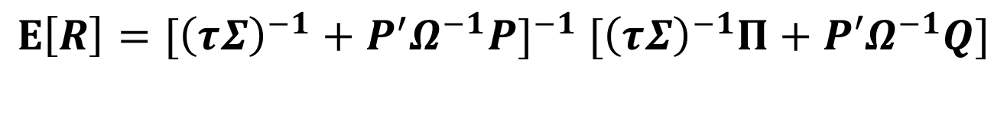
Using LSTM to Predict Stock Price and Apply Black-Litterman Model to Allocate Asset
Professor: 柯拉飛
Student: B10604044 李明揚
I. Introduction
II. Black-Litterman Model
This project used Black-Litterman(BL) model to do asset allocation. I compare two methods. One is using LSTM to predict stocks price then computing the rate of return as input of BL-Model. The other is the report of investment company, using the target price of stocks to compute the rate of return as input. We want to view the performance of these two, and whether BL model is efficient or not.
$$E\left[R\right]={[{\left(τΣ\right)}^{−1}+P^{′}Ω^{−1}P]}^{−1} [{\left(τΣ\right)}^{−1}Π+P′Ω^{−1}Q]$$
τ: scale factor
Σ: Covariance matrix of Excess rate of return
P: Investor’s view matrix
Π: Implied equilibrium rate of return vector
Q: Point of view earnings vector
Ω: Covariance matrix of opinion error, used to express the difference between the investor’s opinion and the actual situation
III. Using LSTM to Predict Stock Price
IV. Report of Investment Company
I use 3 years stocks data to train model, and using it predict the stocks price on April
This figure is using LSTM to predict price of stocks 2603.
I use four stocks, these stock companies are very famous and some of them have status in the international arena.
2002 中鋼: 兆豐 31.0
2330 台積電: 瑞士信貸 650.0
2603 長榮: 兆豐 58.0
2881 富邦金: 宏遠 63.0
VI. 報酬率比較
4月股票實際漲跌幅(開盤價)
V. BL Model Asset Allocation
Stock ID | 2002 | 2330 | 2603 | 2881
4/01 | 26 | 598 | 47 | 57.6
4/29 | 39.5 | 609 | 77.8 | 64.9
報酬率(%) | 51.9 | 1.5 | 65.5 | 12.7
LSTM
2002 | 2330 | 2603 | 2881
-0.08 | -0.49 | 1.5 | 0.07
Report
2002 | 2330 | 2603 | 2881
0.74 | 0.015 | 0.195 | 0.05

