Slide 1
Undecidability

Slide 2
Recursive Language
A language L is recursive, if L is the set of strings accepted by some Turing Machine (TM) that halts on every input.
The Turing Machine will halt every time and give answer(accepted or rejected) for each and every input string.
Recursive Enumerable Language
A language L is recursively enumerable if L is the set of strings accepted by some TM.
But may or may not halt for all input strings which are not in ‘L’.

Slide 3
Read closure properties of Recursive and Recursive enumerable from copy

Slide 4
Decidable Language
A language L is decidable if it is a recursive language. All decidable languages are recursive languages and vice-versa.
A problem is said to be a Decidable problem if there exists a corresponding Turing machine which halts on every input with an answer- yes or no.
It is also important to know that these problems are termed as Turing Decidable since a Turing machine always halts on every input, accepting or rejecting it.

Slide 5
Decidable Language
Example :
Are two regular languages L and M equivalent? - We can easily check this by using Set Difference operation. L-M =Null and M-L =Null. Hence (L-M) U (M-L) = Null, then L,M are equivalent.

Slide 6
Semi (Partial) - Decidable Language
A languages L is semi decidable if L is a recursive enumerable language
Semi-Decidable problems are those for which a Turing machine halts on the input accepted by it but it can either halt or loop forever on the input which is rejected by the Turing Machine.
Such problems are termed as Turing Recognizable problems.

Slide 7
Undecidable Language
A languages L is undecidable if it is not decidable
An undecidable languages may sometimes be partially decidable but not decidable
If a languages in not even partially decidable, then there exist no Turing machine for that language

Slide 8
Undecidable Language
Example:
Whether a CFG generates all the strings or not? As a CFG generates infinite strings, we can’t ever reach up to the last string and hence it is Undecidable.
Whether two CFG L and M equal? Since we cannot determine all the strings of any CFG, we can not predict that two CFG are equal or not.

Slide 9
Church-Turing Thesis
“A computation on numbers by an algorithm if and only if it is computable by Turing Machine”
This statement has been given in the year 1936 by Alonzo Church and Alan Turing, but the fact is that till that time even the logic gate was also not available
This thesis can not be proven, but is believed on the basis of amount of evidence that support it
Computer scientist have designed several alternative model of computation, but all have proven to be equivalent to the turing machine
Church-turing can also be viewed as offering a definition of what an algorithm is

Slide 10
Church-Turing Thesis
According to it “ any real world computation can be translated into an equivalent Turing machine computation”
Anything that can be done by current digital computer can also be done by a Turing machine
Currently there is no problem which can be solved by a digital computer and can not be solved by a Turing Machine
Many mathematical models are suggested but no one of them is more powerful than the Turing machine

Slide 11
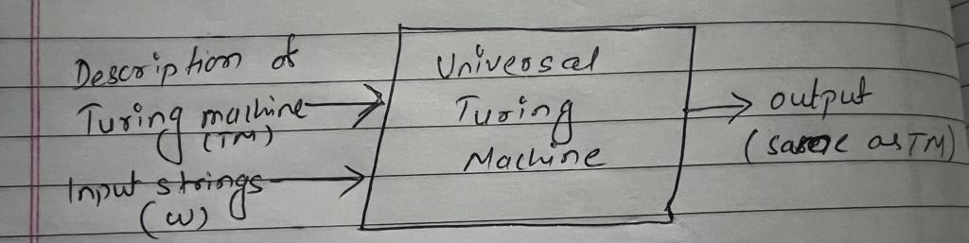
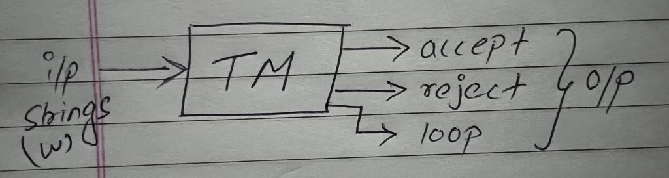
Universal Turing Machine
A Turing Machine is said to be Universal Turing Machine (UTM) if it can accept the input data and an algorithm(description) for computing
TM is hardwired machine where UTM is programmable Turing machine
TM does single task where UTM can do different type of task

Slide 12
Universal Turing Machine
A Universal Turing Machine is a specified Turing Machine that can simulate the behavior of any Turing Machine
To design a UTM, we have to increase the number of read/write heads, dimension of input tape & adding a special purpose memory in basic model of Turing Machine
The problem with Turing Machine is that a different machine must be constructed for every new computation to be performed, that is for every input output relation
To solve this problem of Turing Machine, Universal Turing machine introduced, which takes description of a machine M & input on the tape

Slide 13
Universal Turing Machine
We design UTM then simulate TM on the content of input tape = Therefore UTM can simulate any other Turing Machine
So for any problem that can be solved by Turing Machine, you can either use a Turing Machine that directly solves the problem or you could use a UTM

Slide 14
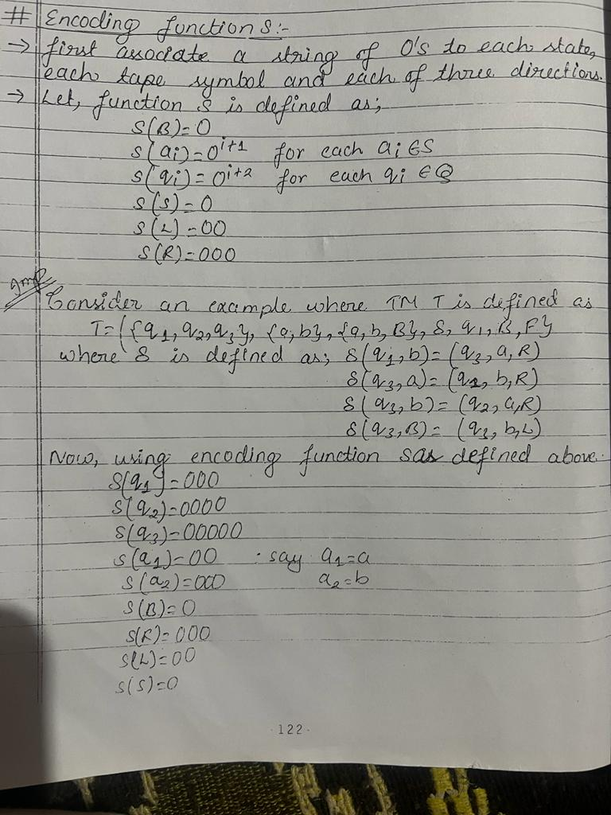

Slide 15
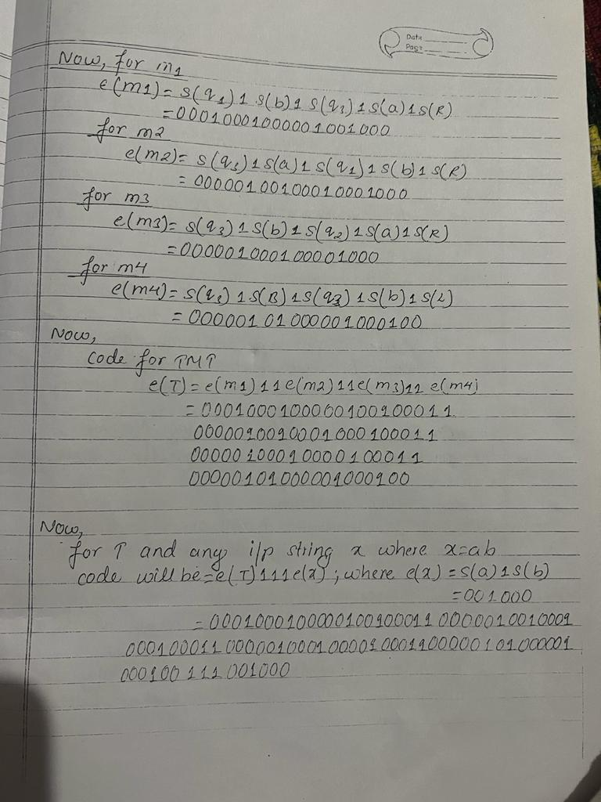

Slide 16
Halting problem of Turing machine
The halting problem of Turing machine is that “ For a given program/algorithm, it is not possible to determine that whether the Turing machine will ever halt or not ”
Halting means that program on certain input will accept it and halt, or reject it and halt. It will never go into infinite loop
Halting actually means terminating.
So can we have an algorithm that will tell that the given program will halt or not. In terms of Turing machine, Will it terminate when run on a Turing machine with some particular given input string?? - The answer is no, i.e. we can not design a generalized algorithm which can appropriately say that given a program will ever halt or not

Slide 17
Halting problem of Turing machine
So this is an Undecidable problem because we can not have an algorithm which tell us whether a given Turing machine will halt or not in a generalized way
The best possible solution is to run a program or turing machine and see whether it halts or not.

Slide 18

Recursive functions theory
Initial Functions
There are three initial functions
Zero functions(Z)
It is defined as Z(x) = 0
For eg: Z(5) = 0
Successor function(S)
It is defined as S(x) = x + 1
For eg: S(6) = 6 + 1 = 7
Projection functions (P)
It is defined as $P_{i}^{n}$($x_{1}$, $x_{2}$, $x_{3}$, $x_{4}$….. $x_{n}$) = $x_{i}$
For eg: $P_{2}^{4}$(1,3,5,7) = 3

Slide 19
Recursive functions theory
Composite functions
A composite function is defined when one functions is substituted into another function.
For eg: Let f(x) = 3x+1 g(x) = x+5 then, f(g(x)) = f(x+5) = 3(x+5)+1 = 3x+16 or g(f(x)) = g(3x+1) = (3x+1)+5 = 3x+6

Slide 20
Recursive functions theory
Recursive function
A function that repeats itself again and again is called recursive functions
Types:
Primitive Recursive function
Partial Recursive function
Total Recursive function

Slide 21
Recursive functions theory
Primitive Recursive function
A function is called primitive recursive function, if it can be obtained from initial functions through finite number of composition and recursive steps.
For eg: Addition of integer (x,y) add(x,0) = x …….. (1) add(x,y+1) = add(x,y) + 1 ………(2) for add 3 and 2 add(3,2) = add(3,1+1) = add(3,1) + 1 = add(3,0+1) + 1 = add(3,0) + 1 + 1 = 3 + 1 + 1 = 5

Slide 22
Recursive functions theory
Primitive Recursive function
For eg: Multiplication of integer (x,y) mult(x,0) = 0 …….. (1) mult(x,y+1) = add(x,mult(x,y)) ………(2) for add 3 and 2 mult(3,2) = mult(3,1+1) =add(3,mult(3,1)) = add(3,mult(3,0+1)) = add(3,add(3,mult(3,0))) = add(3,add(3,0)) = add(3,3)
= add(3,2) + 1 = add(3,1)+1+1 = add(3,0)+1+1+1 = 3+1+1+1 = 6

Slide 23
Recursive functions theory
2. Partial Recursive function
A functions is called partial recursive function if it is defined only for some of its arguments. For eg: subtraction of two positive integer number m and n is also a positive f(m,n) = m – n, m >= n m < n

Slide 24
Recursive functions theory
3. Total Recursive function
A recursive function is said to be total recursive function, if it is designed for all its arguments.
So a total function is said to be primitive recursive function if and only if it is an initial functions obtained by applying composition and recursion with finite no. steps
For eg: multiplication of two positive no’s is total recursive and primitive recursive

Slide 25
Computational Complexity

Slide 26
Computational Complexity
The complexity theory provides the theoretical estimates for the resources needed by an algorithm to solve any computational task
It involves classifying problem according to their tractability or intractability i.e. whether they are easy or hard to solve
The complexity of an algorithm computes the amount of time and spaces required by an algorithm for an input of size (n).
The complexity of an algorithm can be divided into two types. - The time complexity and the space complexity.

Slide 27
Complexities of an Algorithm
Time Complexity
The time complexity is defined as the process of determining a formula for total time required towards the execution of that algorithm.
This calculation is totally independent of implementation and programming language.
Space Complexity
Space complexity is defining as the process of defining a formula for prediction of how much memory space is required for the successful execution of the algorithm.
The memory space is generally considered as the primary memory.

Slide 28
Time and Space Complexity are two important concepts in computer science and algorithm analysis. These concepts help us to analyze the efficiency and performance of algorithms, especially when comparing different algorithms for a given problem.
Time Complexity refers to the amount of time an algorithm takes to run as a function of the size of its input. It is usually expressed using Big O notation, which provides an upper bound on the growth of the running time of an algorithm. For example, if the time complexity of an algorithm is O(n), it means that the running time of the algorithm increases linearly with the size of the input. Other common time complexities include O(log n), O(n log n), O(n^2), O(2^n), etc.
Space Complexity refers to the amount of memory an algorithm requires to run as a function of the size of its input. Like time complexity, space complexity is also expressed using Big O notation. For example, if the space complexity of an algorithm is O(n), it means that the memory used by the algorithm increases linearly with the size of the input. Other common space complexities include O(1), O(log n), O(n), O(n^2), etc.

Slide 29
It is important to note that the time and space complexity of an algorithm are often trade-offs. For example, an algorithm with a low time complexity may require more memory, and vice versa. Therefore, when selecting an algorithm for a particular problem, we need to consider both the time and space complexity and determine which one is more important for our specific use case.
Here's an example of time complexity analysis: Consider a simple algorithm that finds the maximum value in an array of n elements. One possible implementation of this algorithm is to traverse the entire array and keep track of the maximum value seen so far. The time complexity of this algorithm can be expressed as O(n), since it takes linear time with respect to the size of the input array.
Here's an example of space complexity analysis: Consider a recursive algorithm that calculates the nth Fibonacci number. The space complexity of this algorithm can be expressed as O(n), since it requires linear space with respect to the size of the input. This is because each recursive call generates a new level of the call stack, and the maximum number of levels is equal to the size of the input (n).

Slide 30
In conclusion, Time and Space Complexity are important concepts that help us analyze the efficiency and performance of algorithms. Understanding these concepts is crucial for selecting the right algorithm for a particular problem and ensuring that the algorithm runs efficiently in both time and space.

Slide 31
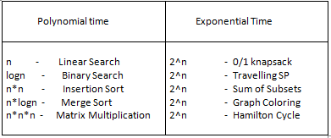
Algorithm
An algorithm is a finite set of instructions, those if followed, accomplishes a particular task.
It is not language specific, we can use any language and symbols to represent instructions.
5 | 10 | 3 | 6 | 7
Algorithm

Slide 32
Tractability and Intractability
A problem is called tractable iif there is an efficient algorithm that solves it in polynomial time
Eg: Linear search (O(n)), binary search (O(logn)), merge sort(O(nlogn))
There is no efficient algorithm to solve it or A problem that cant be solved in polynomial time but verifiable in polynomial time
Eg: Travelling sales man, Graph coloring, scheduling, SU-DU-KU = (2^n)

Slide 33
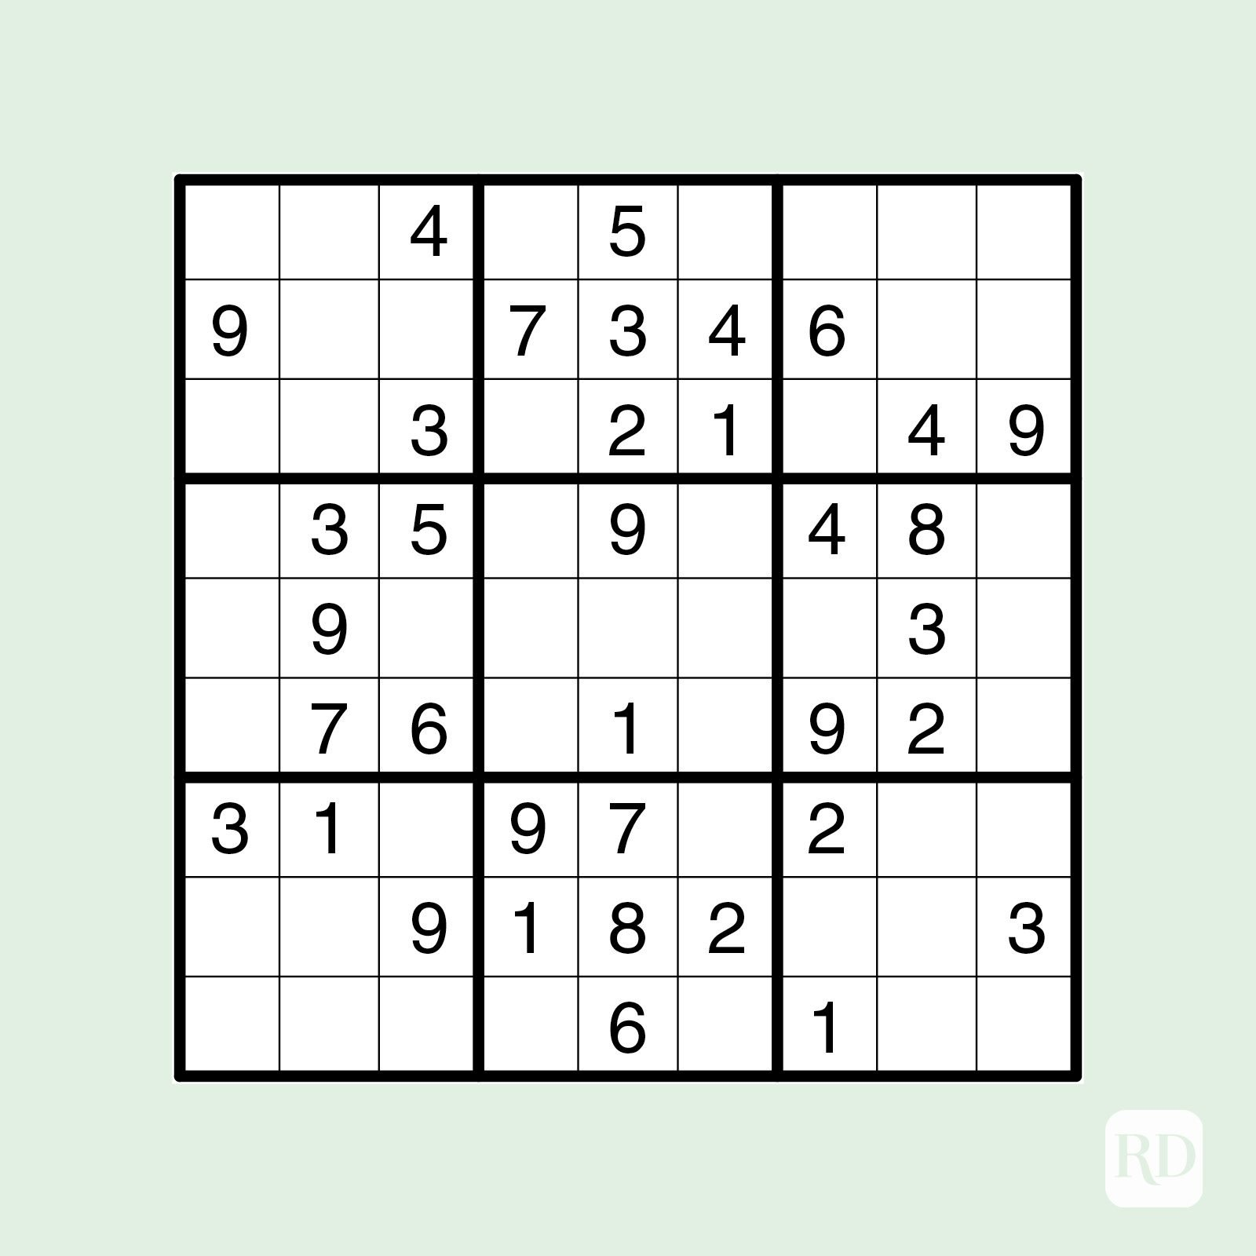
Tractability and Intractability
EG: SU-DU-KU

Slide 34
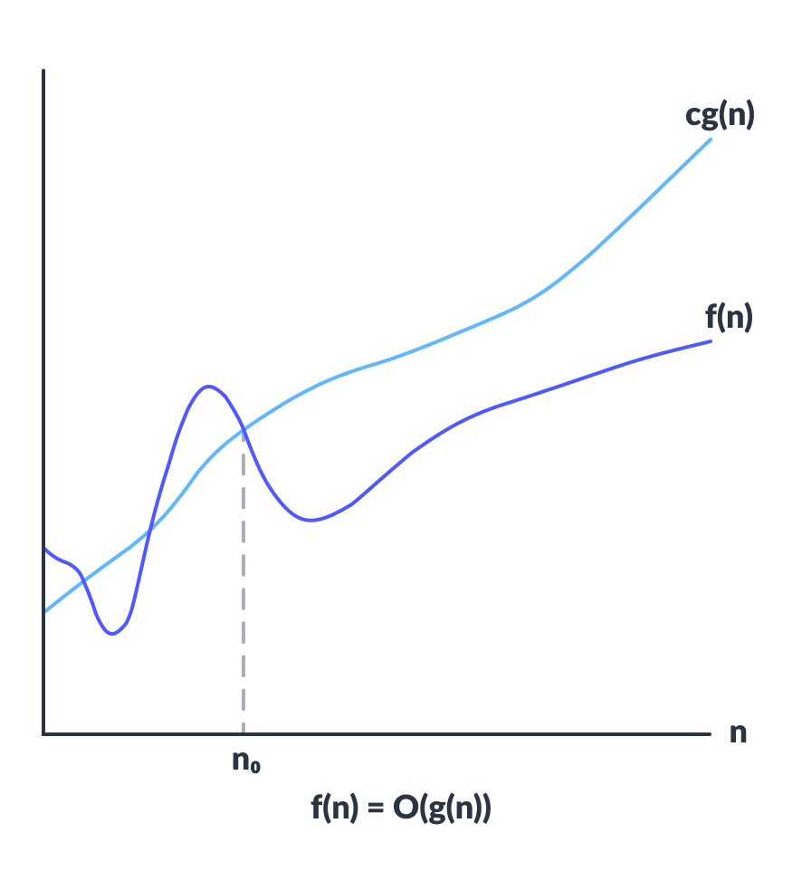
BIG OH ‘O’ Notation
Big-O notation represents the upper bound of the running time of an algorithm. Thus, it gives the worst-case complexity of an algorithm.
O(g(n)) = { f(n): there exist positive constants c and n₀ such that 0 ≤ f(n) ≤ cg(n) for all n ≥ n₀ }
The above expression can be described as a function f(n) belongs to the set O(g(n)) if there exists a positive constant c such that it lies between 0 and cg(n), for sufficiently large n.
For any value of n, the running time of an algorithm does not cross the time provided by O(g(n)).
Since it gives the worst-case running time of an algorithm, it is widely used to analyze an algorithm as we are always interested in the worst-case scenario.

Slide 35
Class P and NP Problem
P Class – Problem
P is set of problems that can be solved(deterministic) in polynomial [P] time
Eg: Linear search (O(n)), binary search (O(logn)), merge sort(O(nlogn))
Formally, an algorithm is polynomial time algorithm, if there exists a polynomial p(n) such that the algorithm can solve any instance of size n in a time O(p(n))

Slide 36
Class P and NP Problem
NP Class – Problem
NP is set of problems that can be solved (non-deterministic) in polynomial time
Also NP problem can be verified in polynomial time
Eg: Travelling sales man, 0/1 knapsack, graph coloring, Hamilton cycle, SUDUKU

Slide 37
Class P and NP Problem
P class problems are subset of NP class problem
Does P=NP?
P!=np
NP
P

Slide 38
Non deterministic algorithm
Baral Search (A, n, Key) key = 9
{
i = choice(); 5 -------O(1)
if(A[i]==key) 9==9 ---O(1)
{
print(i) //success
}
print(0) //failure
}
1
A Key = 9
1 2 3 4 5 6
2 | 5 | 6 | 8 | 9 | 3

Slide 39
REDUCTION
Let A and B are two problems in NP. If problem A is reduce to problem B, iff there is a way to solve A by deterministic algorithm that solve B in polynomial time. The we can denote A ∝ B
Properties:
If A is reducible to B and B is in polynomial time, then A also in polynomial time
A is not in polynomial time, It implies that B is not in polynomial time
Deterministic Algorithm
A
B
Reduce
solve

Slide 40
NP-Hard and NP-Complete
NP-Hard Problem
Every problem in NP class can be reduced into other set using polynomial time, then it is called as NP- Hard problem
P.T.
NP
NP- HARD
Reduce
P

Slide 41
NP-Hard and NP-Complete
NP-Complete
The group of problems which are both in NP and NP-hard are known as NP complete problem
The NP-Complete problems are NP-Hard but not all NP-Hard problems are NP-Complete
If you write a non deterministic polynomial time algorithm for np hard problem is called np complete= o/1 knapsack problem reduce (PT) in Hamilton cycle = Non deterministic manner using polynomial time
NP
NP- HARD
P

