Slide 1
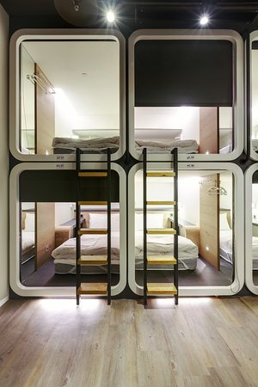
MATCH 7, 2026
PodNest
PodNest
Smart Modular “Plug-and-Play” Hotel Extension Pods
Student Name:
Student ID:
Course Code:
institution Affiliation:
Instructor's Name:
PAGE ONE

Slide 2

MATCH 7, 2026
PodNest
INTRODUCTION
PodNest: Smart Modular Hotel Pods
A fast and affordable solution for modern travel accommodation
PodNest is a module sleep pod that is meant to assist hotels to increase their capacity in a fast manner and at the same time offer affordable personal accommodation to travellers.
Key Features
• Installed in 3–7 days on rooftops, car parks, or unused land
• Smart lock and app-based check-in for seamless access
• AI-enhanced sleep environment (lighting, temperature, sound)
• Affordable private accommodation from £35–£55 per night
Value Proposition
PodNest enables hotels to create more rooms within a short period of time without necessarily constructing new hotels at lower costs and charges to the traveller.
PAGE TWO

Slide 3
MATCH 7, 2026
PodNest
THE PROBLEM
Hotels cannot expand quickly enough to meet demand.
Affordable accommodation shortage
Market opportunity
  UK hospitality market valued at $63.8 billion (Mordor Intelligence, 2026)
Result:
  Hotels cannot add more rooms quicly, while young travellers have problems with finding affordable accommodation in their own rooms.
  UK hotel occupancy recovered strongly, reaching 77% in 2023 (VisitBritain, 2023)
  Construction delays and planning restrictions slow hotel expansion
  High construction costs make new hotels expensive
  UK student population continues to grow rapidly
  470,000 new students but only 258,000 beds added since 2012 (Knight Frank, 2024)
PAGE Three

Slide 4

MATCH 7, 2026
PodNest
THE SOLUTION
PodNest
Key Benefits
Hotels
  Expand capacity in days instead of years
  Use unused spaces such as rooftops or car parks
Travellers
  Private room at hostel-level prices
  Fast digital check-in and smart comfort features
A modular hotel pod system that allows hotels to add rooms rapidly without building new hotels.
Each Pod Includes
  Smart lock and mobile check-in
  AI-based sleep environment (lighting, temperature, sound)
  Compact private sleeping space
  Integrated breakfast vending option
PAGE FOUR

Slide 5

MATCH 7, 2026
PodNest
FEASIBILITY (HOW IT WORKS)
Key Business Model Elements
Key Partners
  Hotels
  Modular construction manufacturers
Key Resources
  Pod design and manufacturing
  Digital booking platform
Revenue Streams
  Pod sales
  Monthly leasing
  Booking commissions
Modular construction significantly reduces construction time and costs compared with traditional buildings (Parracho et al., 2025).
Hotels purchase or lease PodNest pods
Pods are delivered and installed within 3–7 days
Customer Journey
Guests book through PodNest app or hotel website
PAGE FIVE
Hotels earn revenue from additional rooms
Guests check-in using mobile smart locks

Slide 6



MATCH 7, 2026
PodNest
DESIRABILITY
Target Customers
Customer Needs
Price Willingness
Market Evidence
There is a growth in demand of cheap travel accommodation and the hostel industry is poised to expand tremendously, with younger travellers giving preference to low-cost travelling (Future Market Insights, 2025).
PodNest offers an individual option instead of shared hostel rooms at an equivalent cost.
  University students
  Backpackers
  Short-stay travellers
  Budget-conscious tourists
  Affordable accommodation
  Privacy compared with hostels
  Convenient digital booking and check-in
Estimated price range:
£35–£55 per night
PAGE SIX

Slide 7

MATCH 7, 2026
PodNest
Revenue Model
  Pod sales to hotel operators
  Monthly leasing agreements
  Commission from bookings
  Data insights for hotel revenue optimisation
Market Opportunity
  UK hospitality industry worth $63.8 billion (Mordor Intelligence, 2026)
  Global modular construction market expected to exceed $300 billion by 2035 (Global Market Insights, 2025)
Key Competitors
  Budget hotels
  Hostels
  Airbnb
Competitive Advantage
PodNest offers:
  Faster hotel expansion
  Lower accommodation prices
  Smart modular technology
This combination creates a scalable solution for both hotels and travellers.
VIABILITY
PAGE SEVEN

Slide 8

MATCH 7, 2026
PodNest
CONCLUSION
PodNest: The Future of Flexible Hotel Expansion
PodNest offers an innovative solution to two major challenges in the hospitality industry: slow hotel expansion and the growing demand for affordable accommodation.
Key Takeaways
  Enables hotels to expand capacity quickly without new construction
  Provides affordable and private accommodation for young travellers
  Uses modular and sustainable construction technology
  Creates new revenue opportunities for hotel operators
PAGE EIGHT
Vision
To support the hospitality industry with flexible, fast, and affordable accommodation solutions while improving travel accessibility for the next generation of travellers.

Slide 9
MATCH 7, 2026
PodNest
REFERENCES
  Future Market Insights. (2025). United Kingdom hostel market outlook 2025–2035. https://www.futuremarketinsights.com/reports/united-kingdom-hostel-market
  Global Market Insights. (2025). Modular and prefabricated construction market size. https://www.gminsights.com/industry-analysis/modular-and-prefabricated-construction-market
  Knight Frank. (2024). Student accommodation survey report. https://content.knightfrank.com/research/1663/documents/en/knight-frank-ucas-student-accommodation-survey-report-2024-11543.pdf
  Mordor Intelligence. (2026). United Kingdom hospitality industry report. https://www.mordorintelligence.com/industry-reports/hospitality-industry-in-the-united-kingdom
  Parracho, D. F. R., et al. (2025). Modular construction in the digital age. Buildings Journal. https://www.mdpi.com/2075-5309/15/5/765
  VisitBritain. (2023). England hotel occupancy statistics. https://www.visitbritain.org/research-insights/england-hotel-occupancy-latest
PAGE NINE

Slide 10
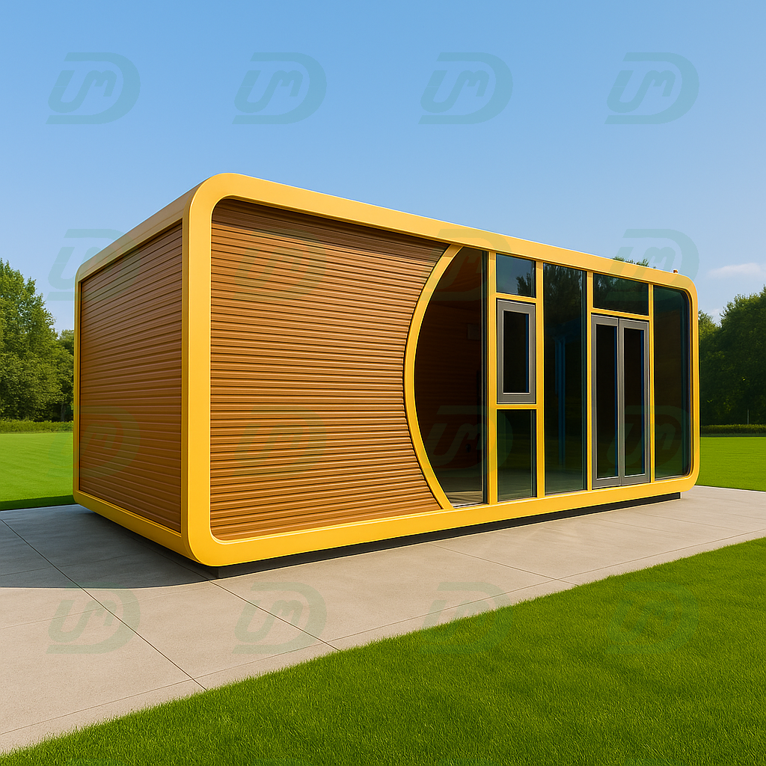
PodNest
Thank you for your attention.

