Slide 1
PROJECT 2
ALGO-TRADING MODEL [stocks, bitcoin, futures contracts, etc)
Team Members:
Adam Cooke
Nia Robinson
Ros Tiamzon

Slide 2
TABLE OF CONTENTS
01
04
About the Algo-Trading Project
Data Preparation – Model Training
02
05
Models Used, Tools
Achieving Project Goal, Results and Conclusions
03
06
Project Goal
Next Steps
Stock, Bitcoin, Futures Contracts, etc
Data sources, libraries, codes
SK-Learn and PyTorch
Algo and predictive analysis
Predict closing prices - subscription/access to trading models
Expanding the Algo-Trading Model Project

Slide 3
About the Project
Algo-Trading Project
Our project is to create a profitable trading algorithm - model that anyone can use or subscribe to.
We selected 3 type of asset types (securities) i.e. index fund, futures contract and a digital asset (cryptocurrency) for analysis.
We also selected different trading strategies for the 3 different asset types. We used the momentum trading strategy for an exchange traded fund (SPY), pullback strategy for futures contracts, and bollinger bands for a cryptocurrency.
We calculated standard deviations, sharpe ratios and cumulative returns for each type of asset.
We used SK-Learn and PyTorch libraries to create prediction models for future prices.
The ultimate project goal is to create a platform for users to be able to use to choose a specific type of asset, match with a trading strategy, predict prices and make a profit using our trading algo - model/platform.

Slide 4
MODELS USED
SK - Learn
PyTorch
Scikit-learn (Sklearn) is the most robust machine learning library in Python. It uses a Python consistency interface to provide a set of efficient tools for statistical modeling and machine learning, like classification, regression, clustering, and dimensionality reduction.
A model with different parameters in the same module and the same dataset where the data is from tensors or CUDA from which we can create different iterators is called PyTorch Model. We can set the model to a training model which does not train the model as such but will set the dataset to different methods of dropout and others.

Slide 5
PROJECT REQUIREMENTS / TOOLS
Libraries
Applications
Deep Learning Modeling
panda, numpy, yfinance, finta
hvplot, matplotlib
PyTorch, sklearn

Slide 6
—TEAM ONE PROJECT GOAL
“We want to create an Algo-Trading model/platform that individuals/companies can have access to (via subscription, etc.) at a reasonable price, where they can choose a specific type of asset (stocks, funds, bonds, digital assets, derivatives, swaps, options, futures, forwards, etc), and match with or explore trading strategies they like, and make profit with their excess cash.”

Slide 7
DATA PREPARATION – MODEL TRAINING
STEP 1
STEP 3
STEP 4
STEP 2
STEP 5
Take in the data via the Yfinance library and turn it into a data frame, calculate the necessary information based on the specific strategy used. PMAVG/VMAVG vs BB Lower-Upper
Use a for loop along with the entry and exit points to make an algorithmic trading process that also keeps track of profits and losses over time.
COLLECTION>SCALE>TRAIN-TEST-SPLIT>PREDICT
Determine entry and exit points based on the calculations used (trading signals) and make a plot to help visualize the trading patterns.
Use a for loop to run the model and have it so that every 1000 epochs it prints out the model loss. Then plot the results of the model that compare the actual price vs the model’s predicted price.

Slide 8

APPROACH TO ACHIEVE GOAL - DEMO

Slide 9
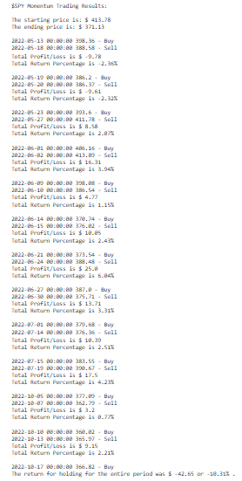
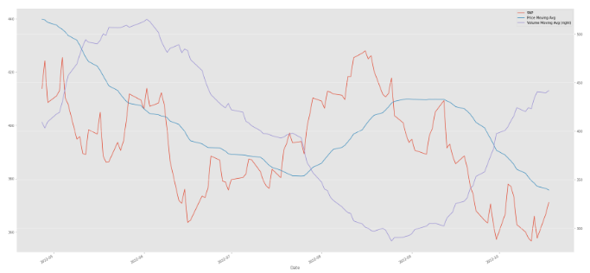
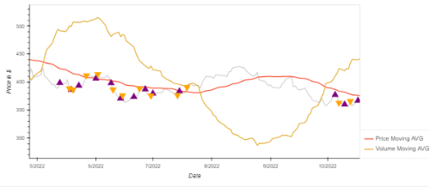
RESULTS and CONCLUSIONS
Index Fund - S&P 500- Momentum Strategy
PRICE, MOVING AVERAGE PRICE AND VOLUME MOVING AVERAGE VOLUME
2.2%
Profit

Slide 10
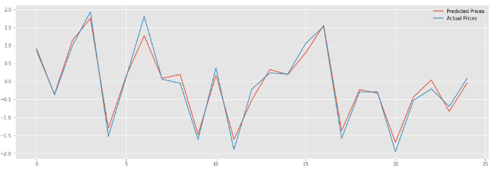
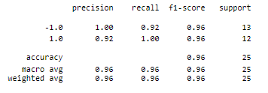
RESULTS and CONCLUSIONS
Index Fund - S&P 500- Momentum Strategy
BACK TESTING RESULTS

Slide 11
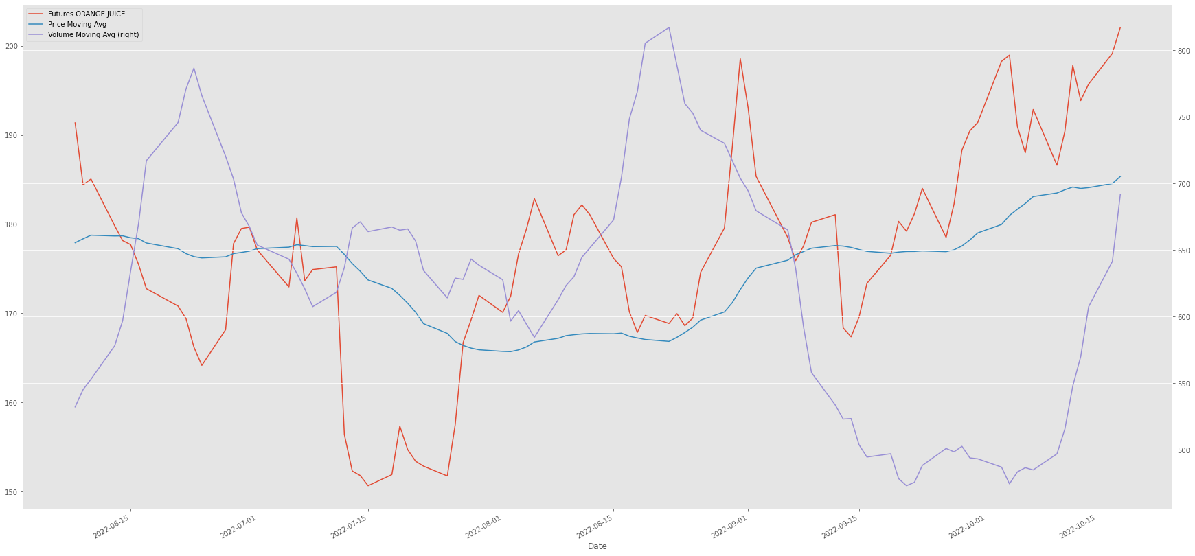
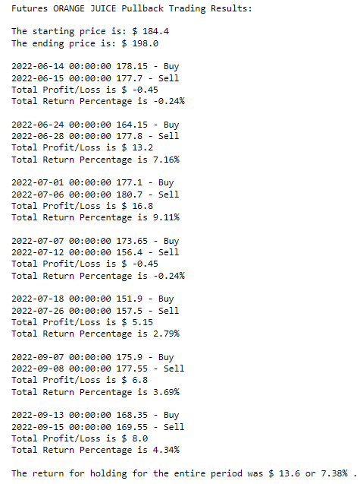
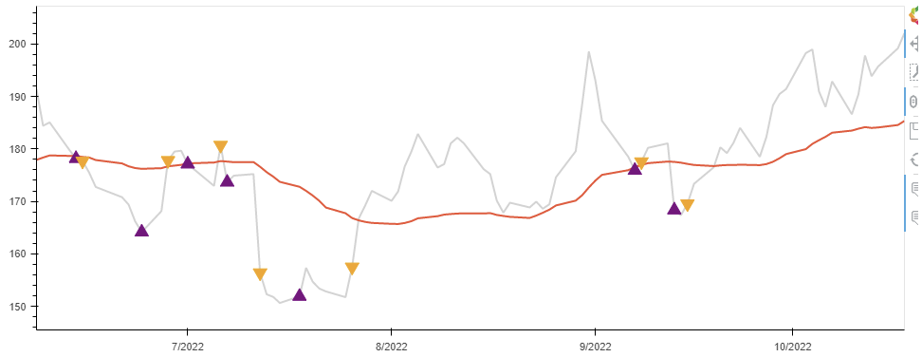
RESULTS and CONCLUSIONS
FUTURES - ORANGE JUICE - Pullback Strategy
PRICE, MOVING AVERAGE PRICE (PRICE ACTION) AND MOVING AVERAGE VOLUME (MOMENTUM)
4.3%
Profit

Slide 12
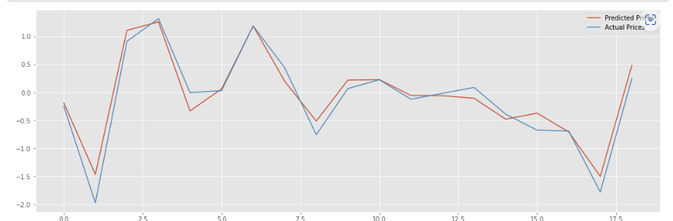

RESULTS and CONCLUSIONS
FUTURES - ORANGE JUICE - Pullback Strategy
BACK TESTING RESULTS

Slide 13
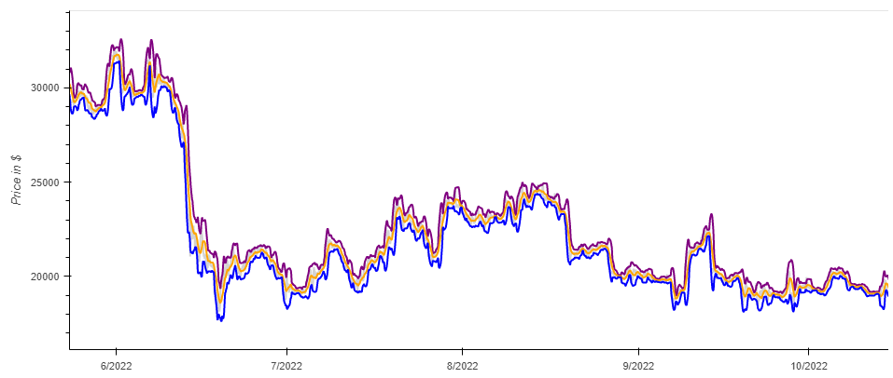
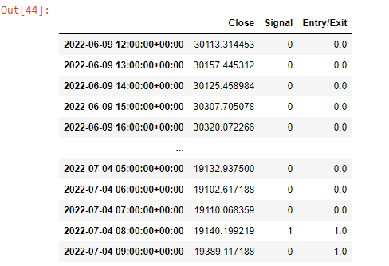
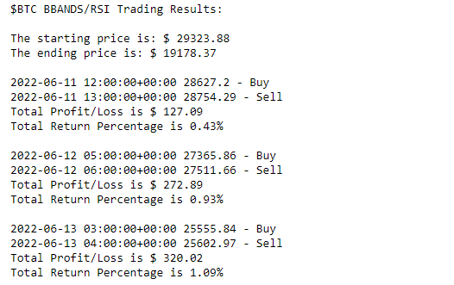
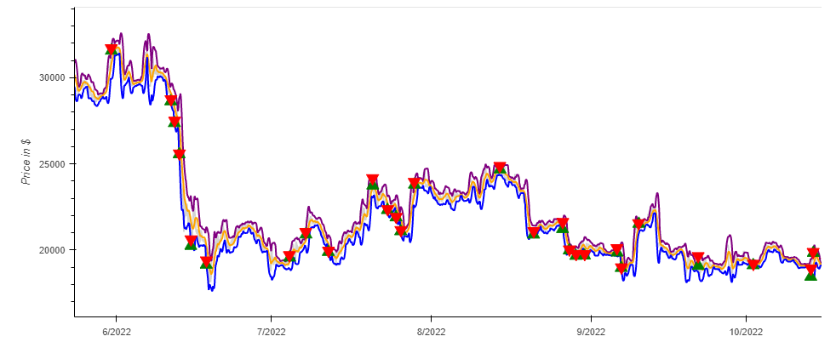
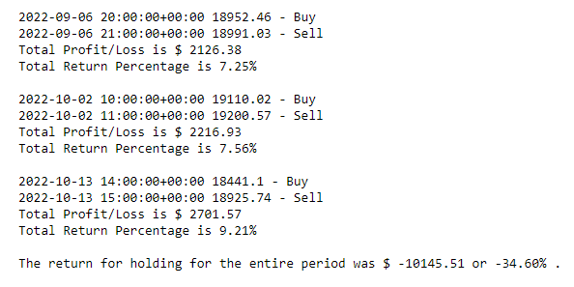
RESULTS and CONCLUSIONS
Crypto Currency- Bitcoin - Bollinger Bands Strategy
PRICE, BOLLINGER BANDS AND RSI
9.21%
Profit

Slide 14
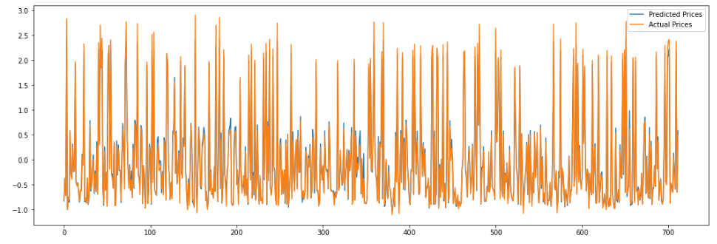
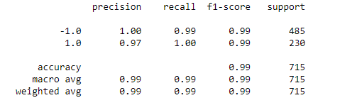
RESULTS and CONCLUSIONS
Crypto Currency- Bitcoin - Bollinger Bands Strategy
BACK TESTING RESULTS

Slide 15
NEXT STEPS - EXPANDING OUR PROJECT
Expand asset type (bonds, digital assets, derivatives (options, swaps, forwards), insurance linked securities, etc
Expand available trading strategies for each type of assets
Create a user interface, where user can choose asset type, trading strategies, explore, match, set their algorithms and make profit.

Slide 16






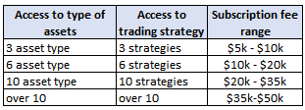


HOW IS OUR BUSINESS GOING TO MAKE PROFITS
Exit Strategy
Pricing Strategy
Market
sell the Partnership
IPO
monthly subscription fee
fee bands depend on access rights
transaction / commission fee for every trade ordered
corporations
asset managers
trusts
pension funds
individuals
**all type of clients with excess cash to invest

Slide 17
THANKS!
Does anyone have any question?
addyouremail@freepik.com

