Slide 1
Assignment 1-Implementation of Backpropagation and Training a Palindrome Network
Niare Doyom, 200260032
Piyush Mourya, 200260037
Varad Mahashabde, 200260057
13-02-2024

Slide 2
Problem Statement
Check if 10-bit string is palindrome or not
Input: 10-bit String (of numbers: 1s and 0s)
Output: Palindrome or not (class 0 or 1)
Technique used : We have used two architectures
An FNN with a single hidden neuron but connections jump from the input neurons to output neurons too
A standard FNN with no inter-layer jumping, but with 10 hidden neurons. This uses a sigmoid

Slide 3
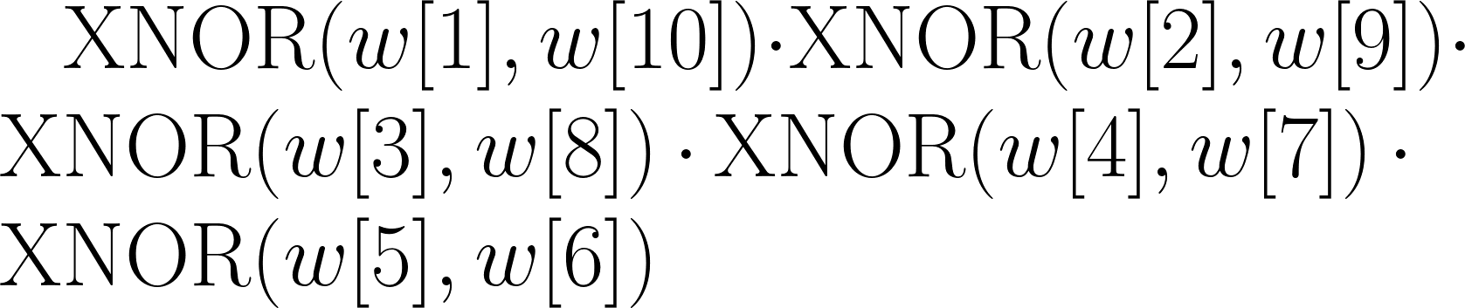
Linear Separability
To evaluate the linear separability of the inputs, first we consider that a Boolean formula is sufficient to represent the Palindrome algorithm.
This is because the inputs are a series of Boolean values (1s or 0s), and the output is also Boolean (palindrome or not).
Particularly, the formula is given by the following formula

Slide 4
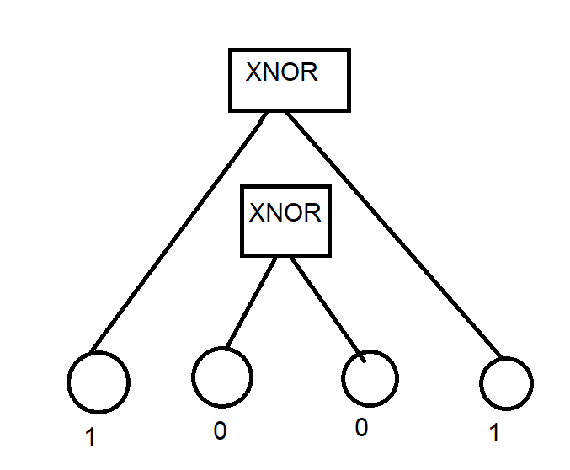
Linear Separability
As checking if a string is palindrome requires us to compute equivalence i.e. XNOR between the bits at different ends, the problem is not linearly separable.
If we consider the sum-of-products or product-of-sums form of any Boolean formula, then we see that any formula not representable as a single sum (in product-of-sums) or a single product (in sum-of-products) is not linearly separable.

Slide 5
Input representation
The input neurons activations were simply set to the letter at the corresponding position
I.e. If the word is ‘00111011000’, then
the first and second input neurons’ activation is 0
the third has activation 1, etc.
One-hot-encoding was unnecessary to represent it as the input is binary and has only 2 possible values.

Slide 6
Jumping FNN : BP implementation
We used Directed Acyclic Graph for implementation of backpropagation
Reference used: Andrej Karpathy’s neural network youtube video
we created a class called Value
And each value have information about who are their children
Children’s are the variables/Nodes which are used to compute the current node

Slide 7
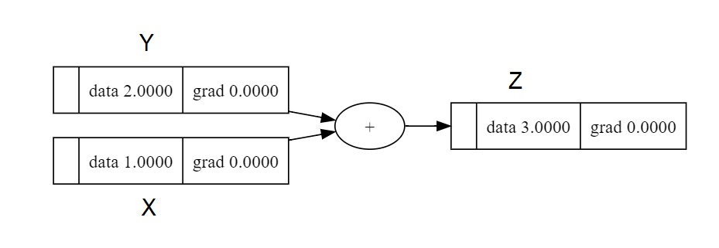
Jumping FNN : BP implementation
So each Node contains the information about which variables are it’s children and information about how to update their (children’s) gradient
For example let’s say we instantiate 2 values
X = Value(1) and Y = Value(2)
And we create a new variable Z by adding these two variables
Z = X + Y = Value(3)

Slide 8
Jumping FNN : BP implementation
When we create Z we store the information that X and Y are it’s children on the Z node, so:
Z.children = [X, Y], X.children = None, Y.children = None
We also store the gradient update rule for Z’s children on Z node
So the function Z._backward() will compute gradient for X and Y
We can do that as we also know the operation performed by X and Y to compute Z

Slide 9
Jumping FNN : BP implementation
In this case since X and Y are the children gradient Z._backward() would be
X.grad += 1*Z.grad, Y.grad += 1*Z.grad
update rule: X.grad += (δZ/δX)*(δloss/δZ)
We use += instead of = because X/Y might be used in computation of another variable too, which may then operate with Z to form the loss function, so we don’t want to overwrite the gradient due to that variable/value
Let’s say we create one more variable called A
A = Y*X = Value(1)
Here A.children = [Y, X]
A._backward(): Y.grad += X*A.grad, X.grad += Y*A.grad

Slide 10
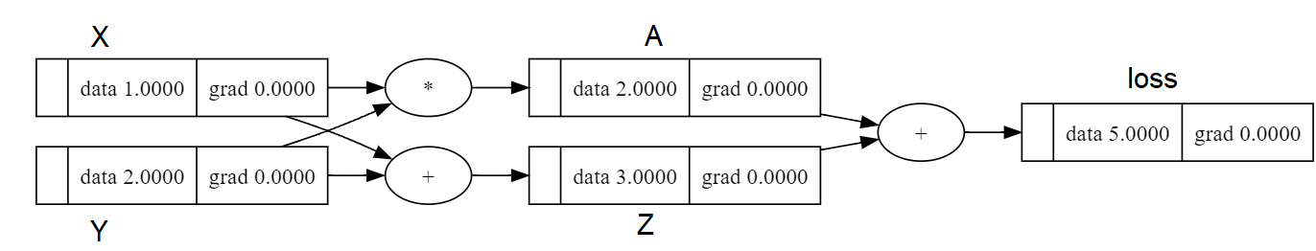
Jumping FNN : BP implementation
And let’s say loss = A+Z
loss._backward(): A.grad += 1*loss.grad, Z.grad += 1*loss.grad
So DAG looks something like this
We set the gradient of loss as 1 so that other gradient computation becomes possible

Slide 11
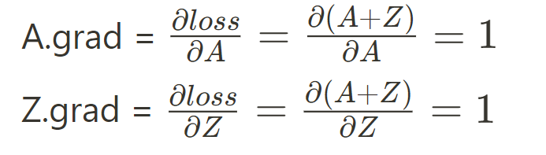
Jumping FNN : BP implementation
Now when we call loss.backward() it calls ._backward() in all the children in topologically sorted order i.e
[loss, A, Z, X, Y]
Now we will try to map mathematics with the gradient update function
loss._backward(): A.grad += 1*loss.grad, Z.grad += 1*loss.grad
Since .grad are initialized to zero and loss.grad is set to 1
A.grad = 1 and Z.grad = 1

Slide 12
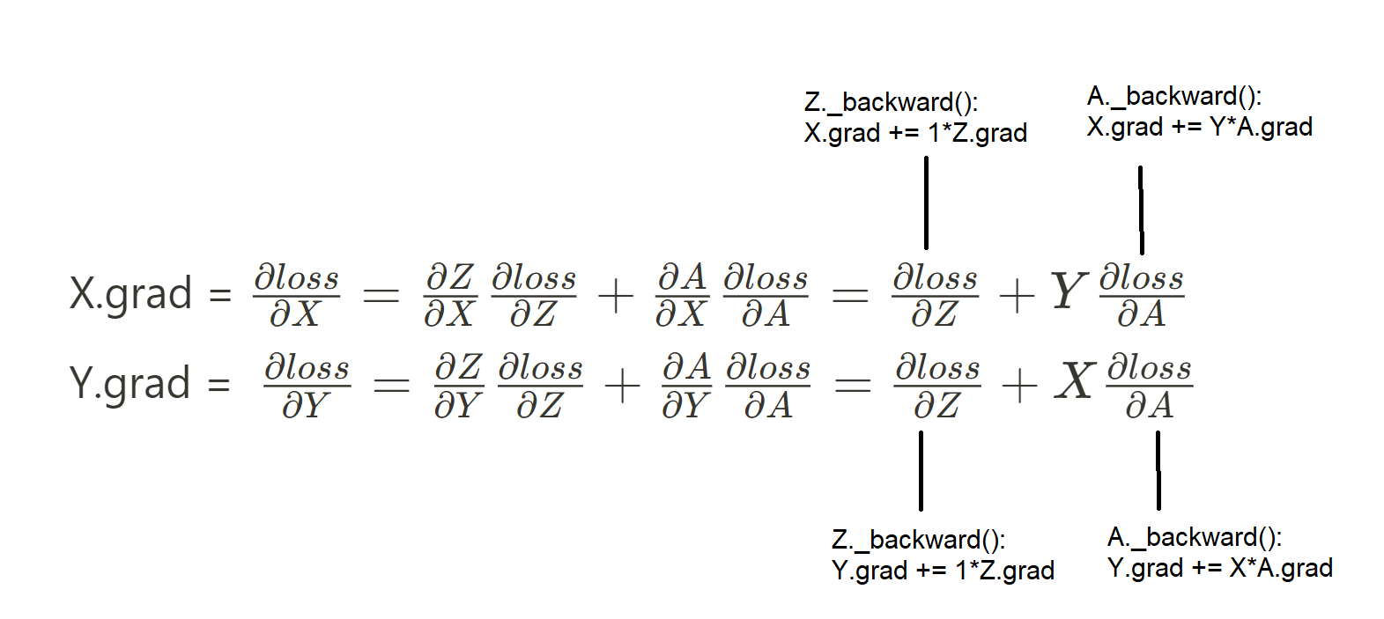
Jumping FNN :BP implementation
X.grad = 1 + 2*1 = 3 Y.grad = 1 + 1*1 = 2

Slide 13
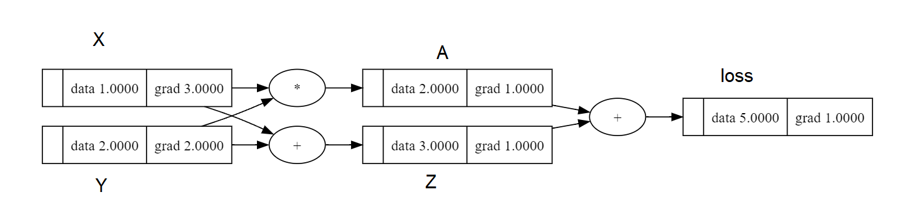
Jumping FNN : BP implementation
So this is how i calculate gradient with respect to loss
The same idea is scaled to compute gradient in the entire neural network, main idea is
child.grad += (δparent/δchild)*(δloss/δparent)
Where (δparent/δchild) is coded manually in the code and
(δloss/δparent) is received from parent.grad

Slide 14
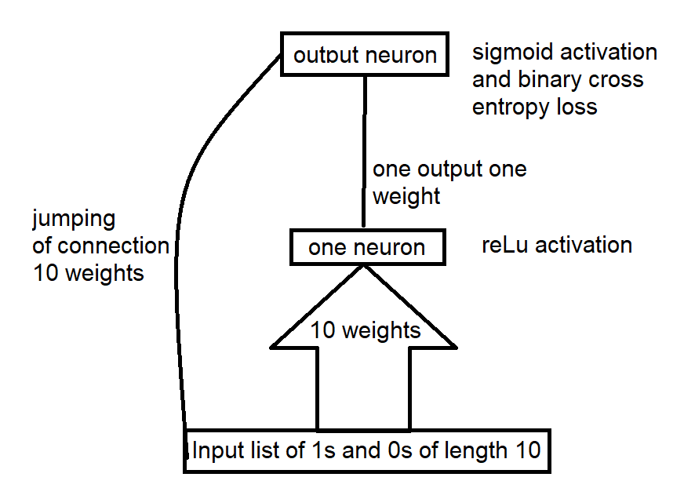
Jumping FNN : Architecture details
Learning rate = 1
Epochs = 130
Beta = 0.7

Slide 15
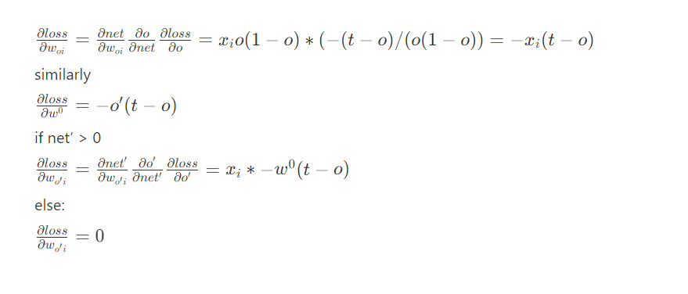
Jumping FNN : Architecture details, weights change rules

Slide 16
Jumping FNN :Architecture details and interpretability of middle layer
So the distribution of weights for the first layer is asymmetrical
So something like [10, -5, 1, 2, -3, 3, -2, -1, 5, -10]
If the string is perfect palindrome then input becomes zero
Otherwise it is positive or negative
The first layer checks if the net_in is greater than zero or less than equal to zero, the output weight through the first layer is a large negative number
so that if the input to the first layer is a large positive number then we definitely not have a palindrome
And when that large positive number is multiplied with the large negative number, it will pull down the input to output layer to a negative number

Slide 17
Jumping FNN :Architecture details and interpretability of middle layer
But in case it’s less than or equal to zero
The output of the first layer becomes zero
And negative contribution due to first layer is not there anymore, so to deal with the condition when input is negative we have jumped connections
The jumped connection from input to the output neuron again does the same, but since the weights are connected to the output neuron, the effect of negative weights are actually negative
So it checks whether the input in the first layer was negative or not, since positive check has already been performed

Slide 18
Jumping FNN :Architecture details and interpretability of middle layer
Now that we know that net input is 0 the string is likely to be palindrome
Problems: the network will give wrong result when zero input is not due to the symmetrically opposite weights
So network is very good at identifying positive class, but sometimes fail when identifying negative class palindrome, which makes the recall 1
After figuring out what the layers are doing, I tried initializing the weights a bit smartly i.e anti symmetrically, which greatly improved the results, and all the network had to do was to find the weights which does not cause net input to be zero when input is asymmetrical

Slide 19
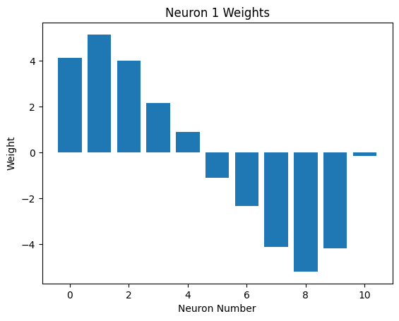
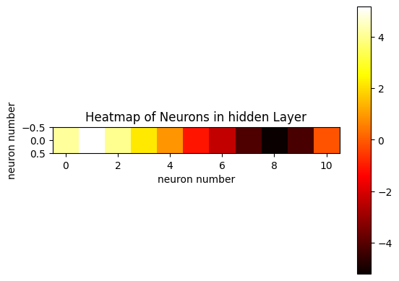
Jumping FNN : Architecture details and interpretability of middle layer
These are the weight value from input to hidden neuron
Here the value at the rightmost side represents the bias

Slide 20
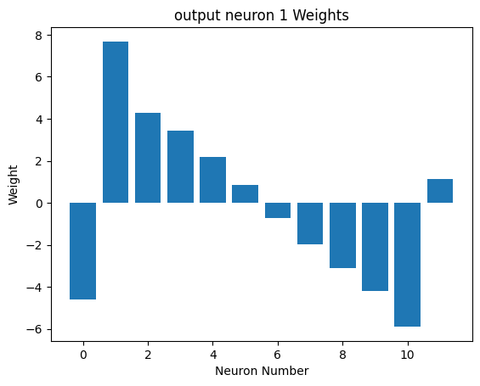
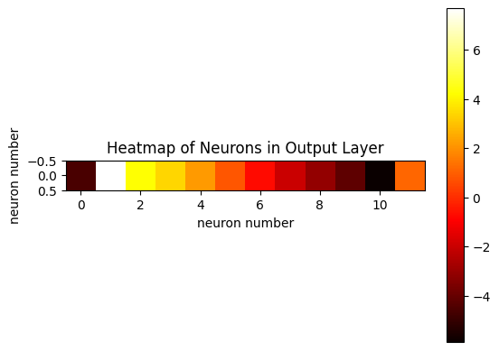
Jumping FNN :Architecture details and interpretability of middle layer
The left most weight represent weight connecting hidden neuron to output neuron
The right most weight is the bias

Slide 21
Jumping FNN : Ideal Case
If we train the network for much longer we would’ve reached the ideal case which would be
Weights from input to hidden neuron:
[1, 2, 4, 8, 16, -16, -8, -4, -2, -1] and bias = 0
Weight from hidden to output = -1000
Weights from input to output:
[1, 2, 4, 8, 16, -16, -8, -4, -2, -1] and bias = 1
The above set of weights and biases will give accuracy of 1

Slide 22
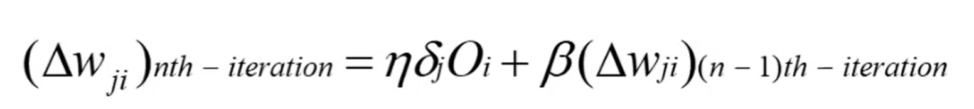
Jumping FNN : Effect of Momentum Term
All though the final results were same whether we use momentum term on gradient update or not the rate of convergence was shaky but faster when momentum term was added

Slide 23
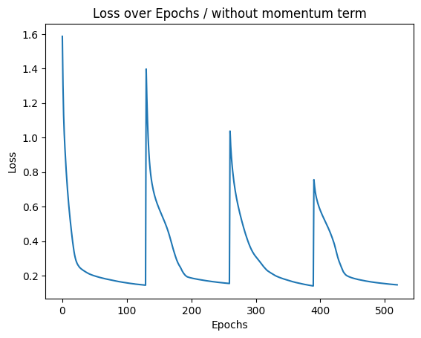
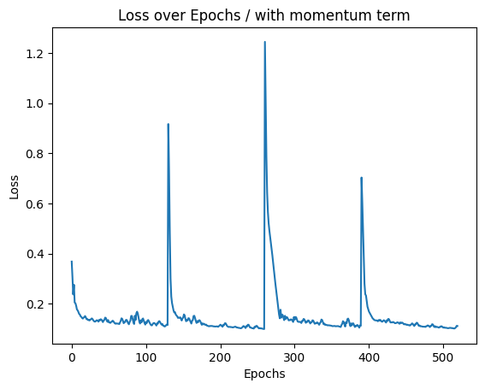
Jumping FNN:Effect of Momentum Term
Here we have 4 peaks because we are looking at loss over 4 iteration 4 fold cross validation

Slide 24
Jumping FNN:Overall performance
Final 4 fold cross-validation performance
final accuracy: 0.95
final f1 score: 0.95
final precision score: 0.91
final recall score: 1.0

Slide 25
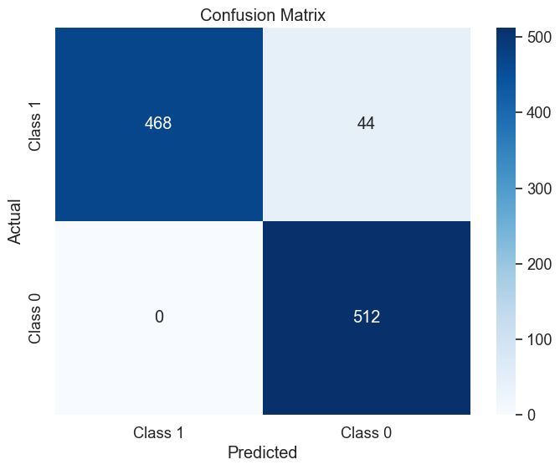
Confusion Matrix

Slide 26
Jumping FNN: Learnings
In summary our network assigns asymmetric distribution Of weights and checks whether the net input is zero or not, which is not a one layer task, so 2 layer is needed, hidden and output
After asymmetricity is taken care of the network tries to find the weights which when combined together in a non symmetrical way does not give a 0 input
So initializing the weights asymmetrically drastically improves the performance, as the first part of gradient reduction were network finds weight with opposite value is taken care of
Getting 100% accuracy was difficult with one hidden layer, but I believe if trained for longer epoch it is totally possible

Slide 27
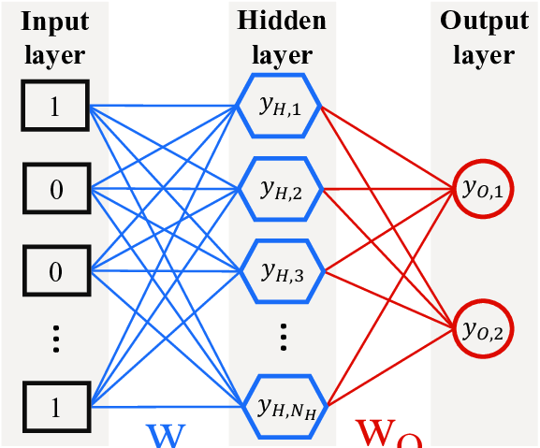
Big Layer FNN : Implementation
The second architecture was a standard FNN with a hidden layer of 10 neurons.
We chose this size because the product-of-sum form of each XNOR has 2 terms. We can then combine the product of the XNOR with the product combining the XNORs, giving us a single product of 10 terms.
Image from : The principle of learning sign rules by neural networks in qubit lattice models - Scientific Figure on ResearchGate. Available from: https://www.researchgate.net/figure/The-feed-forward-neural-network-FNN-is-designed-to-learn-the-sign-rules-for-a-quantum_fig1_368304372 [accessed 20 Feb, 2024]

Slide 28
Big Layer FNN :
Back-Propagation Implementation
Here we used the standard Back-prop algorithm.
A layer receives the dependence of the error on it’s output.
It then calculates the dependence of the error on it’s own parameters (here, weights and the bias)
It then accumulates this difference for each test case inside itself.
Then it calculates the dependence of the error on the input it received, and passes that back to the layer behind it.

Slide 29
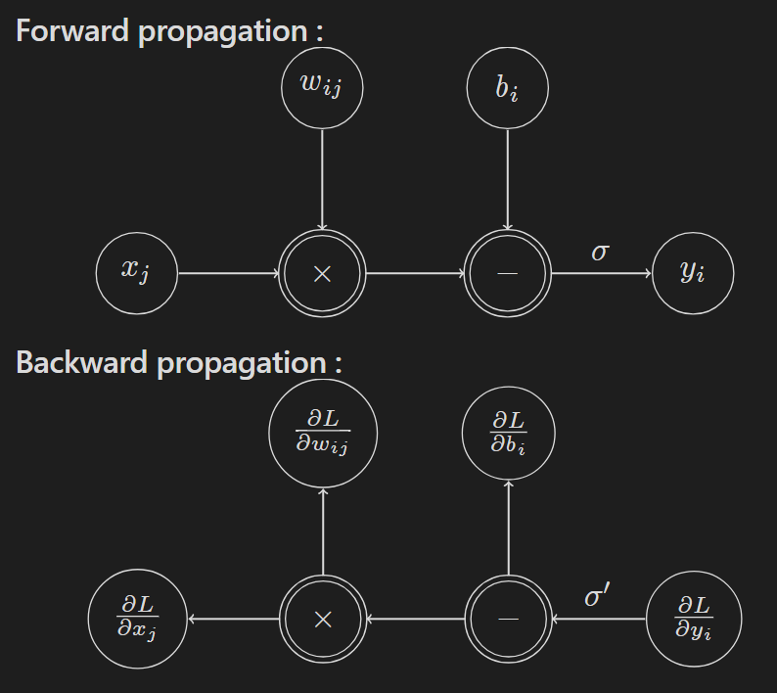
Big Layer FNN :
Back-Propagation Implementation
Diagrammatically,

Slide 30
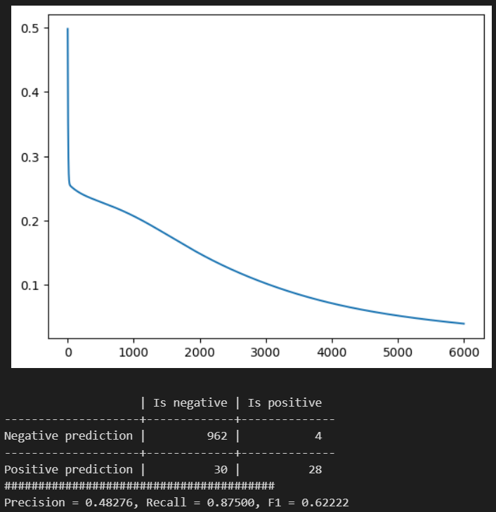
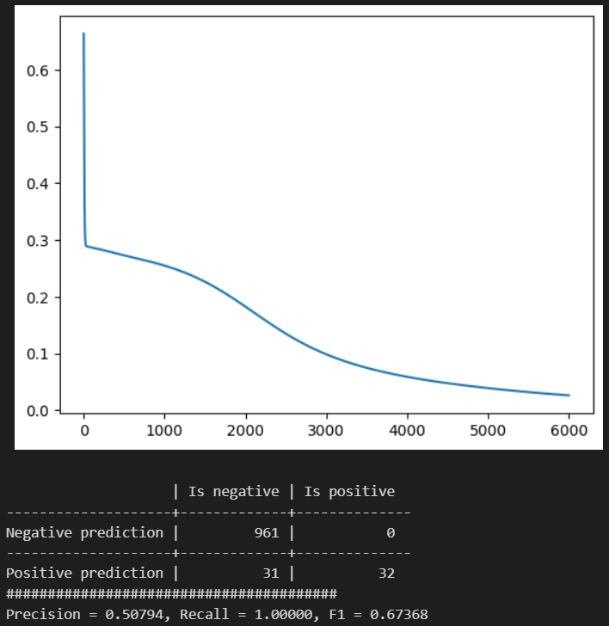
Big Layer FNN : Results
We obtain high-recall, medium precision model for all 4-folds in 6k epochs. Learning rate = 5e-3

Slide 31
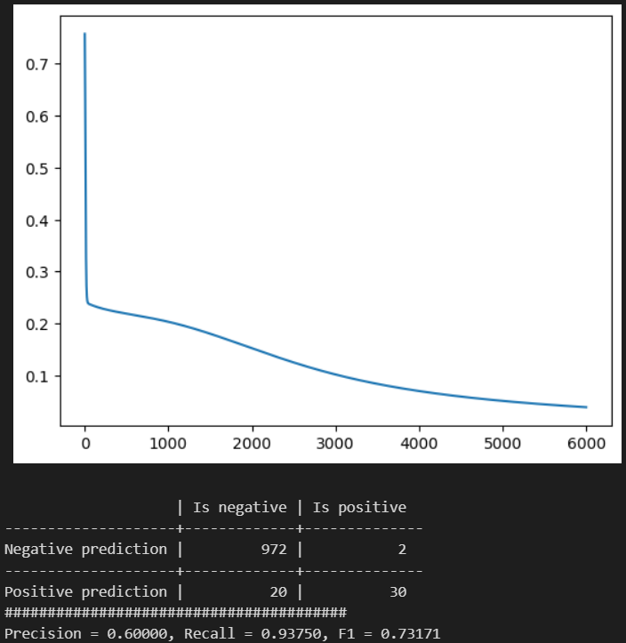
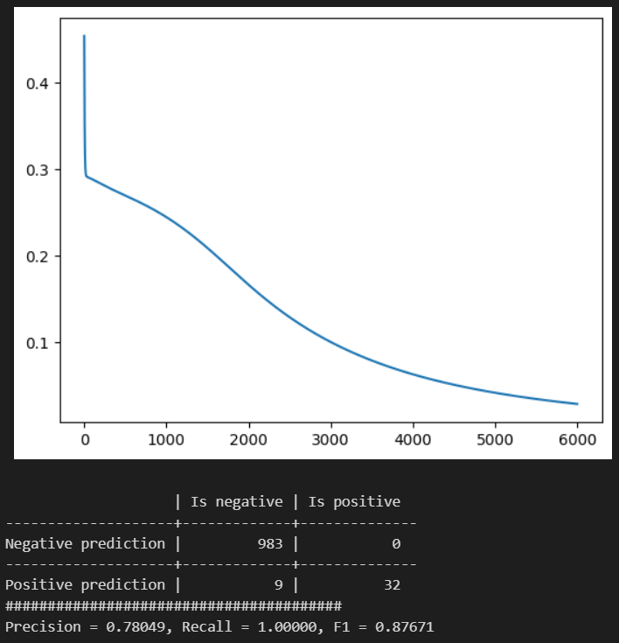
Big Layer FNN : Results
Average F1 = 0.46045, Average Recall = 0.984375,
Average Precision = 0.3009825

Slide 32
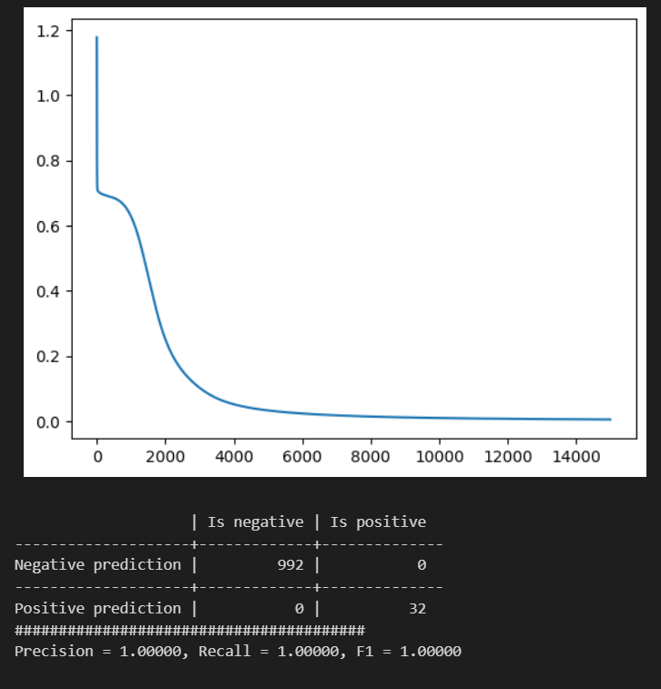
Big Layer FNN : Results
But a single model trained for 15k epochs with no folding gives perfect classification.
Learning rate = 5e-3

Slide 33
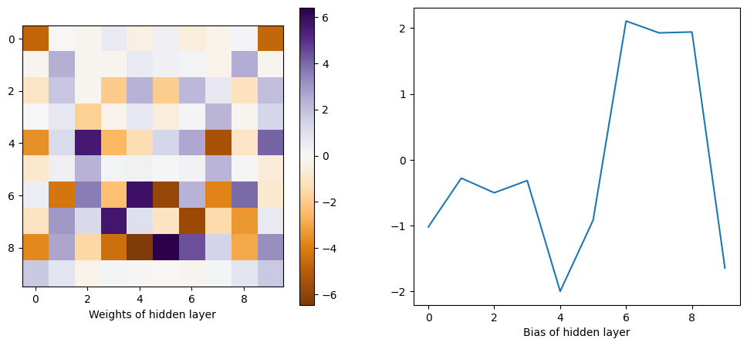
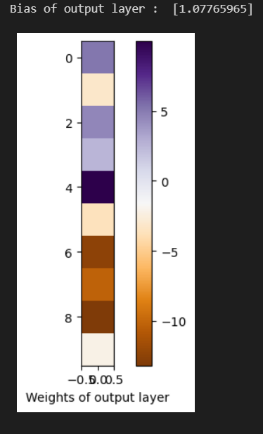
Big Layer FNN : Hidden Layer Interpretation
We see that the hidden neurons with asymmetric weights to the input neurons (4, 6, 7 and 8) are the highest weighted in the output layer. Neuron 0, 1, 5 and 9 are symmetric and are comparatively lightly weighted.
Clearly this asymmetry is spiritually similar the XNOR function and key to the computation of the palindrome function.

