Slide 1

Credit Card Spend Analysis and risk profiling
Made By:- Nihal Kumar
Name of the College:- Amity University
Enrolment no. :- A010145024175

Slide 2
Problem Statement
Sanity Checks – Data Cleaning:-
Provide a meaningful treatment to all values where age is less than 18.
Is there any customer who have spent more than his/her Credit Limit for any particular month.

Slide 3
Problem Statement
Tasks:-
Monthly spend of each customer.
Monthly repayment of each customer.
Highest paying 10 customers.
People in which segment are spending more money.
Which age group is spending more money?
Which is the most profitable segment?
In which category the customers are spending more money?
Impose an interest rate of 2.9% for each customer for any due amount.
Monthly profit for the bank.

Slide 4
Technology used
Language:- Python
Libraries:-
Numpy:- We used numpy for mathematical operation.
Pandas:- We used pandas for Data Manipulation (Data Loading, Data Cleaning, etc).
Matplotlib:- We used matplotlib for data visualization (Box Plot, Bar Graph, Line Chart, etc).
Seaborn:- We used seaborn for advanced data visualization.

Slide 5
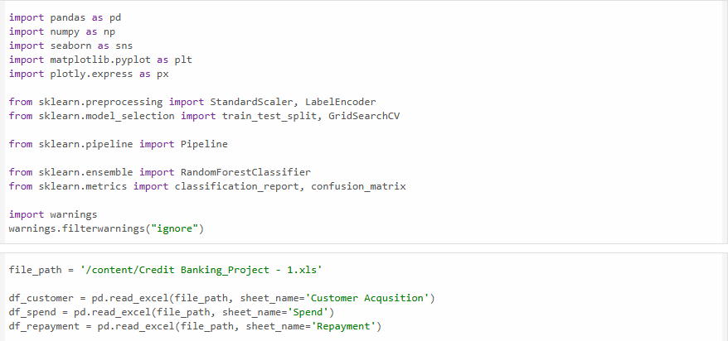
Data insertion

Slide 6
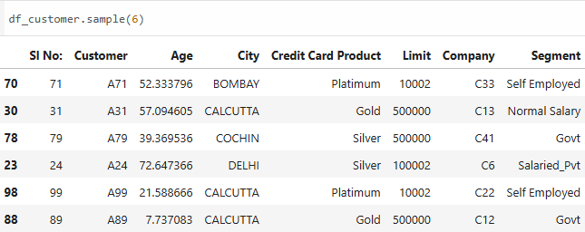
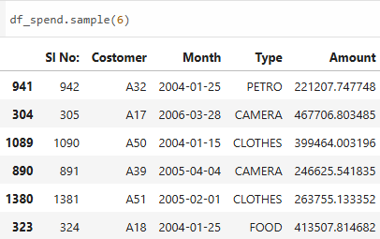
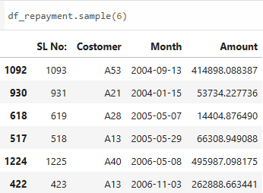
Data insertion

Slide 7
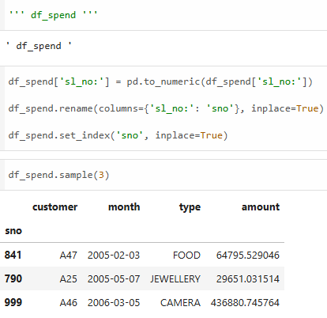
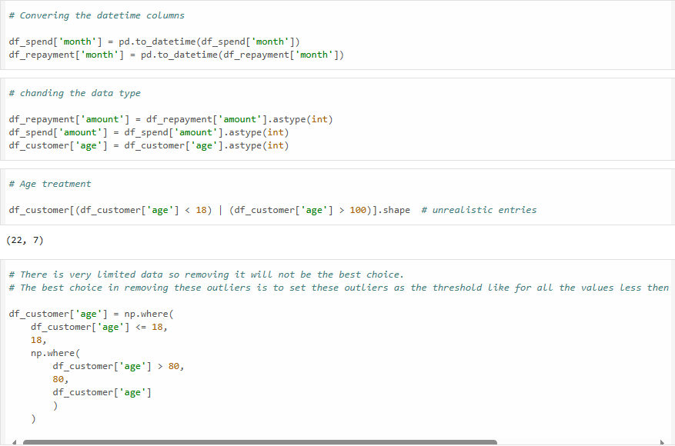
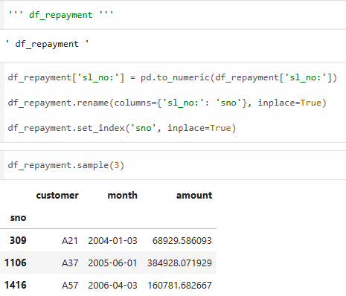
Preprocessing

Slide 8
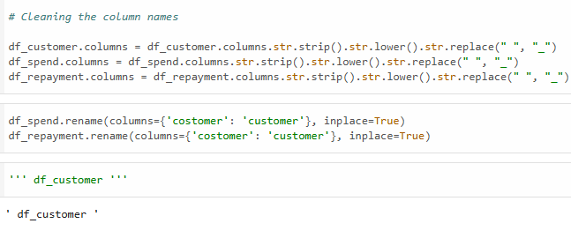
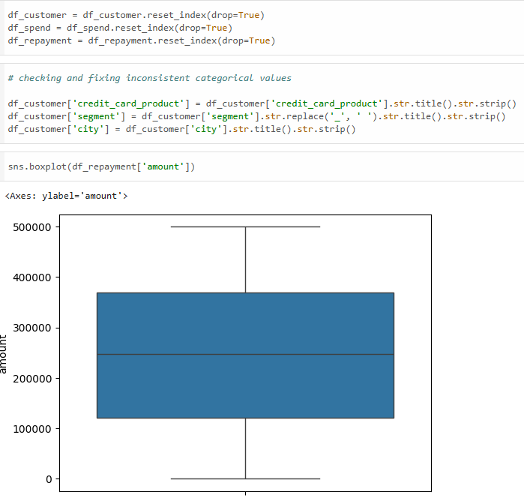
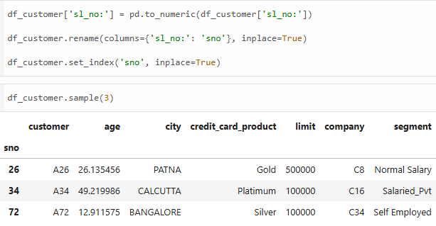
Preprocessing

Slide 9
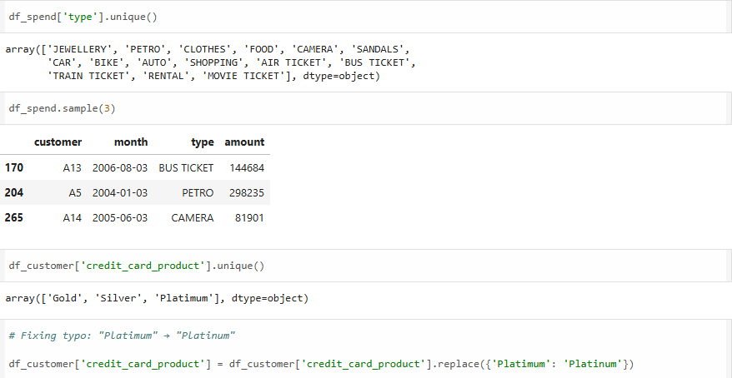
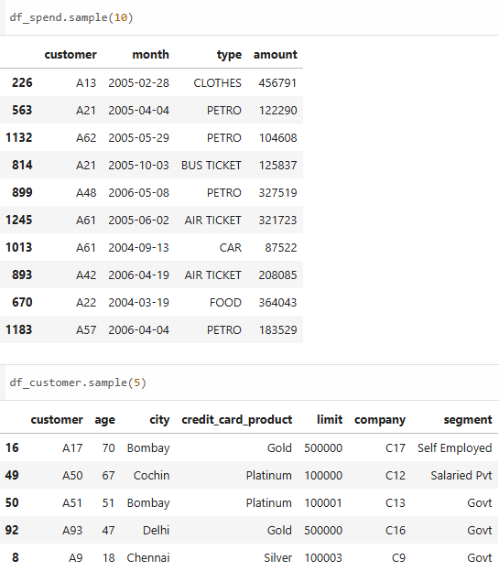
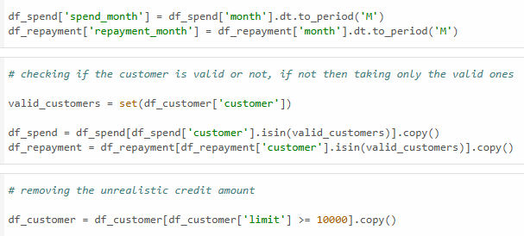
Preprocessing

Slide 10
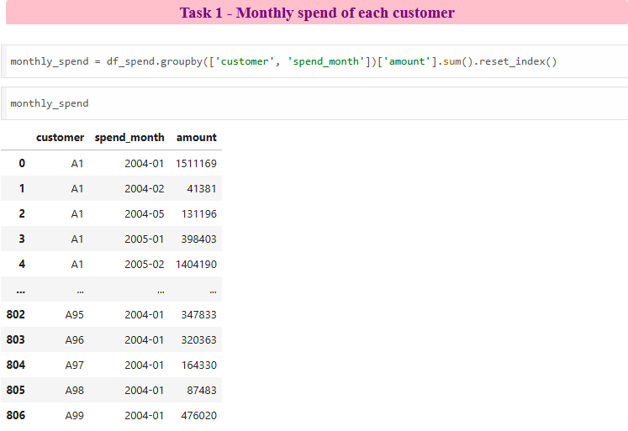
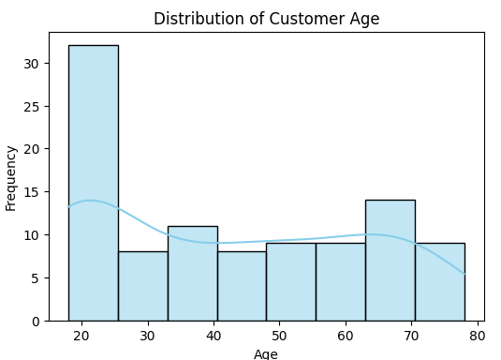
Task 1

Slide 11
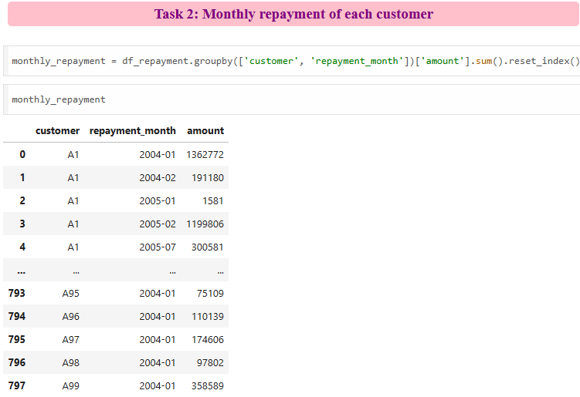
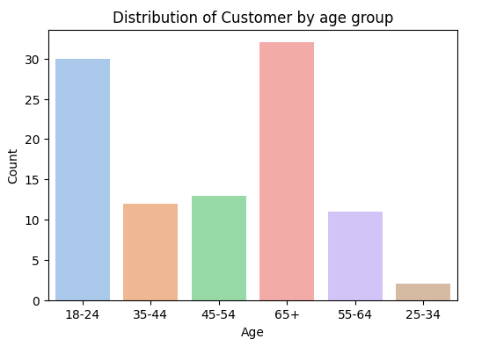
Task 2

Slide 12
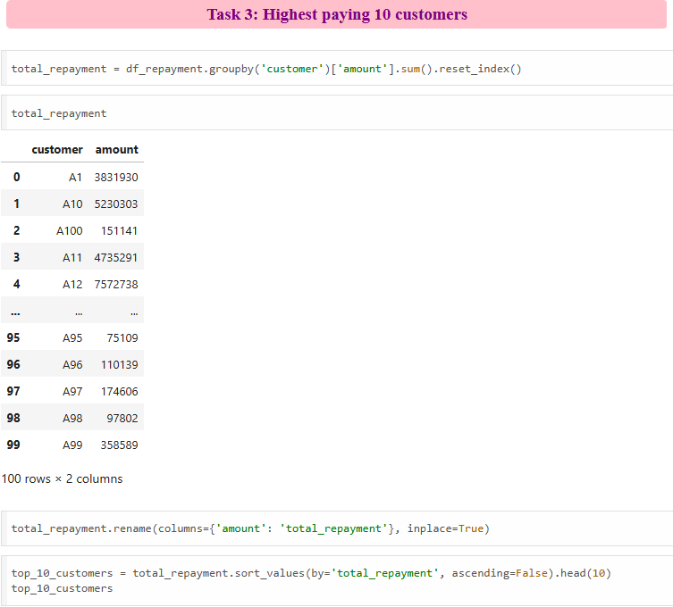
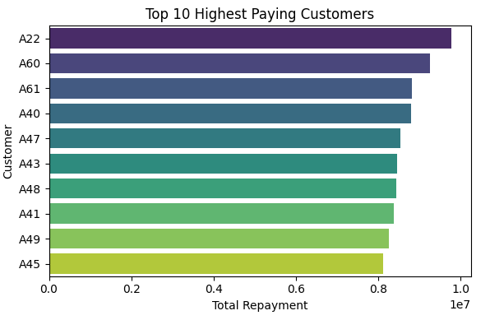
Task 3

Slide 13
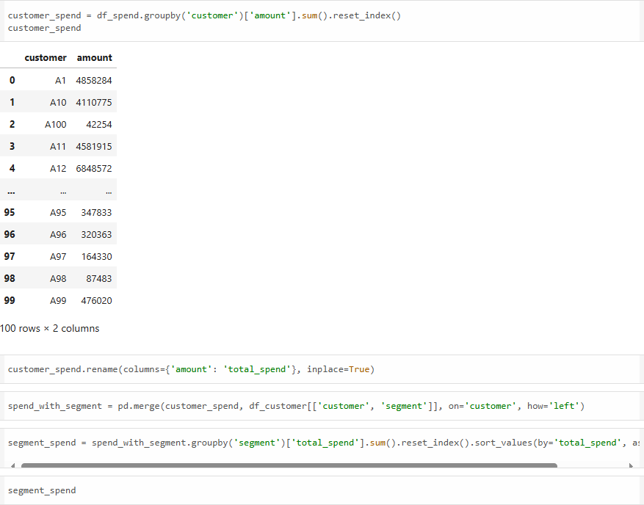
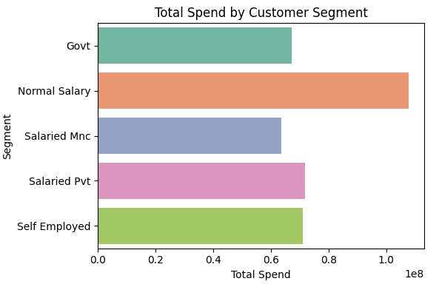
Task 4

Slide 14
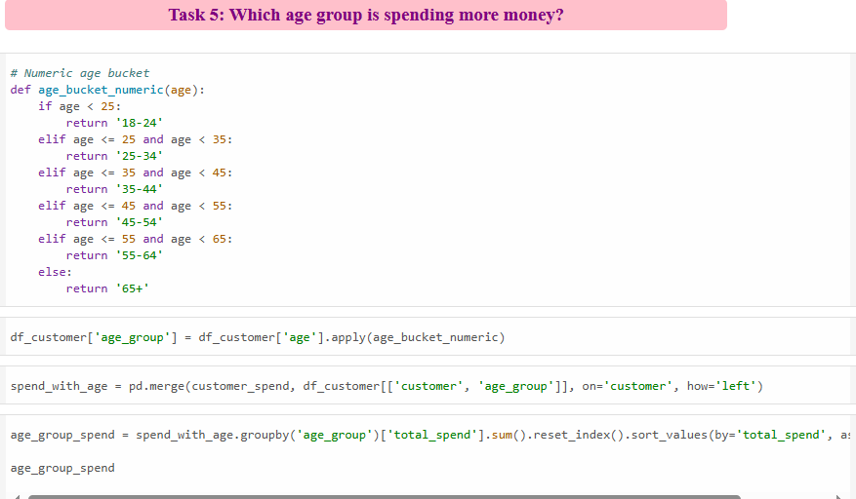
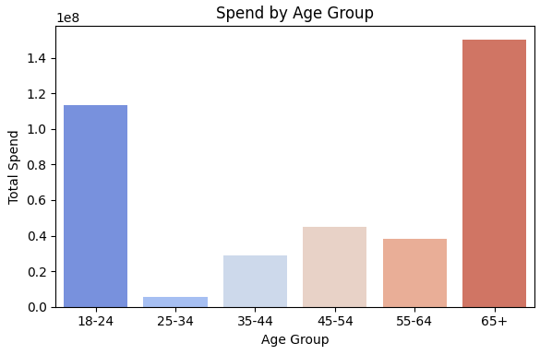
Task 5

Slide 15
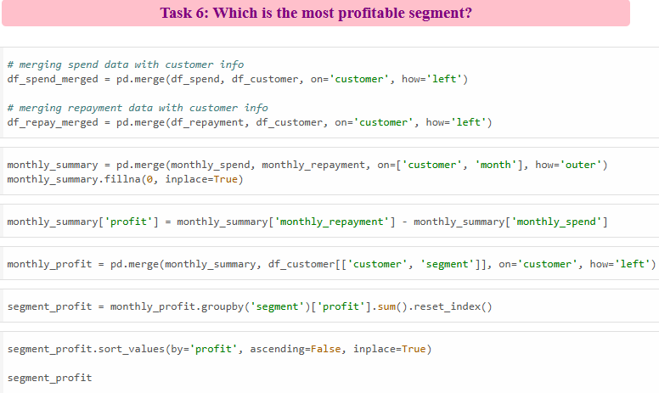
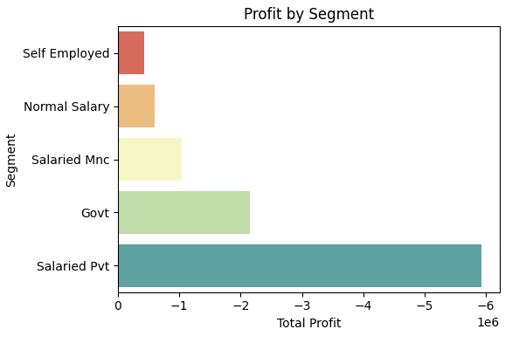
Task 6

Slide 16
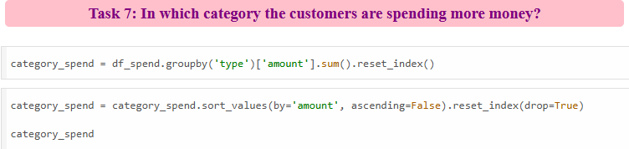
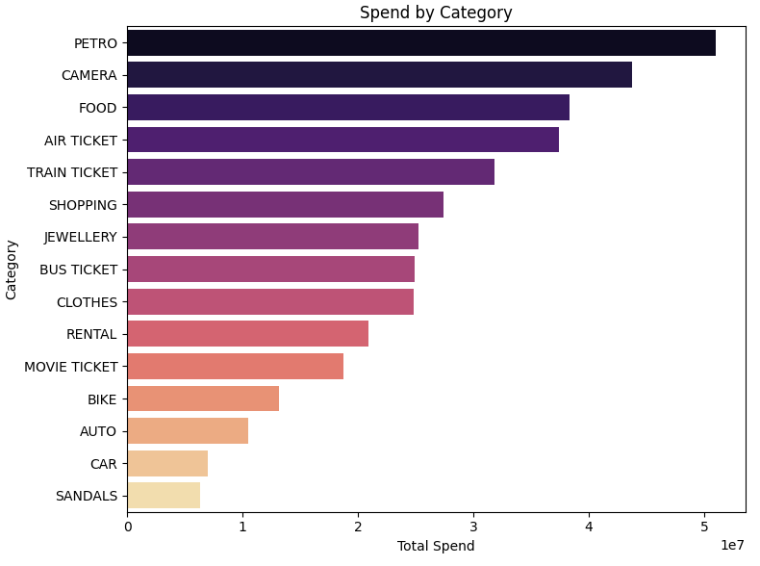
Task 7

Slide 17
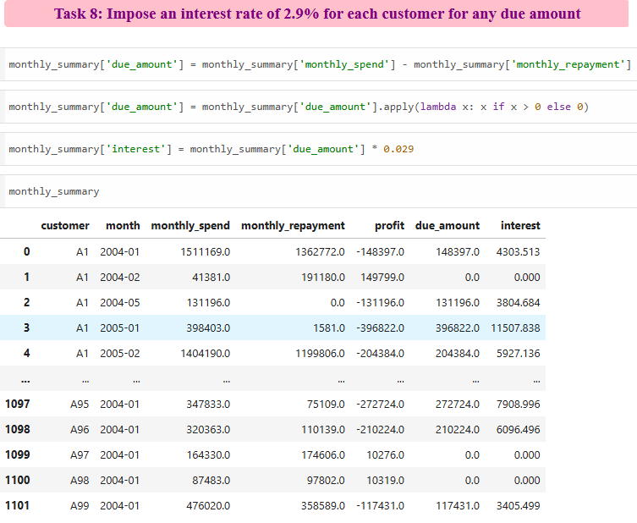
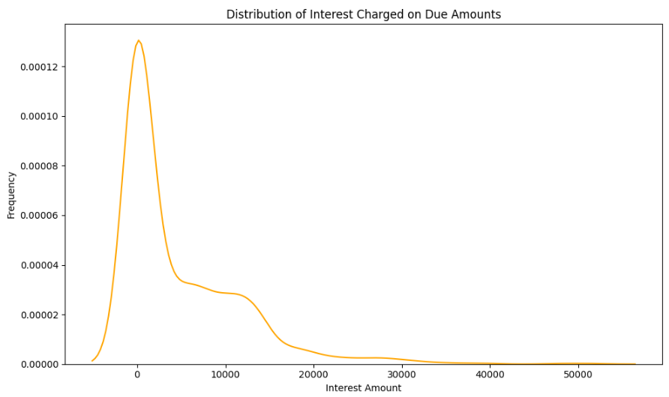
Task 8

Slide 18
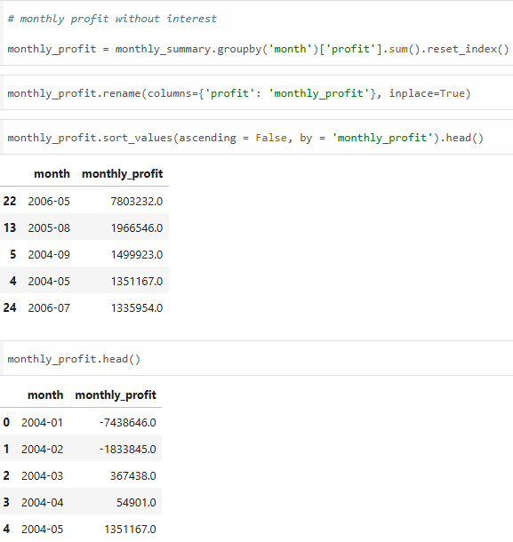
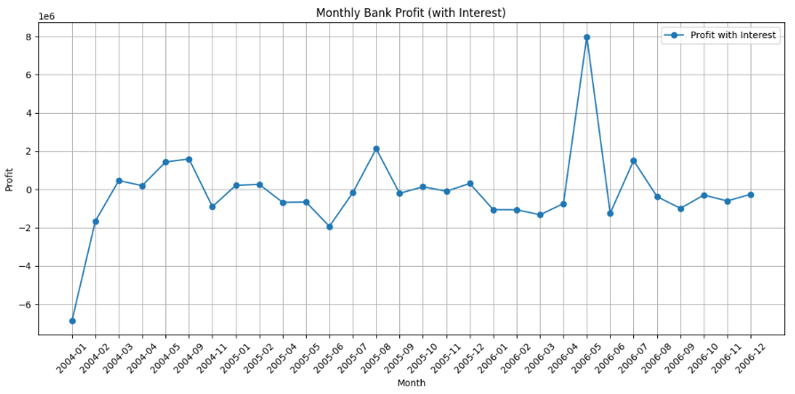
Task 9

Slide 19
Thank you

