Slide 1

GoTo
Shared mobility across multiple transportation mediums

Slide 2
High Availability By Sitting at a Layer Over the Existing Transportation Infrastructure

Slide 3
Competitive Pricing By More Effectively Utilizing the Underlying Infrastructure

Slide 4
Reducing Congestion And thus the Environmental Problems Caused by it, by alleviating the stress on the Network

Slide 5
Aggregating Microlevel Commute Flow
By Aggregating at the Lowest Granular Level of Route Information we can do multiple Interesting Things such as
Route Optimization based on Multiple Constraints such as Cost, Number of Hops, Least Congested
At extreme Granular Level you can begin to shape Traffic, Incentivize delays, and other things such as multiple hop delivery
Notes:
Bounce Gaadi movement by traffic shaping

Slide 6
How

Slide 7
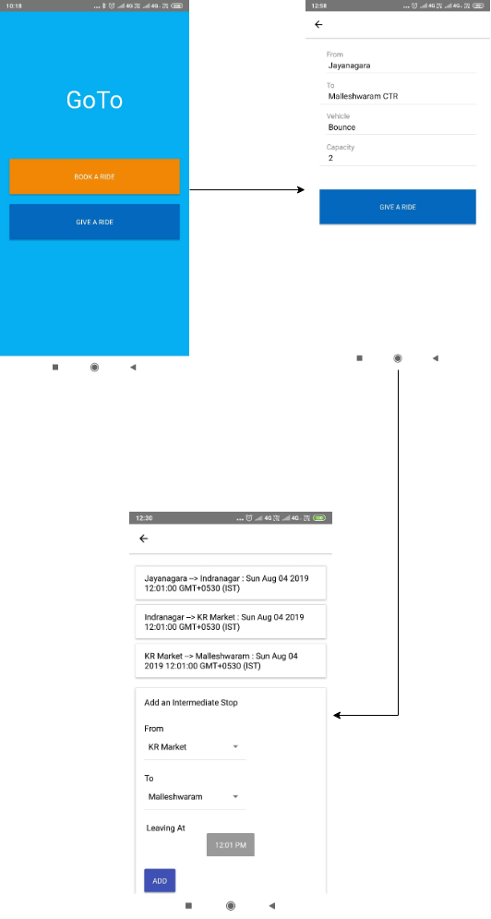
Driver Flow More Generally can be thought of as Input Flow

Slide 8
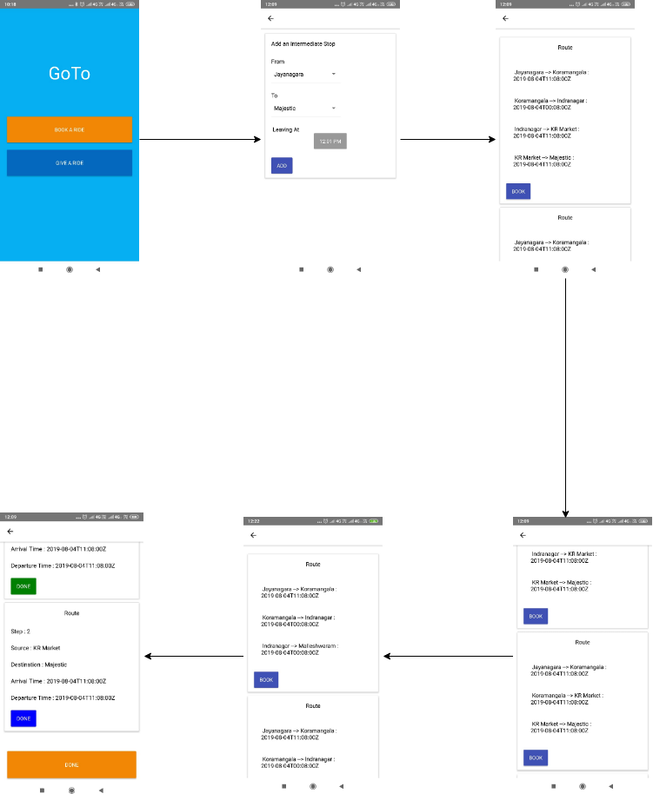
User Flow More Generally can be thought of as Commuter Flow

